Slide 1
Notes:
1. Cover: Elisha and the Widow’s Oil 2 Kings 4:1-7

Slide 2
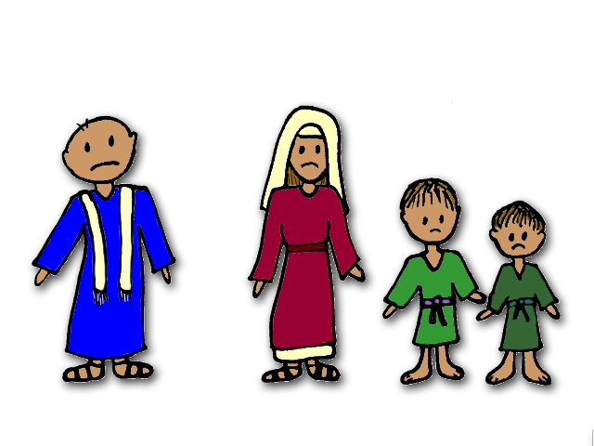
Notes:
2. Elisha was a prophet of God. God would give him important truths to tell the people and Elisha would preach those truths to them.
Once, when Elisha passed through a town, he saw a woman with two sons. “Please, sir,” the woman said, “I am a widow. My husband was a prophet who served God. When he was alive he borrowed money from someone. He knew he could work and pay the man back. But then a terrible thing happened - my husband died.

Slide 3
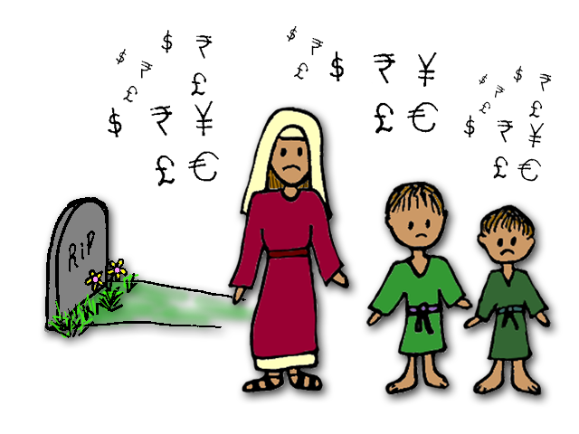
Notes:
3. Now that he is gone, we can never pay back the money. I do not have any money left. All I have in my house is a little olive oil. If I had a lot of oil I could sell it and earn some money but I do not even have enough to sell.
The man that my husband borrowed from said that if I did not pay him back, he would take my sons away to be his slaves. I love my sons and I don’t want anything bad to happen to them. Please help me!”

Slide 4
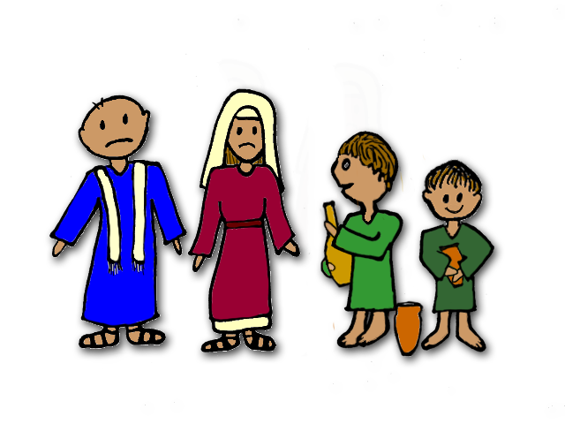
Notes:
4. Elisha felt sorry for the woman. He wanted to help her. Elisha told the woman, “Tell your sons to go out and gather all the empty jars that they can find. Tell them to borrow jars from your neighbours and friends. They should borrow as many as they can.”
The boys went out and did just as their mother said. They asked all the neighbours and all of their friends to give them their empty jars. Finally, there were no more jars left to find or borrow.

Slide 5
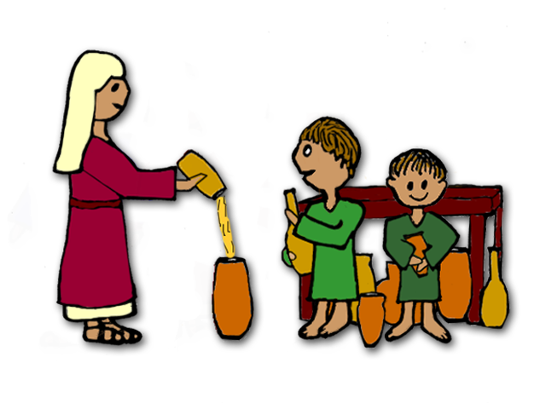
Notes:
5. Now Elisha told the woman and her sons to go inside her house and shut the door. “Use the little bit of oil that you have to fill the first jar and then set it aside. Then fill the next jar with your little bit of oil. Keep using that same oil to fill all the jars you have collected.”
“How could a little jar of oil fill so many other jars?” the woman thought, “That does not make sense. I will run out of oil.”
But the woman knew that Elisha was a prophet of God so she trusted that he was speaking truth. She and her sons did exactly what Elisha told her to. They went inside the house and shut the door. She filled one jar and set it aside. Then she filled another and set it aside. Her sons continued to pass her empty jars to fill. Over and over she poured from her jar and filled another jar with oil. There was always enough oil in her jar and it did not run out.

Slide 6
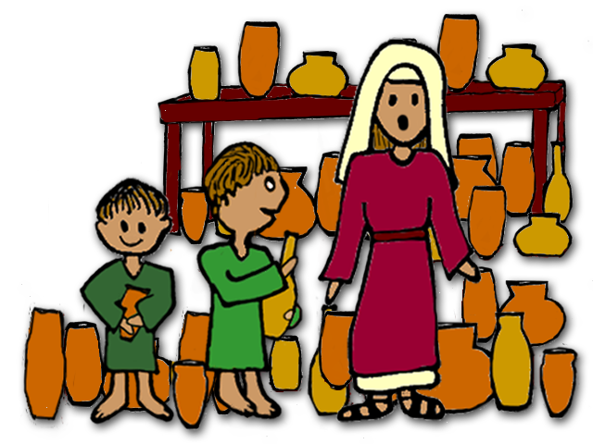
Notes:
6. Finally, when she asked her sons to pass her another jar, they had to tell her that there were no more jars left to fill. The woman and her sons looked around their house and saw all of the jars full of oil. What an amazing sight to see!

Slide 7
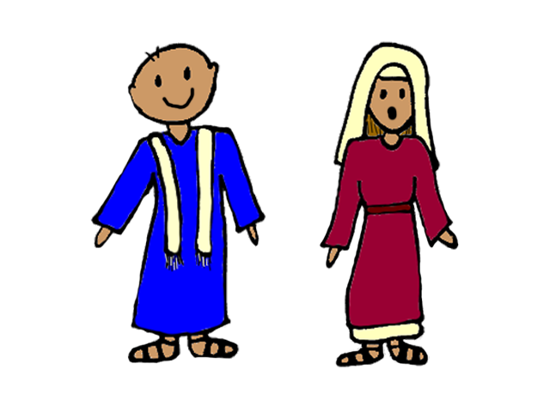
Notes:
7. The woman rushed outside and told Elisha.
“Now you have enough oil!” said Elisha, “Take the oil and sell it. Soon you will have enough money to pay back all of the debts. In fact, you will have enough money left over. You can use that money to make sure you can always buy food and have a place to live.”

Slide 8
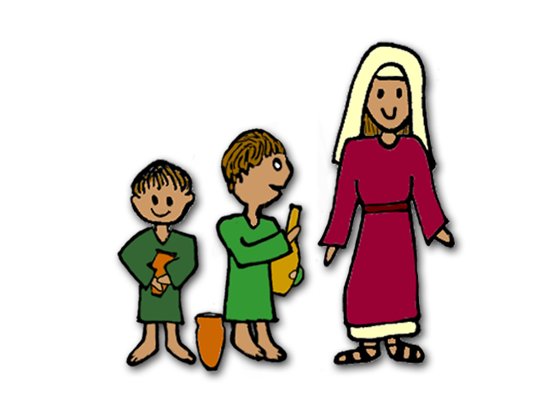
Notes:
8. The woman and her sons were so happy that Elisha had come to visit them. They used to think that their situation was so bad that there was no hope. But Elisha had helped them when they needed it the very most. Now they did not have to worry about food or a place to stay. The best thing was that now her sons would not be taken away from her!
God had blessed this family through the prophet, Elisha.

Slide 9
Teacher Notes Page 1
1. Cover: Elisha and the Widow’s Oil 2 Kings 4:1-7
2. Elisha was a prophet of God. God would give him important truths to tell the people and Elisha would preach those truths to them.
Once, when Elisha passed through a town, he saw a woman with two sons. “Please, sir,” the woman said, “I am a widow. My husband was a prophet who served God. When he was alive he borrowed money from someone. He knew he could work and pay the man back. But then a terrible thing happened - my husband died.
3. Now that he is gone, we can never pay back the money. I do not have any money left. All I have in my house is a little olive oil. If I had a lot of oil I could sell it and earn some money but I do not even have enough to sell.
The man that my husband borrowed from said that if I did not pay him back, he would take my sons away to be his slaves. I love my sons and I don’t want anything bad to happen to them. Please help me!”
4. Elisha felt sorry for the woman. He wanted to help her. Elisha told the woman, “Tell your sons to go out and gather all the empty jars that they can find. Tell them to borrow jars from your neighbours and friends. They should borrow as many as they can.”
The boys went out and did just as their mother said. They asked all the neighbours and all of their friends to give them their empty jars. Finally, there were no more jars left to find or borrow.
5. Now Elisha told the woman and her sons to go inside her house and shut the door. “Use the little bit of oil that you have to fill the first jar and then set it aside. Then fill the next jar with your little bit of oil. Keep using that same oil to fill all the jars you have collected.”
“How could a little jar of oil fill so many other jars?” the woman thought, “That does not make sense. I will run out of oil.”
But the woman knew that Elisha was a prophet of God so she trusted that he was speaking truth. She and her sons did exactly what Elisha told her to. They went inside the house and shut the door. She filled one jar and set it aside. Then she filled another and set it aside. Her sons continued to pass her empty jars to fill. Over and over she poured from her jar and filled another jar with oil. There was always enough oil in her jar and it did not run out.

Slide 10
Teacher Notes Page 2
6. Finally, when she asked her sons to pass her another jar, they had to tell her that there were no more jars left to fill. The woman and her sons looked around their house and saw all of the jars full of oil. What an amazing sight to see!
7. The woman rushed outside and told Elisha.
“Now you have enough oil!” said Elisha, “Take the oil and sell it. Soon you will have enough money to pay back all of the debts. In fact, you will have enough money left over. You can use that money to make sure you can always buy food and have a place to live.”
8. The woman and her sons were so happy that Elisha had come to visit them. They used to think that their situation was so bad that there was no hope. But Elisha had helped them when they needed it the very most. Now they did not have to worry about food or a place to stay. The best thing was that now her sons would not be taken away from her!
God had blessed this family through the prophet, Elisha.

Slide 11
Artwork and Text by Mary Nelson for www.missionbibleclass.org
Creative Commons Attribution_NonCommercial 4.0 International License. CC BY-NC-SA: This license allows reusers to distribute, remix, adapt, and build upon the material in any medium or format for noncommercial purposes only, and only so long as attribution is given to the creator. If you remix, adapt, or build upon the material, you must license the modified material under identical terms.
Please visit www.missionbibleclass.org to find this and many other free resources to help you teach the Bible to children.

