Slide 1
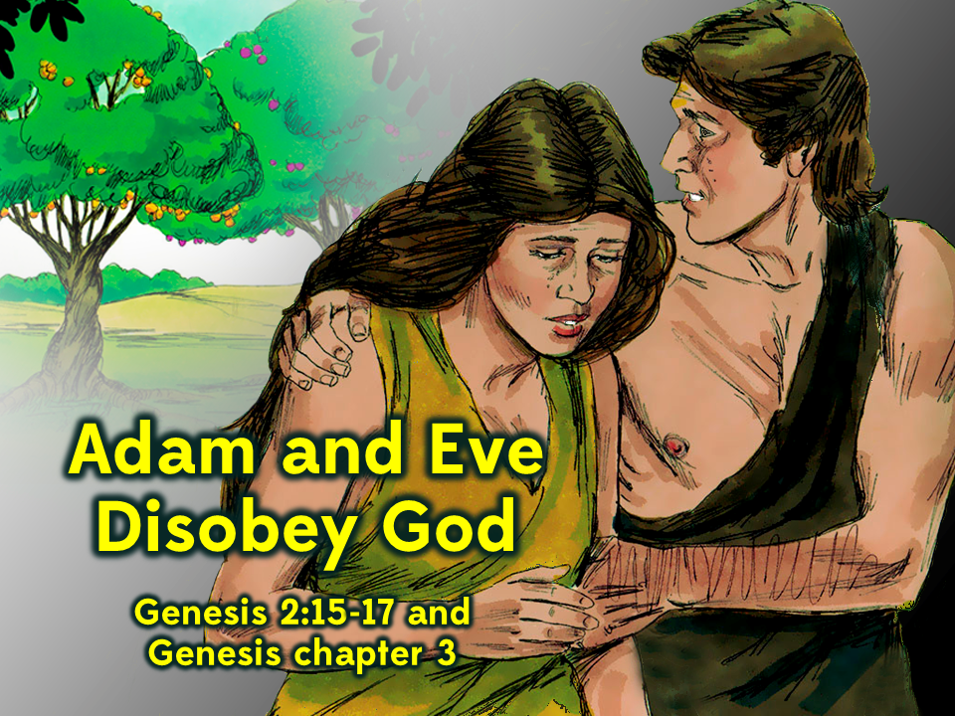
Notes:
1. Cover: Adam and Eve Disobey God (Genesis 2:15-17 and 3:1-24)

Slide 2
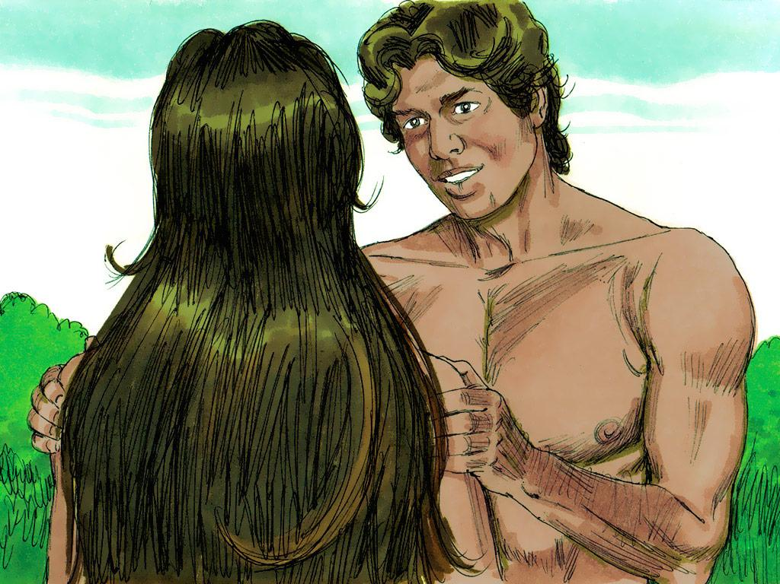
Notes:
2. Adam and Eve were the first man and woman that ever lived. They lived a happy life in a beautiful place called the Garden of Eden. They knew God loved them and they even spent time with him when he walked in the garden.
Only good things had ever happened in the Garden of Eden. Adam and Eve had never felt bad feelings of shame or guilt. They did not wear any clothes but that did not even bother them because they had never even heard about feeling embarrassed.

Slide 3
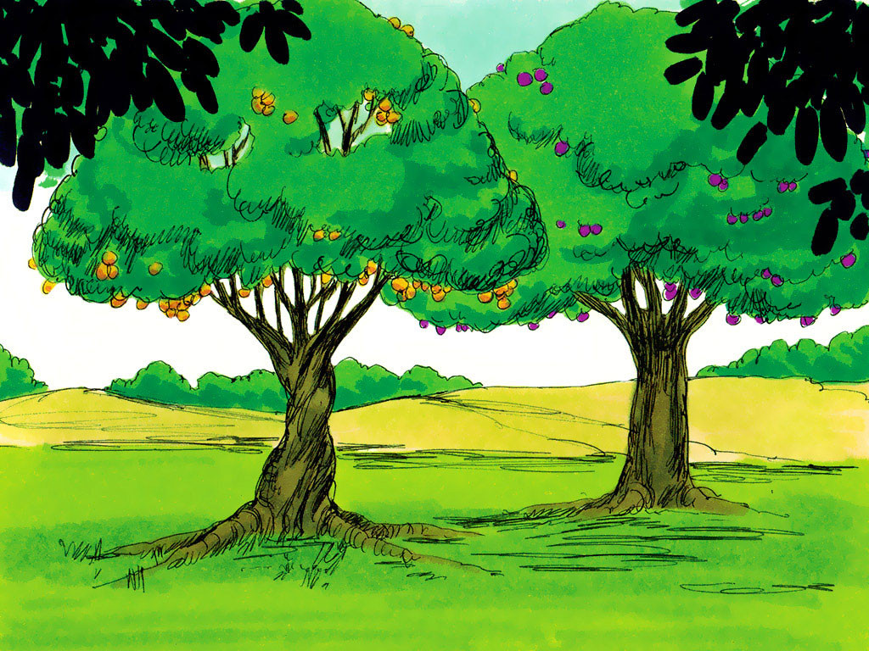
Notes:
3. There were many trees in the garden so there was always plenty of fruit to eat. God told Adam and Eve that there was one tree in the garden that they must never ever eat fruit from.
Adam and Eve had only ever known good but eating from this tree would give them the knowledge of good AND EVIL.
Only God could understand good and evil. If people ate from this tree they would experience something that had never happened before in the garden. They would die.

Slide 4
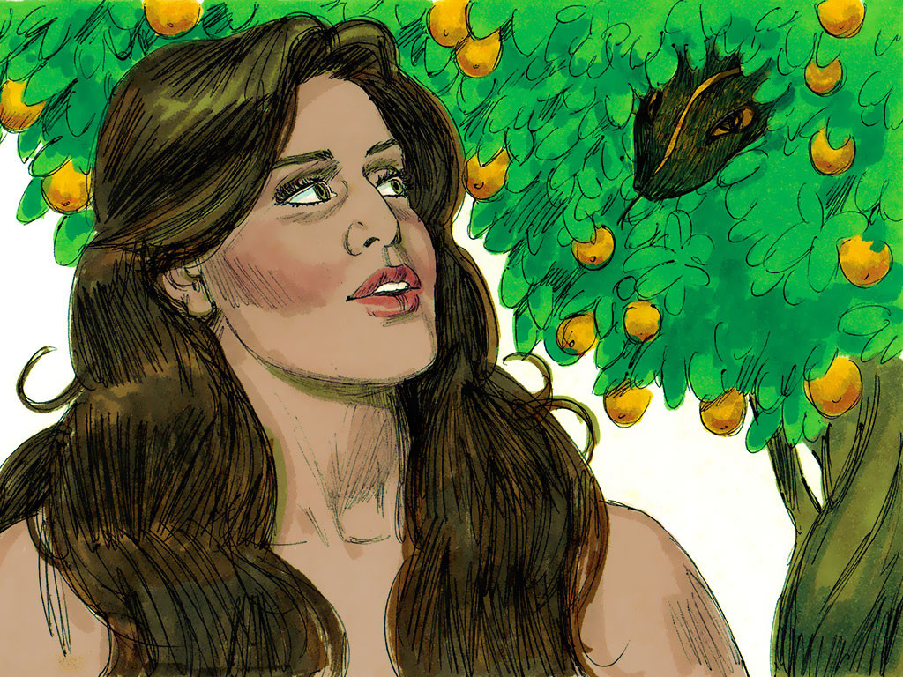
Notes:
4. Adam and Eve had only ever obeyed God but that was about to change.
There was one animal in the garden that was different. This animal was a snake that was very clever and very tricky. This snake could talk and he spoke to Eve.
“Did God REALLY say that you must not eat fruit from ANY tree in the garden?” he asked.

Slide 5
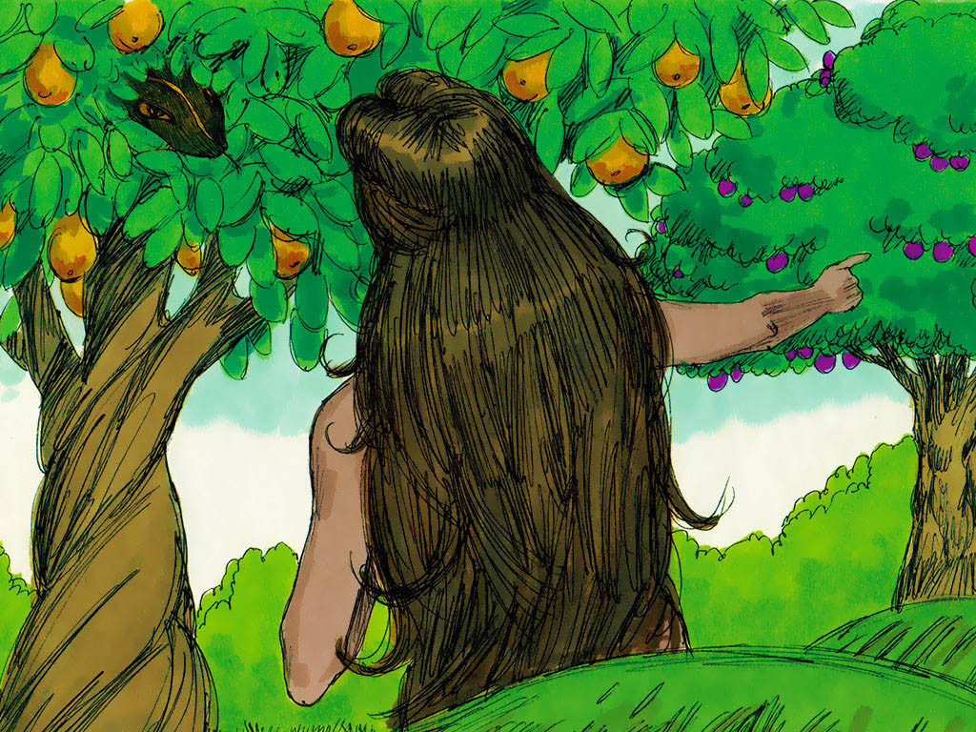
Notes:
5. Well, that really was a tricky question. Even explained, “We can eat from any tree in the garden but God’s rule is that we must never ever eat from the tree in the middle of the garden. He says that if we even touch it we will die.”

Slide 6
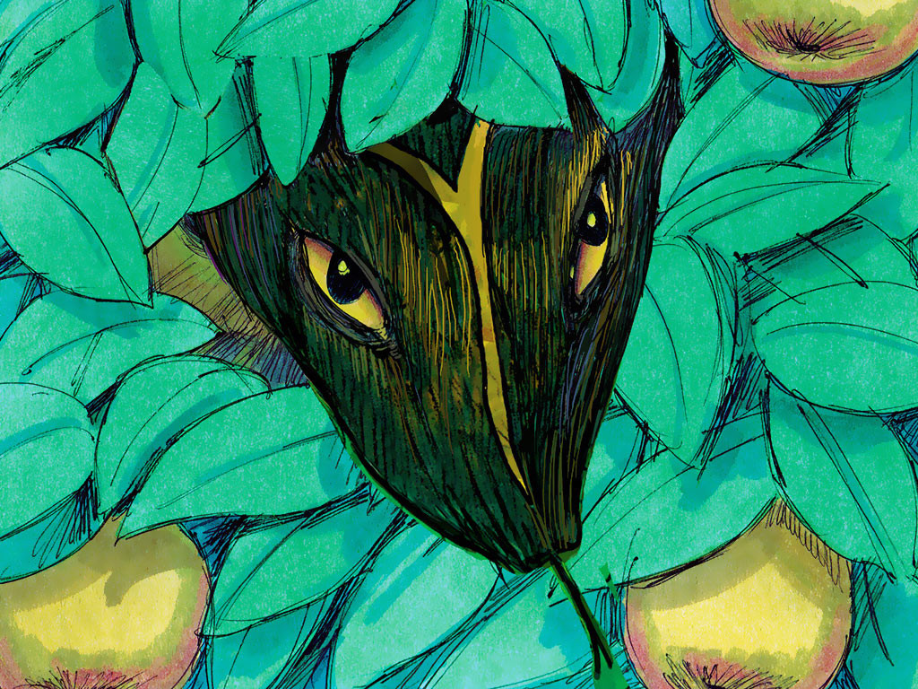
Notes:
6. But the snake was very bad. In fact, later we will learn that this was really the devil. You see, the devil only wants to hurt people and get them to do bad things. He does not want people to love God.
So the snake told the woman a lie. He said, “You will not die! If you eat fruit from the tree you will know all kinds of things like God knows.”

Slide 7
Notes:
7. Thinking about and feeling like maybe you want to do something bad is called “temptation”. The snake was tempting Eve to do something bad. Eve began to look at the fruit and she thought it looked very good to eat. She began to think about that more than about God’s rule.
And then it happened. Eve wasn’t just thinking about it any more, she decided to actually take some of the fruit and eat it. Then she gave some of the fruit to her husband, Adam, and he ate it too.

Slide 8
Notes:
8. Oh, no! What had they done? It was just as God said. Before they ate the fruit they had only thought good things. Now they began to think about bad and evil things too. They felt guilty. They felt embarrassed. They felt ashamed.
They just wanted to hide and cover themselves so they would stop feeling this way! They sewed leaves together to cover themselves.

Slide 9
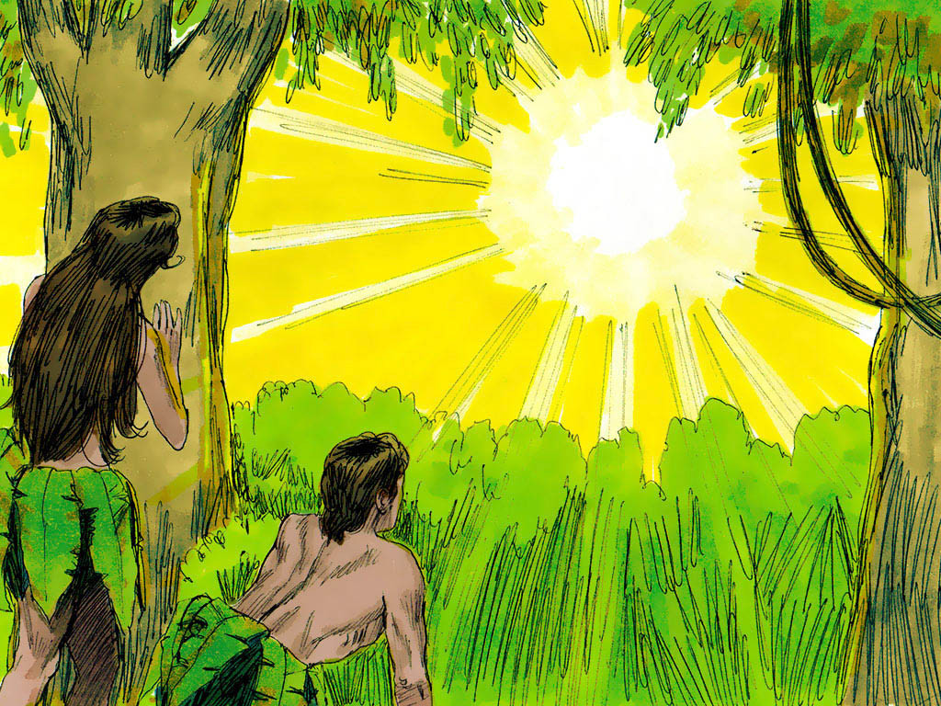
Notes:
9. When they heard God walking in the garden they were so ashamed they hid from him.
“Where are you?” God asked.
“We were afraid and naked so we are hiding,” Adam answered.

Slide 10
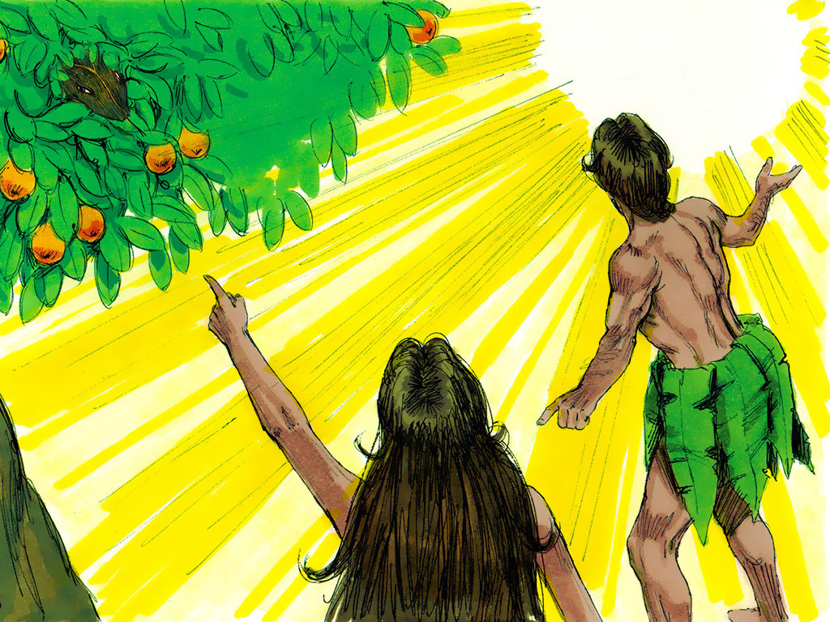
Notes:
10. Yes, everything had changed. God knew that they had eaten from the tree of the knowledge of good and evil. They were no longer only thinking good things.
When God asked Adam why he ate the fruit he blamed Eve. He said, “the woman you made for me gave me the fruit so I ate it.”
When God asked Eve about it she blamed the snake. “The snake tricked me so I ate the fruit.”

Slide 11
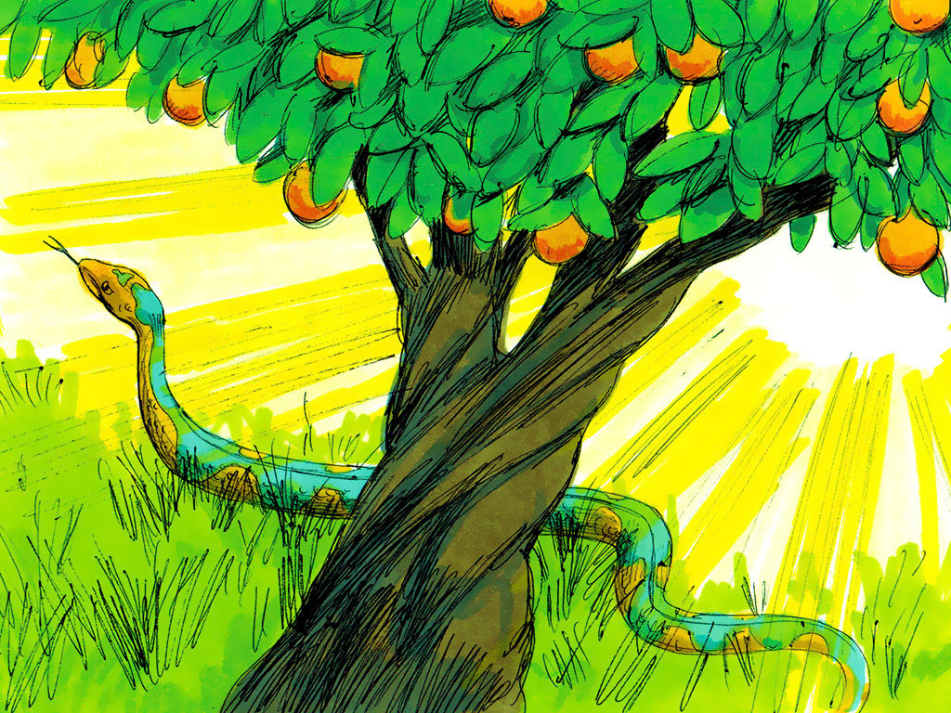
Notes:
11. Everyone was blaming everyone else but one thing was certain. Everything would be different now. Evil had come to the garden. Everyone would suffer.
So God put a curse on the snake. No one knows what the snake was like before but God said from that point onward the snake would be the lowest of all animals and crawl on its stomach. He would be so low it would feel like he was eating dust.
The devil would always be an enemy to people but someday a descendant of the woman would destroy him.

Slide 12
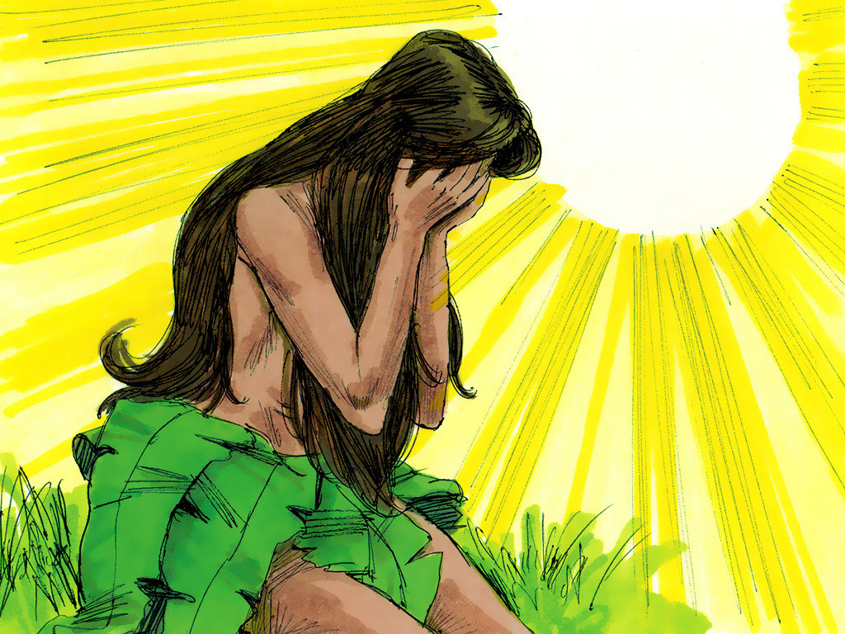
Notes:
12. And there was a curse for the woman too. From now on, having a baby would bring her trouble and pain. Her husband would be the ruler over her now.

Slide 13
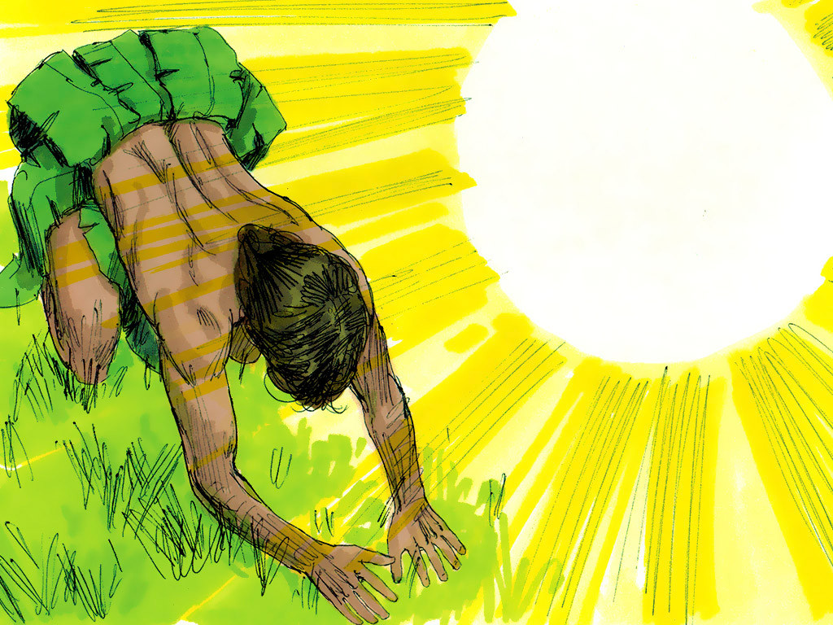
Notes:
13. Everything had been easy in the garden but even the ground would be different now. There would now be thorns and weeds and Adam would have to sweat and work very hard his whole life just to make things grow.

Slide 14
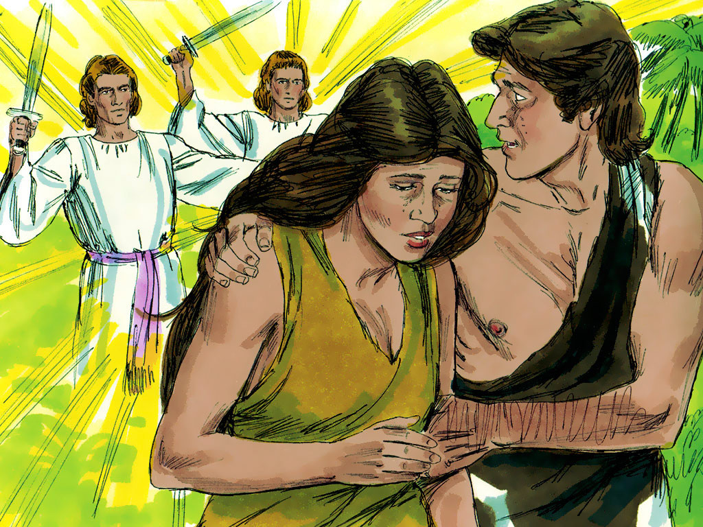
Notes:
14. But the worst punishment of all was that Adam and Eve could no longer live in God’s special garden. The garden had been a place where they could have only good and live forever. But now they knew about being bad too. Because they had disobeyed God and eaten the fruit they would start getting older until a day would come when they would die.
God made them clothes out of animal skins but angels stood guard at the gate of the garden so they could never ever return.

Slide 15
So give yourselves to God.
Stand against the devil,
and the devil will run away from you.
James 4:7 (ICB)
Notes:
15. Even today the devil keeps trying to trick people and tempt them away from God. Even if we can’t see him he is still trying to get us to do bad things. He wants you to think he is stronger than God but GOD IS STRONGER!
This is what is written in the Bible book of James. “So give yourselves to God. Stand against the devil, and the devil will run away from you.” James 4:7 (ICB)
Now you have a choice. Will you obey God or listen to the devil?

Slide 16
Teacher Notes Page 1
1. Cover: Adam and Eve Disobey God (Genesis 2:15-17 and 3:1-24)
2. Adam and Eve were the first man and woman that ever lived. They lived a happy life in a beautiful place called the Garden of Eden. They knew God loved them and they even spent time with him when he walked in the garden.
Only good things had ever happened in the Garden of Eden. Adam and Eve had never felt bad feelings of shame or guilt. They did not wear any clothes but that did not even bother them because they had never even heard about feeling embarrassed.
3. There were many trees in the garden so there was always plenty of fruit to eat. God told Adam and Eve that there was one tree in the garden that they must never ever eat fruit from.
Adam and Eve had only ever known good but eating from this tree would give them the knowledge of good AND EVIL.
Only God could understand good and evil. If people ate from this tree they would experience something that had never happened before in the garden. They would die.
4. Adam and Eve had only ever obeyed God but that was about to change.
There was one animal in the garden that was different. This animal was a snake that was very clever and very tricky. This snake could talk and he spoke to Eve.
“Did God REALLY say that you must not eat fruit from ANY tree in the garden?” he asked.
5. Well, that really was a tricky question. Even explained, “We can eat from any tree in the garden but God’s rule is that we must never ever eat from the tree in the middle of the garden. He says that if we even touch it we will die.”
6. But the snake was very bad. In fact, later we will learn that this was really the devil. You see, the devil only wants to hurt people and get them to do bad things. He does not want people to love God.
So the snake told the woman a lie. He said, “You will not die! If you eat fruit from the tree you will know all kinds of things like God knows.”
7. Thinking about and feeling like maybe you want to do something bad is called “temptation”. The snake was tempting Eve to do something bad. Eve began to look at the fruit and she thought it looked very good to eat. She began to think about that more than about God’s rule.
And then it happened. Eve wasn’t just thinking about it any more, she decided to actually take some of the fruit and eat it. Then she gave some of the fruit to her husband, Adam, and he ate it too.
8. Oh, no! What had they done? It was just as God said. Before they ate the fruit they had only thought good things. Now they began to think about bad and evil things too. They felt guilty. They felt embarrassed. They felt ashamed.
They just wanted to hide and cover themselves so they would stop feeling this way! They sewed leaves together to cover themselves.
9. When they heard God walking in the garden they were so ashamed they hid from him.
“Where are you?” God asked.
“We were afraid and naked so we are hiding,” Adam answered.
10. Yes, everything had changed. God knew that they had eaten from the tree of the knowledge of good and evil. They were no longer only thinking good things.
When God asked Adam why he ate the fruit he blamed Eve. He said, “the woman you made for me gave me the fruit so I ate it.”
When God asked Eve about it she blamed the snake. “The snake tricked me so I ate the fruit.”
11. Everyone was blaming everyone else but one thing was certain. Everything would be different now. Evil had come to the garden. Everyone would suffer.
So God put a curse on the snake. No one knows what the snake was like before but God said from that point onward the snake would be the lowest of all animals and crawl on its stomach. He would be so low it would feel like he was eating dust.
The devil would always be an enemy to people but someday a descendant of the woman would destroy him.

Slide 17
Teacher Notes Page 2
12. And there was a curse for the woman too. From now on, having a baby would bring her trouble and pain. Her husband would be the ruler over her now.
13. Everything had been easy in the garden but even the ground would be different now. There would now be thorns and weeds and Adam would have to sweat and work very hard his whole life just to make things grow.
14. But the worst punishment of all was that Adam and Eve could no longer live in God’s special garden. The garden had been a place where they could have only good and live forever. But now they knew about being bad too. Because they had disobeyed God and eaten the fruit they would start getting older until a day would come when they would die.
God made them clothes out of animal skins but angels stood guard at the gate of the garden so they could never ever return.
15. Even today the devil keeps trying to trick people and tempt them away from God. Even if we can’t see him he is still trying to get us to do bad things. He wants you to think he is stronger than God but GOD IS STRONGER!
This is what is written in the Bible book of James.
“So give yourselves to God. Stand against the devil, and the devil will run away from you.” James 4:7 (ICB)
Now you have a choice. Will you obey God or listen to the devil?

Slide 18
Attributions: This visual aid was constructed by Mary Nelson www.missionbibleclass.org using:
-Text and slideshow compilation by Mary Nelson -Illustrations from Sweet Publishing http://sweetpublishing.com/ (Artist: Jim Padgett) accessed through www.freebibleimages.org . Alterations:
-On the cover slide two illustrations were merged and text added.
-Text added to last slide over the illustration.
Attribution-ShareAlike 3.0 Unported (CC BY-SA 3.0) https://creativecommons.org/licenses/by-sa/3.0/
User may reproduce it without permissions.
DOWNLOAD THIS SLIDESHOW FROM www.missionbibleclass.org
Please visit www.missionbibleclass.org to find this and many other free resources to help you teach the Bible to children.

