Slide 1
Notes:
1. Cover: Wise Men and a Star
Matthew 2:1-15

Slide 2
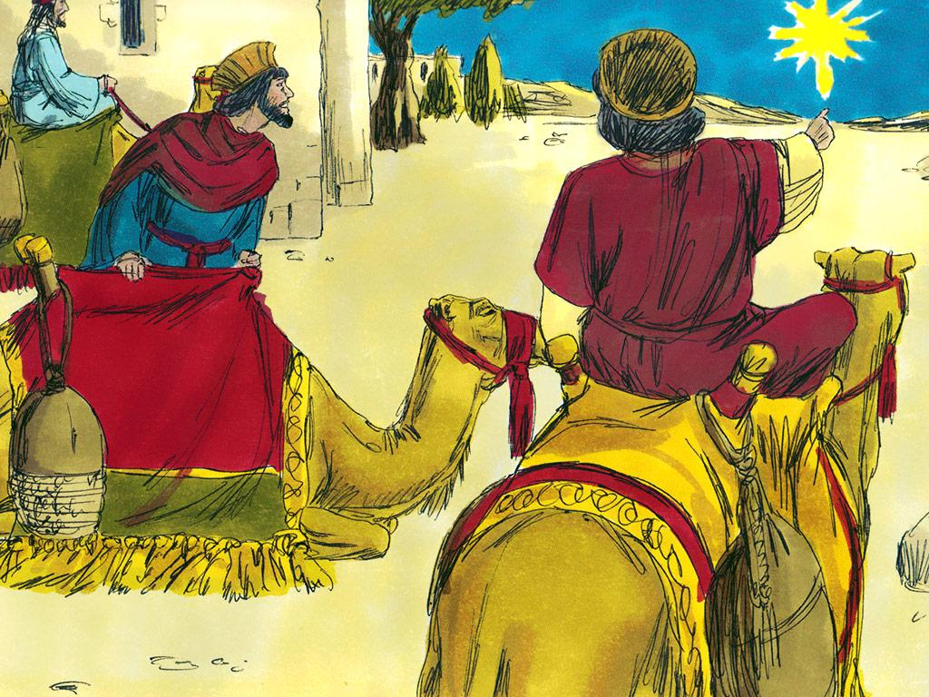
Notes:
2. Far to the east of Bethlehem there were men who were referred to as “magi”. The magi were considered to be very wise. Even though they were wise in many ways the magi did not worship God.
The magi did, however, study science and the stars. They had seen the stars many times but there was something very different about one star they began to see in the sky. There was something so special about this star that the magi knew they must go and see what it was about.

Slide 3
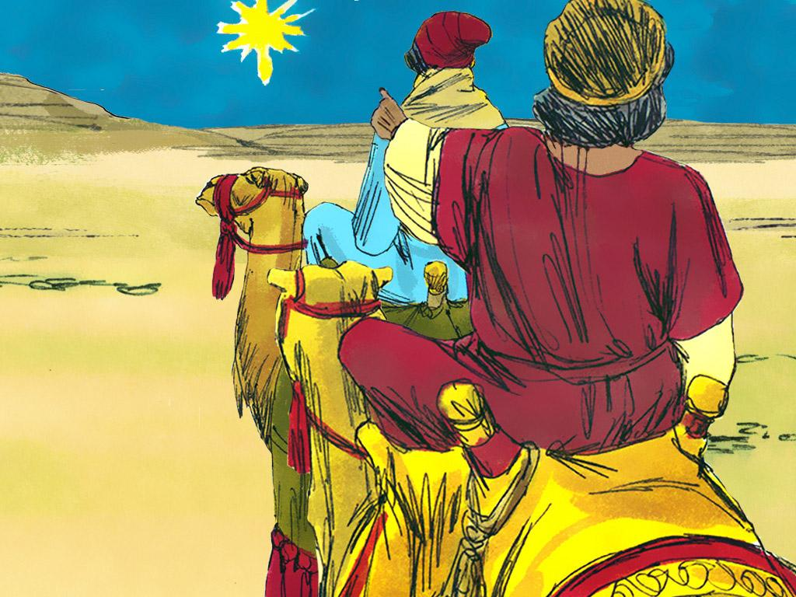
Notes:
3. After studying the star the magi began to follow it. This star was so special that they realised that it was leading them to a king. The king of the Jews. This was exciting! They wanted to worship this new king.

Slide 4
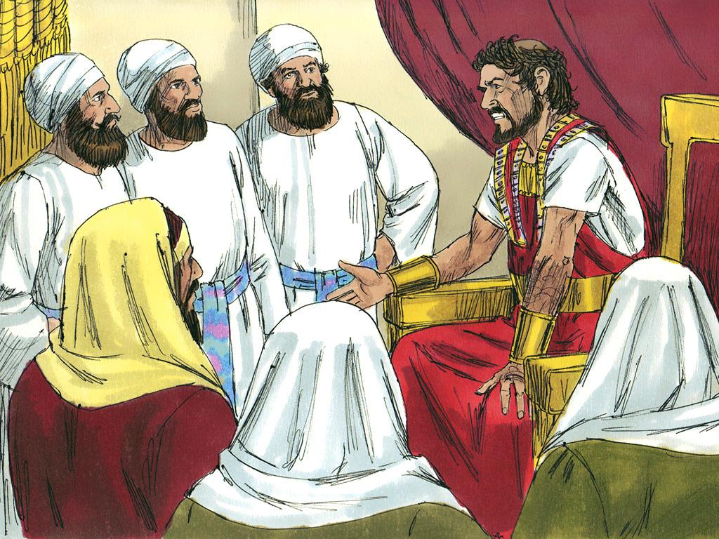
Notes:
4. The star was over the town of Bethlehem but the magi decided to stop in the city of Jerusalem on the way. Herod was the King of the Jews and he lived in a palace in Jerusalem. The magi thought that since he was a king that surely Herod would know about the new king.
“Where is the one who has been born king of the Jews?” the wise men asked Herod, “We saw his star when it rose and have come to worship him.” They wanted to give him gifts and praise him like a king deserved.

Slide 5
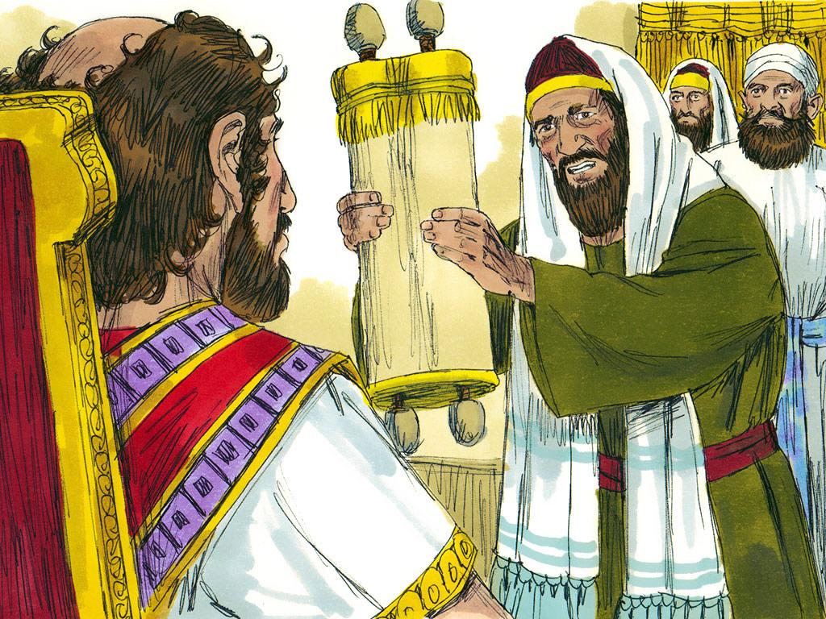
Notes:
5. King Herod seemed puzzled. He called together the chief priests and teachers of the law and asked for their advice. Herod was the king. Had the priests and teachers of the law ever hear about another king.
These advisers knew what the prophets had written about in the Old Testament. They knew that God was sending a Messiah to save his people. The prophets had said that the Messiah, the real King of the Jews, would be born in Bethlehem.
The “real King of the Jews?”. This meant that when the Messiah came, he would be more important than King Herod. King Herod did not want anyone to be more important than him! He was king and he liked himself a lot. He knew he had to find out where this new king was. He had to get rid of him.

Slide 6
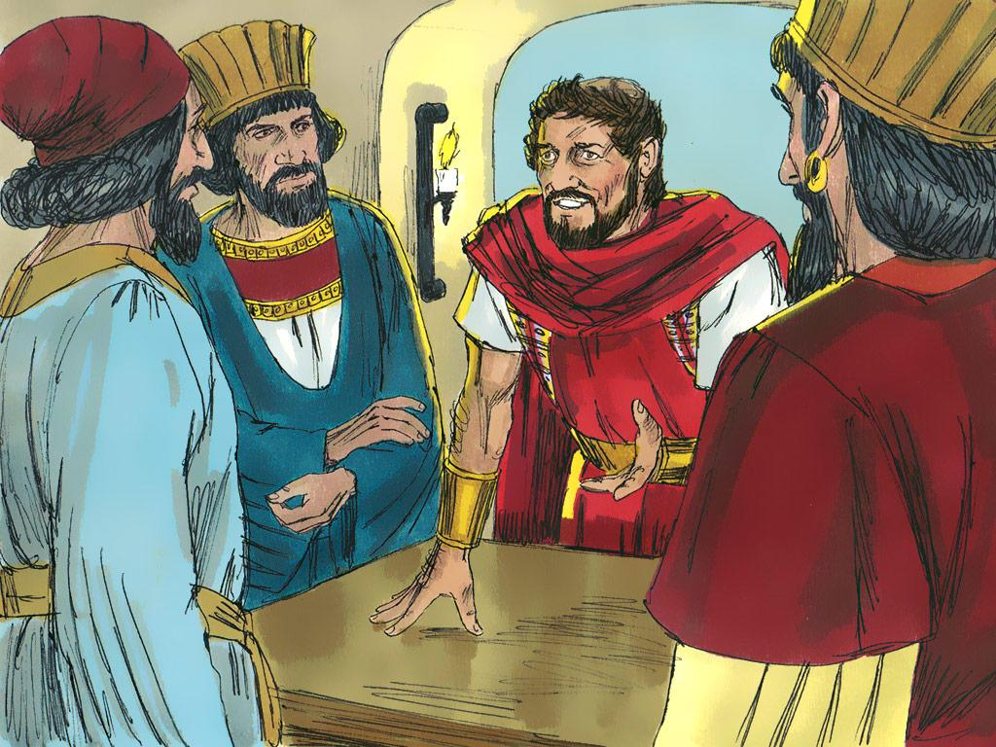
Notes:
6. So Herod came back to the Magi and tried to trick them. He told them to go and find the newborn king so he could go and worship him and give him honour too. But this was a trick. King Herod didn’t really want to worship the new king – he wanted to kill him! He just wanted to follow the magi so he would know where the new king was.

Slide 7
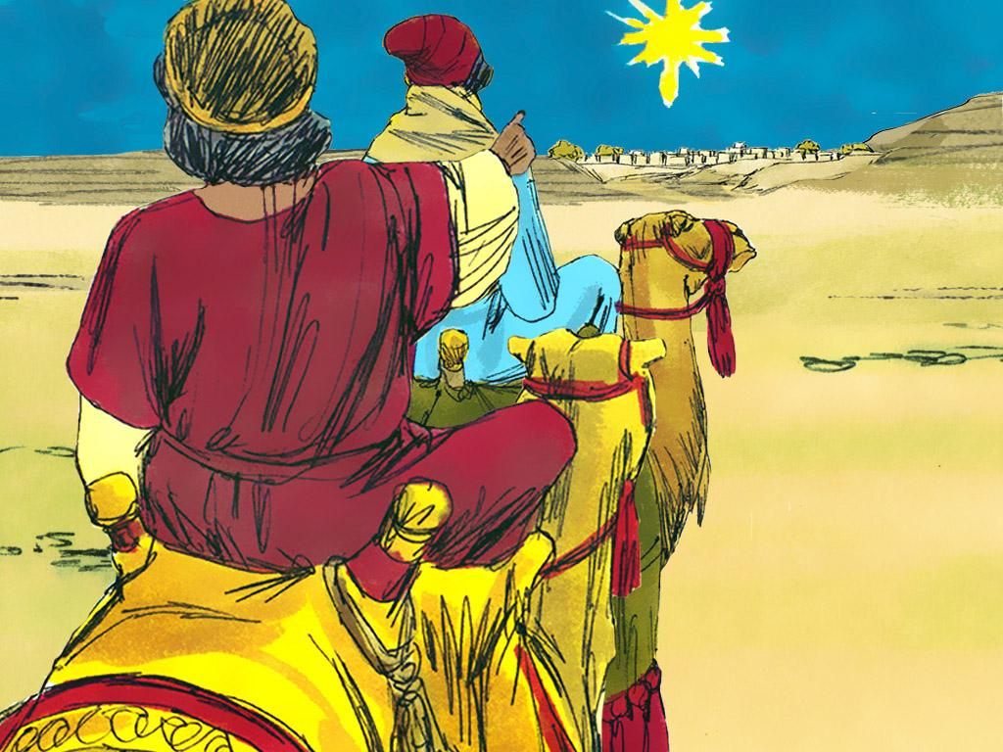
Notes:
7. The star began to shine again so the wise men followed it once again. Soon they found the house in Bethlehem where Joseph, Mary and their little boy, Jesus were staying.

Slide 8
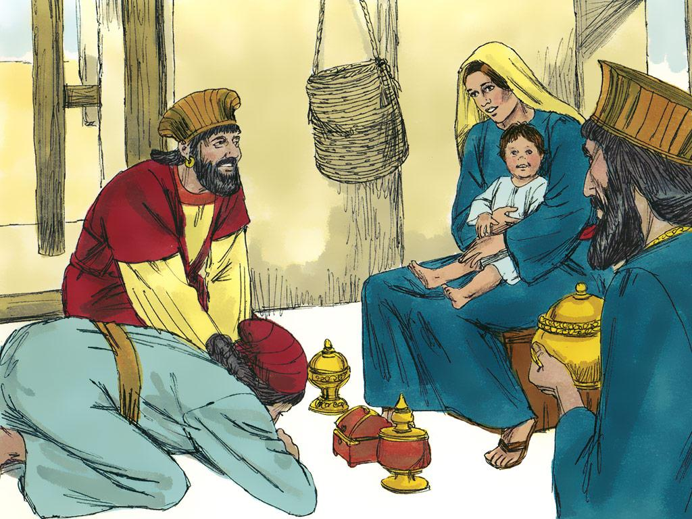
Notes:
8. Mary and Joseph told the wise men all about how Jesus had been born in a stable. They told them about the angels singing to the shepherds when they announced his birth.
The wise men knew immediately that this little boy was truly the new king of the Jews. They bowed down in front of him and gave him very expensive gifts from their country in the east. The gifts were gold, incense and myrrh. These were the kinds of expensive gifts that people would give to a king. The Magi gave Jesus this special honour.

Slide 9
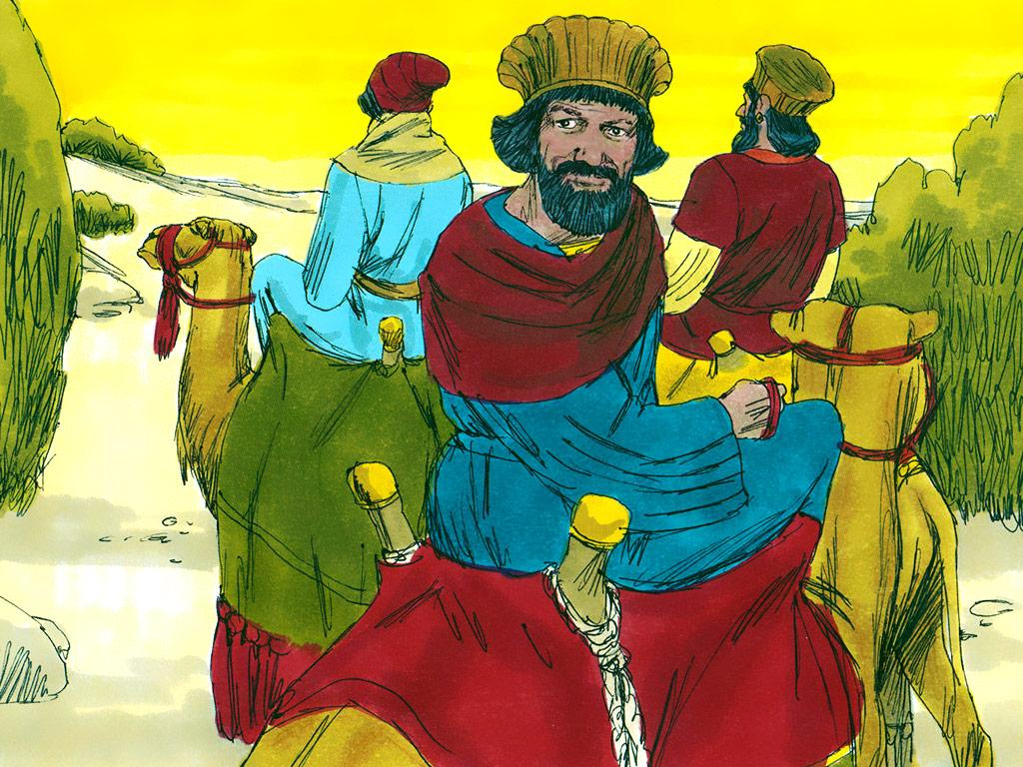
Notes:
9. The magi had a dream and knew that King Herod was going to try to kill Jesus. The magi did not want to tell King Herod where to find Jesus. They went back home a different way so that King Herod would not be able to follow them.

Slide 10
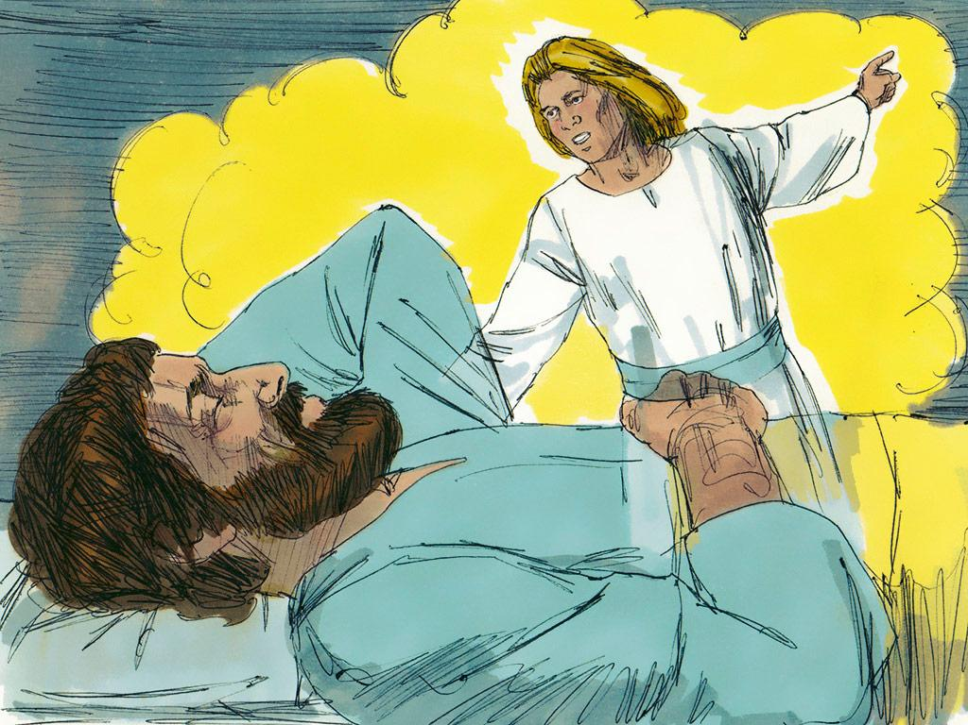
Notes:
10. The magi weren’t the only ones to have a dream. An angel appeared to Joseph in a dream and said, “Joseph, get up, take the child and his mother and escape to Egypt. Stay there until I tell you. If you don’t go then Herod will search and find your son. Then he will kill him.”

Slide 11
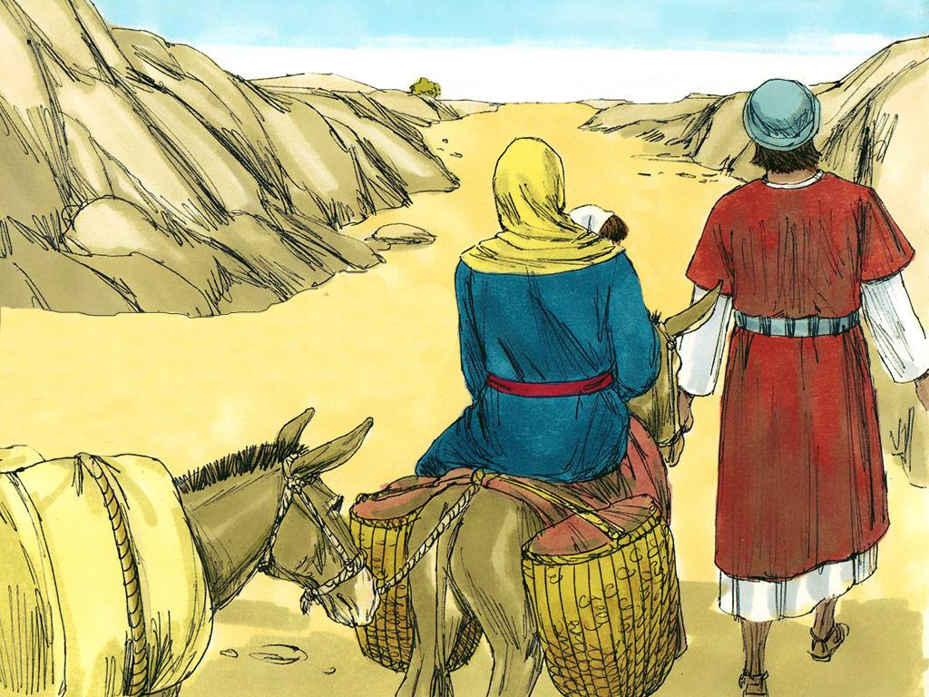
Notes:
11. So Joseph got up at that very moment. In the middle of the night he took his family on the long trip to Egypt. They were safe.

Slide 12
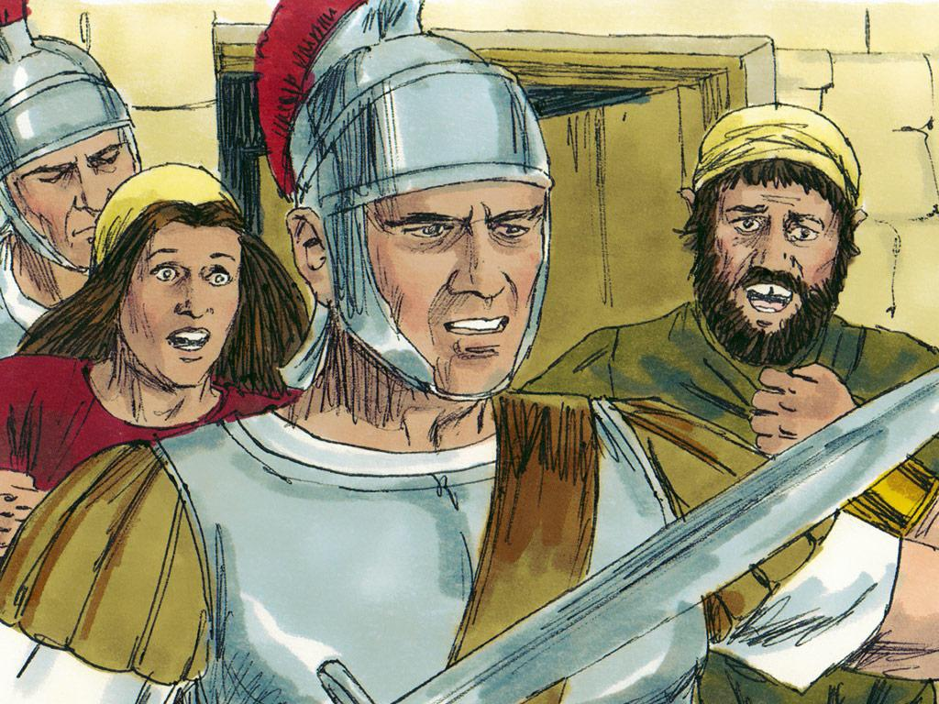
Notes:
12. It was a good thing that Joseph did act quickly. When the other Magi and I did not return to King Herod he got very angry. King Herod ordered his soldiers to kill every single little Jewish boy under the age of two. He did not know that Jesus was already gone so he thought that he could kill him this way. What a sad day.

Slide 13
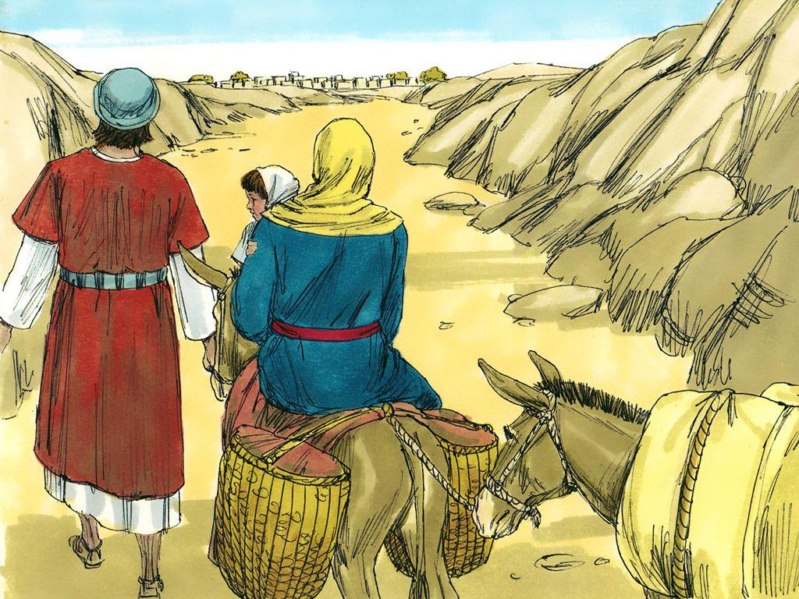
Notes:
13. But God kept Jesus safe! Jesus was God’s special gift to the world. The wise men knew that Jesus was special so they wanted to give him special honour.
Are you like the wise men? You can give Jesus special honour by obeying him and telling him how much you love him. Have you given Jesus honour today?

Slide 14
Teacher Notes Page 1
1. Cover: Wise Men and a Star Matthew 2:1-18
2. Far to the east of Bethlehem there were men who were referred to as “magi”. The magi were considered to be very wise. Even though they were wise in many ways the magi did not worship God.
The magi did, however, study science and the stars. They had seen the stars many times but there was something very different about one star they began to see in the sky. There was something so special about this star that the magi knew they must go and see what it was about.
3. After studying the star the magi began to follow it. This star was so special that they realised that it was leading them to a king. The king of the Jews. This was exciting! They wanted to worship this new king.
4. The star was over the town of Bethlehem but the magi decided to stop in the city of Jerusalem on the way. Herod was the King of the Jews and he lived in a palace in Jerusalem. The magi thought that since he was a king that surely Herod would know about the new king.
“Where is the one who has been born king of the Jews?” the wise men asked Herod, “We saw his star when it rose and have come to worship him.” They wanted to give him gifts and praise him like a king deserved.
5. King Herod seemed puzzled. He called together the chief priests and teachers of the law and asked for their advice. Herod was the king. Had the priests and teachers of the law ever hear about another king.
These advisers knew what the prophets had written about in the Old Testament. They knew that God was sending a Messiah to save his people. The prophets had said that the Messiah, the real King of the Jews, would be born in Bethlehem.
The “real King of the Jews?”. This meant that when the Messiah came, he would be more important than King Herod. King Herod did not want anyone to be more important than him! He was king and he liked himself a lot. He knew he had to find out where this new king was. He had to get rid of him.
6. So Herod came back to the Magi and tried to trick them. He told them to go and find the newborn king so he could go and worship him and give him honour too.
But this was a trick. King Herod didn’t really want to worship the new king – he wanted to kill him! He just wanted to follow the magi so he would know where the new king was.
7. The star began to shine again so the wise men followed it once again. Soon they found the house in Bethlehem where Joseph, Mary and their little boy, Jesus were staying.

Slide 15
Teacher Notes Page 2
8. Mary and Joseph told the wise men all about how Jesus had been born in a stable. They told them about the angels singing to the shepherds when they announced his birth.
The wise men knew immediately that this little boy was truly the new king of the Jews. They bowed down in front of him and gave him very expensive gifts from their country in the east. The gifts were gold, incense and myrrh. These were the kinds of expensive gifts that people would give to a king. The Magi gave Jesus this special honour.
9. The magi had a dream and knew that King Herod was going to try to kill Jesus. The magi did not want to tell King Herod where to find Jesus. They went back home a different way so that King Herod would not be able to follow them.
10. The magi weren’t the only ones to have a dream. An angel appeared to Joseph in a dream and said, “Joseph, get up, take the child and his mother and escape to Egypt. Stay there until I tell you. If you don’t go then Herod will search and find your son. Then he will kill him.”
11. So Joseph got up at that very moment. In the middle of the night he took his family on the long trip to Egypt. They were safe.
12. It was a good thing that Joseph did act quickly. When the other Magi and I did not return to King Herod he got very angry. King Herod ordered his soldiers to kill every single little Jewish boy under the age of two. He did not know that Jesus was already gone so he thought that he could kill him this way. What a sad day.
13. But God kept Jesus safe! Jesus was God’s special gift to the world. The wise men knew that Jesus was special so they wanted to give him special honour.
Are you like the wise men? You can give Jesus special honour by obeying him and telling him how much you love him. Have you given Jesus honour today?

Slide 16
Attributions: This visual aid was constructed by Mary Nelson www.missionbibleclass.org using:
Text and slideshow compilation by Mary Nelson
Illustrations by Sweet Publishing http://sweetpublishing.com/ As accessed through www.freebibleimages.org Notice of Alteration: Text added to cover slide.
Attribution-ShareAlike 3.0 Unported (CC BY-SA 3.0) https://creativecommons.org/licenses/by-sa/3.0/
User may reproduce it without permissions.
DOWNLOAD THIS SLIDESHOW FROM www.missionbibleclass.org
Please visit www.missionbibleclass.org to find this and many other free resources to help you teach the Bible to children.

