Slide 1
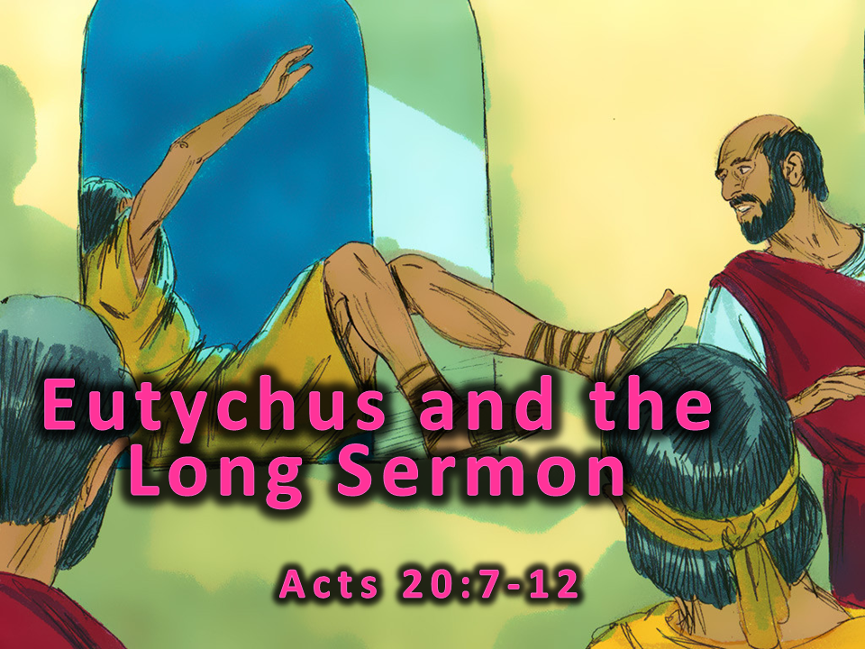
Notes:
1. Cover: Eutychus and the Long Sermon Acts 20:7-12

Slide 2
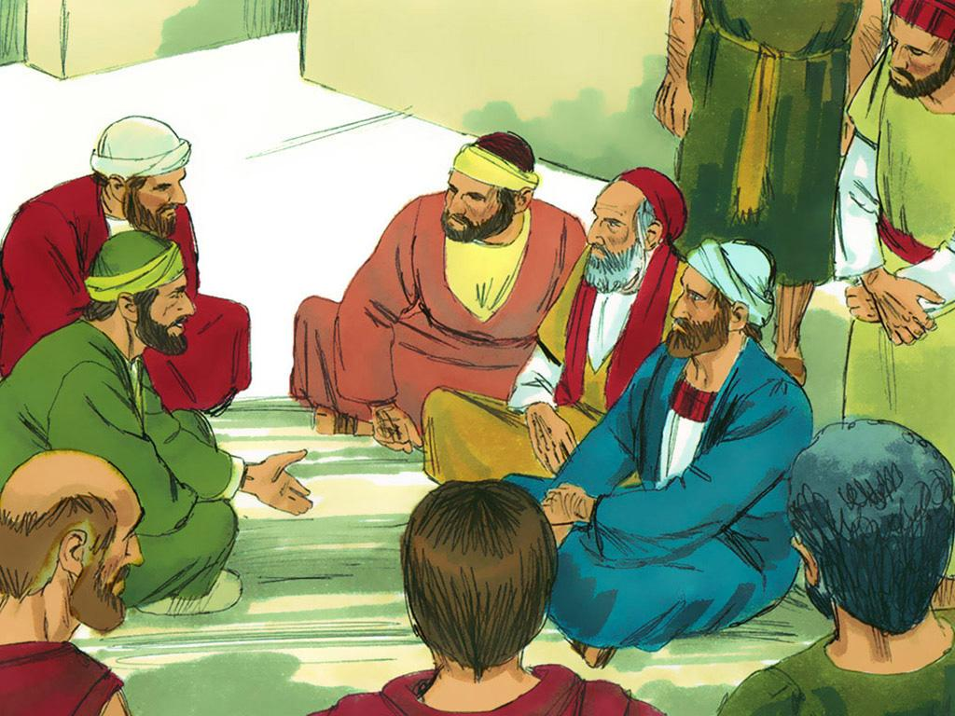
Notes:
2. Paul had a very important job to do. He was a missionary who travelled to many different cities and countries, telling people about Jesus. Being a missionary was a very important job because many people had not even heard about Jesus. They did not know that he had died on the cross so that their sins could be forgiven. They did not know that they could be with him forever if they followed him. They did not even know that Jesus wanted to be their friend.

Slide 3
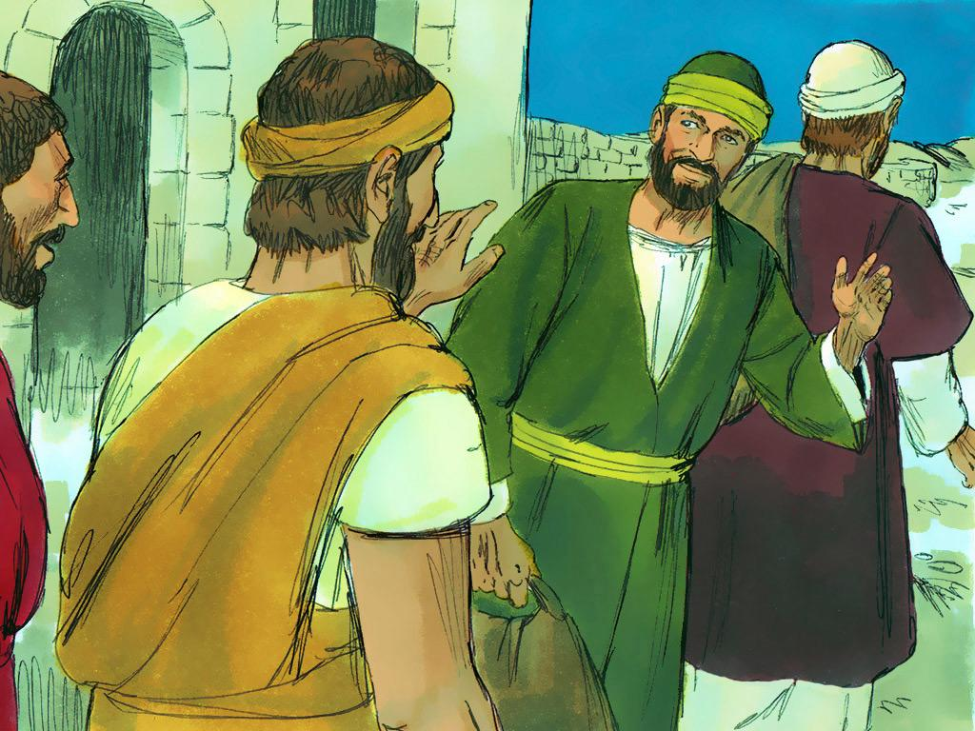
Notes:
3. As a missionary, Paul went on several important trips or journeys. During his third missionary journey, Paul and his friends told many people that Jesus was God’s son. Some people believed what Paul was saying and started following Jesus. But some people did not like what Paul was saying.

Slide 4
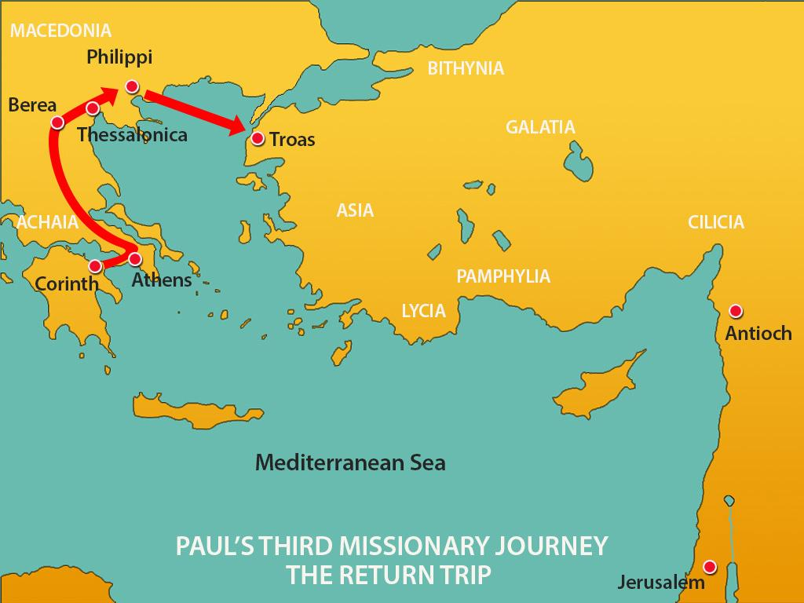
Notes:
4. Paul knew it was time to conclude this journey and make his way to Jerusalem. He travelled back the same way he had come. Some of his friends went ahead of him, and he caught up with them in the city of Troas.

Slide 5
Notes:
5. On the first day of the week (Sunday), Paul and a group of Christians met together to take the Lord’s Supper. Everyone was so happy that Paul was with them. They knew that Paul was both an Apostle and a missionary. They had heard how Paul had shared the Good News of Jesus with many people. They had also heard about the miracles he had done to show the power of God and help people believe.

Slide 6
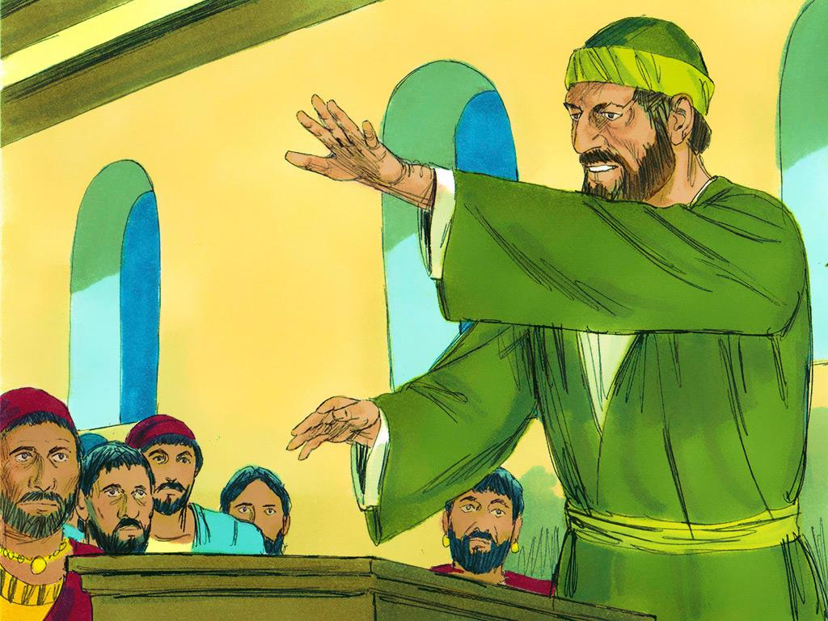
Notes:
6. 6. The followers of Jesus met in a room on the third floor of a building. Everyone had to climb stairs to get to the meeting place. Paul kept preaching until midnight, so there were many lamps to help everyone see.
One young man named Eutychus found what he thought was a very good place to sit. He didn’t sit on a chair, and he didn’t sit on the floor. Instead, Eutychus found a window and sat right on the window sill. There was no glass in the window because windows did not have glass in those days. But the window was a nice place to sit because of the fresh air.
The third floor was very high, and the ground was very far down, so Eutychus would have had to pay attention and be careful not to lean too far out of the window. That would be dangerous!

Slide 7
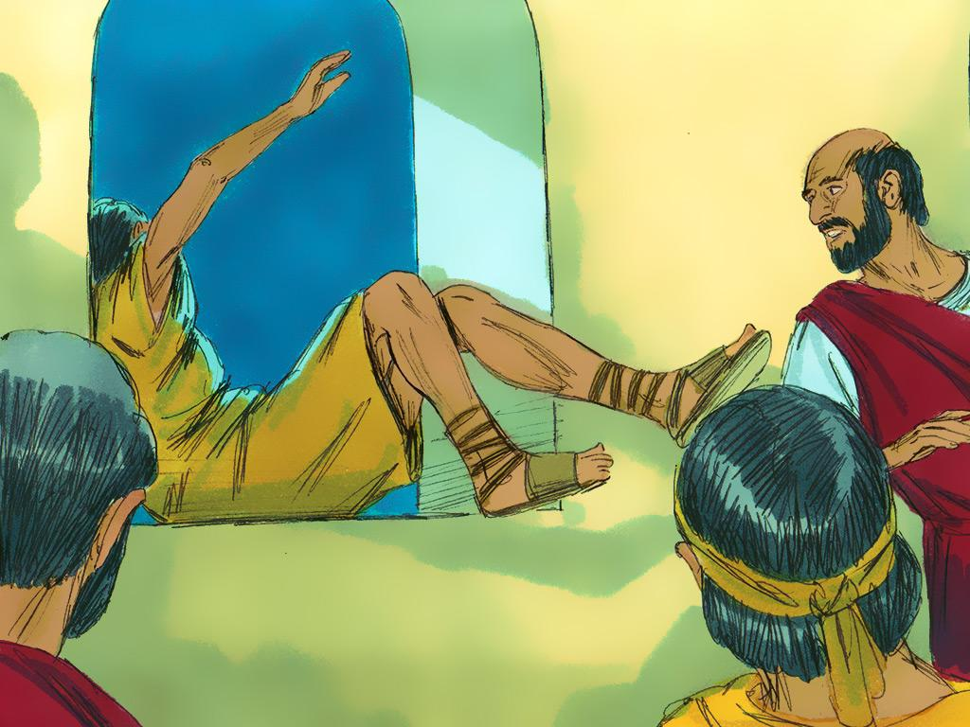
Notes:
7. Paul kept preaching on and on, and Eutychus got so sleepy that he could not stay awake any longer. Finally, he fell fast asleep and leaned too far out of the window. He fell all the way down to the ground.
This was very serious! When people went down to him and picked him up, they found that he was dead. Everyone was so sad. Poor Eutychus! While everyone was standing around thinking about this, Paul arrived. He had climbed down the stairs to where Eutychus was.

Slide 8
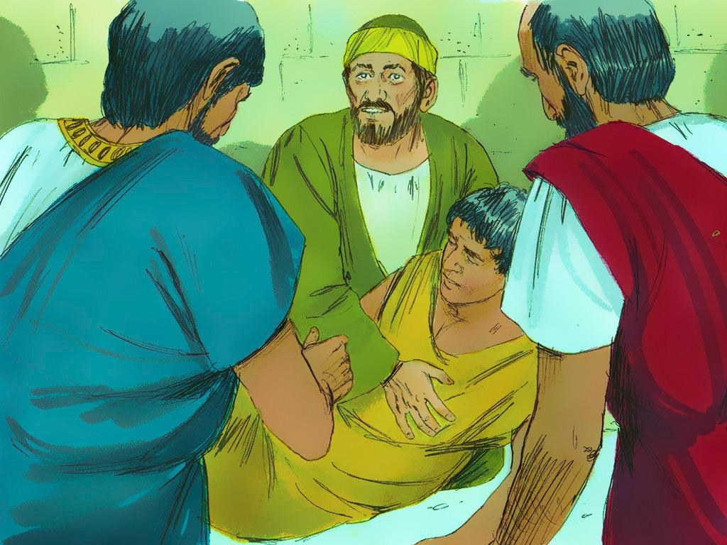
Notes:
8. Paul knelt down and put his arms around Eutychus’ dead body. Through the power of Jesus, Eutychus came alive again. Paul told everyone, “Don’t worry. He is alive now.”
When Eutychus died, everyone had been afraid and sad. Now they were comforted and very happy. If Jesus’ power could raise Eutychus from the dead, then Jesus could take care of them too.

Slide 9
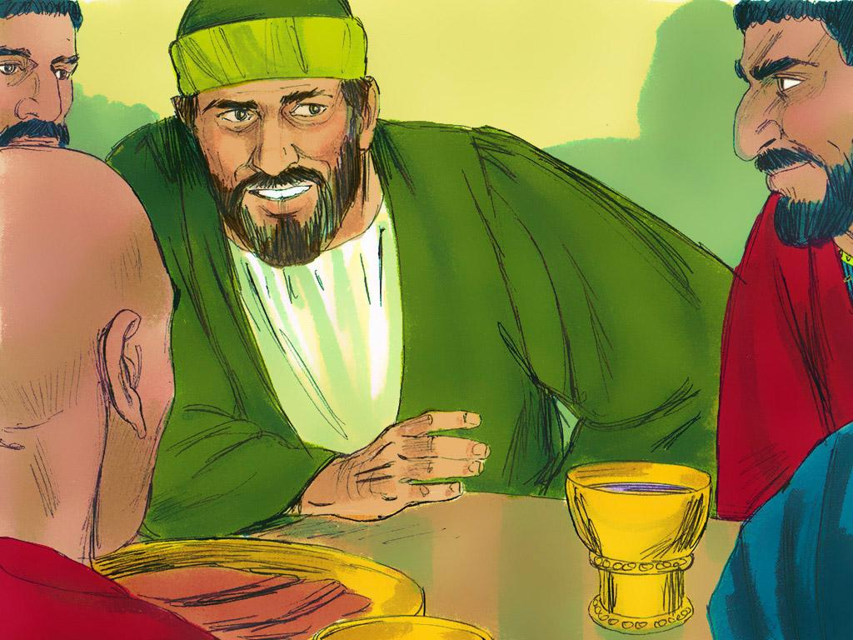
Notes:
9. After this, everyone returned up the stairs and continued their time together. They took the Lord’s Supper, and Paul talked with them all night. In the morning, Paul left to continue his journey. The followers of Jesus took Eutychus home safe and sound.
Have you ever fallen asleep in church like Eutychus? Or have you had a hard time listening? It is sometimes very difficult to sit still and quiet for a long time. But it is good manners and very respectful to try your best. That way, you can listen, and everyone else can listen, too. We want everyone to hear the Good News about Jesus!

Slide 10
Teacher Notes Page 1
1. Cover: Eutychus and the Long Sermon Acts 20:7-12
2. Paul had a very important job to do. He was a missionary who travelled to many different cities and countries, telling people about Jesus. Being a missionary was a very important job because many people had not even heard about Jesus.
They did not know that he had died on the cross so that their sins could be forgiven. They did not know that they could be with him forever if they followed him. They did not even know that Jesus wanted to be their friend.
3. As a missionary, Paul went on several important trips or journeys. During his third missionary journey, Paul and his friends told many people that Jesus was God’s son. Some people believed what Paul was saying and started following Jesus. But some people did not like what Paul was saying.
4. Paul knew it was time to conclude this journey and make his way to Jerusalem. He travelled back the same way he had come. Some of his friends went ahead of him, and he caught up with them in the city of Troas.
5. On the first day of the week (Sunday), Paul and a group of Christians met together to take the Lord’s Supper. Everyone was so happy that Paul was with them. They knew that Paul was both an Apostle and a missionary. They had heard how Paul had shared the Good News of Jesus with many people. They had also heard about the miracles he had done to show the power of God and help people believe.
6. The followers of Jesus met in a room on the third floor of a building. Everyone had to climb stairs to get to the meeting place. Paul kept preaching until midnight, so there were many lamps to help everyone see.
One young man named Eutychus found what he thought was a very good place to sit. He didn’t sit on a chair, and he didn’t sit on the floor. Instead, Eutychus found a window and sat right on the window sill. There was no glass in the window because windows did not have glass in those days. But the window was a nice place to sit because of the fresh air.
The third floor was very high, and the ground was very far down, so Eutychus would have had to pay attention and be careful not to lean too far out of the window. That would be dangerous!
7. Paul kept preaching on and on, and Eutychus got so sleepy that he could not stay awake any longer. Finally, he fell fast asleep and leaned too far out of the window. He fell all the way down to the ground.
This was very serious! When people went down to him and picked him up, they found that he was dead. Everyone was so sad. Poor Eutychus! While everyone was standing around thinking about this, Paul arrived. He had climbed down the stairs to where Eutychus was.

Slide 11
Teacher Notes Page 2
8. Paul knelt down and put his arms around Eutychus’ dead body. Through the power of Jesus, Eutychus came alive again. Paul told everyone, “Don’t worry. He is alive now.”
When Eutychus died, everyone was afraid and sad. Now, they are comforted and very happy. If Jesus’ power could raise Eutychus from the dead, then Jesus could take care of them, too.
9. After this, everyone returned up the stairs and continued their time together. They took the Lord’s Supper, and Paul talked with them all night. In the morning, Paul left to continue his journey. The followers of Jesus took Eutychus home safe and sound.
Have you ever fallen asleep in church like Eutychus? Or have you had a hard time listening? It is sometimes very difficult to sit still and quiet for a long time. But it is good manners and very respectful to try your best. That way, you can listen, and everyone else can listen, too. We want everyone to hear the Good News about Jesus!

Slide 12


Attributions: This visual aid was constructed by Mary Nelson www.missionbibleclass.org using:
Text and slideshow compilation by Mary Nelson
Illustrations by Sweet Publishing http://sweetpublishing.com/
As accessed through www.freebibleimages.org
Notice of Alteration: Text added to cover slide
Attribution-ShareAlike 3.0 Unported (CC BY-SA 3.0) https://creativecommons.org/licenses/by-sa/3.0/
User may reproduce it without permissions.
DOWNLOAD THIS SLIDESHOW FROM www.missionbibleclass.org
Please visit www.missionbibleclass.org to find this and many other free resources to help you teach the Bible to children.

