Slide 1
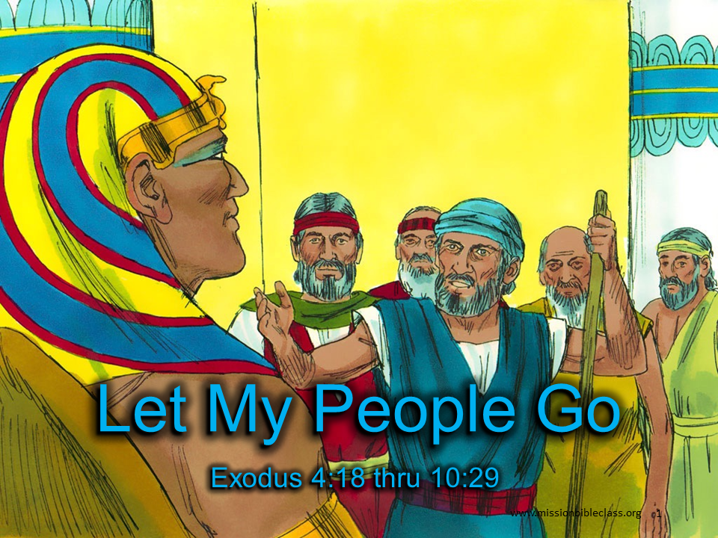
Let My People Go
Exodus 4:18 thru 10:29
Notes:
1. Cover: Let My People Go (Exodus 4:20-23 and 4:27-10:29)

Slide 2
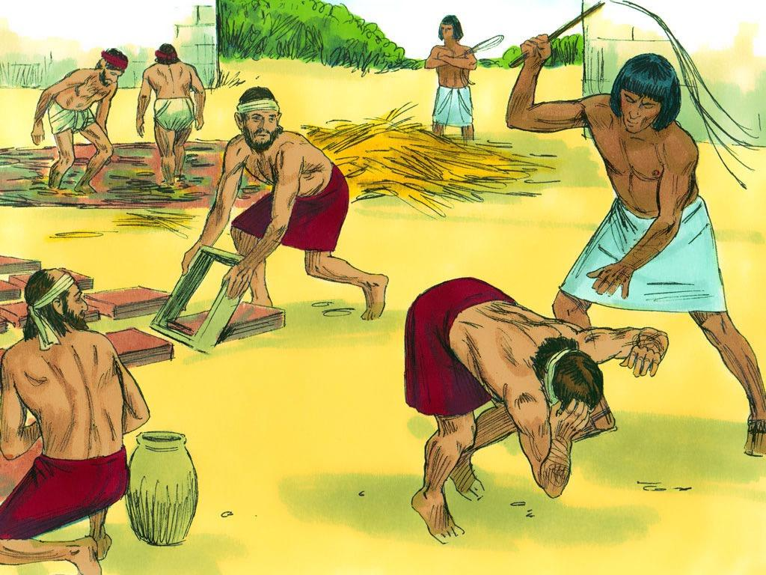
Notes:
2. God loved his people, the Israelites like a father loves his son. The Israelites were receiving very bad treatment in Egypt. What do you think a father would do to people who were hurting his son?
For four hundred years, God’s people had been slaves in Egypt. Being slaves meant that even though they had to work hard and do everything that the Egyptians said, the Egyptians never had to pay them any money.

Slide 3
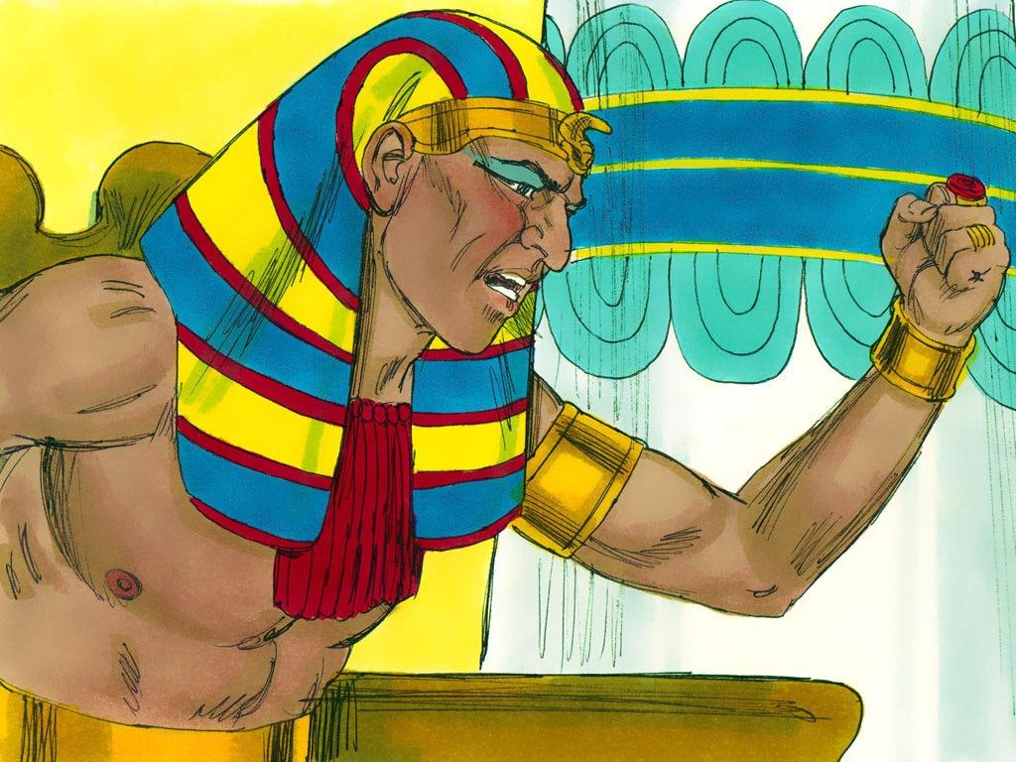
Notes:
3. The Pharaoh or king of Egypt had a very hard heart and was mean to the Israelites. He did not believe in the God we read about in our Bibles. Pharaoh and the rest of the Egyptian people believed in the many “gods” of Egypt. They made statues of these “gods.” Some were shaped like frogs, while others were shaped like crocodiles or even geese. Pharaoh thought these “gods” could keep Egypt safe, but he was wrong.

Slide 4
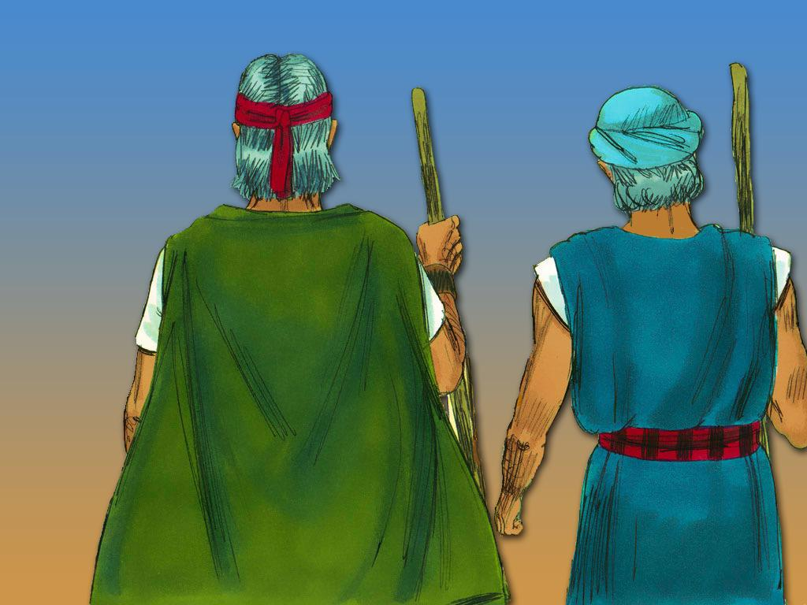
Notes:
4. God had a plan for his people. He wanted them to live in their own country where they could worship him. God sent Moses and his brother, Aaron, to speak to the Pharaoh. He chose Moses to lead his people out of Egypt to a new land.
God told Moses that he had a message for Pharaoh: “Pharaoh, let my people go!”

Slide 5
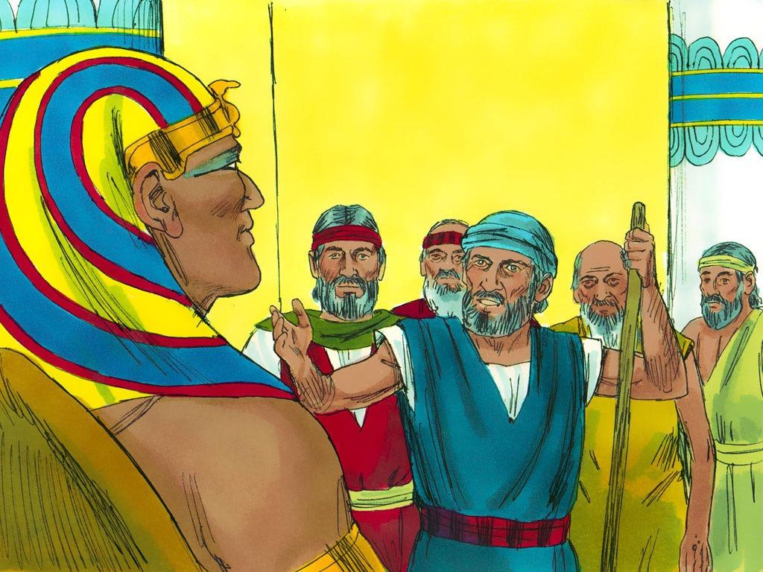
Notes:
5. What a shock Pharaoh must have had when Moses told him to let the Israelites leave Egypt and worship their own God. Pharaoh said, “No! The Israelites cannot leave Egypt!”.
The Pharaoh was so angry about it that he made the Israelites work even harder. But remember, God loved his people like a father loves his son.
God told Moses not to worry. He would perform mighty “wonders,” and soon, everyone would know that He was more powerful than Pharaoh and any of Egypt’s “gods.”

Slide 6
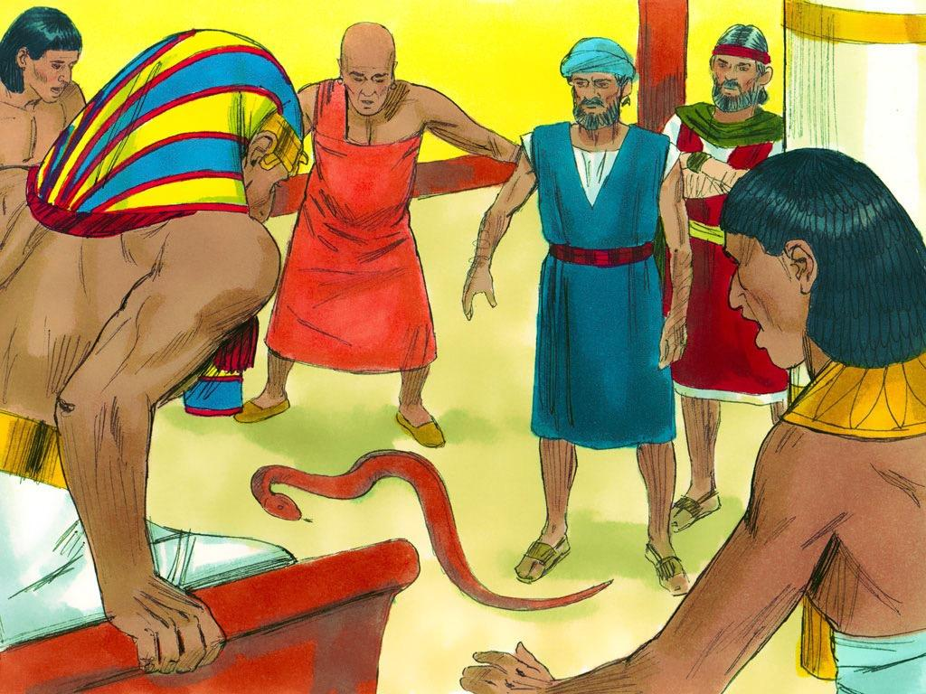
Notes:
6. So Moses and Aaron went back to Pharaoh again. Pharaoh wanted to see a miracle. Moses and Aaron knew exactly what to do next. Aaron threw down his staff (the long stick that he carried), and the staff turned into a snake. Everyone was amazed!

Slide 7
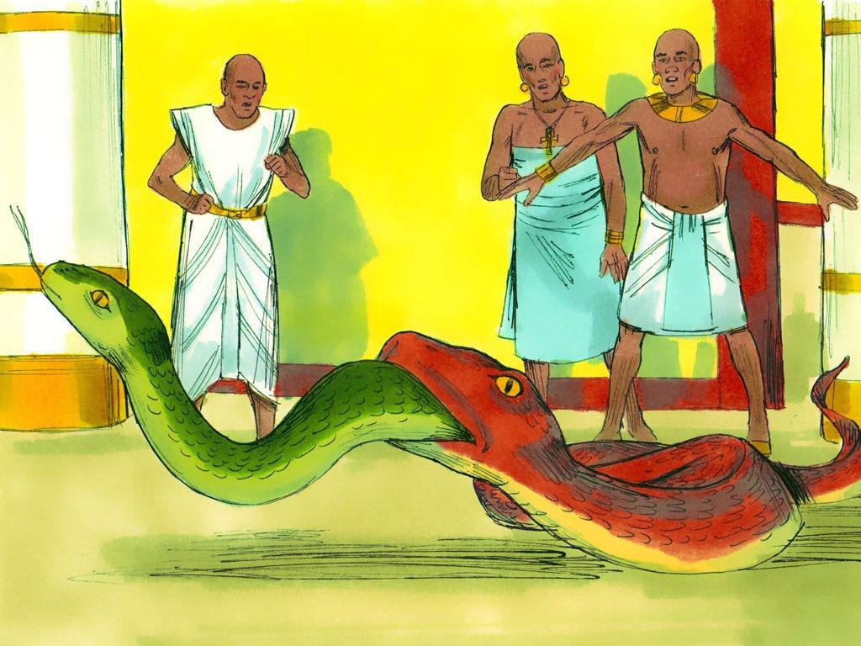
Notes:
7. Pharaoh then called his sorcerers and magicians in, and they could do the same thing using their tricks and "secret arts".
The sorcerers and magicians thought they were clever until Aaron’s snake swallowed their snake. But even though he could see God’s power, Pharaoh's heart remained hard, and he would not let the people go.

Slide 8
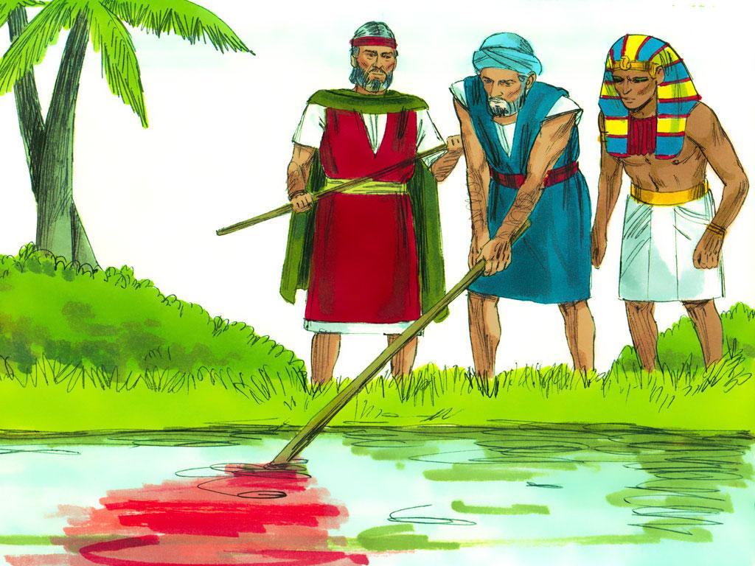
Notes:
8. But that was just the beginning of God’s power! One after another, God sent plagues to Egypt.
(Plague 1—Water to Blood) The next time Moses came to the Pharaoh, he repeated the same message: “Let My People Go!” He warned Pharaoh that if he didn’t agree, God’s power would make the Nile River turn to blood. In fact, all water, even water that had already been poured into jars, would become blood.
But Pharaoh would not let the people go. Aaron took his staff and stretched his hand over the Nile. All the water turned to blood, and the people around Egypt would not have had water to drink. The blood also caused the fish to die, so the air smelled like dead fish.
Pharaoh's heart remained hard. He would not let the people go.

Slide 9
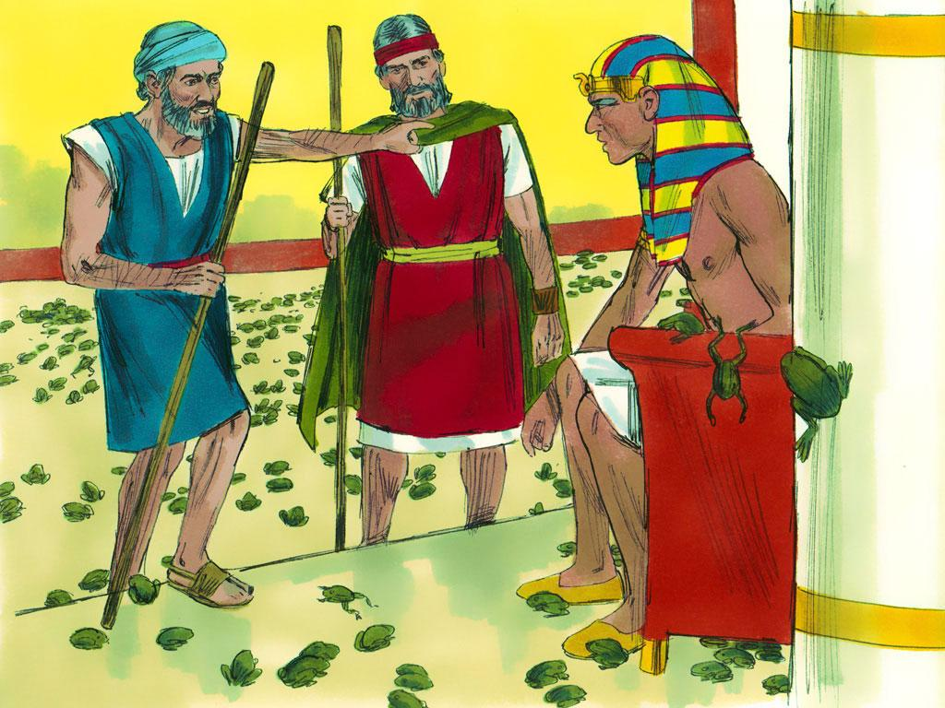
Notes:
9. (Plague 2- Frogs) Next, God sent a plague of frogs. Hundreds of frogs came out of the Nile River and hopped everywhere. The frogs got in peoples’ beds, in their ovens and on their tables.
Finally, Pharaoh asked Moses to stop the plague. Even after Moses made the frogs go away, Pharaoh still refused to let the Israelites leave Egypt.

Slide 10
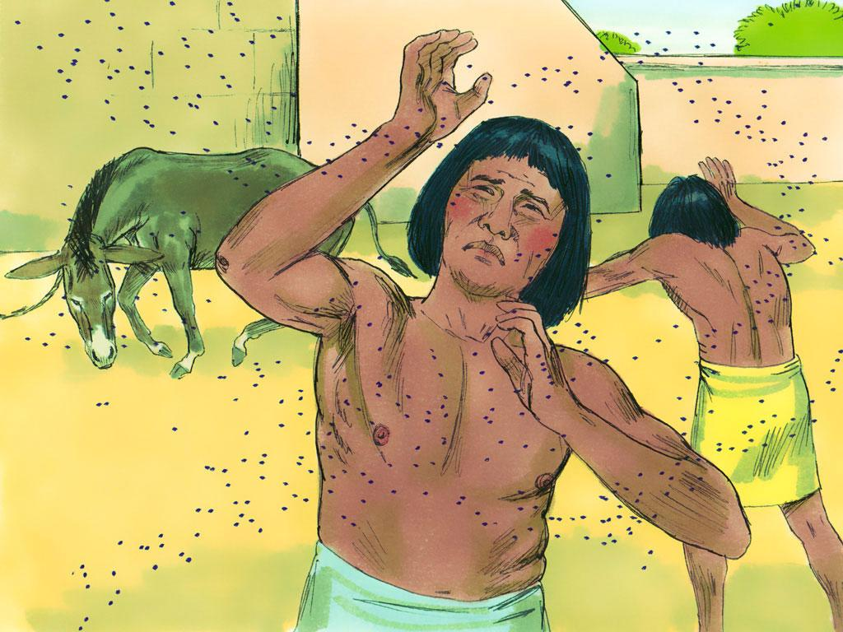
Notes:
10. (Plague 3—Gnats) Next, God told Moses to tell Aaron to use his staff to strike the dust off the ground. When he did this, the dust turned into gnats, which got all over the people and the animals.
When Pharaoh’s magicians saw how many gnats there were, they said to Pharaoh, “Moses and Aaron are not doing tricks. This is really the power of God!”
But Pharaoh would not even listen to his own magicians. He would not let the people go.

Slide 11
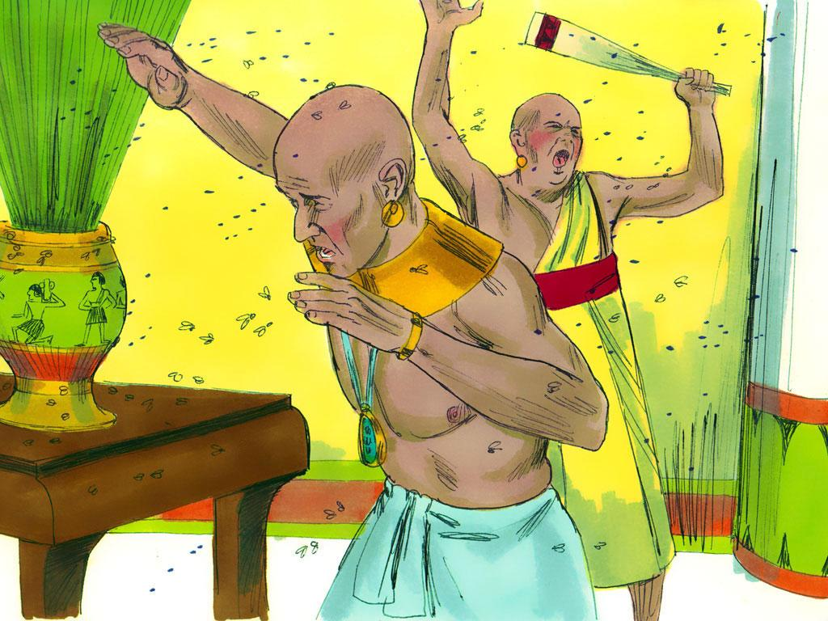
Notes:
11. (Plague 4-Flies) Once again, Moses came to Pharaoh with God’s message and said, "Let My People Go!" When Pharaoh said “no”, hundreds of flies invaded Egypt. Flies were almost everywhere in Egypt.

Slide 12
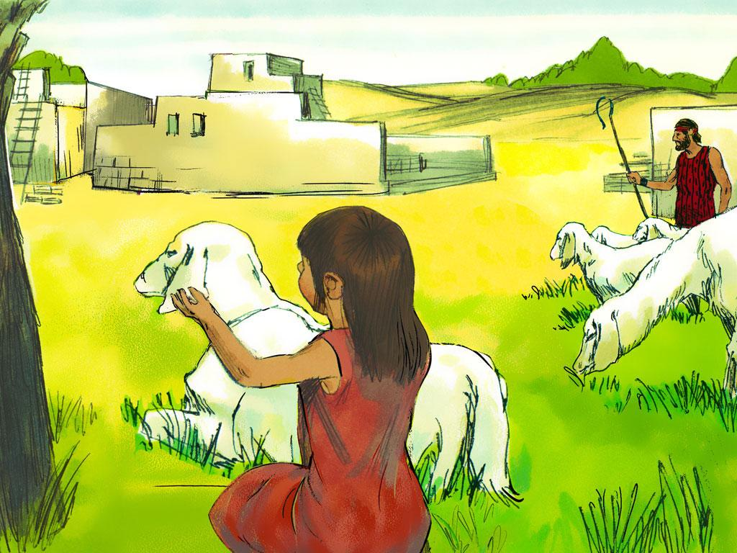
Notes:
12. Before, when Pharaoh had said “no”, bad things had happened to everyone. This time something different happened. The flies went everywhere in Egypt EXCEPT in a place called “Goshen”. That is the part of Egypt where the Israelites lived. God was taking care of His people.

Slide 13
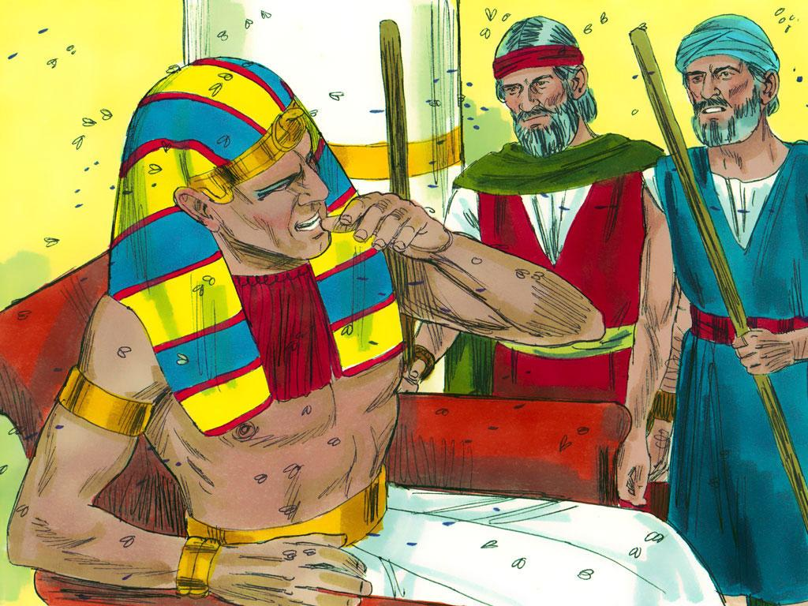
Notes:
13. Pharaoh finally said he would let the people go out into the desert to worship God, so Moses prayed to God, and the flies left.
But guess what? Pharaoh changed his mind and said, “No, the people cannot leave.”

Slide 14
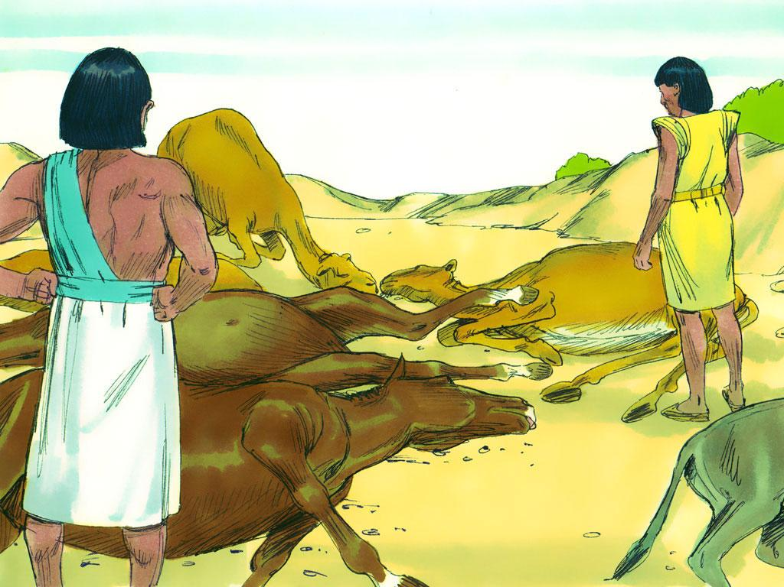
Notes:
14. (Plague 5-Death of Livestock) Next, when Pharaoh would not let the people go, a terrible thing happened. The horses, donkeys, camels, cattle, sheep, and goats belonging to the Egyptians died, but not one animal belonging to the Israelites died.
Even though all of these terrible things were happening, Pharaoh's heart remained as hard as ever.

Slide 15
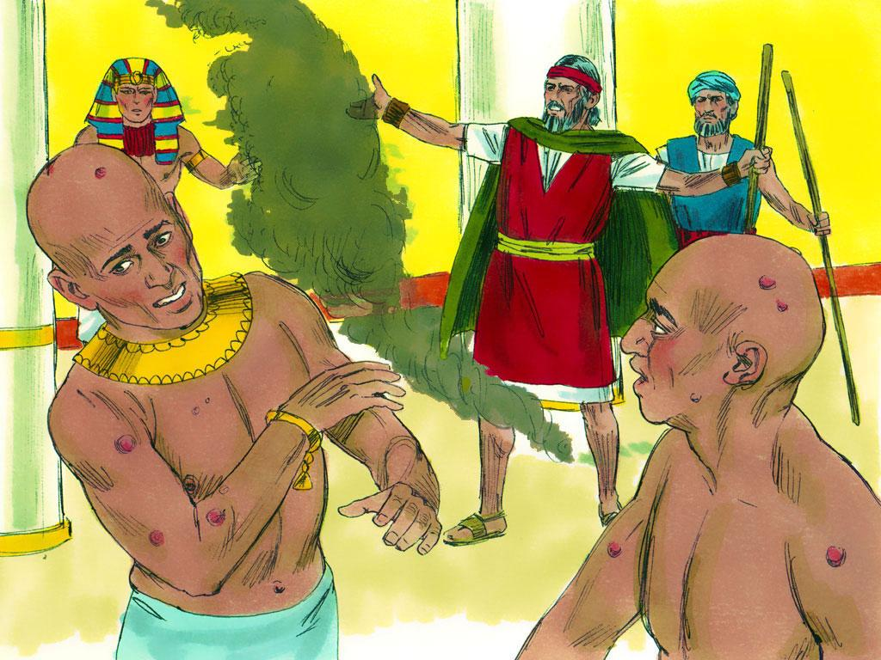
Notes:
15. (Plague 6-Boils) Then Aaron tossed soot from a furnace into the air in front of Pharaoh. This would spread through Egypt, causing the Egyptian people and their animals to break out in big sores called "boils". People could not even stand up because of the sores on the soles of their feet. Still, Pharaoh did not relent.

Slide 16
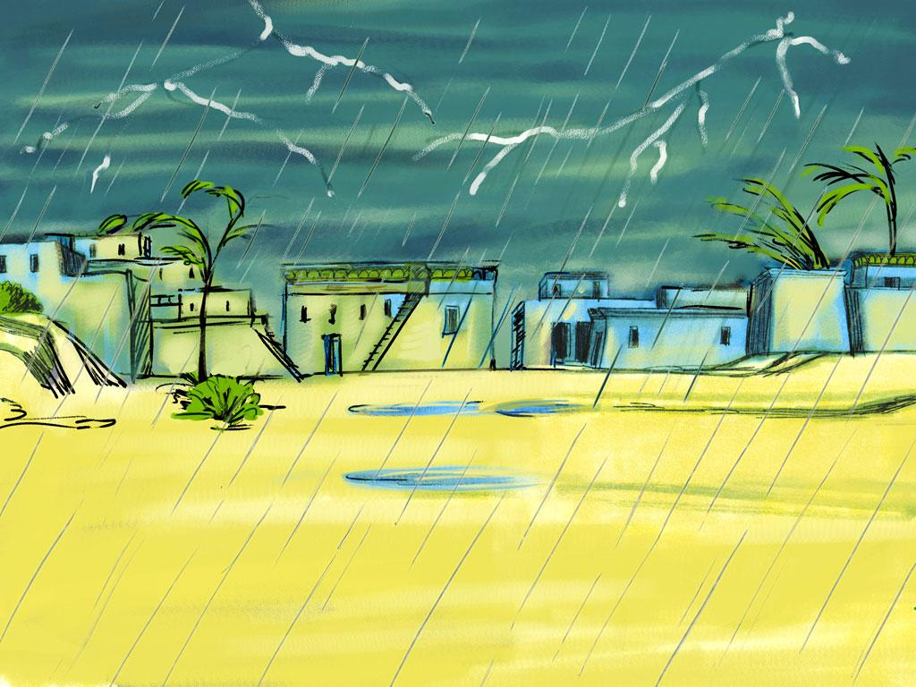
Notes:
16. God had already sent six plagues, but Pharaoh’s heart was still hard. He refused to change his mind. But God would never give up. He would make sure Pharaoh knew how powerful he was and how much he loved his people.
(Plague 7-Hail Storm) When Pharaoh said “no”, this time, God told Moses to stretch his hand toward the sky to bring on the worst hailstorm that had ever hit the nation of Egypt.

Slide 17
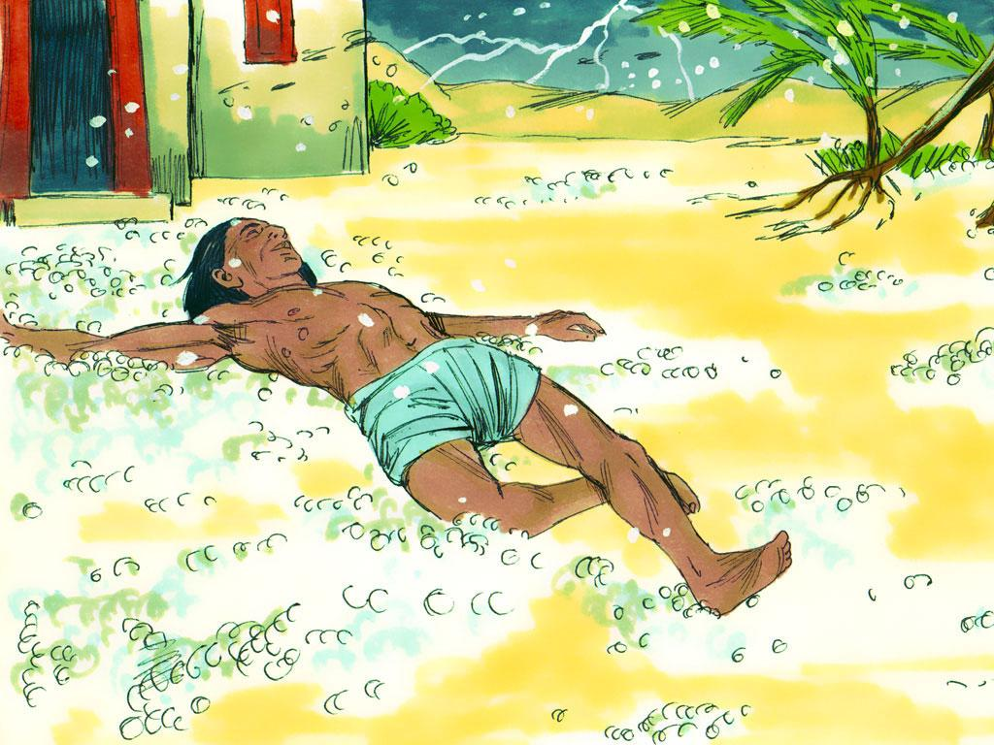
Notes:
17. Hail is like balls of ice that rain down hard from the sky. Many people and animals died when the hail hit them, and most of the food crops were destroyed by the hail. Only Goshen remained untouched.
When Pharaoh saw this, he confessed he had sinned and that he had been wrong not to let the people go. But guess what? Once again, as soon as Moses stopped the hail, Pharaoh changed his mind. He would not let the people go.

Slide 18
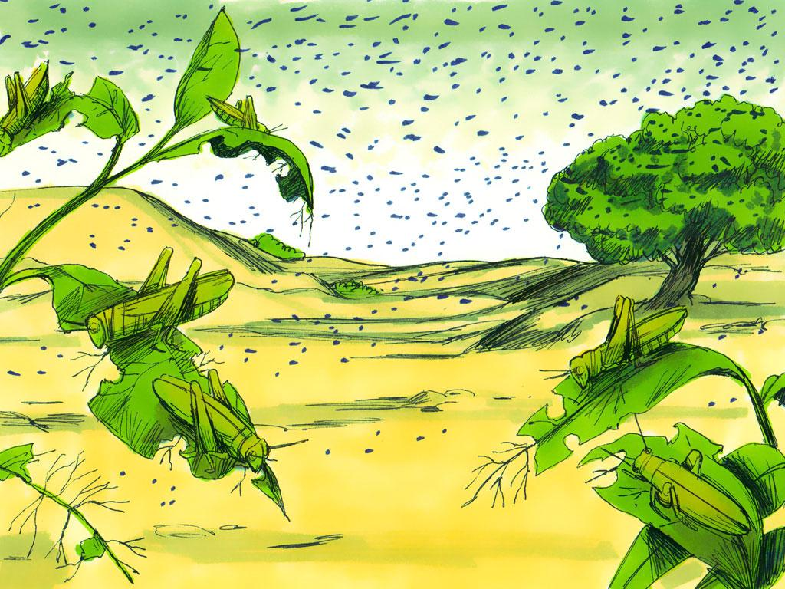
Notes:
18. (Plague 8-Locusts) Now Moses and Aaron warned Pharaoh that a swarm of locust insects (like flying grasshoppers) worse than anyone in Egypt had ever seen would eat anything that was left of the crops and trees in Egypt following the hailstorm.
Pharaoh's officials begged him to let the Israelites go, but He refused. He said, "Maybe I’ll just let the men go but keep all of the women and children in Egypt." This would not do! When Moses stretched out his hand, God caused the East wind to bring in an invasion of locusts. They destroyed everything that was still growing.
Once again, Pharaoh said he was sorry but changed his mind after Moses prayed and the locusts left. Pharaoh really did have a hard heart!

Slide 19
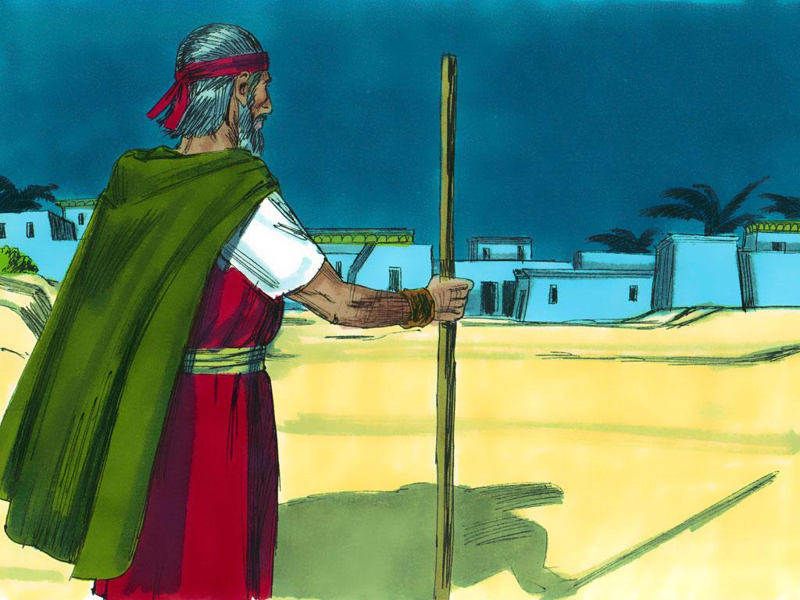
Notes:
19. (Plague 9-Darkness) Now God caused darkness to fall over all of Egypt. For 3 days, there was no light in Egypt. It felt like night-time all of the time. There was only one part of Egypt that had light. Guess where that was? There was light in Goshen, where the Israelites lived.
Pharaoh tried to trick Moses again and say that the Israelites could leave but had to leave their animals behind. But Moses knew how hard Pharaoh’s heart was. He told Pharaoh that God wanted all of his people (men, women, old people, children and babies) and even all of their animals to leave Egypt together.

Slide 20
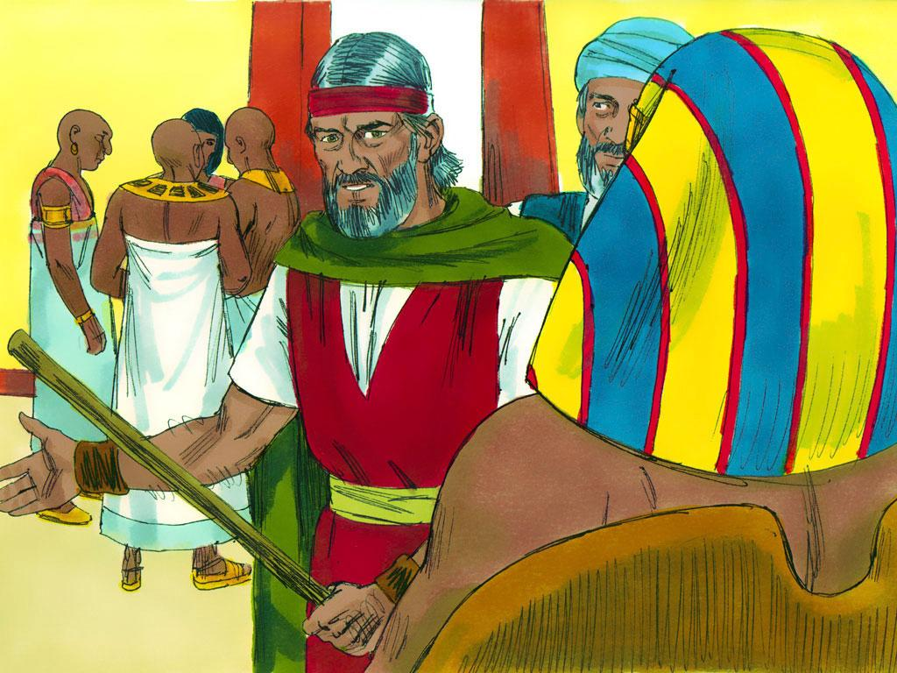
Notes:
20. Pharaoh became extremely angry and threw Moses and Aaron out of the palace. He told Moses that he never wanted him to come to the palace again.
Nothing else could make Pharaoh change his mind. Now, the very last and worst plague was about to happen.

Slide 21
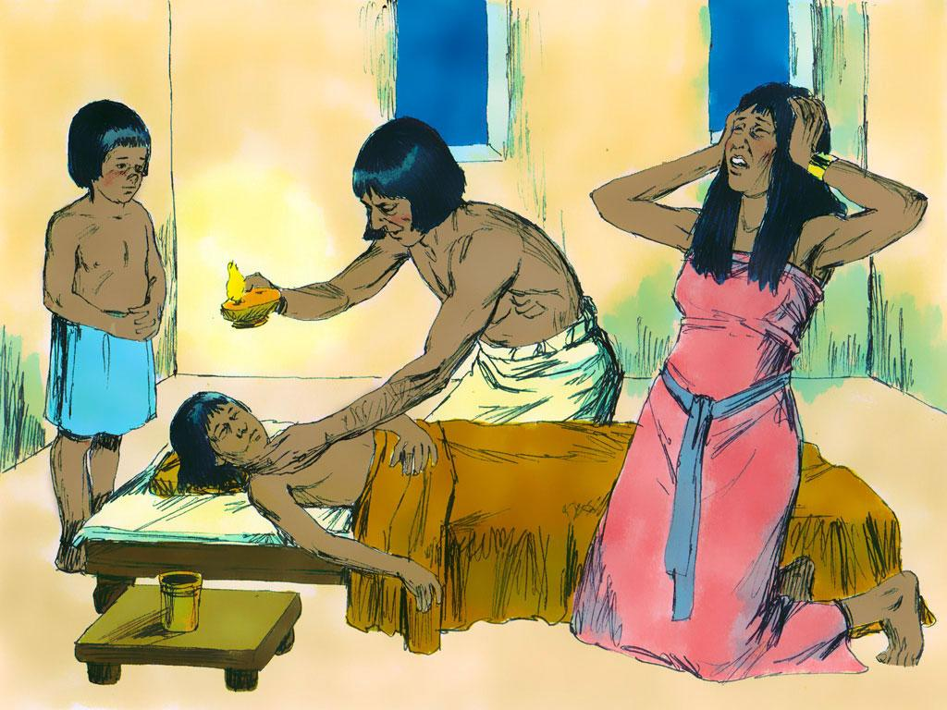
Notes:
21. (Plague 10-Death of the Firstborn) Every plague had caused pain and suffering, but the tenth (and last) plague was the most devastating of all. The Egyptians would find out that, without God’s protection, even their own children would not be safe from death. The oldest child in every family died. Only the Israelites who obeyed God were safe from this last plague.
The Pharaoh thought he was the most powerful, but he was not. The magicians, sorcerers, and Egyptian people thought that their gods would protect them, but they did not.
Through the 10 plagues, God showed that he was the most powerful and that only He could protect and save His people.
Finally, after this most terrible plague, Pharaoh said the Israelites could leave Egypt.

Slide 22
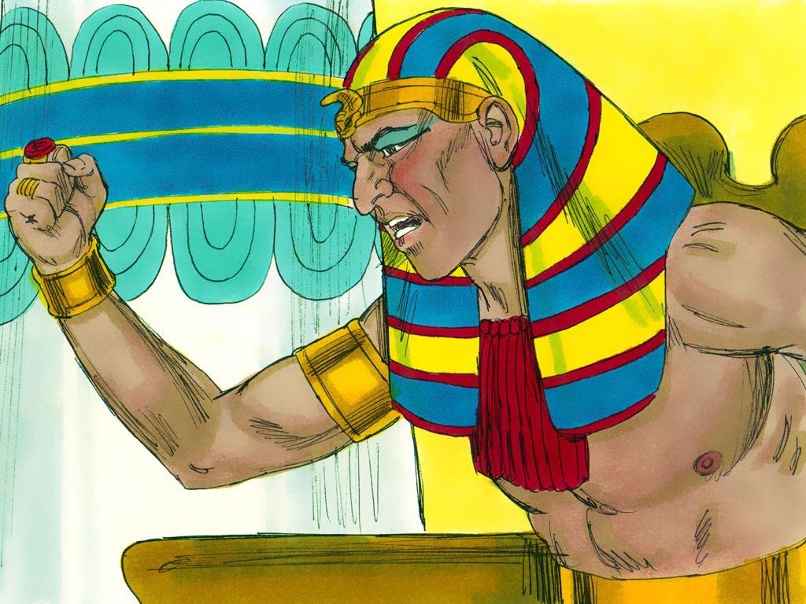
Notes:
22. But none of this had to happen. Pharaoh did not love his people like God loved Israel. Because of Pharaoh’s hard heart, everyone in Egypt suffered.

Slide 23
Teacher Notes Page 1
6. So Moses and Aaron went back to Pharaoh again. Pharaoh wanted to see a miracle. Moses and Aaron knew exactly what to do next. Aaron threw down his staff (the long stick that he carried), and the staff turned into a snake. Everyone was amazed!
7. Pharaoh then called his sorcerers and magicians in, and they could do the same thing using their tricks and "secret arts".
The sorcerers and magicians thought they were clever until Aaron’s snake swallowed their snake. But even though he could see God’s power, Pharaoh's heart remained hard, and he would not let the people go.
8. But that was just the beginning of God’s power! One after another, God sent plagues to Egypt.
(Plague 1—Water to Blood) The next time Moses came to the Pharaoh, he repeated the same message: “Let My People Go!” He warned Pharaoh that if he didn’t agree, God’s power would make the Nile River turn to blood. In fact, all water, even water that had already been poured into jars, would become blood.
But Pharaoh would not let the people go. Aaron took his staff and stretched his hand over the Nile. All the water turned to blood, and the people around Egypt would not have had water to drink. The blood also caused the fish to die, so the air smelled like dead fish.
Pharaoh's heart remained hard. He would not let the people go.
9. (Plague 2- Frogs) Next, God sent a plague of frogs. Hundreds of frogs came out of the Nile River and hopped everywhere. The frogs got in peoples’ beds, in their ovens and on their tables.
Finally, Pharaoh asked Moses to stop the plague. Even after Moses made the frogs go away, Pharaoh still refused to let the Israelites leave Egypt.
1. Cover: Let My People Go (Exodus 4:20-23 and 4:27-10:29)
2. God loved his people, the Israelites like a father loves his son. The Israelites were receiving very bad treatment in Egypt. What do you think a father would do to people who were hurting his son?
For four hundred years, God’s people had been slaves in Egypt. Being slaves meant that even though they had to work hard and do everything that the Egyptians said, the Egyptians never had to pay them any money.
3. The Pharaoh or king of Egypt had a very hard heart and was mean to the Israelites. He did not believe in the God we read about in our Bibles. Pharaoh and the rest of the Egyptian people believed in the many “gods” of Egypt. They made statues of these “gods.” Some were shaped like frogs, while others were shaped like crocodiles or even geese. Pharaoh thought these “gods” could keep Egypt safe, but he was wrong.
4. God had a plan for his people. He wanted them to live in their own country where they could worship him. God sent Moses and his brother, Aaron, to speak to the Pharaoh. He chose Moses to lead his people out of Egypt to a new land.
God told Moses that he had a message for Pharaoh: “Pharaoh, let my people go!”
5. What a shock Pharaoh must have had when Moses told him to let the Israelites leave Egypt and worship their own God. Pharaoh said, “No! The Israelites cannot leave Egypt!”.
The Pharaoh was so angry about it that he made the Israelites work even harder. But remember, God loved his people like a father loves his son.
God told Moses not to worry. He would perform mighty “wonders,” and soon, everyone would know that He was more powerful than Pharaoh and any of Egypt’s “gods.”

Slide 24
Teacher Notes Page 2
15. (Plague 6-Boils) Then Aaron tossed soot from a furnace into the air in front of Pharaoh. This would spread through Egypt, causing the Egyptian people and their animals to break out in big sores called "boils". People could not even stand up because of the sores on the soles of their feet. Still, Pharaoh did not relent.
16. God had already sent six plagues, but Pharaoh’s heart was still hard. He refused to change his mind. But God would never give up. He would make sure Pharaoh knew how powerful he was and how much he loved his people.
(Plague 7-Hail Storm) When Pharaoh said “no”, this time, God told Moses to stretch his hand toward the sky to bring on the worst hailstorm that had ever hit the nation of Egypt.
17. Hail is like balls of ice that rain down hard from the sky. Many people and animals died when the hail hit them, and most of the food crops were destroyed by the hail. Only Goshen remained untouched.
When Pharaoh saw this, he confessed he had sinned and that he had been wrong not to let the people go. But guess what? Once again, as soon as Moses stopped the hail, Pharaoh changed his mind. He would not let the people go.
18. (Plague 8-Locusts) Now Moses and Aaron warned Pharaoh that a swarm of locust insects (like flying grasshoppers) worse than anyone in Egypt had ever seen would eat anything that was left of the crops and trees in Egypt following the hailstorm.
Pharaoh's officials begged him to let the Israelites go, but He refused. He said, "Maybe I’ll just let the men go but keep all of the women and children in Egypt." This would not do! When Moses stretched out his hand, God caused the East wind to bring in an invasion of locusts. They destroyed everything that was still growing.
Once again, Pharaoh said he was sorry but changed his mind after Moses prayed and the locusts left. Pharaoh really did have a hard heart!
10. (Plague 3—Gnats) Next, God told Moses to tell Aaron to use his staff to strike the dust off the ground. When he did this, the dust turned into gnats, which got all over the people and the animals.
When Pharaoh’s magicians saw how many gnats there were, they said to Pharaoh, “Moses and Aaron are not doing tricks. This is really the power of God!”
But Pharaoh would not even listen to his own magicians. He would not let the people go.
11. (Plague 4-Flies) Once again, Moses came to Pharaoh with God’s message and said, "Let My People Go!" When Pharaoh said “no”, hundreds of flies invaded Egypt. Flies were almost everywhere in Egypt.
12. Before, when Pharaoh had said “no”, bad things had happened to everyone. This time something different happened. The flies went everywhere in Egypt EXCEPT in a place called “Goshen”. That is the part of Egypt where the Israelites lived. God was taking care of His people.
13. Pharaoh finally said he would let the people go out into the desert to worship God, so Moses prayed to God, and the flies left.
But guess what? Pharaoh changed his mind and said, “No, the people cannot leave.”
14. (Plague 5-Death of Livestock) Next, when Pharaoh would not let the people go, a terrible thing happened. The horses, donkeys, camels, cattle, sheep, and goats belonging to the Egyptians died, but not one animal belonging to the Israelites died.
Even though all of these terrible things were happening, Pharaoh's heart remained as hard as ever.

Slide 25
Teacher Notes Page 3
19. (Plague 9-Darkness) Now God caused darkness to fall over all of Egypt. For 3 days, there was no light in Egypt. It felt like night-time all of the time. There was only one part of Egypt that had light. Guess where that was? There was light in Goshen, where the Israelites lived.
Pharaoh tried to trick Moses again and say that the Israelites could leave but had to leave their animals behind. But Moses knew how hard Pharaoh’s heart was. He told Pharaoh that God wanted all of his people (men, women, old people, children and babies) and even all of their animals to leave Egypt together.
20. Pharaoh became extremely angry and threw Moses and Aaron out of the palace. He told Moses that he never wanted him to come to the palace again.
Nothing else could make Pharaoh change his mind. Now, the very last and worst plague was about to happen.
21. (Plague 10-Death of the Firstborn) Every plague had caused pain and suffering, but the tenth (and last) plague was the most devastating of all. The Egyptians would find out that, without God’s protection, even their own children would not be safe from death. The oldest child in every family died. Only the Israelites who obeyed God were safe from this last plague.
The Pharaoh thought he was the most powerful, but he was not. The magicians, sorcerers, and Egyptian people thought that their gods would protect them, but they did not.
Through the 10 plagues, God showed that he was the most powerful and that only He could protect and save His people.
Finally, after this most terrible plague, Pharaoh said the Israelites could leave Egypt.
22. But none of this had to happen. Pharaoh did not love his people like God loved Israel. Because of Pharaoh’s hard heart, everyone in Egypt suffered.

Slide 26


Attributions: This visual aid was constructed by Mary Nelson www.missionbibleclass.org using:
Text and slideshow compilation by Mary Nelson
Illustrations by Sweet Publishing http://sweetpublishing.com/ As accessed through www.freebibleimages.org Notice of Alteration: Text added to cover slide. Slide 4 contains parts of 2 different illustrations.
Attribution-ShareAlike 3.0 Unported (CC BY-SA 3.0) https://creativecommons.org/licenses/by-sa/3.0/
User may reproduce it without permissions.
DOWNLOAD THIS SLIDESHOW FROM www.missionbibleclass.org
Please visit www.missionbibleclass.org to find this and many other free resources to help you teach the Bible to children.

