Slide 1
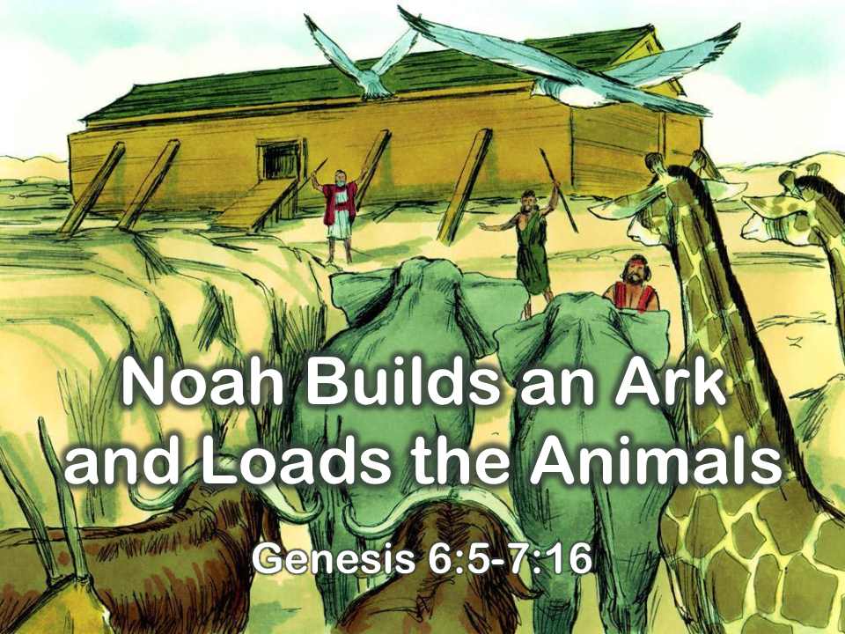
Notes:
1. Cover: Noah Builds an Ark and Loads the Animals (Genesis 6:5-7:16)

Slide 2
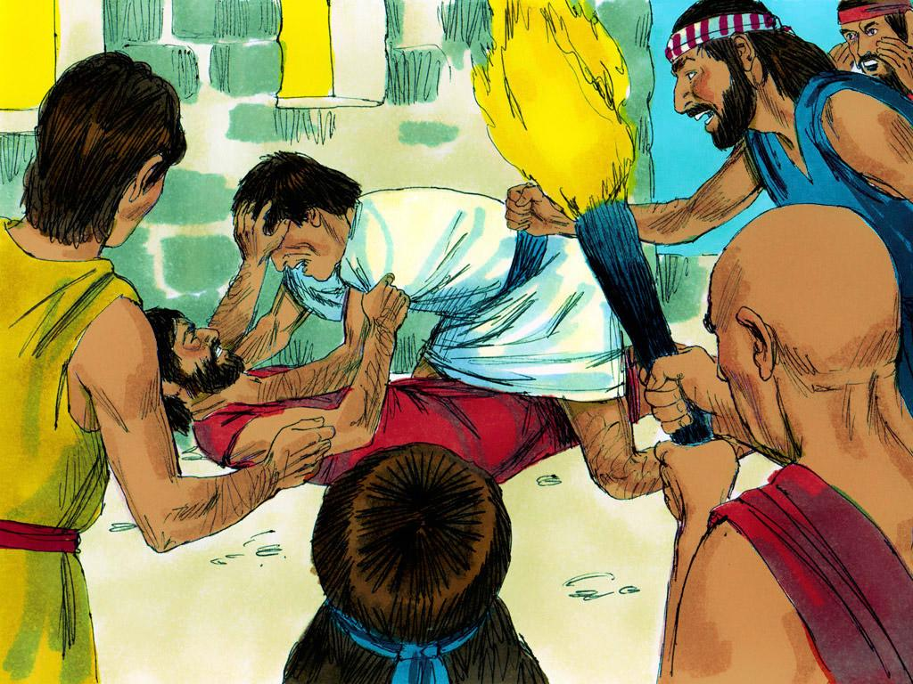
Notes:
2. All the people who lived on the earth had forgotten about God. Instead, they chose to reject God and live wicked lives. This made God very sad, and He became very sorry He made people. God decided He would send a flood so He could start over.

Slide 3
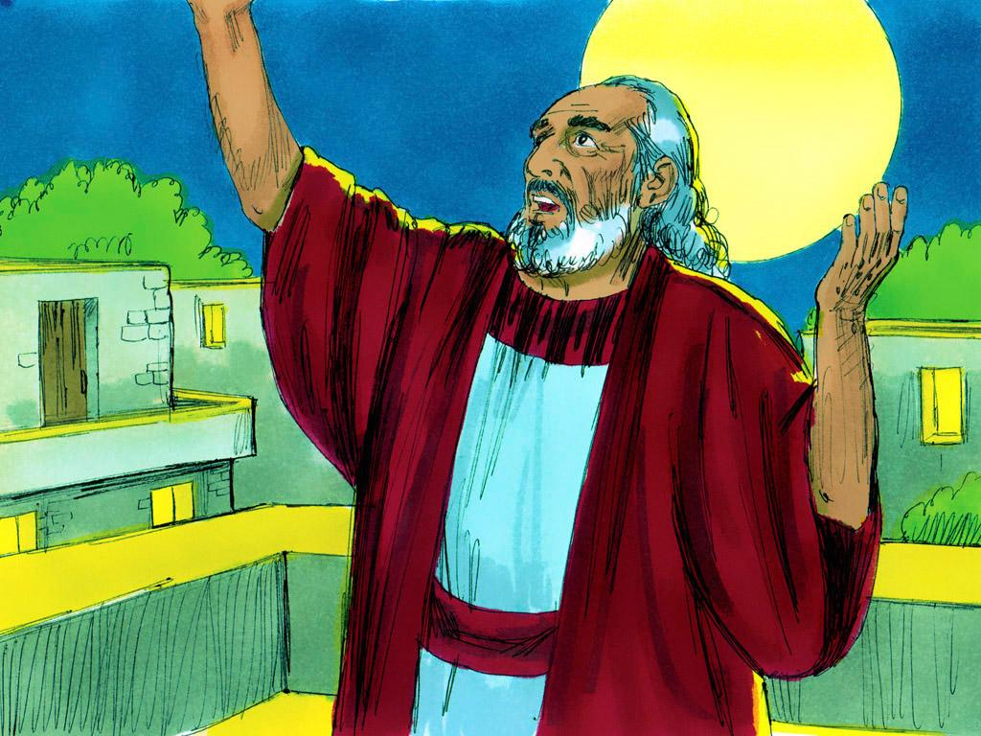
Notes:
3. At that time, there was one man who had not forgotten God. His name was Noah. Noah was a good man who loved God.
God said to Noah, “People are doing wicked things, I am sorry I made them. I will be sending a flood to destroy the world, so I can start over.”

Slide 4
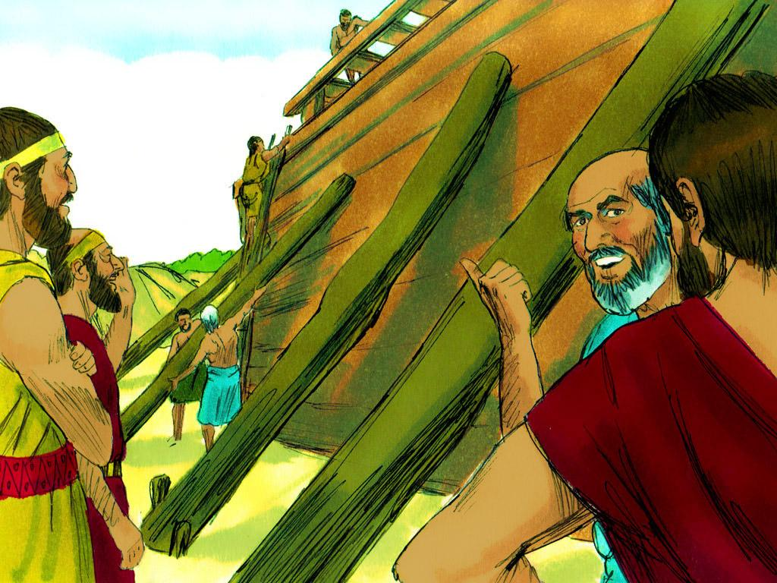
Notes:
4. God instructed Noah to build an Ark. The Ark was a large boat made of cypress wood and coated with tar inside and out. It had to be a certain height, width, and length. It would have rooms, a roof, and a door.

Slide 5
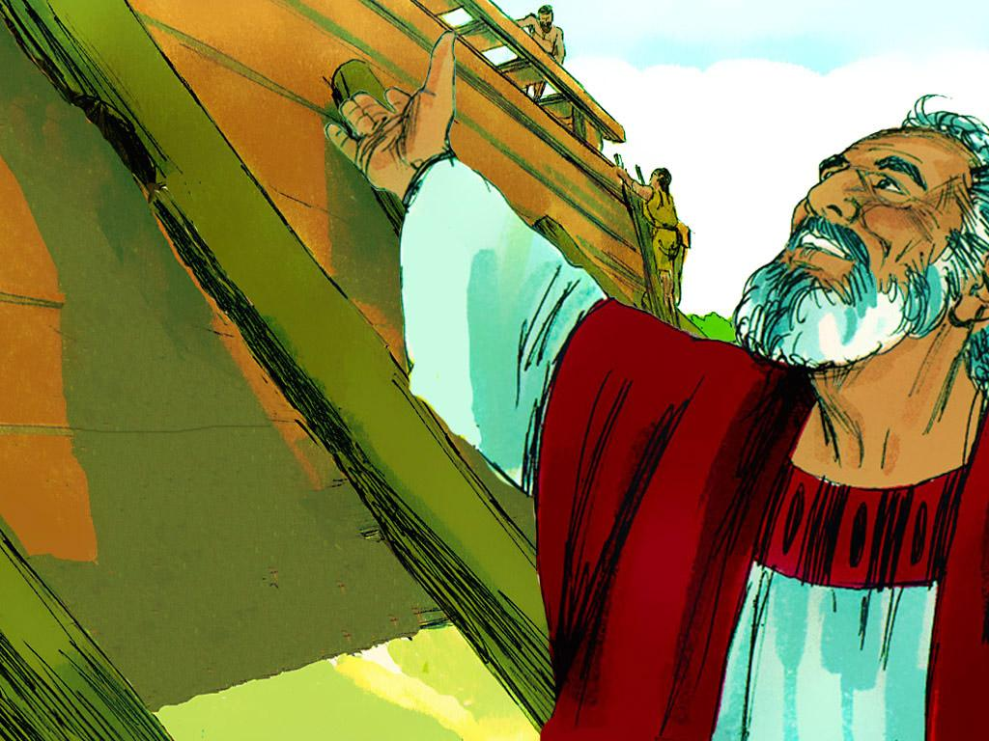
Notes:
5. God told Noah to put two of every unclean animal and seven pairs of every clean animal onto the Ark and enough food to feed Noah, his family, and all the animals.
The instructions God gave Noah must have seemed so strange to him, but he didn’t question it. Other people must have mocked Noah. He would have looked silly building a great big boat when there had never been a flood on the earth before. But Noah trusted God and obeyed Him.

Slide 6
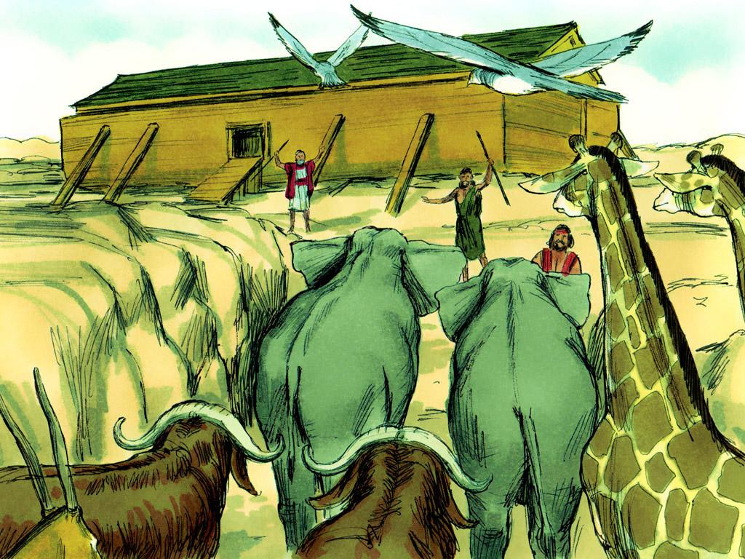
Notes:
6. When Noah had finished building the Ark, he loaded in all the food, all the animals, and his own family.

Slide 7
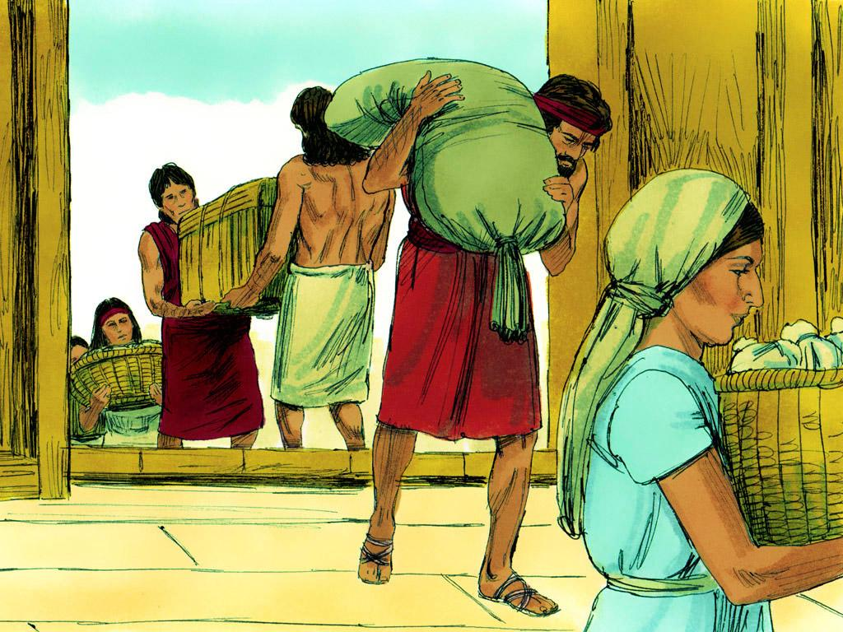
Notes:
7. Only eight people were on the ark: Noah, his wife, and their three sons, Shem, Ham, Japheth, and their wives.

Slide 8
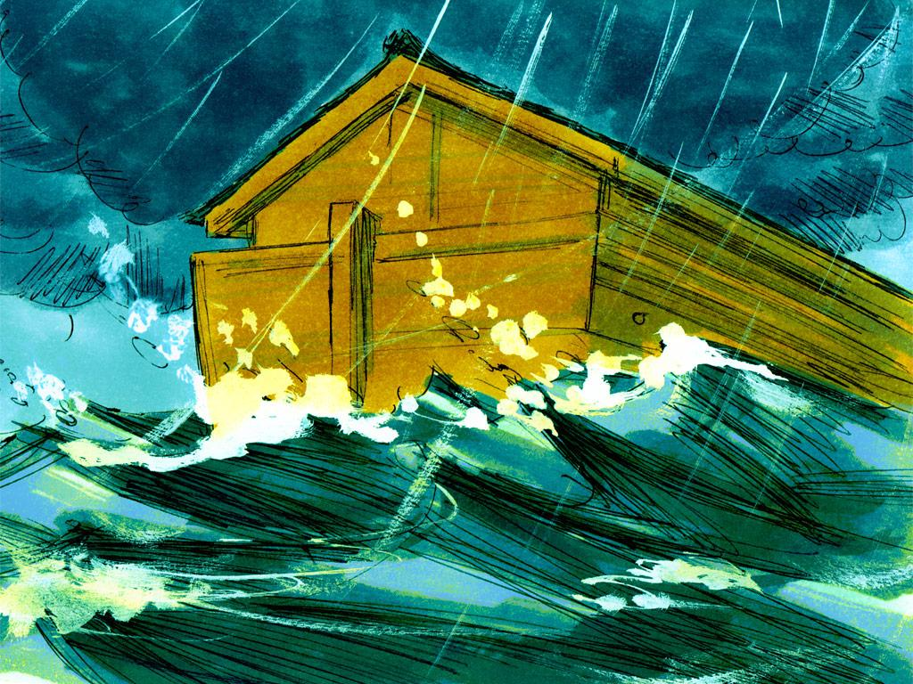
Notes:
8. Then God shut the door, and the rain began to fall.

Slide 9
Teacher Notes Page
1. Cover: Noah Builds an Ark and Loads the Animals
(Genesis 6:5-7:16)
2. All the people who lived on the earth had forgotten about God. Instead, they chose to reject God and live wicked lives. This made God very sad, and He became very sorry He made people. God decided He would send a flood so He could start over.
3. At that time, there was one man who had not forgotten God. His name was Noah. Noah was a good man who loved God.
God said to Noah, “People are doing wicked things, I am sorry I made them. I will be sending a flood to destroy the world, so I can start over.”
4. God instructed Noah to build an Ark. The Ark was a large boat made of cypress wood and coated with tar inside and out. It had to be a certain height, width, and length. It would have rooms, a roof, and a door.
5. God told Noah to put two of every unclean animal and seven pairs of every clean animal onto the Ark and enough food to feed Noah, his family, and all the animals.
The instructions God gave Noah must have seemed so strange to him, but he didn’t question it. Other people must have mocked Noah. He would have looked silly building a great big boat when there had never been a flood on the earth before. But Noah trusted God and obeyed Him.
6. When Noah had finished building the Ark, he loaded in all the food, all the animals, and his own family.
7. Only eight people were on the ark: Noah, his wife, and their three sons, Shem, Ham, Japheth, and their wives.
8. Then God shut the door, and the rain began to fall.

Slide 10


Attributions: This visual aid was constructed by Mary Nelson www.missionbibleclass.org using:
Text and slideshow compilation by Mary Nelson
Illustrations by Sweet Publishing http://sweetpublishing.com/ As accessed through www.freebibleimages.org Notice of Alteration: Text added to cover slide.
Attribution-ShareAlike 3.0 Unported (CC BY-SA 3.0) https://creativecommons.org/licenses/by-sa/3.0/
User may reproduce it without permissions.
DOWNLOAD THIS SLIDESHOW FROM www.missionbibleclass.org
Please visit www.missionbibleclass.org to find this and many other free resources to help you teach the Bible to children.

