Slide 1
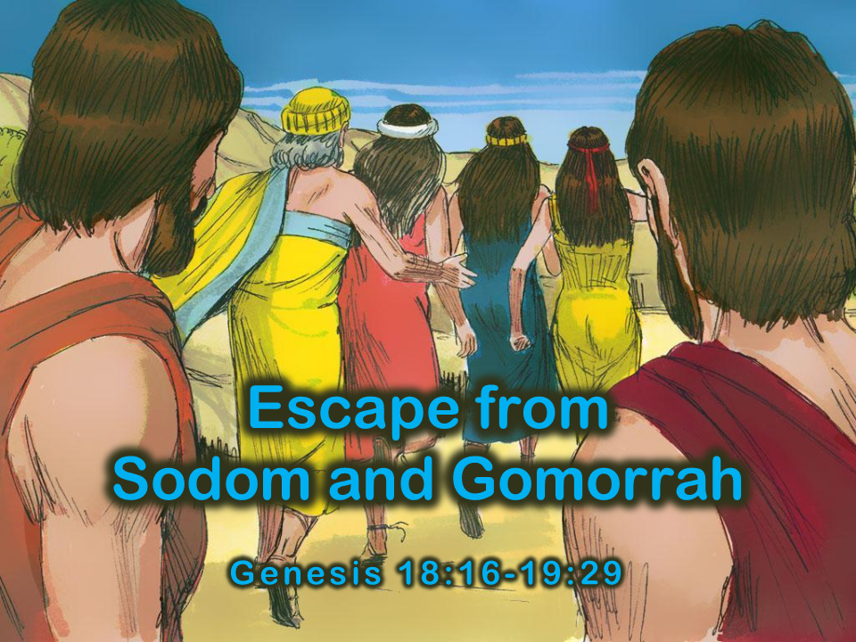
Notes:
1. Cover: The Escape from Sodom and Gomorrah Genesis 18:16-19:29

Slide 2
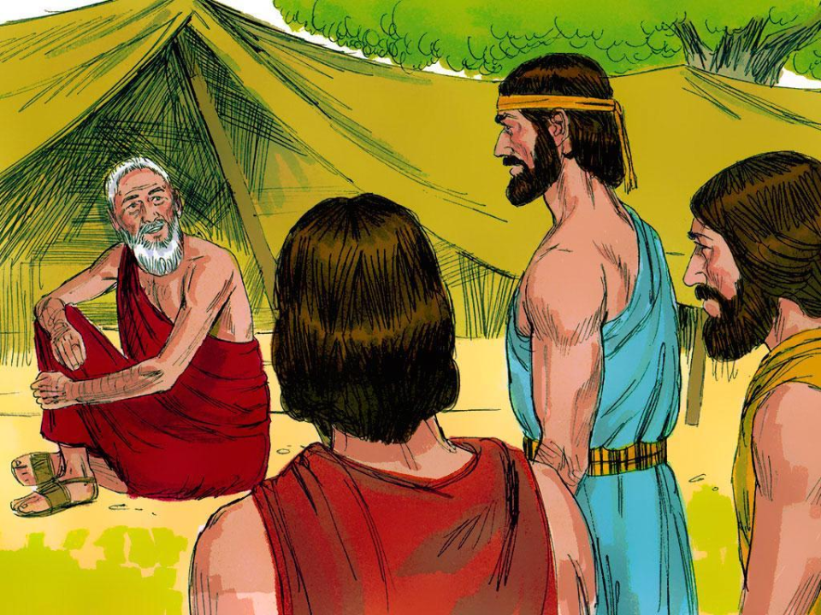
Notes:
2. The three visitors who came to Abraham with such good news also had other news. It was not so good. One of the three visitors was the Lord. As the men turned to go to Sodom, the Lord stayed to talk to Abraham. He told Abraham that the people in Sodom were so wicked and evil that He had come to see if what they were doing was true. God hates sin very much. Sin is what it means when a person does, says, or thinks something that is against God. The sins of the people in Sodom made God very sad and unhappy.

Slide 3
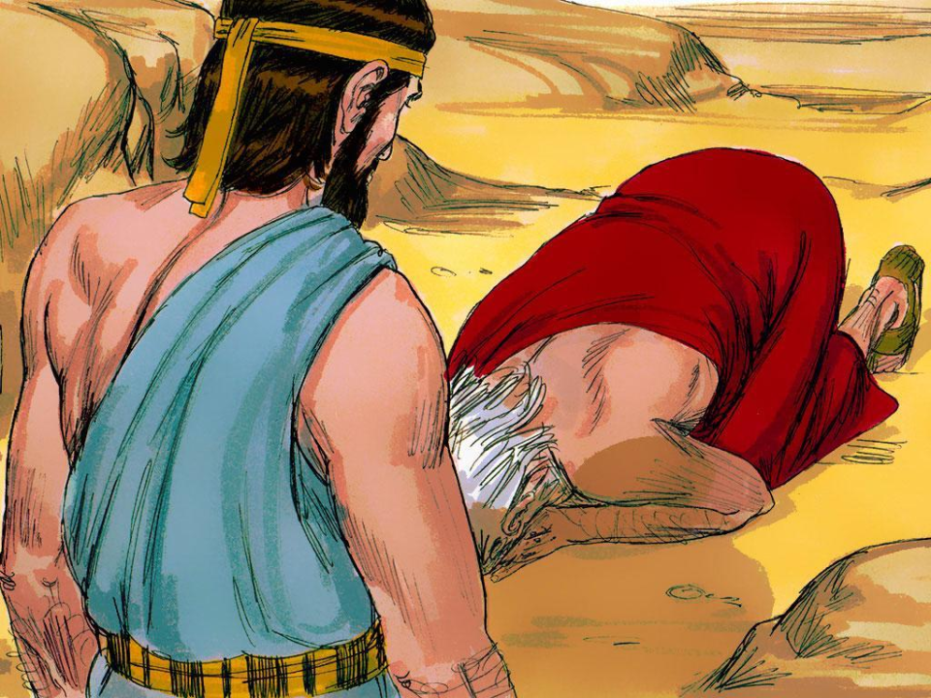
Notes:
3. Abraham did not want the Lord to destroy the city where his nephew, Lot, lived. There must be some good people in the large city. “If there are fifty good people in Sodom, would you please let everyone live?” Abraham asked the Lord.
The Lord said, “Yes, Abraham, if there are fifty good people in Sodom, I will not destroy it.”

Slide 4
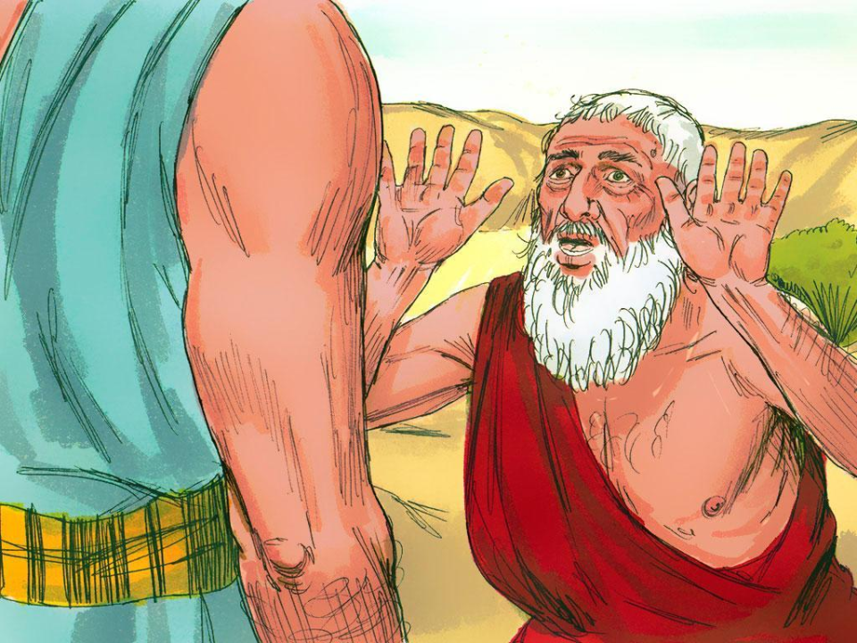
Notes:
4. “Will you keep Sodom safe if there are only forty-five good people?” Abraham begged.
“If there are forty-five good people in Sodom, I will not destroy it.” The Lord answered. Abraham kept asking the Lord to spare Sodom if there were forty, thirty, twenty, and finally, ten good people in the city of Sodom. Every time, the Lord agreed to spare Sodom.

Slide 5
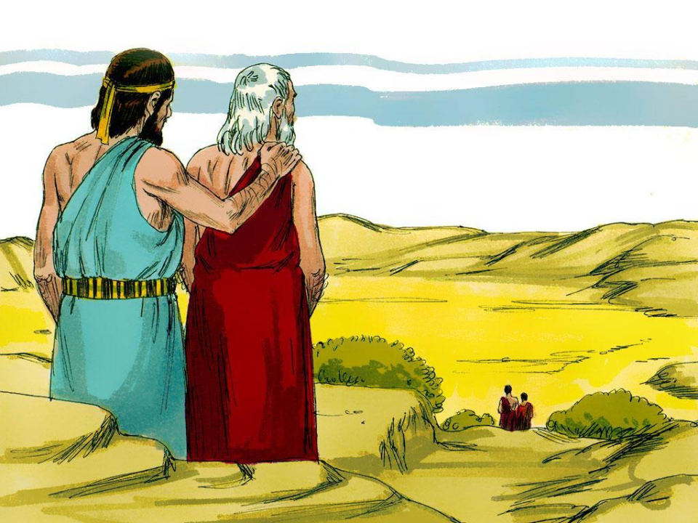
Notes:
5. “Yes,” said the Lord, “if I find just ten good people, I will not destroy Sodom.”
The Lord stopped, but the two angels continued on to the city.

Slide 6
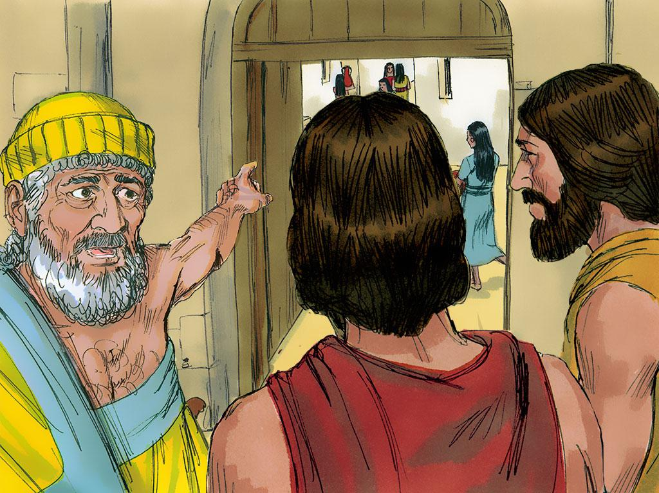
Notes:
6. As the two angels came to Sodom, they saw Lot, Abraham’s nephew, sitting by the gate. When he saw the two men approaching, he jumped up and asked them to come to his house.

Slide 7
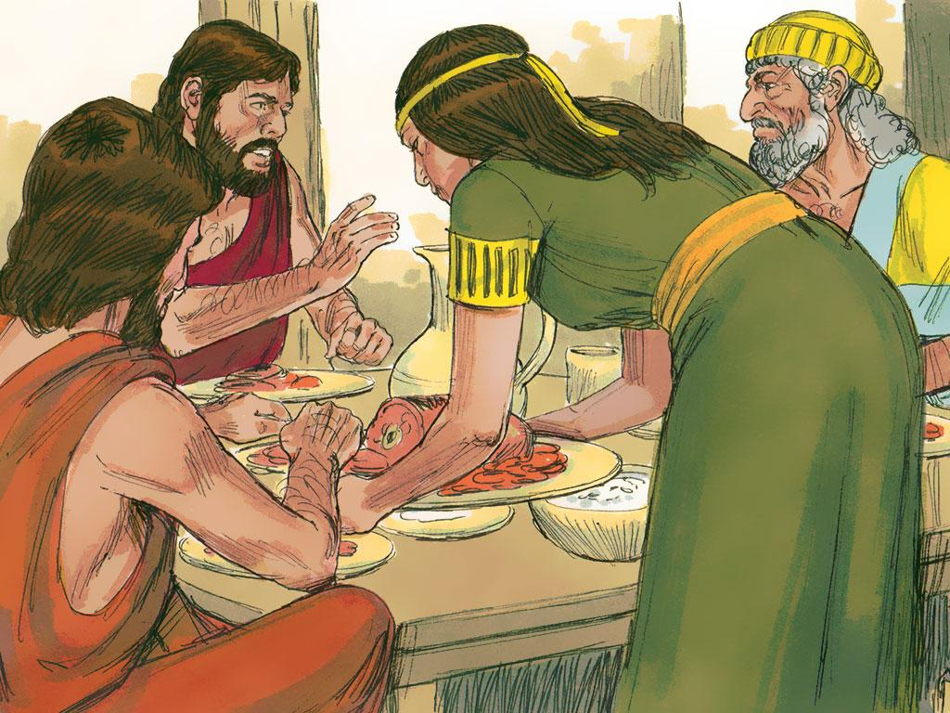
Notes:
7. The men went with him and rested at his house. Lot was kind to them.

Slide 8
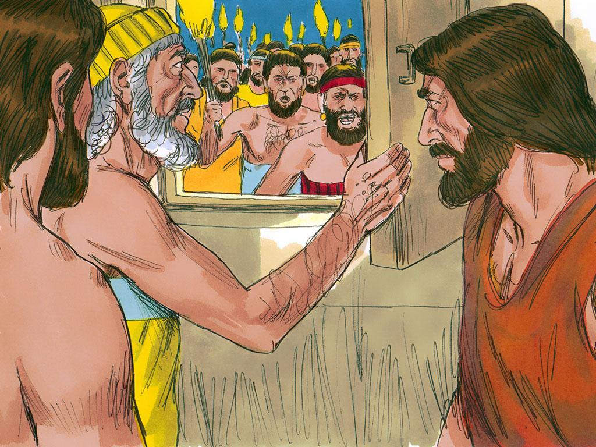
Notes:
8. When the men of the city tried to hurt the angels, Lot told them to stop.

Slide 9
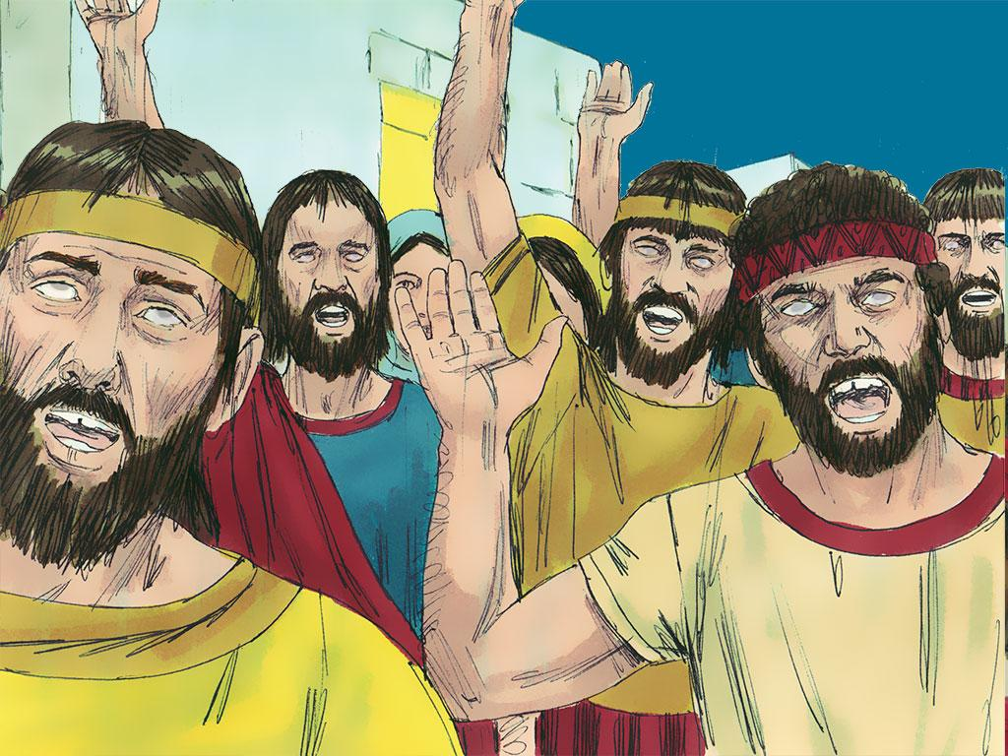
Notes:
9. When they would not stop, the angels used their powers to make them blind.

Slide 10
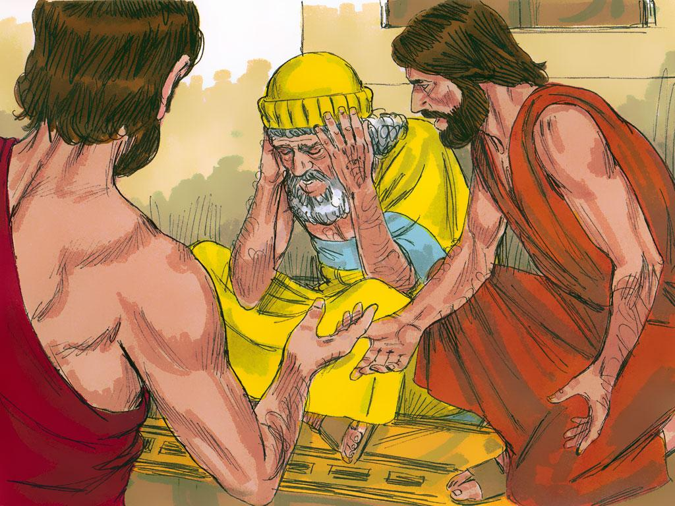
Notes:
10. The angels knew that Lot was not wicked like the other people living in the city. Since he was Abraham’s nephew, they told him of their plans. The men told him to take his family and leave Sodom because they were going to send fire and destroy the city.

Slide 11
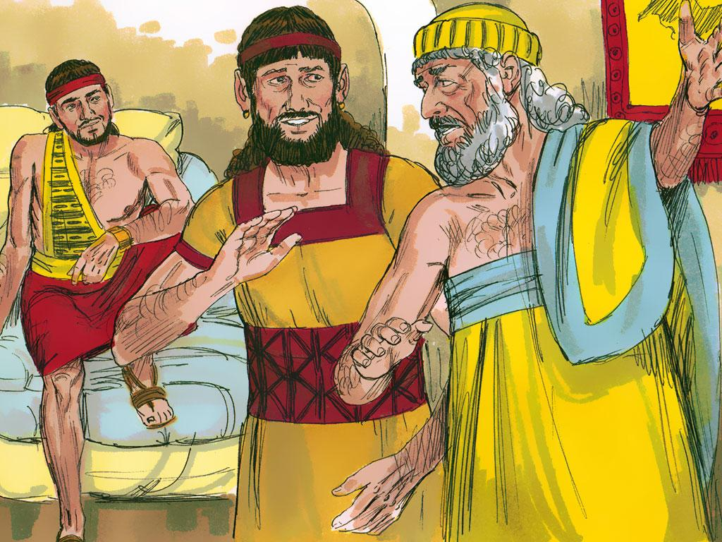
Notes:
11. The angels told Lot and his family to leave the city as quickly as possible. Lot tried to get others to stop being wicked. He wanted to save them, too, but they just laughed at him. They did not believe anything would happen to them.

Slide 12
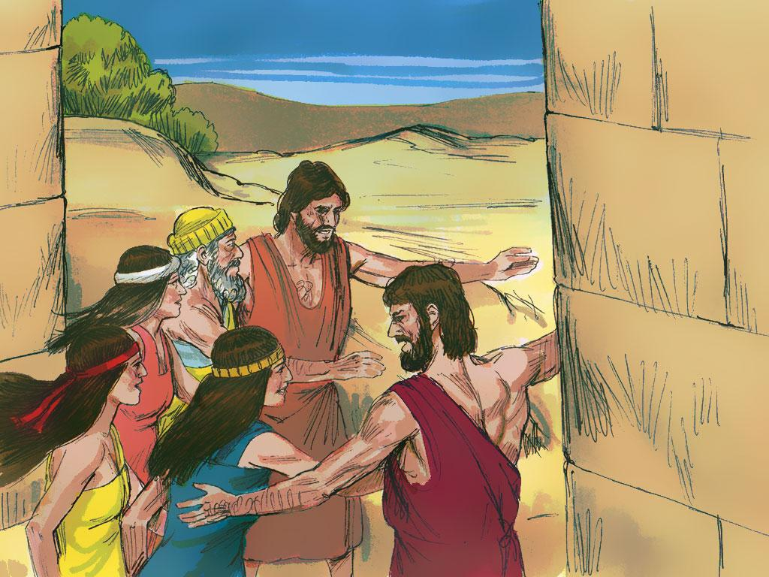
Notes:
12. The angels took Lot, his wife, and two daughters by the hand and led them from Sodom. The angels told them they MUST NOT look back to see what was happening to the city. They must run and run as fast as they can to get away. Lot and his family hurried away from the wicked city. They ran to a small city named Zoar.

Slide 13
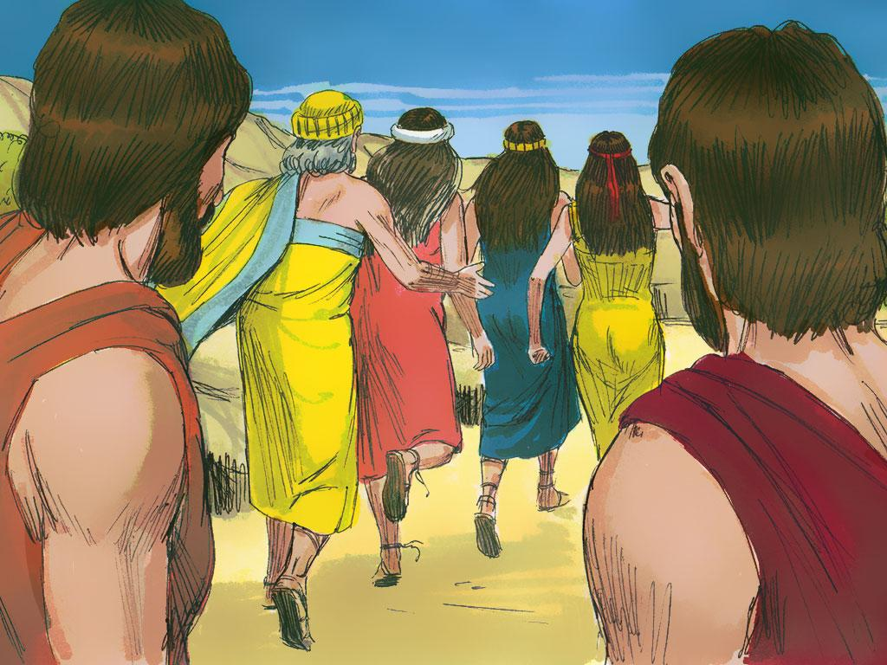
Notes:
13. As the sun rose over the land, the Lord sent burning fire over Sodom. It came down like rain in the city. He destroyed all the cities of the plain because He hated the sin of the people. Even Gomorrah, the city next to Sodom, was destroyed. In fact, He destroyed all the cities of the plain because He hated the sin of the people.

Slide 14
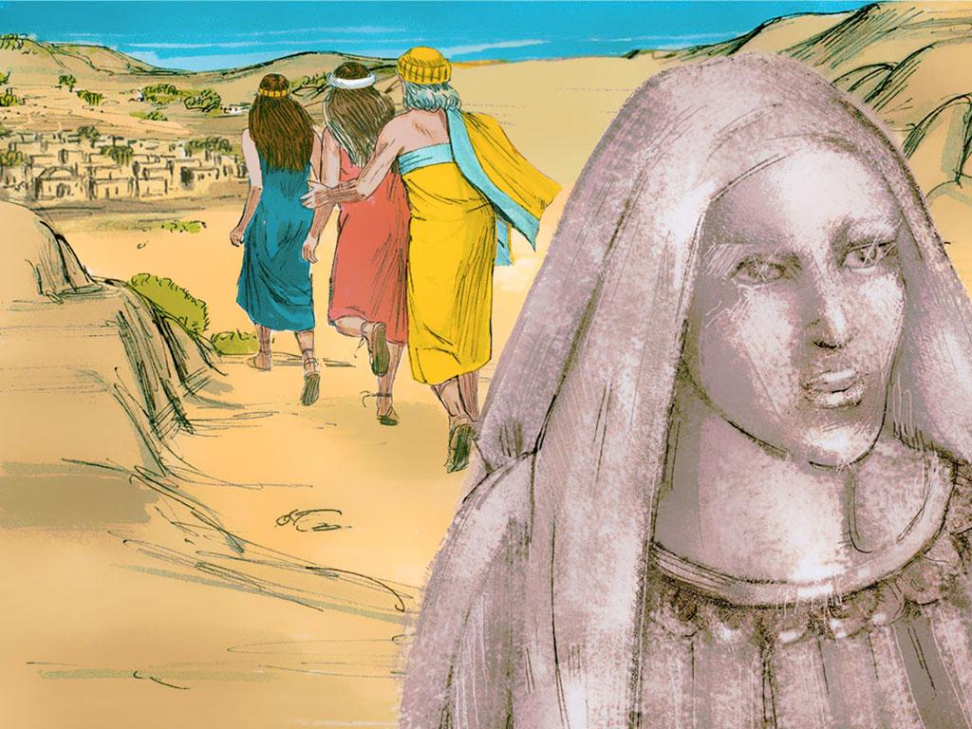
Notes:
14. As the fire rose and smoke filled the air, Lot’s wife looked back toward Sodom. She did not listen to the words of the angels. She disobeyed and was turned into a pillar of salt.

Slide 15
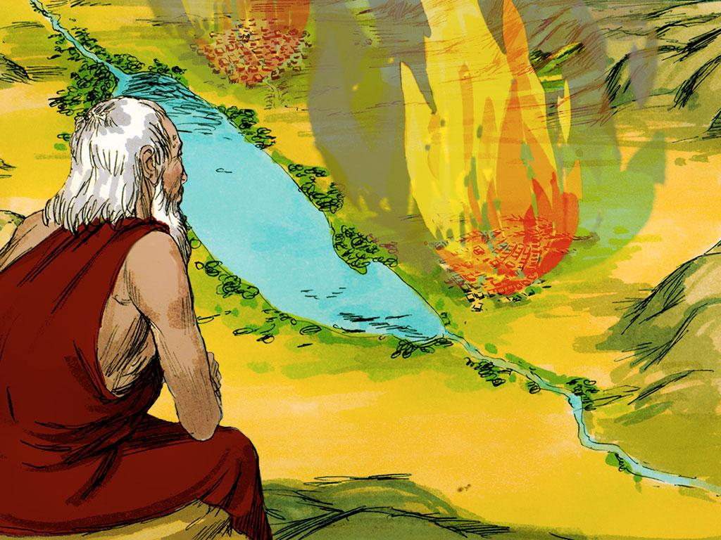
Notes:
15. God destroyed the wicked cities because He hates sin so much. When people do or say or think bad things, it makes the Lord sad and angry. He wants people to be sorry when they do bad things. He wants to forgive people when they sin. The people of Sodom and Gomorrah sinned so much that they stopped listening to good people like Lot. They did not trust in God. They only wanted to do things their own way.
God will help us do good if we listen to Him. We should read our Bible and learn more and more about Him. The Bible tells us how to do good things and make God happy.

Slide 16
Teacher Notes Page 1
1. Cover: The Escape from Sodom and Gomorrah Genesis 18:16-19:29
2. The three visitors who came to Abraham with such good news also had other news. It was not so good. One of the three visitors was the Lord. As the men turned to go to Sodom, the Lord stayed to talk to Abraham. He told Abraham that the people in Sodom were so wicked and evil that He had come to see if what they were doing was true. God hates sin very much. Sin is what it means when a person does, says, or thinks something that is against God. The sins of the people in Sodom made God very sad and unhappy.
3. Abraham did not want the Lord to destroy the city where his nephew, Lot, lived. There must be some good people in the large city. “If there are fifty good people in Sodom, would you please let everyone live?” Abraham asked the Lord.
The Lord said, “Yes, Abraham, if there are fifty good people in Sodom, I will not destroy it.”
4. “Will you keep Sodom safe if there are only forty-five good people?” Abraham begged.
“If there are forty-five good people in Sodom, I will not destroy it.” The Lord answered. Abraham kept asking the Lord to spare Sodom if there were forty, thirty, twenty, and finally, ten good people in the city of Sodom. Every time, the Lord agreed to spare Sodom.
5. “Yes,” said the Lord, “if I find just ten good people, I will not destroy Sodom.”
The Lord stopped, but the two angels continued on to the city.
6. As the two angels came to Sodom, they saw Lot, Abraham’s nephew, sitting by the gate. When he saw the two men approaching, he jumped up and asked them to come to his house.
7. The men went with him and rested at his house. Lot was kind to them.
8. When the men of the city tried to hurt the angels, Lot told them to stop.
9. When they would not stop, the angels used their powers to make them blind.
10. The angels knew that Lot was not wicked like the other people living in the city. Since he was Abraham’s nephew, they told him of their plans. The men told him to take his family and leave Sodom because they were going to send fire and destroy the city.
11. The angels told Lot and his family to leave the city as quickly as possible. Lot tried to get others to stop being wicked. He wanted to save them, too, but they just laughed at him. They did not believe anything would happen to them.

Slide 17
Teacher Notes Page 2
12. The angels took Lot, his wife, and two daughters by the hand and led them from Sodom. The angels told them they MUST NOT look back to see what was happening to the city. They must run and run as fast as they can to get away. Lot and his family hurried away from the wicked city. They ran to a small city named Zoar.
13. As the sun rose over the land, the Lord sent burning fire over Sodom. It came down like rain in the city. He destroyed all the cities of the plain because He hated the sin of the people. Even Gomorrah, the city next to Sodom, was destroyed. In fact, He destroyed all the cities of the plain because He hated the sin of the people.
14. As the fire rose and smoke filled the air, Lot’s wife looked back toward Sodom. She did not listen to the words of the angels. She disobeyed and was turned into a pillar of salt.
15. God destroyed the wicked cities because He hates sin so much. When people do or say or think bad things, it makes the Lord sad and angry. He wants people to be sorry when they do bad things. He wants to forgive people when they sin. The people of Sodom and Gomorrah sinned so much that they stopped listening to good people like Lot. They did not trust in God. They only wanted to do things their own way.
God will help us do good if we listen to Him. We should read our Bible and learn more and more about Him. The Bible tells us how to do good things and make God happy.

Slide 18


Attributions: This visual aid was constructed by Mary Nelson www.missionbibleclass.org using:
Text and slideshow compilation by Mary Nelson
Illustrations by Sweet Publishing http://sweetpublishing.com/ As accessed through www.freebibleimages.org Notice of Alteration: Text added to cover slide.
Attribution-ShareAlike 3.0 Unported (CC BY-SA 3.0) https://creativecommons.org/licenses/by-sa/3.0/
User may reproduce it without permissions.
DOWNLOAD THIS SLIDESHOW FROM www.missionbibleclass.org
Please visit www.missionbibleclass.org to find this and many other free resources to help you teach the Bible to children.

