Slide 1
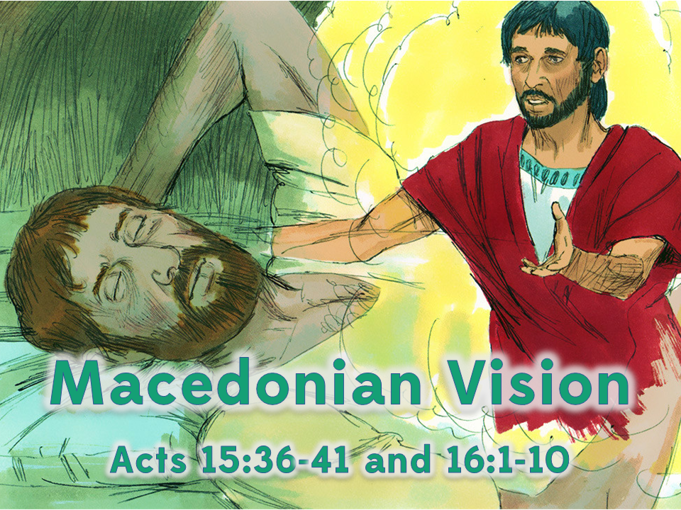
Notes:
1. Cover: Macedonian Vision (on Paul’s 2nd Missionary Journey Acts 15:36-41 and 16:1-10

Slide 2
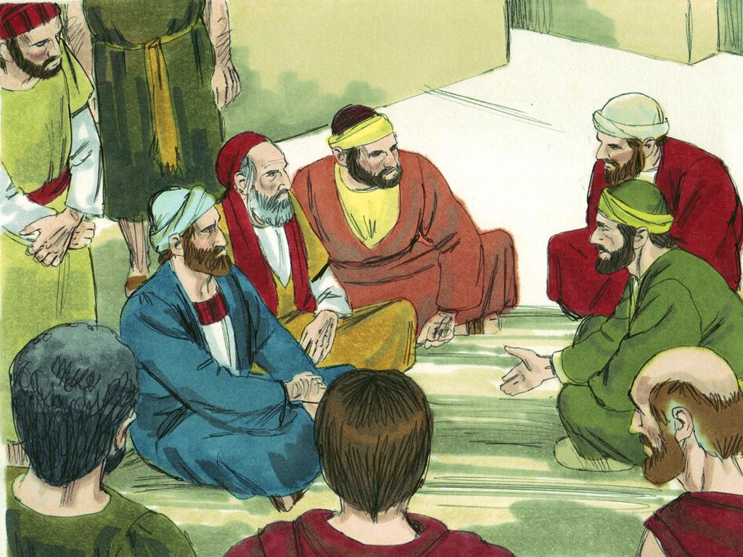
Notes:
2. There were many Christians in the Antioch church. Some of them were from Jewish families and some were from Gentile families but they all loved God. Paul and Barnabas were two missionaries that were members of the Antioch church.

Slide 3
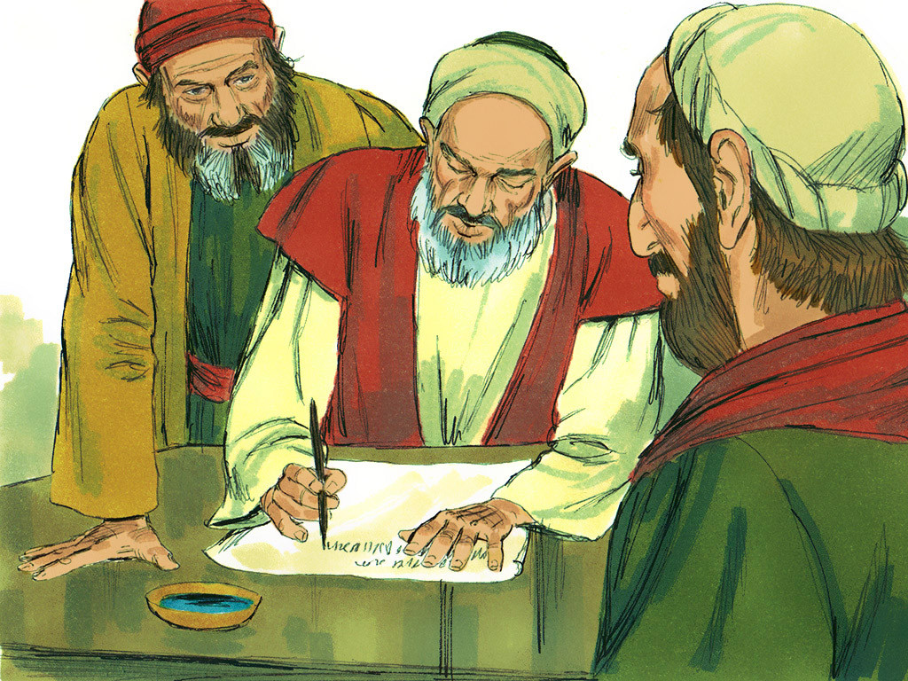
Notes:
3. Once, some men from Jerusalem came to Antioch and told the Christians that Gentiles could not become full members of God’s people unless they became Jews first. But Paul and Barnabas said this was not true. They travelled to Jerusalem and talked to the church leaders there about it.
The Jerusalem leaders sent a letter back to Antioch to tell all of the Christians there that what Paul and Barnabas were saying was correct. Gentile Christians did NOT have to become Jews first to be full members of God’s people. Both Jew and Gentile are part of God’s people through faith in Jesus. There may be differences on many things but it was important that there be PEACE and UNITY among all Christians.

Slide 4
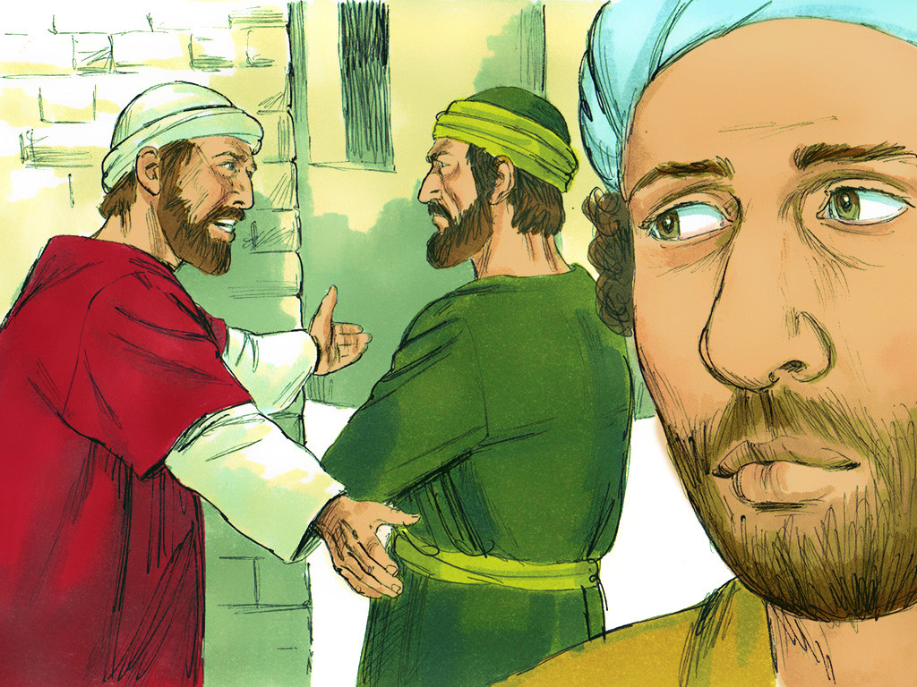
Notes:
4. After some time had passed Paul began to think about all of the people he and Barnabas had visited on their 1st Missionary Journey.
When Paul asked Barnabas to go on a 2nd Missionary Journey with him Barnabas wanted to take his cousin John Mark. Paul remembered how John Mark had deserted them when they were on the 1st Journey. He did not want him to come again. Paul and Barnabas had a very big disagreement about this.

Slide 5
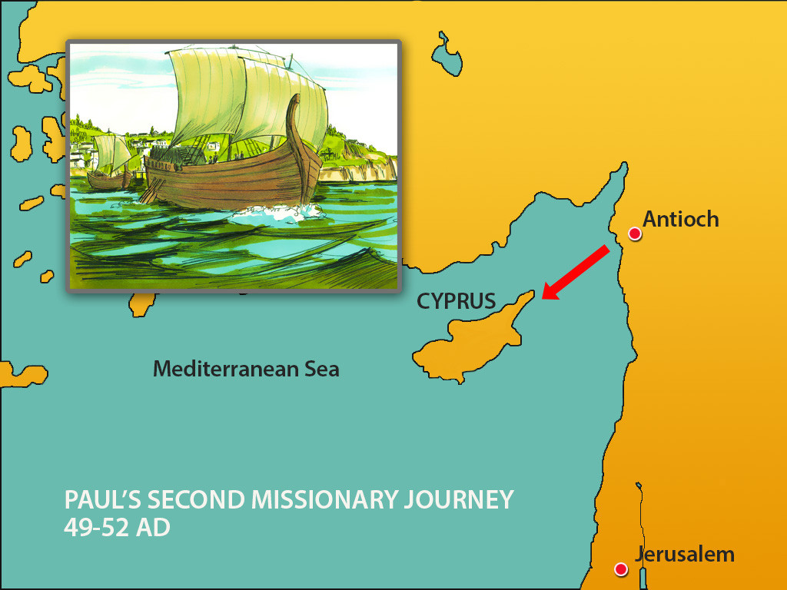
Notes:
5. Since they could not agree about John Mark Barnabas and Paul decided to go on two different journeys.
Barnabas took John Mark and sailed to Cyprus to encourage the churches there.

Slide 6
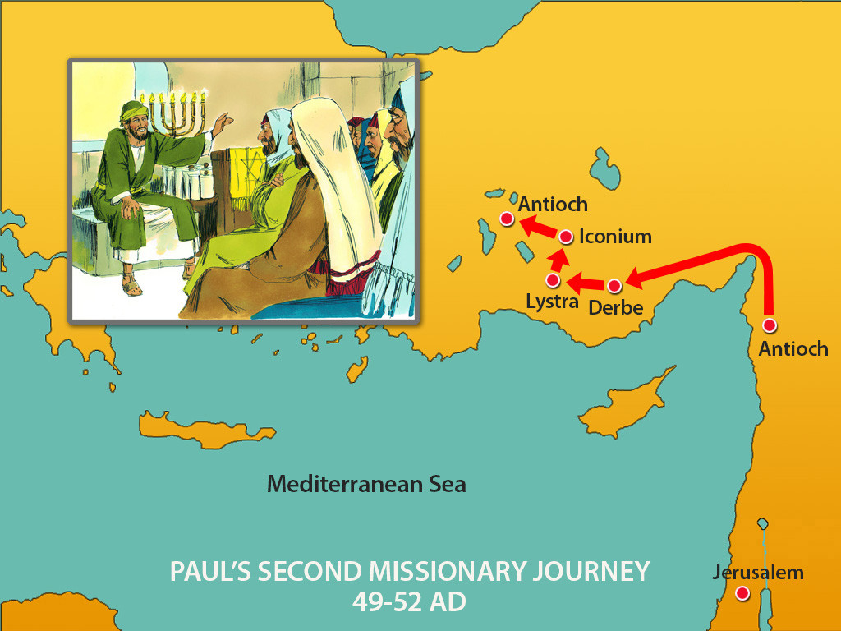
Notes:
6. But Paul went a different direction. Instead of taking a ship Paul set out walking. He travelled to many of the churches that he had established on his last journey.
Paul also took someone along with him to be a helper. He took a good worker called Silas.

Slide 7
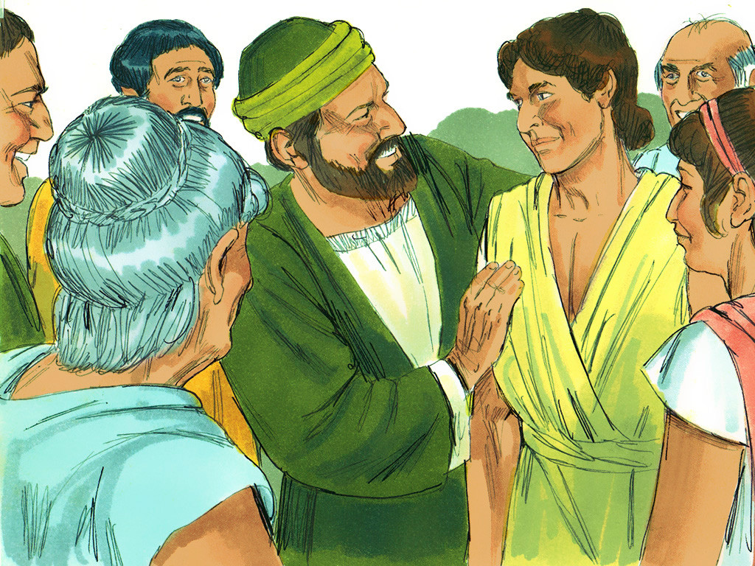
Notes:
7. On this 2nd Missionary Journey Paul visited some of the churches he had started on his 1st Journey. When they came to the town of Lystra the Christians were so happy to see Paul again.
In Lystra Paul and Silas met a young man named Timothy. Timothy’s father was a Greek and most Greeks did not follow God. But ever since he was a little boy Timothy’s mother (Eunice) and grandmother (Lois) had taught him about God. Paul was so impressed by this young man that he invited him to join him on his missionary journey. Timothy left his family and began to travel along with Paul and Silas telling people about Jesus.

Slide 8
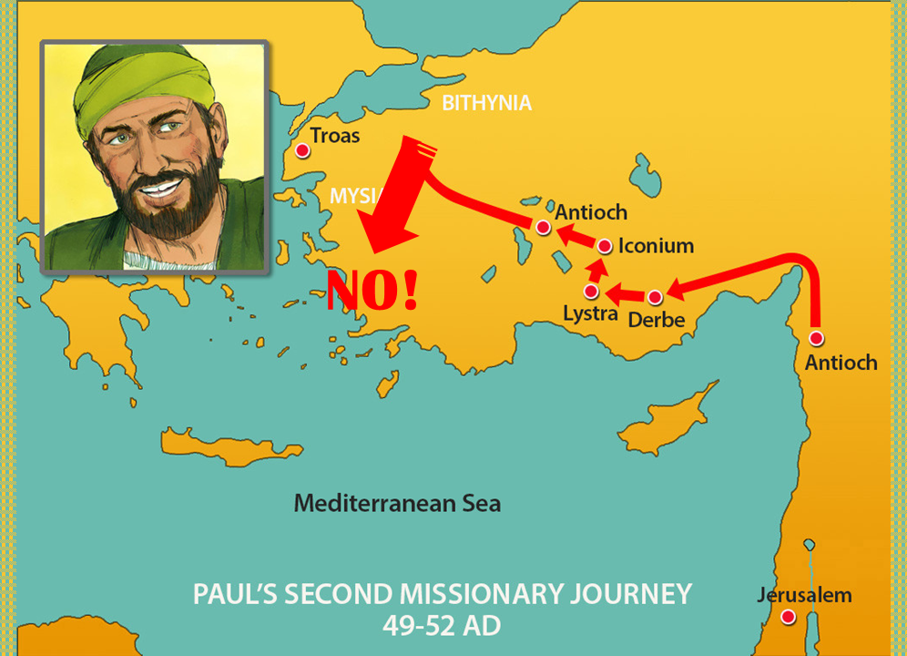
Notes:
8. After Paul, Silas and Timothy left Lystra they travelled about teaching people about Jesus. Paul always tried to think about where God would want him to go. When they tried to enter Asia but the Holy Spirit did not want them to go in that direction.

Slide 9
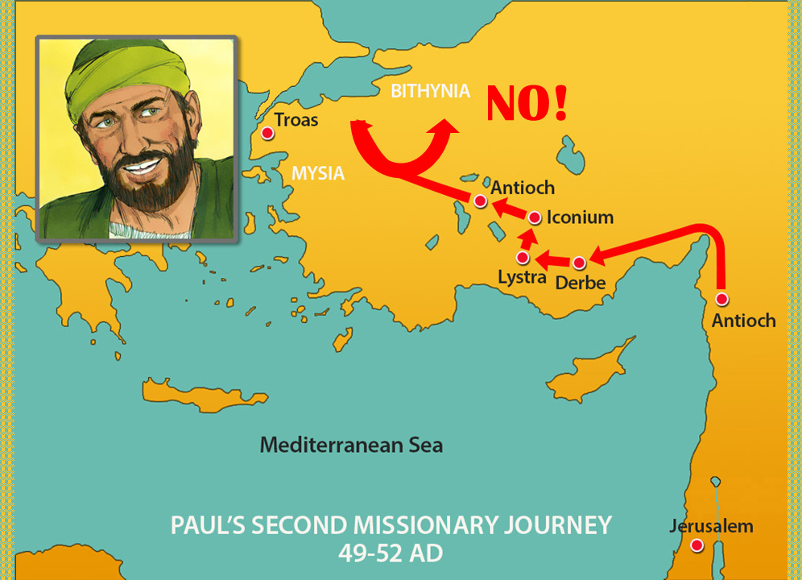
Notes:
9. Later, Paul tried to lead the group into Bithynia but he was stopped by the Holy Spirit once again. Paul was a missionary and wanted to go where God wanted him to go but the Spirit kept saying “no”.

Slide 10
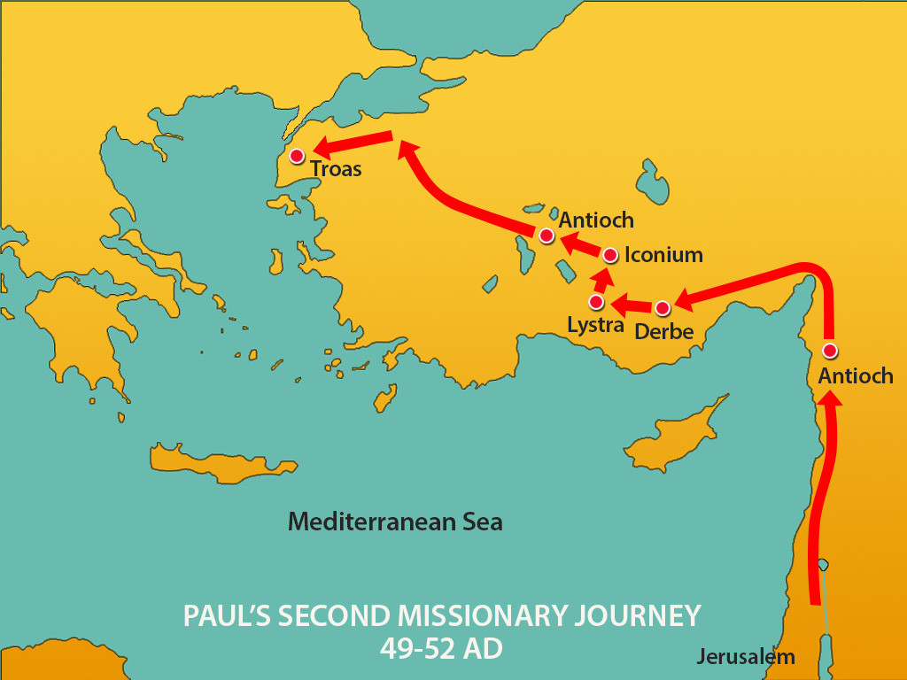
Notes:
10. Paul stopped in the city of Troas to decide what he should do next. But God had a special way of revealing his plans to Paul.

Slide 11
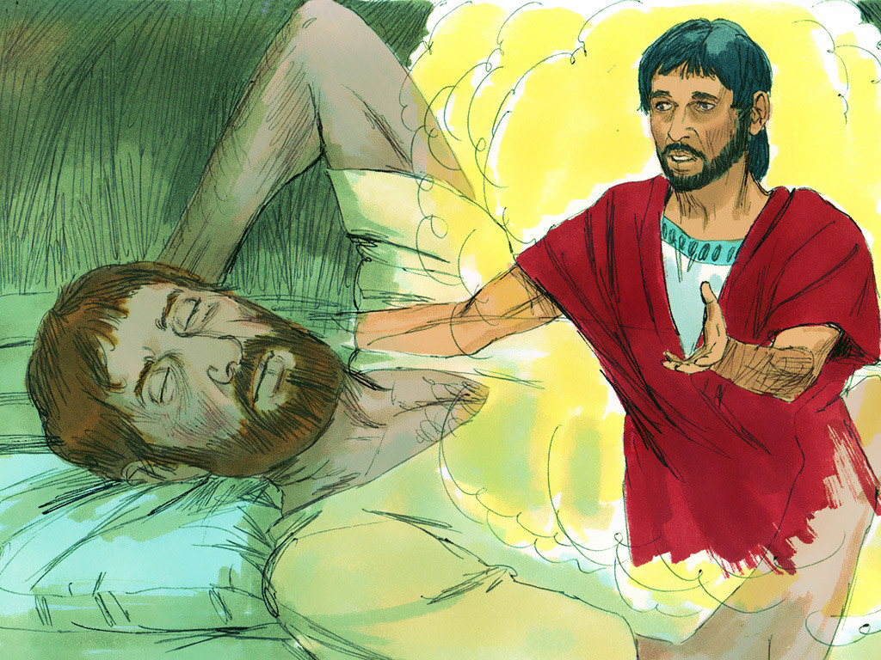
Notes:
11. One night in Troas Paul received an answer from God.
A man came to him in a vision. The man in the vision was from Macedonia and he stood and begged Paul saying, “come to Macedonia and help us.”

Slide 12
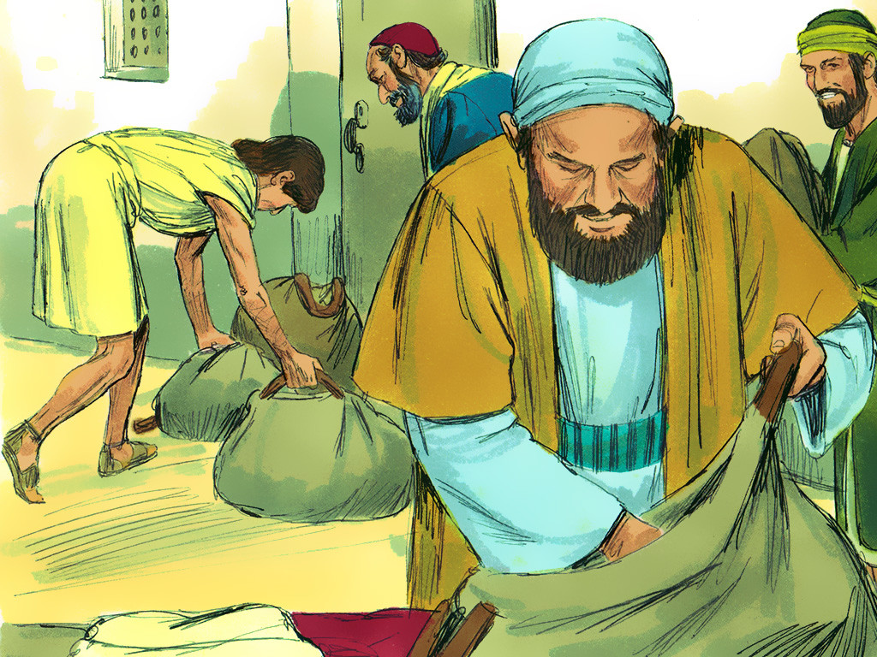
Notes:
12. Now Paul knew where God wanted him to go! The next morning Paul told his travel companions the good news that they were going to Macedonia. Everyone prepared for the trip. There would be many adventures ahead of them.

Slide 13
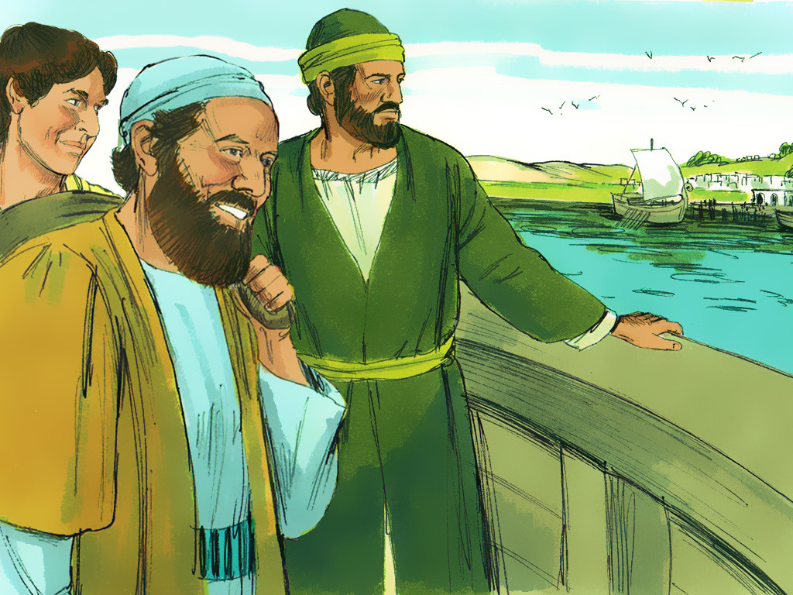
Notes:
13. Macedonia was part of what is now known as Europe. Paul was the first missionary ever recorded as taking the Good News of Jesus to Europe. Paul was a missionary that was willing to go where God wanted him to go.
And how about you? Are you willing to go where God wants you to go? Are you willing to do what God wants you to do?

Slide 14
Teacher Notes- Page 1
1. Cover: Macedonian Vision (on Paul’s 2nd Missionary Journey. Acts 15:36-41 and 16:1-10
2. There were many Christians in the Antioch church. Some of them were from Jewish families and some were from Gentile families but they all loved God. Paul and Barnabas were two missionaries that were members of the Antioch church.
3. Once, some men from Jerusalem came to Antioch and told the Christians that Gentiles could not become full members of God’s people unless they became Jews first. But Paul and Barnabas said this was not true. They travelled to Jerusalem and talked to the church leaders there about it.
The Jerusalem leaders sent a letter back to Antioch to tell all of the Christians there that what Paul and Barnabas were saying was correct. Gentile Christians did NOT have to become Jews first to be full members of God’s people. Both Jew and Gentile are part of God’s people through faith in Jesus. There may be differences on many things but it was important that there be PEACE and UNITY among all Christians.
4. After some time had passed Paul began to think about all of the people he and Barnabas had visited on their 1st Missionary Journey.
When Paul asked Barnabas to go on a 2nd Missionary Journey with him Barnabas wanted to take his cousin John Mark. Paul remembered how John Mark had deserted them when they were on the 1st Journey. He did not want him to come again. Paul and Barnabas had a very big disagreement about this.
5. Since they could not agree about John Mark Barnabas and Paul decided to go on two different journeys.
Barnabas took John Mark and sailed to Cyprus to encourage the churches there.
6. But Paul went a different direction. Instead of taking a ship Paul set out walking. He travelled to many of the churches that he had established on his last journey.
Paul also took someone along with him to be a helper. He took a good worker called Silas.
7. On this 2nd Missionary Journey Paul visited some of the churches he had started on his 1st Journey. When they came to the town of Lystra the Christians were so happy to see Paul again.
In Lystra Paul and Silas met a young man named Timothy. Timothy’s father was a Greek and most Greeks did not follow God. But ever since he was a little boy Timothy’s mother (Eunice) and grandmother (Lois) had taught him about God. Paul was so impressed by this young man that he invited him to join him on his missionary journey. Timothy left his family and began to travel along with Paul and Silas telling people about Jesus.

Slide 15
Teacher Notes- Page 2
8. After Paul, Silas and Timothy left Lystra they travelled about teaching people about Jesus. Paul always tried to think about where God would want him to go. When they tried to enter Asia but the Holy Spirit did not want them to go in that direction.
9. Later, Paul tried to lead the group into Bithynia but he was stopped by the Holy Spirit once again. Paul was a missionary and wanted to go where God wanted him to go but the Spirit kept saying “no”.
10. Paul stopped in the city of Troas to decide what he should do next. But God had a special way of revealing his plans to Paul.
11. One night in Troas Paul received an answer from God.
A man came to him in a vision. The man in the vision was from Macedonia and he stood and begged Paul saying, “come to Macedonia and help us.”
12. Now Paul knew where God wanted him to go! The next morning Paul told his travel companions the good news that they were going to Macedonia. Everyone prepared for the trip. There would be many adventures ahead of them.
13. Macedonia was part of what is now known as Europe. Paul was the first missionary ever recorded as taking the Good News of Jesus to Europe. Paul was a missionary that was willing to go where God wanted him to go.
And how about you? Are you willing to go where God wants you to go? Are you willing to do what God wants you to do?

Slide 16


Attributions: This visual aid was constructed by Mary Nelson www.missionbibleclass.org using:
Text and slideshow compilation by Mary Nelson
Illustrations by Sweet Publishing http://sweetpublishing.com/
As accessed through www.freebibleimages.org
Notice of Alteration: Writing and arrows have been added to Slides 6,8,9 . Text added to cover slide.
Attribution-ShareAlike 3.0 Unported (CC BY-SA 3.0) https://creativecommons.org/licenses/by-sa/3.0/
User may reproduce it without permissions.
DOWNLOAD THIS SLIDESHOW FROM www.missionbibleclass.org
Please visit www.missionbibleclass.org to find this and many other free resources to help you teach the Bible to children.

