Slide 1
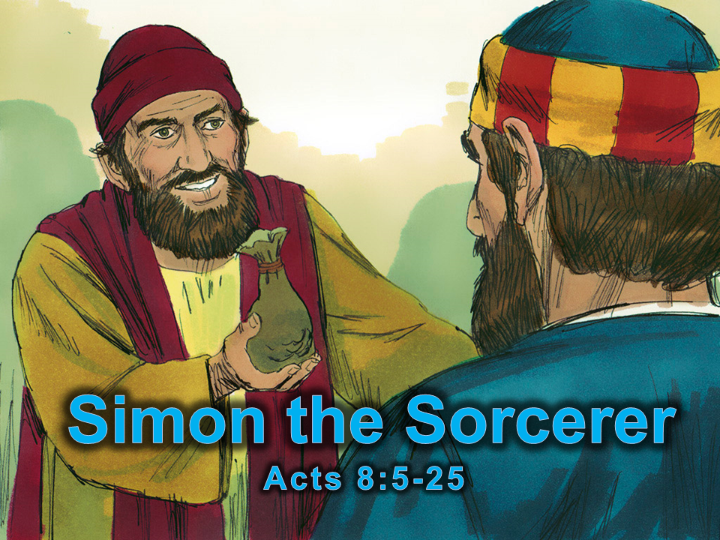
Notes:
1. Cover- Simon the Sorcerer Acts 8:5-25

Slide 2
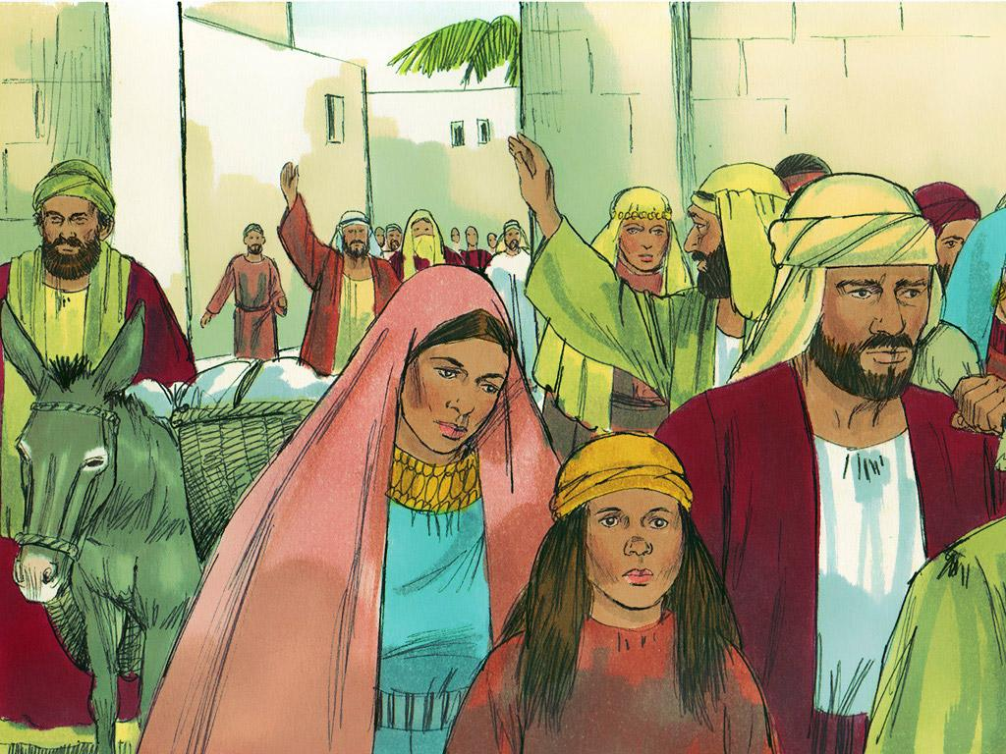
Notes:
2. To persecute someone is to cause harm to them on purpose so that they suffer. In Jerusalem, some people persecuted followers of Jesus. Many followers of Jesus began to leave Jerusalem and move to other places.

Slide 3
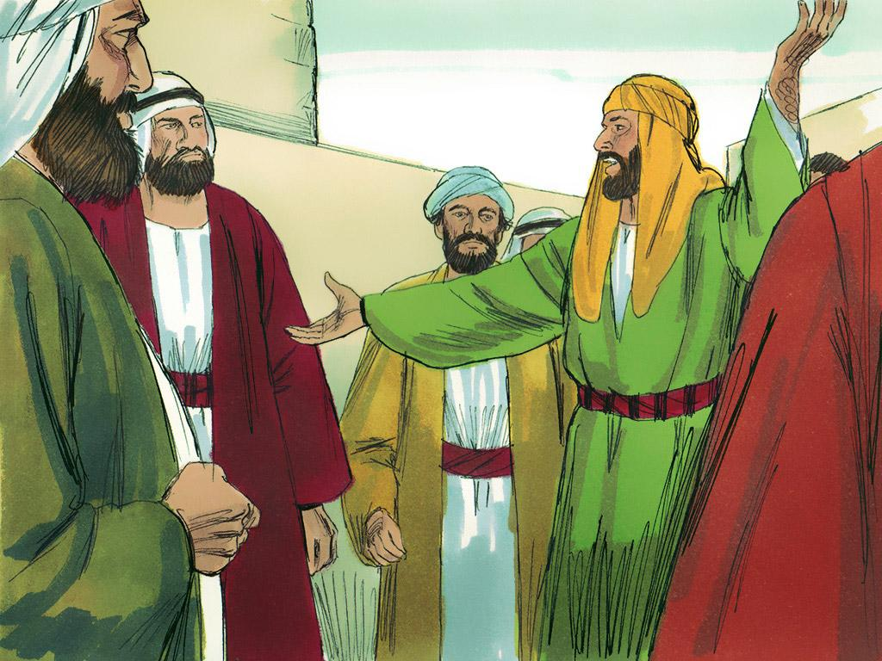
Notes:
3. Wherever the followers of Jesus went, they preached about Jesus. One of these Jesus followers was Philip. He was a man who was wise and lived according to the Holy Spirit. Because he had been with the Apostles, he could perform miracles to prove that the word of God about Jesus was true. Philip travelled to Samaria and told the people there about Jesus.

Slide 4
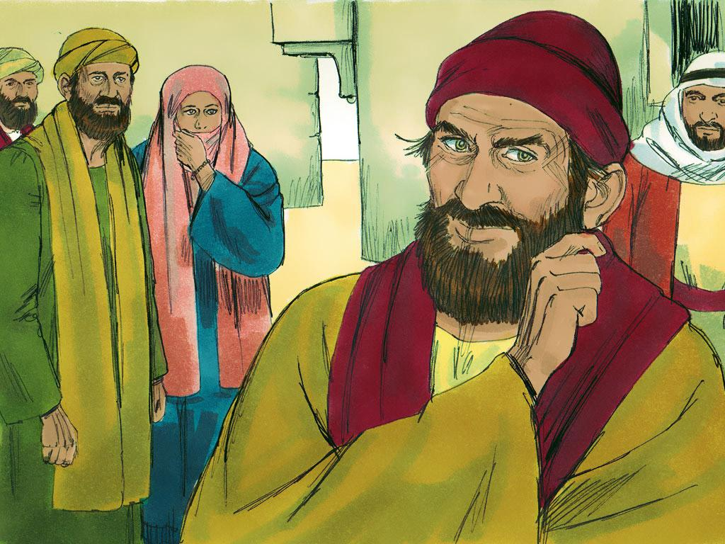
Notes:
4. Simon was a famous magician who lived in Samaria. Simon performed magic tricks, and everyone thought he was amazing. They even said that he had power like a god.

Slide 5
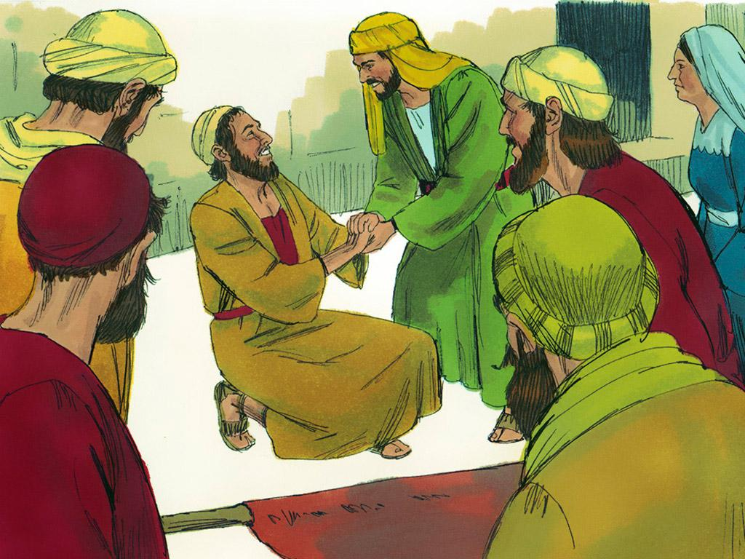
Notes:
5. But when Philip told the Samaritans the good news of Jesus Christ, many of them believed. When the people saw the miracles Philip performed by the power of the Holy Spirit, they knew that miracles from God were much better than just magic tricks that people could do. Anyone can explain a magic trick. But a miracle cannot be explained by science and can only be done through the power of God.

Slide 6
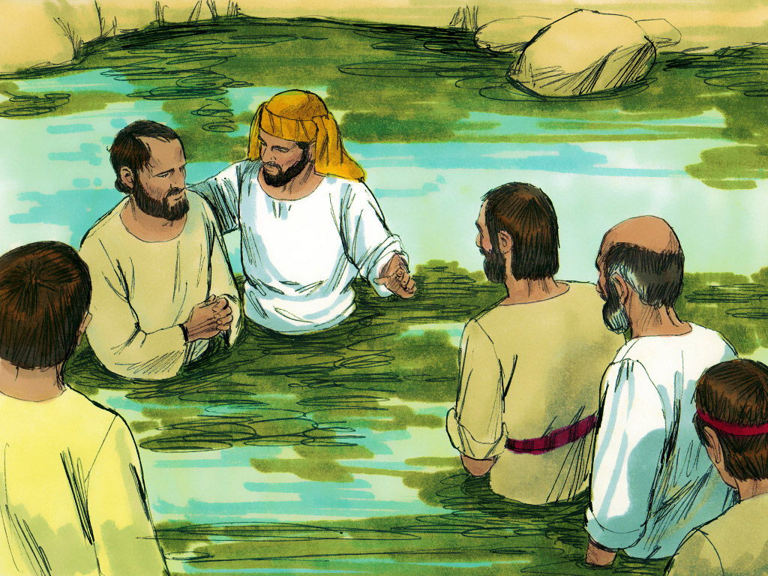
Notes:
6. Many people accepted the teaching of Jesus and decided to be baptised.

Slide 7
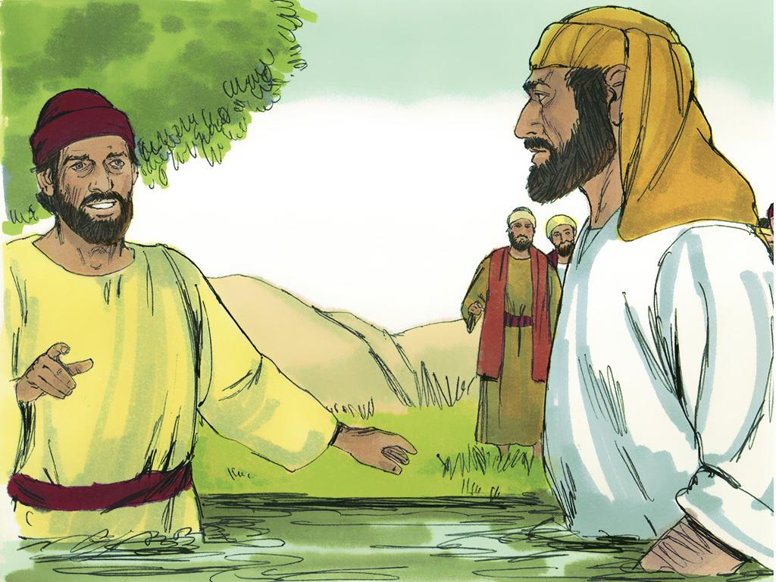
Notes:
7. Even Simon the Sorcerer was baptised. After that, Simon followed Philip everywhere and watched him perform miracles.

Slide 8
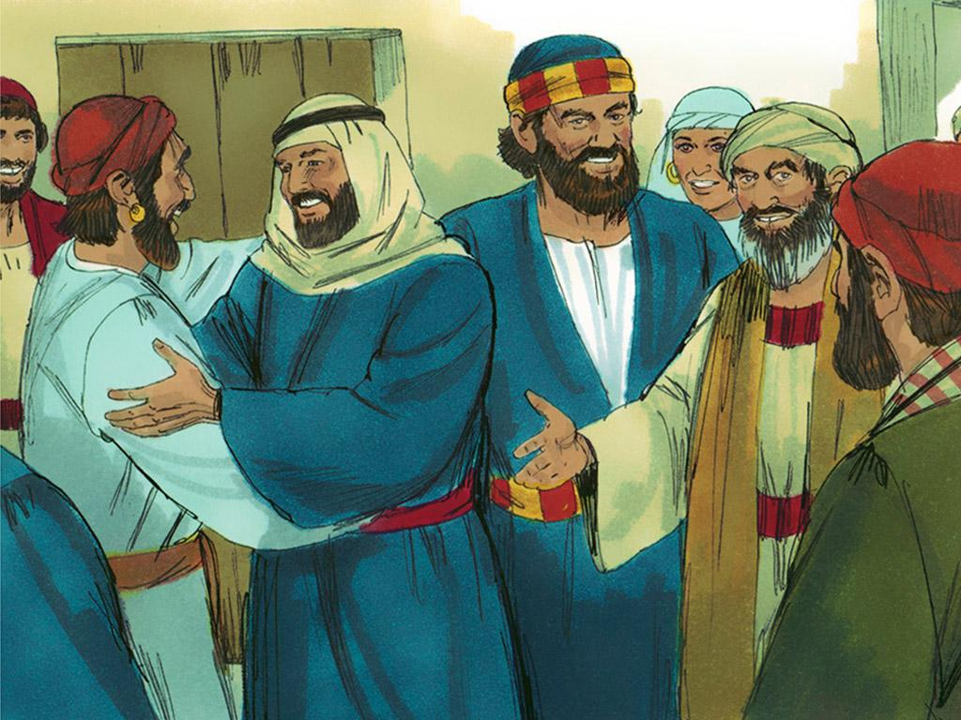
Notes:
8. The good news about the Samaritans spread to the Apostles in Jerusalem. Two of the Apostles, Peter and John travelled to Samaria to see Philip and the new followers of Jesus.

Slide 9
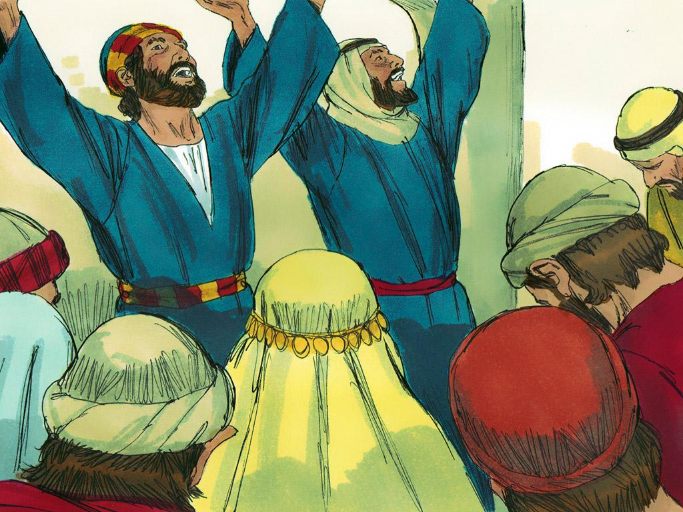
Notes:
9. Peter and John remembered a time when Jesus told the Apostles that they had an important job to do. They knew Jesus better than anyone else, and they were to make sure people knew that Jesus wanted everyone to be part of the family of God. The Holy Spirit would give them special power to do this.
Peter and John laid their hands on some of the people in Samaria and gave them the power to do miracles like Philip had been doing.
Everyone was amazed These Samaritans were receiving powers from the Holy Spirit just like other believers in Jesus had.

Slide 10
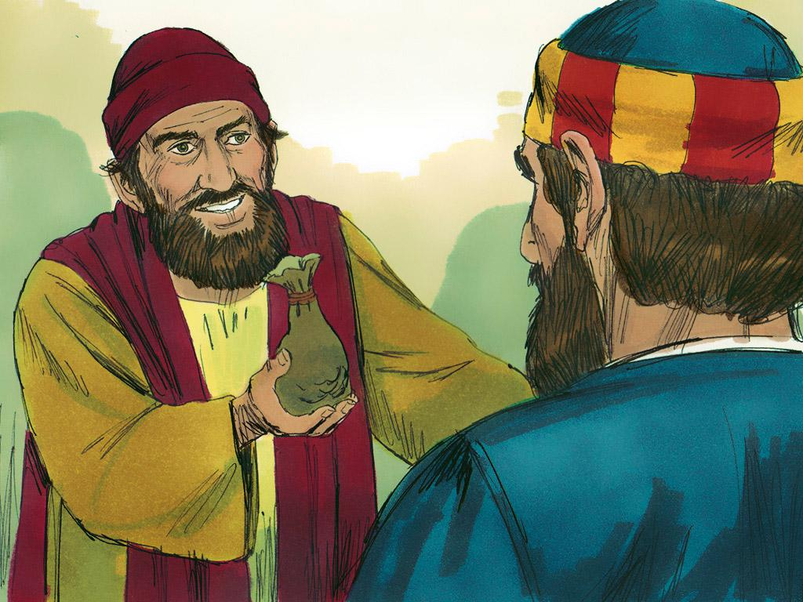
Notes:
10. Simon watched Peter and John very carefully. They laid hands on people and gave them power, so Simon wanted to be able to do that, too.
Simon tried to pay Peter and John money and said to them, “Give me this ability, too. I want to lay my hands on people to give them the power of the Holy Spirit, too.”

Slide 11
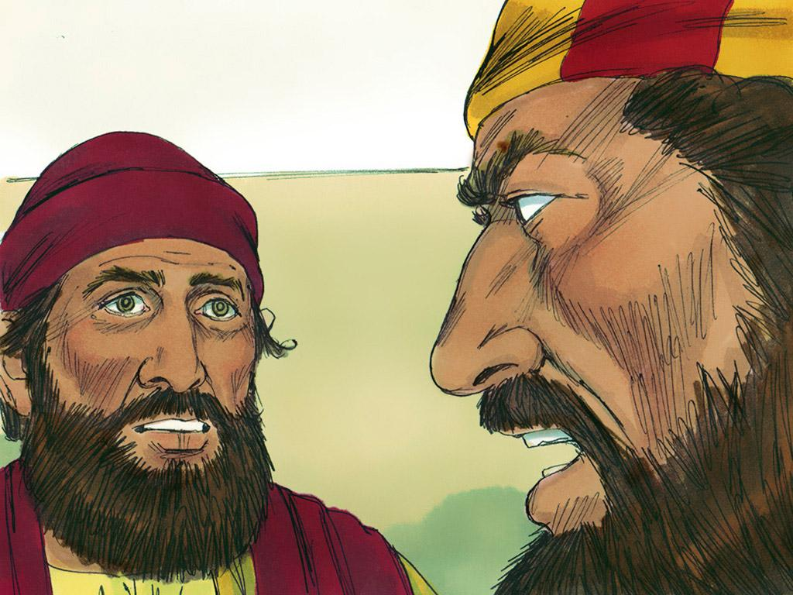
Notes:
11. But Simon was very wrong to think this was about money. This was not magic, this was the power of the Holy Spirit!
Peter reacted very strongly. How dare Simon think anyone could buy what was only God’s to give? No one can buy the gift of God with money! Peter told Simon that he must repent and ask God for forgiveness.
Simon asked Peter and John to pray for him.

Slide 12
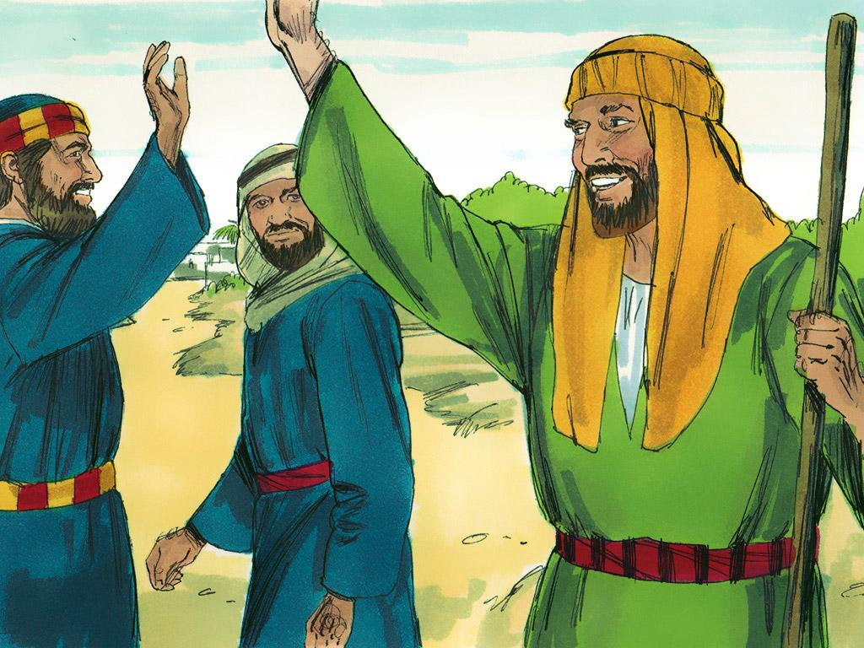
Notes:
12. Peter and John continued to preach to the people about God until it was time for them to return to Jerusalem. They even talked to people about Jesus while they were travelling home.
It was just as Jesus had first said to the Apostles,
"But the Holy Spirit will come to you. Then you will receive power. You will be my witnesses—in Jerusalem, in all of Judea, in Samaria, and in every part of the world.”

Slide 13
Teacher Notes Page 1
1. Cover: Simon the Sorcerer Acts 8:5-25
2. To persecute someone is to cause harm to them on purpose so that they suffer. In Jerusalem, some people persecuted followers of Jesus. Many followers of Jesus began to leave Jerusalem and move to other places.
3. Wherever the followers of Jesus went, they preached about Jesus. One of these Jesus followers was Philip. He was a man who was wise and lived according to the Holy Spirit. Because he had been with the Apostles, he could perform miracles to prove that the word of God about Jesus was true. Philip travelled to Samaria and told the people there about Jesus.
4. Simon was a famous magician who lived in Samaria. Simon performed magic tricks, and everyone thought he was amazing. They even said that he had power like a god.
5. But when Philip told the Samaritans the good news of Jesus Christ, many of them believed. When the people saw the miracles Philip performed by the power of the Holy Spirit, they knew that miracles from God were much better than just magic tricks that people could do. Anyone can explain a magic trick. But a miracle cannot be explained by science and can only be done through the power of God.
6. Many people accepted the teaching of Jesus and decided to be baptised.
7. Even Simon the Sorcerer was baptised. After that, Simon followed Philip everywhere and watched him perform miracles.
8. The good news about the Samaritans spread to the Apostles in Jerusalem. Two of the Apostles, Peter and John travelled to Samaria to see Philip and the new followers of Jesus.
9. Peter and John remembered a time when Jesus told the Apostles that they had an important job to do. They knew Jesus better than anyone else, and they were to make sure people knew that Jesus wanted everyone to be part of the family of God. The Holy Spirit would give them special power to do this.
Peter and John laid their hands on some of the people in Samaria and gave them the power to do miracles like Philip had been doing.
Everyone was amazed These Samaritans were receiving powers from the Holy Spirit just like other believers in Jesus had.

Slide 14
Teacher Notes Page 2
10. Simon watched Peter and John very carefully. They laid hands on people and gave them power, so Simon wanted to be able to do that, too.
Simon tried to pay Peter and John money and said to them, “Give me this ability, too. I want to lay my hands on people to give them the power of the Holy Spirit, too.”
11. But Simon was very wrong to think this was about money. This was not magic, this was the power of the Holy Spirit!
Peter reacted very strongly. How dare Simon think anyone could buy what was only God’s to give? No one can buy the gift of God with money! Peter told Simon that he must repent and ask God for forgiveness.
Simon asked Peter and John to pray for him.
12. Peter and John continued to preach to the people about God until it was time for them to return to Jerusalem. They even talked to people about Jesus while they were travelling home.
It was just as Jesus had first said to the Apostles,
"But the Holy Spirit will come to you. Then you will receive power. You will be my witnesses—in Jerusalem, in all of Judea, in Samaria, and in every part of the world.”

Slide 15


Attributions: This visual aid was constructed by Mary Nelson www.missionbibleclass.org using:
Text and slideshow compilation by Mary Nelson
Illustrations by Sweet Publishing http://sweetpublishing.com/
As accessed through www.freebibleimages.org
Notice of Alteration: Text added to cover slide.
Attribution-ShareAlike 3.0 Unported (CC BY-SA 3.0) https://creativecommons.org/licenses/by-sa/3.0/
User may reproduce it without permissions.
DOWNLOAD THIS SLIDESHOW FROM www.missionbibleclass.org
Please visit www.missionbibleclass.org to find this and many other free resources to help you
teach the Bible to children.

