Slide 1
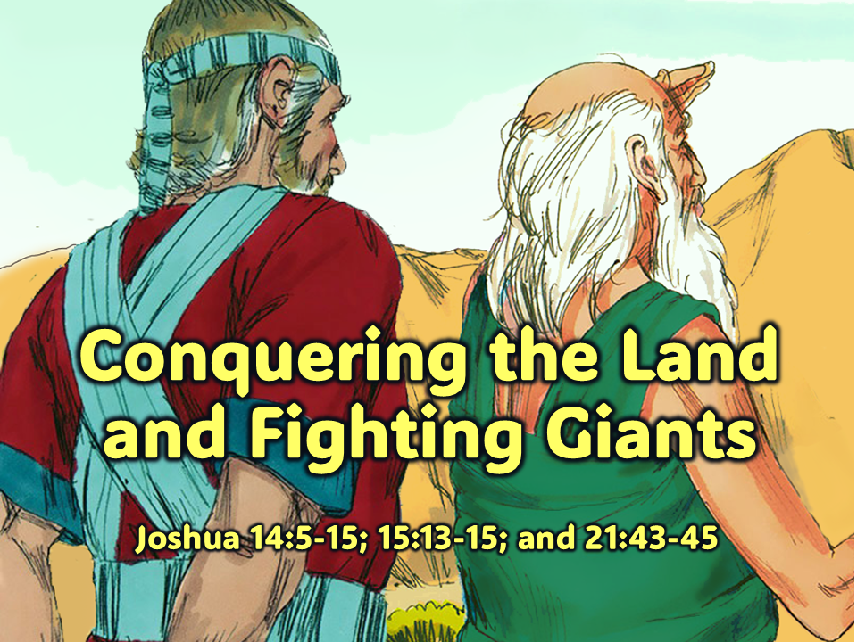
Notes:
1. Cover: Conquering the Land & Fighting Giants
(Joshua 14:5-15; 15:13-15; and 21:43-45)

Slide 2
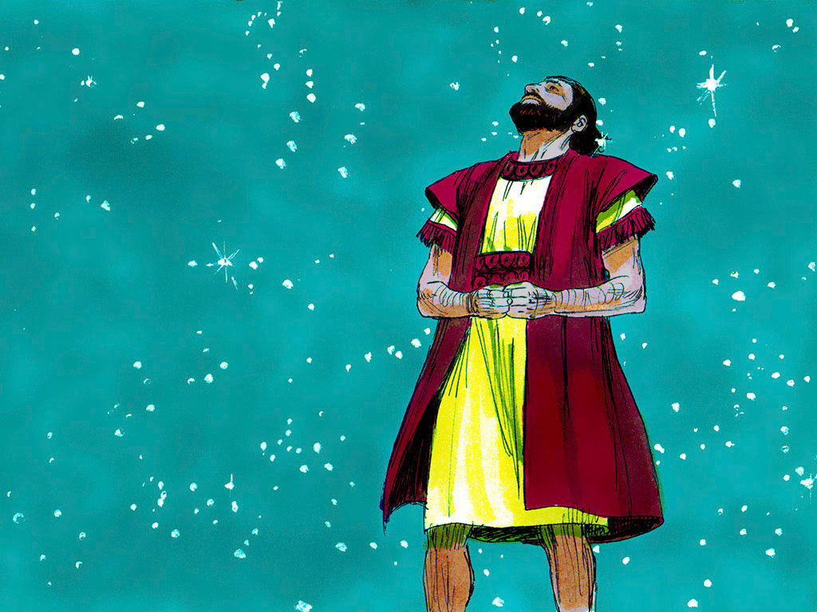
Notes:
2. Long ago, the Lord promised to give His people their land. He made the promise to Abraham, Isaac, Jacob, and Jacob’s 12 sons, Moses and Joshua. After all those years, the Israelite people were in their own land. They fought many battles, but the Lord helped them.

Slide 3
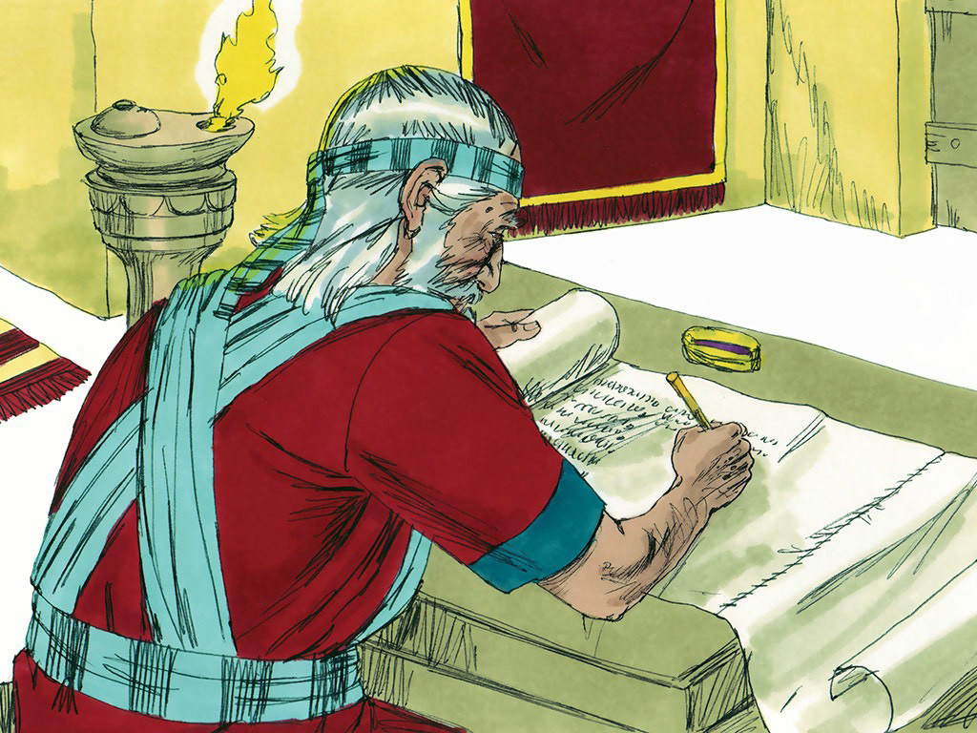
Notes:
3. Now, it was time to divide the land so that all of the tribes of Israel would have a place to live. The Lord told Joshua to divide the land among the twelve tribes of Israel.

Slide 4
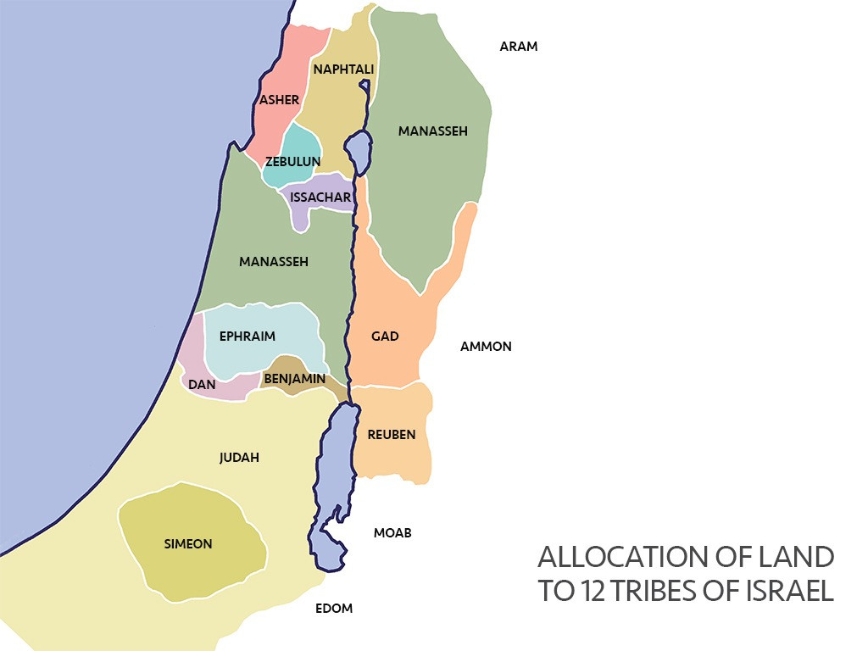
Notes:
4. Ten of the tribes were named after ten of Jacob’s sons. These tribes were Reuben, Simeon, Judah, Issachar, Zebulon, Gad, Asher, Dan, Naphtali, and Benjamin. Joshua gave each of these tribes their own land. The two tribes named after Joseph’s sons were also given a share of the land. These were Ephraim and Manasseh. Now, the land of Canaan was divided between all of the tribes of Israel so that everyone had a share.

Slide 5
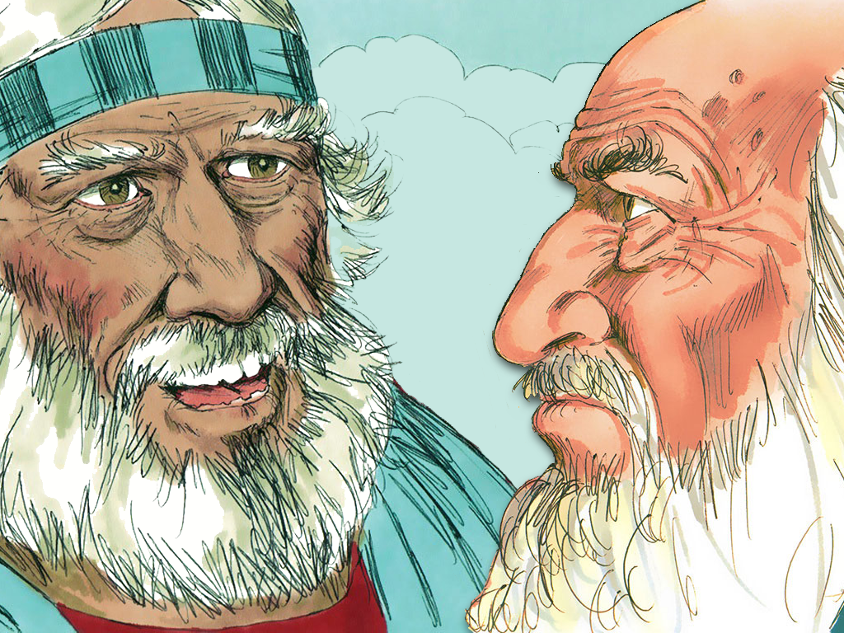
Notes:
5. One man in Israel remembered a very special promise that Moses had made to him. Caleb came up to Joshua and said, “Joshua, do you remember a long time ago when Moses sent you and me into Canaan as spies? Do you remember how we came back and told Moses all about how good the land was?”
“Yes,” said Joshua, “I remember.”

Slide 6
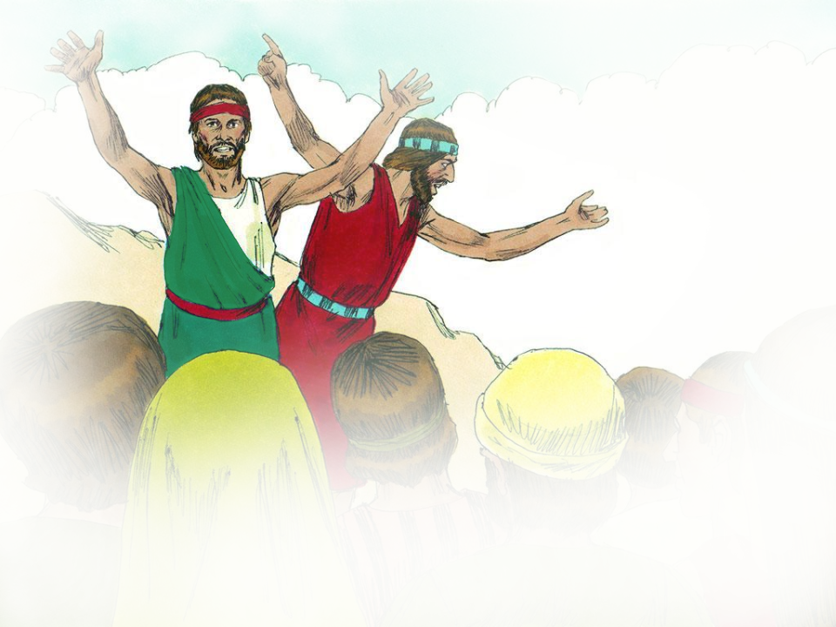
Notes:
6. “All of the other spies did not have enough faith to conquer the land, only you and I did. Do you remember how I told Moses I knew we could take over the new land because God would help us?”
“Yes,” said Joshua, “I remember.”
“And do you remember how Moses said that I could have part of the new land because I always follow God and do what He says?”
“Yes,” said Joshua, “I remember.”

Slide 7
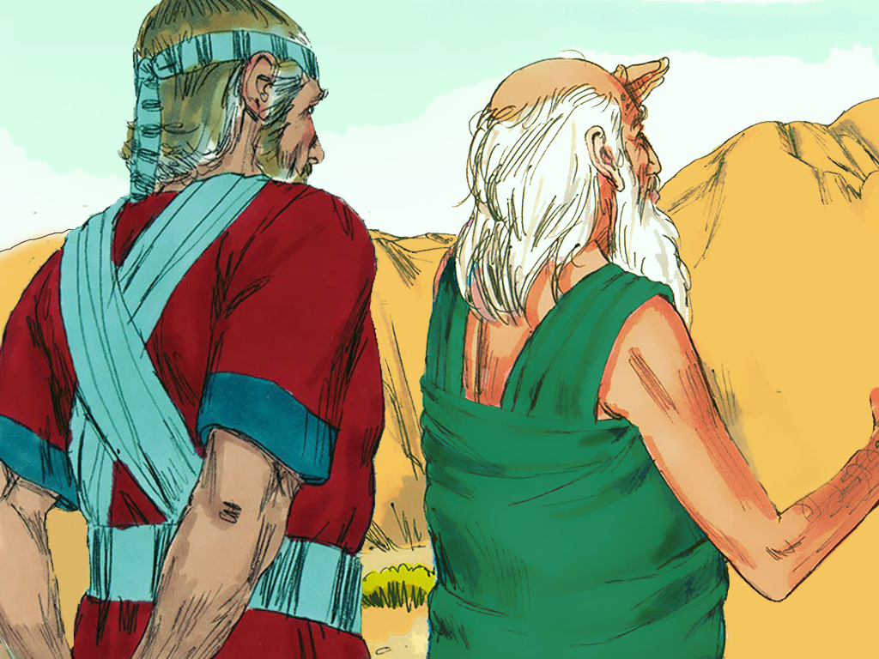
Notes:
7. “That was forty-five years ago,” said Caleb. “Now I am eighty-five years old. But look at me, Joshua, I am as well and strong now as I was back then. And I can do all the things now that I could do back then because I always follow God and do what He says!
I know I am old, but I still want to follow God. I don’t want something easy to do, Joshua; I want something hard! Do you know that mountain near Hebron? It has people living on it who are as big as giants! But I know it is the land God wants me to have, and He will help me against those giants!”
“Yes,” Joshua said to Caleb, “God will help you because you always follow Him. Go and take the land, Caleb. You can fight the giants and then you can have the land.”

Slide 8
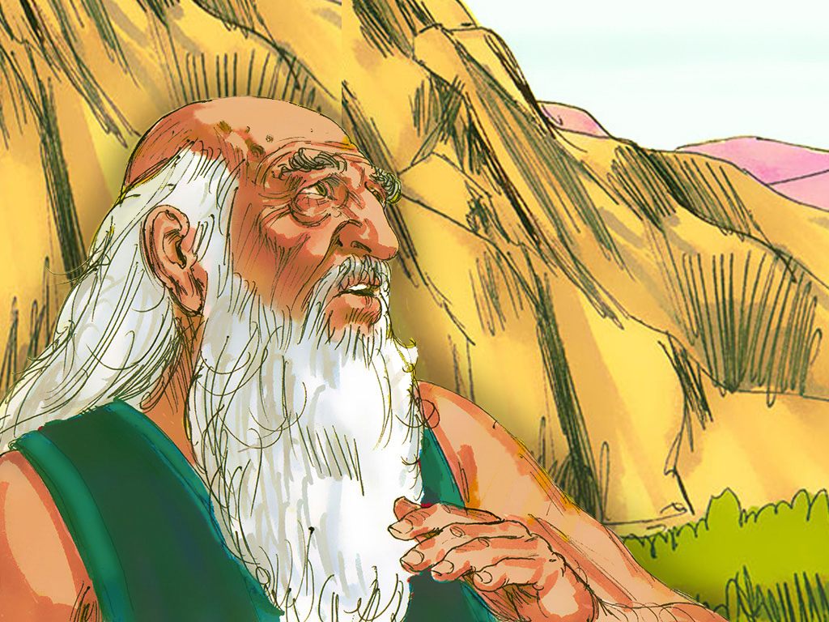
Notes:
8. God did help Caleb send away those giants and take over the mountain. Then Caleb took all his family to live with him there for the rest of his life. He kept following God and doing what God said, and God was always with him.

Slide 9
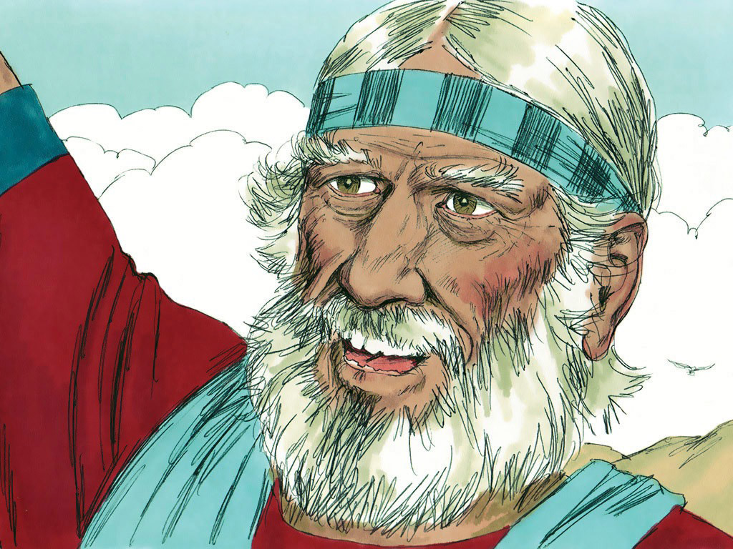
Notes:
9. Joshua was happy that he had been able to lead the people of God into their own land. Now, Israel possessed all of the land that the Lord had promised. He hoped that the people would always remember to follow God. If they followed the Lord, the Lord would always protect and take care of them.

Slide 10
Teacher Notes Page 1
1. Cover: Conquering the Land & Fighting Giants (Joshua 14:5-15; 15:13-15; and 21:43-45)
2. Long ago, the Lord promised to give His people their land. He made the promise to Abraham, Isaac, Jacob, and Jacob’s 12 sons, Moses and Joshua. After all those years, the Israelite people were in their own land. They fought many battles, but the Lord helped them.
3. Now, it was time to divide the land so that all of the tribes of Israel would have a place to live. The Lord told Joshua to divide the land among the twelve tribes of Israel.
4. Ten of the tribes were named after ten of Jacob’s sons. These tribes were Reuben, Simeon, Judah, Issachar, Zebulon, Gad, Asher, Dan, Naphtali, and Benjamin. Joshua gave each of these tribes their own land. The two tribes named after Joseph’s sons were also given a share of the land. These were Ephraim and Manasseh. Now, the land of Canaan was divided between all of the tribes of Israel so that everyone had a share.
5. One man in Israel remembered a very special promise that Moses had made to him. Caleb came up to Joshua and said, “Joshua, do you remember a long time ago when Moses sent you and me into Canaan as spies? Do you remember how we came back and told Moses all about how good the land was?”
“Yes,” said Joshua, “I remember.”
6. “All of the other spies did not have enough faith to conquer the land, only you and I did. Do you remember how I told Moses I knew we could take over the new land because God would help us?”
“Yes,” said Joshua, “I remember.”
“And do you remember how Moses said that I could have part of the new land because I always follow God and do what He says?”
“Yes,” said Joshua, “I remember.”

Slide 11
Teacher Notes Page 2
7. “That was forty-five years ago,” said Caleb. “Now I am eighty-five years old. But look at me, Joshua, I am as well and strong now as I was back then. And I can do all the things now that I could do back then because I always follow God and do what He says!
I know I am old, but I still want to follow God. I don’t want something easy to do, Joshua; I want something hard! Do you know that mountain near Hebron? It has people living on it who are as big as giants! But I know it is the land God wants me to have, and He will help me against those giants!”
“Yes,” Joshua said to Caleb, “God will help you because you always follow Him. Go and take the land, Caleb. You can fight the giants and then you can have the land.”
8. God did help Caleb send away those giants and take over the mountain. Then Caleb took all his family to live with him there for the rest of his life. He kept following God and doing what God said, and God was always with him.
9. Joshua was happy that he had been able to lead the people of God into their own land. Now, Israel possessed all of the land that the Lord had promised. He hoped that the people would always remember to follow God. If they followed the Lord, the Lord would always protect and take care of them.

Slide 12


Attributions: This visual aid was constructed by Mary Nelson www.missionbibleclass.org using:
Text and slideshow compilation by Mary Nelson
Illustrations by Sweet Publishing http://sweetpublishing.com/ As accessed through www.freebibleimages.org Notice of Alteration: Portions of multiple illustrations have been combined to form the final illustrations in slides 1,5,6,7 and 8. Words have been added to the cover slide.
Attribution-ShareAlike 3.0 Unported (CC BY-SA 3.0) https://creativecommons.org/licenses/by-sa/3.0/
User may reproduce it without permissions.
DOWNLOAD THIS SLIDESHOW FROM www.missionbibleclass.org
Please visit www.missionbibleclass.org to find this and many other free resources to help you teach the Bible to children.

