Slide 1
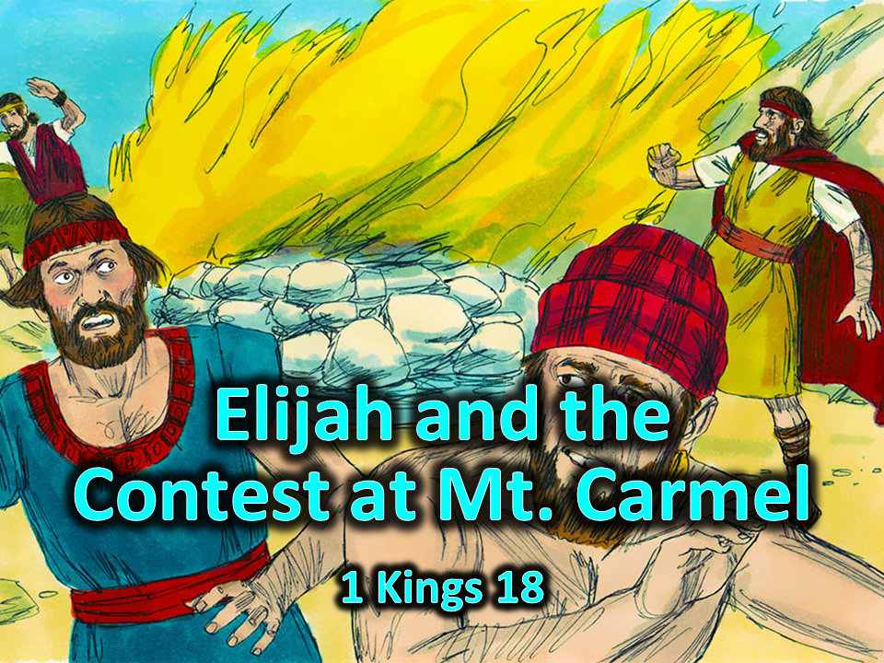

Slide 2
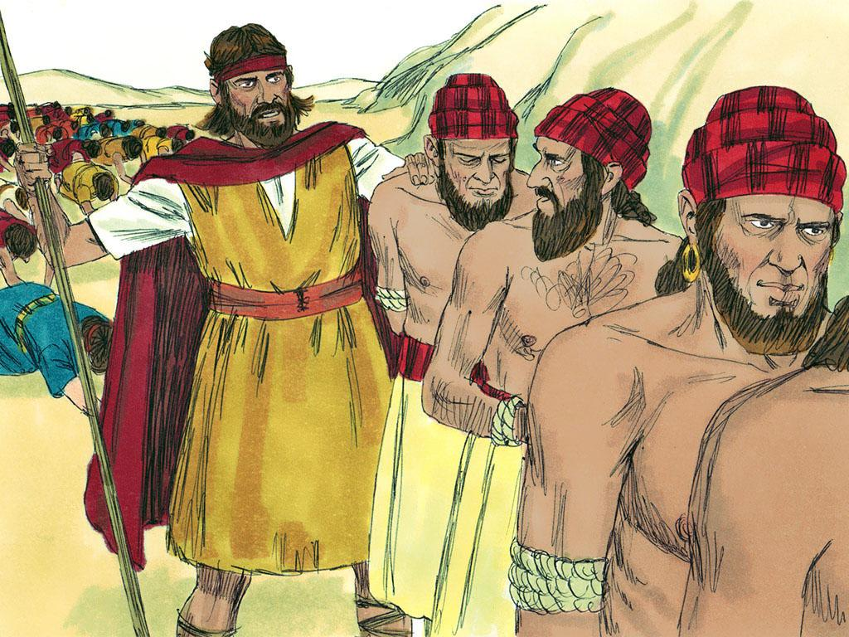
Notes:
2..Elijah was a prophet. A prophet is someone who gives special messages. Elijah was a prophet of God. He gave special messages from God to all of the people.

Slide 3
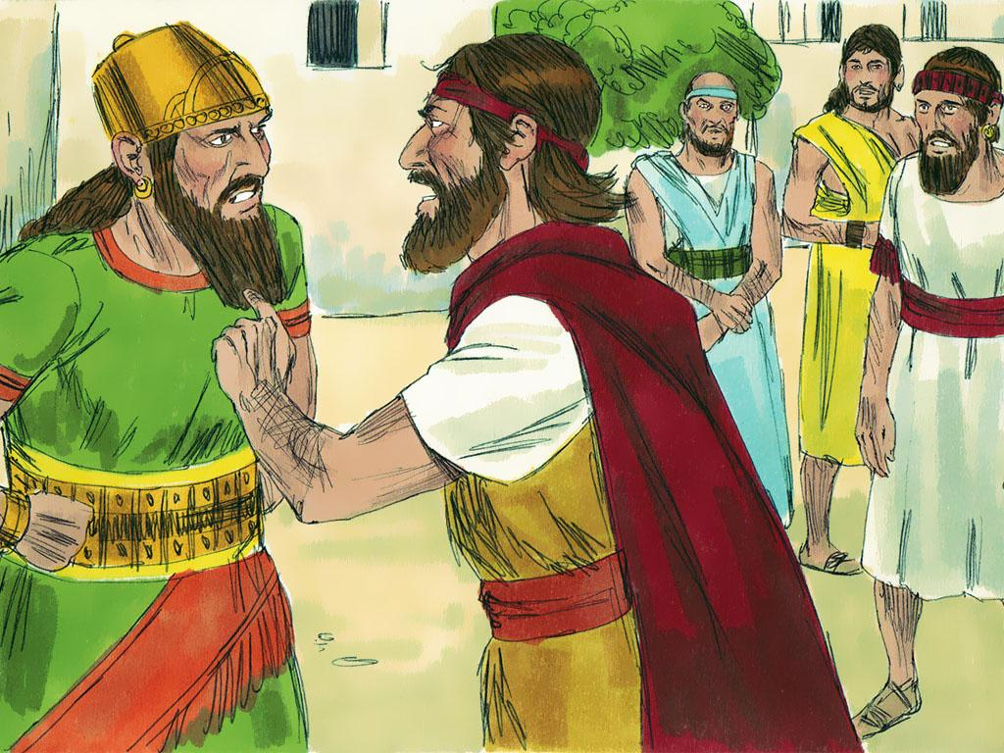
Notes:
3. King Ahab and Queen Jezebel did not like the messages that Elijah gave them. He told them that they were bad and that they were wrong to worship other gods besides the Lord. He told them that God would take away the rain so that they would learn that he was God. Ahab and Jezebel were so angry that they tried to kill Elijah and all of the other prophets.

Slide 4
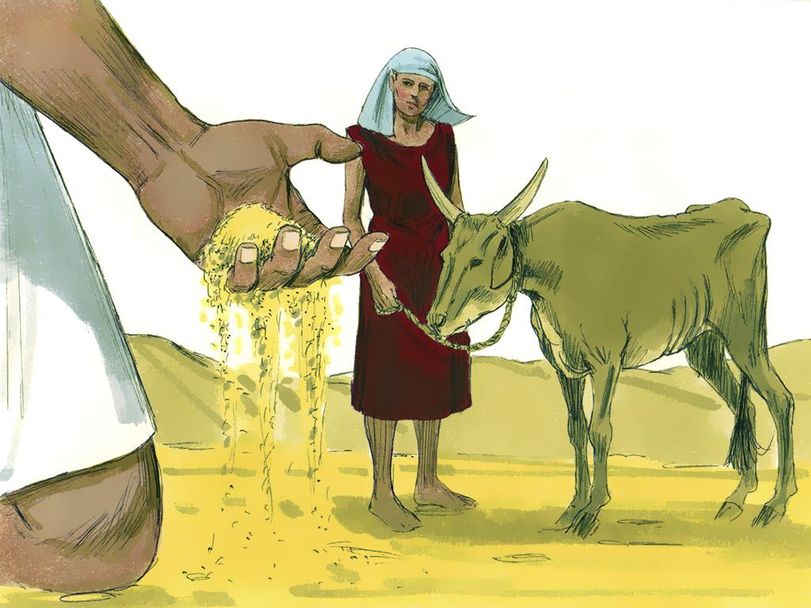
Notes:
4. The Lord hid Elijah and kept him safe… Now, after three years of no rain, the Lord decided it was time for Elijah to talk to the King again. He told Elijah to find King Ahab and give him a message. Even though he was warned that the King would try to kill him, Elijah knew that he must obey the Lord. God had taken care of him before. God would take care of him now!

Slide 5
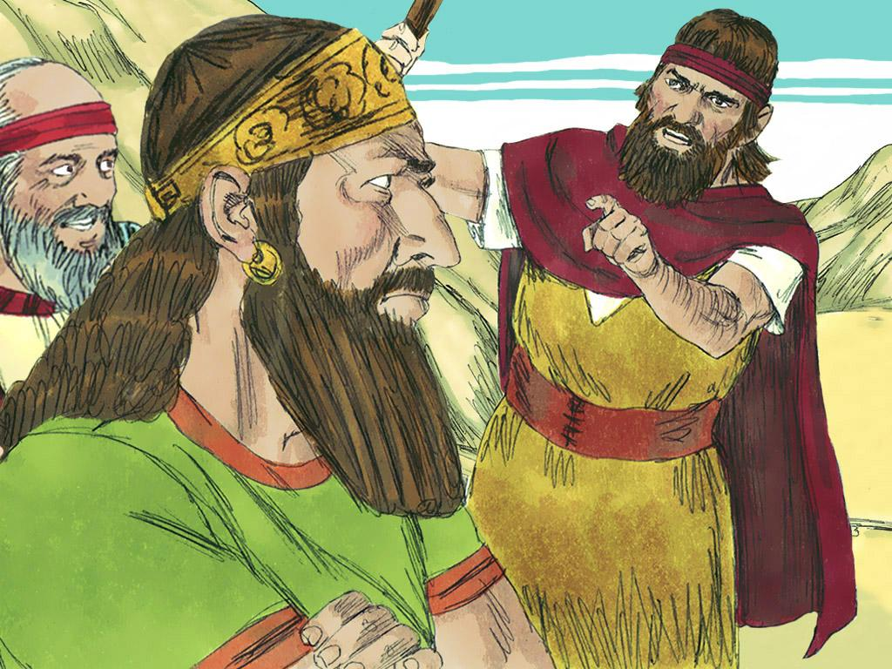
Notes:
5. Elijah met Ahab. Ahab was very angry with Elijah, “You are a trouble-maker Elijah. You caused the rain to go away. It is your fault that we have had a drought.” “No, King Ahab,” said Elijah. “You caused the drought. It was because you stopped worshipping the Lord. The Lord knows that you and your wife, Jezebel, worship false gods. You make idols and bow down before them. You think that there are other gods named Baal and Asherah. You even believe the men who say that they are prophets of these false gods. But you are wrong! There is only one God. He is the Lord God! He is the only real God. All of the others are just made up. Gather all of the people and all of the prophets of Baal and Asherah together at Mount Carmel. We will have a contest to see whose god is real!”

Slide 6
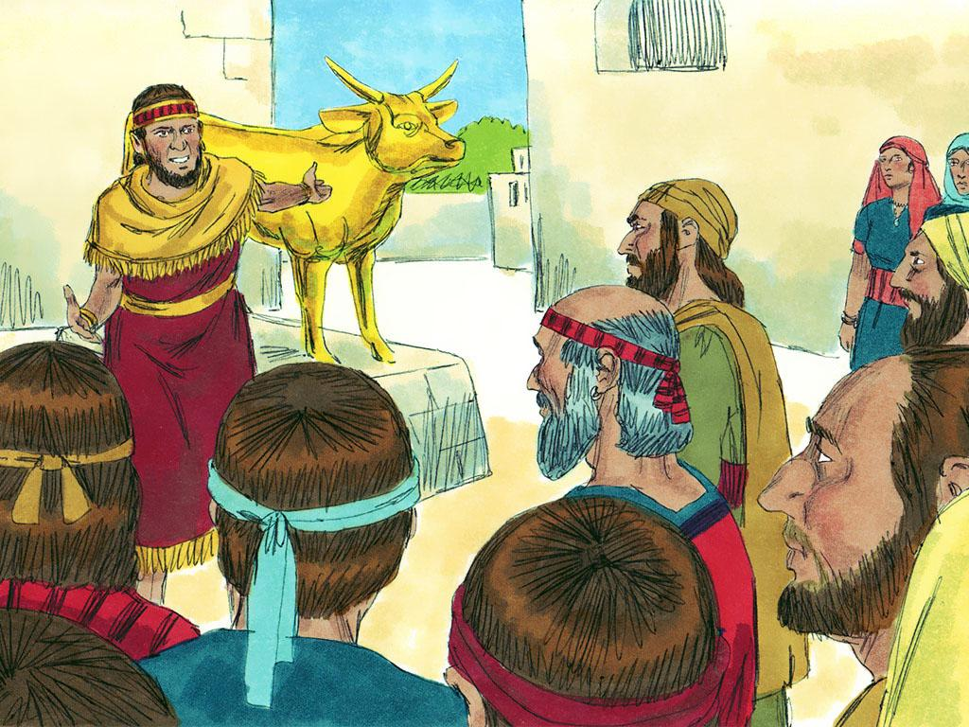
Notes:
6. King Ahab did as Elijah said. People from all over Israel came to watch the contest. It didn’t really seem like a fair contest. Elijah was the only prophet of God there. There were 450 prophets of the false god, Baal, and also 400 prophets of the false god, Asherah.

Slide 7
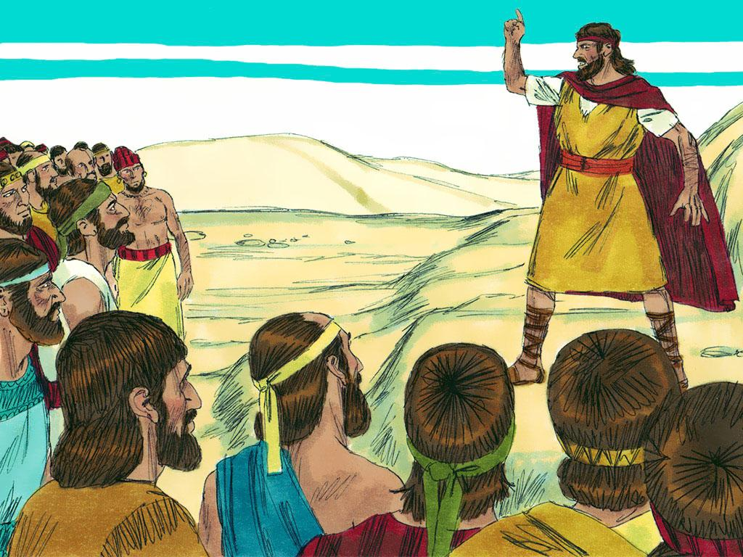
Notes:
7. Elijah spoke to all of the people, “Everyone needs to make a decision today. If Baal is real then you need to worship him. If the Lord God is real, then you need to worship Him!”
Elijah suggested that they should have a contest to prove who the real God was.
The prophets of Baal could build an altar and Elijah could build an altar. Each could place an animal sacrifice on their altar and then pray to their God to light a fire for the sacrifice. The God who could send a fire for the sacrifice was the true God.

Slide 8
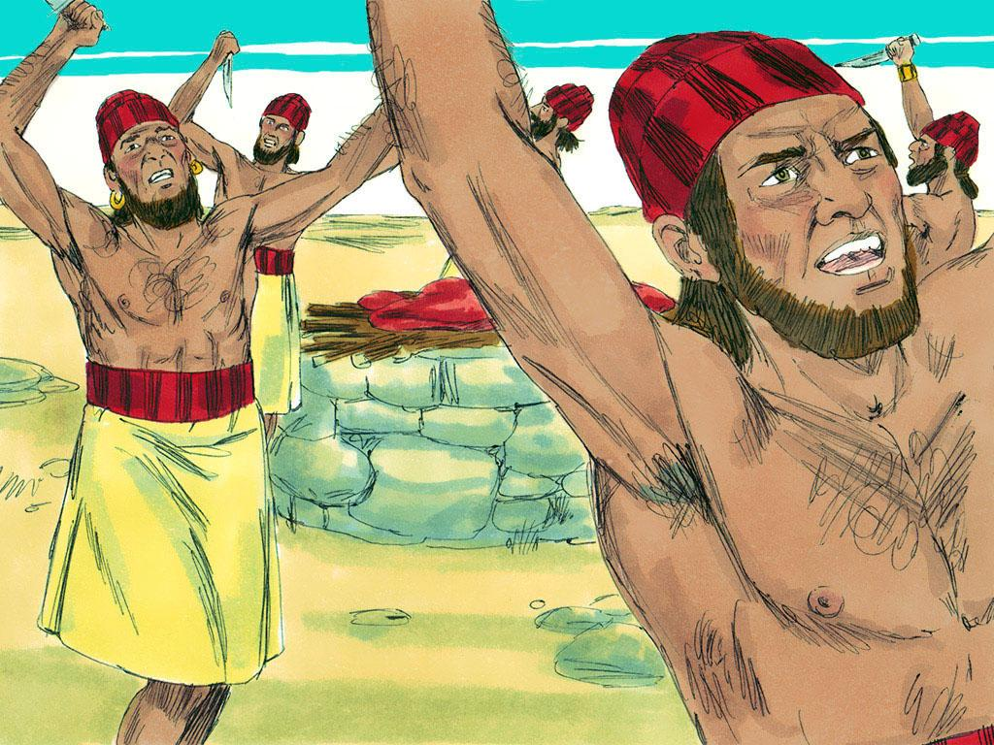
Notes:
8. The prophets of Baal agreed to the contest. They made their altar and then they prayed and cried out to Baal. But nothing happened to the sacrifice on the altar. They cried even louder and harder. But still there was no answer.
The prophets of Baal tried everything. They even cut themselves and acted wild but still there was no answer from Baal.

Slide 9
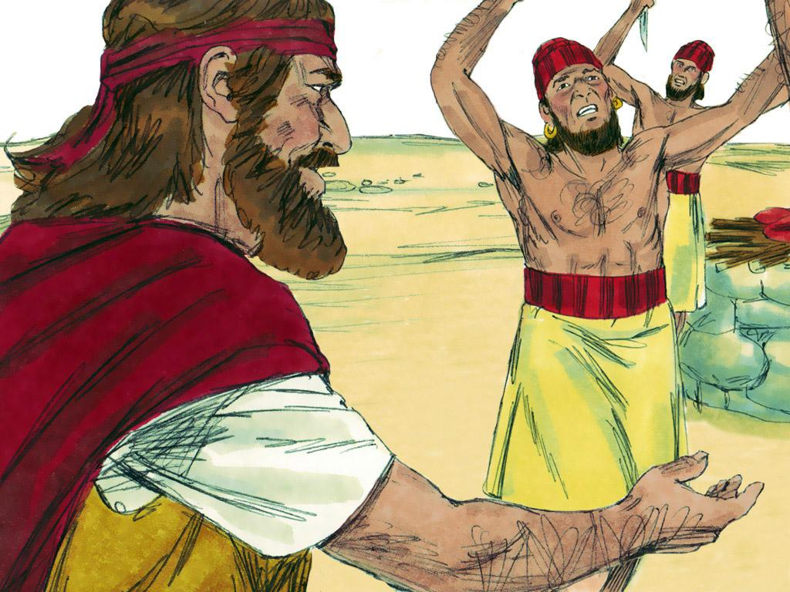
Notes:
9. “Maybe Baal is asleep or maybe he is busy,” said Elijah. Elijah knew that Baal would never cause fire to come down because Baal was not real. Baal was just a god that someone made up.

Slide 10
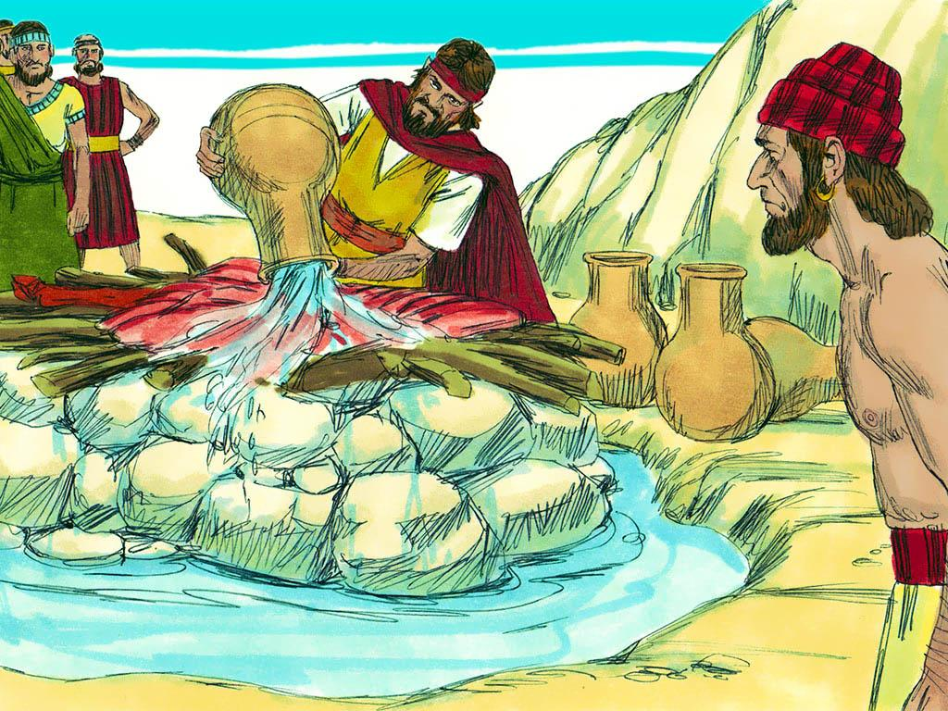
Notes:
10. Next, it was Elijah’s turn. He built an altar to God. He used twelve stones to make it and then he placed the sacrifice on the altar. Then, Elijah did something very unusual! He dug a ditch around the altar he made. He asked for four large jars of water and had them poured over the altar. Then he did it again. And then again. There was so much water that it soaked the sacrifice and all of the wood on the altar. It even ran into the ditch around the altar. How would something soaked in water ever burn? This seemed impossible!

Slide 11
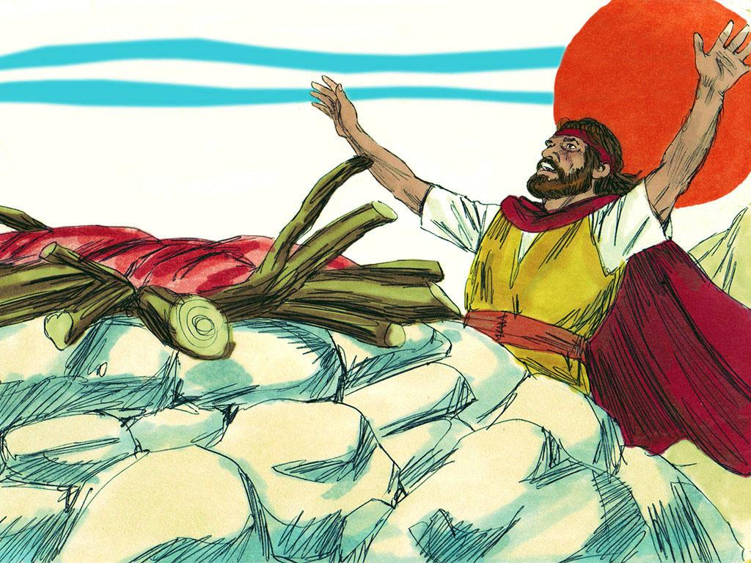
Notes:
11. Then Elijah prayed to God. “I pray to you, Lord, because you are the only God. Please show all of these people here today that you are real. Please send down fire and burn this sacrifice.”

Slide 12
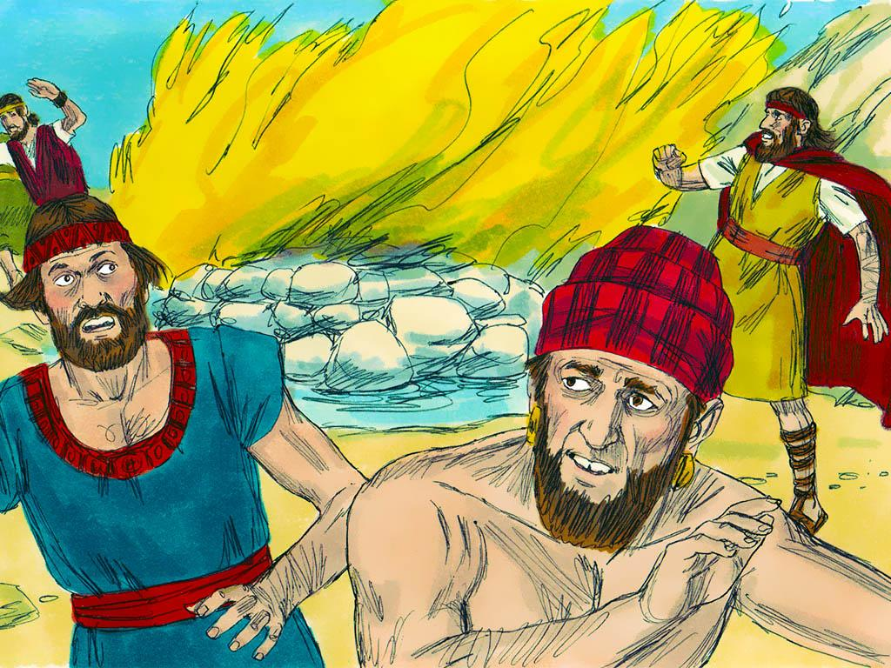
Notes:
12. Then an amazing thing happened. Fire came down out of the sky and burned the sacrifice. But the amazing things did not stop there. The fire was so powerful that it burned the wood on the altar, the stones, the dirt, and even dried up all of the water in the ditch around the altar. There was nothing left. Now everyone knew that the Lord was the only God. They bowed down and kept saying, “The Lord – he is God! The Lord – he is God!”

Slide 13
Notes:
13. The prophets of Baal tried to run away but they were caught and killed.

Slide 14
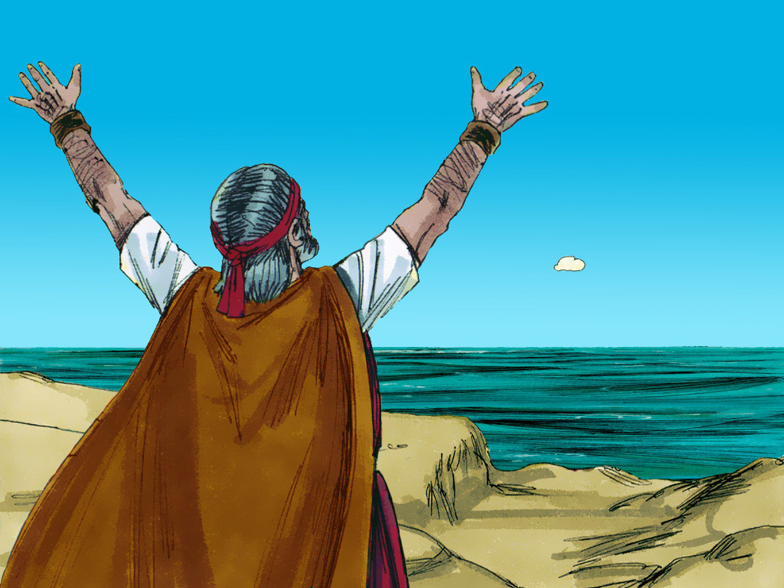
Notes:
14. Remember that there had been a draught for three years? Elijah prayed again. He knew that the Lord would end the drought and that the rain would come. His servant saw a cloud in the sky. The cloud was the size of a man’s hand. Then it got bigger and bigger and the sky became black.

Slide 15
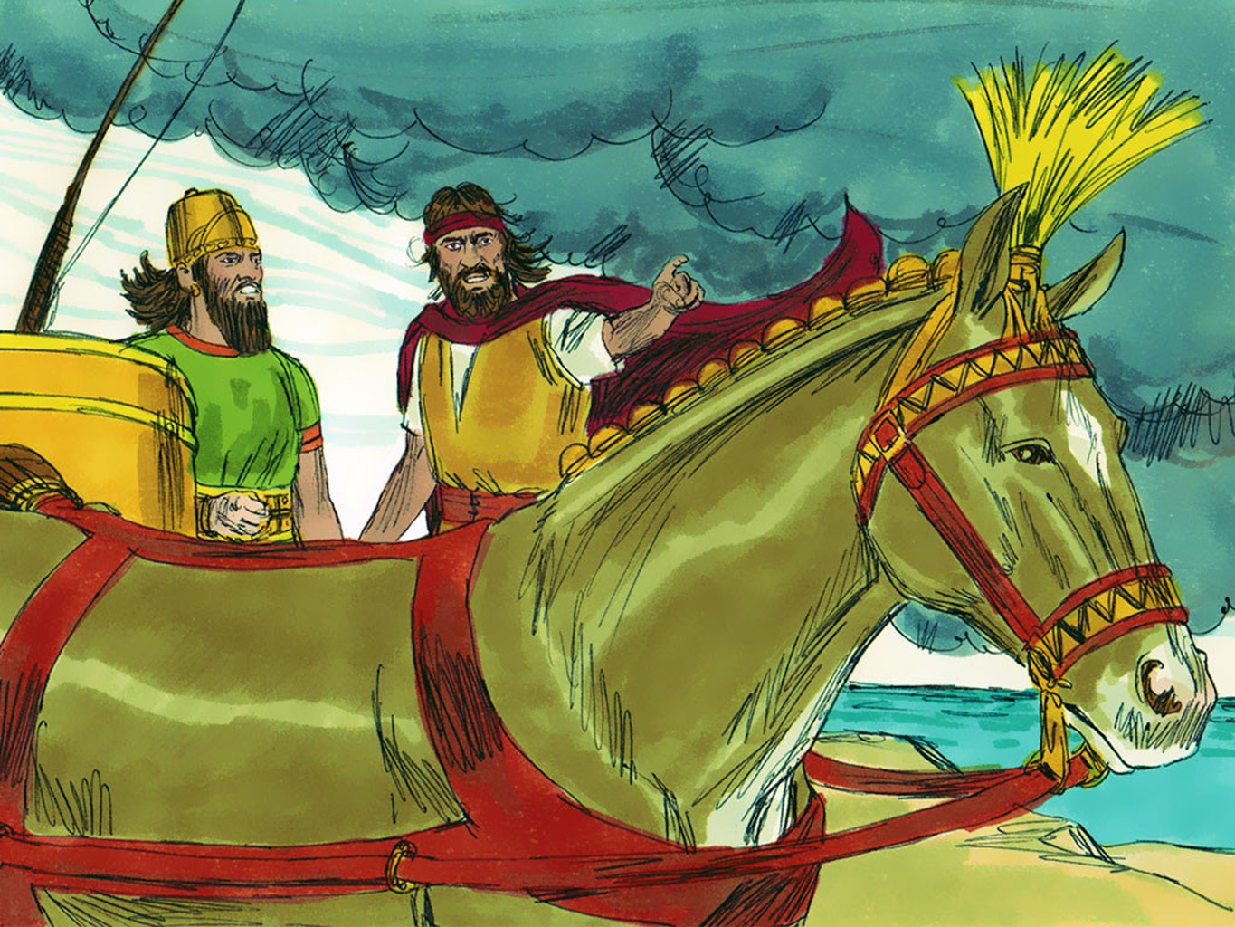
Notes:
14. Elijah told Ahab that the rain was coming. King Ahab rode his chariot and Elijah ran to beat the storm. The drought was over.
Yes, God answered Elijah’s prayer and sent the rain. On that day everyone saw that the God of Israel is the only real and true God.

Slide 16
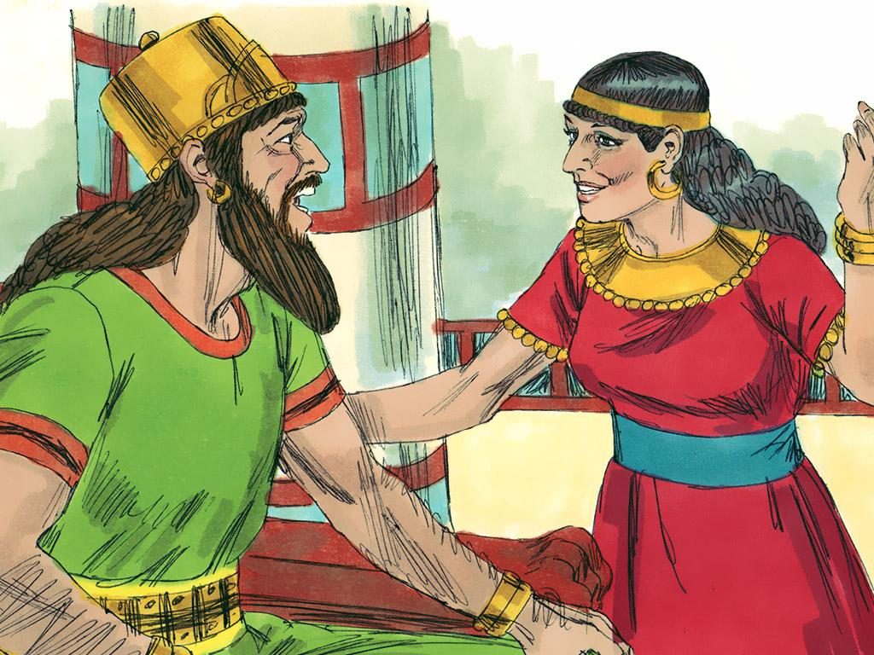
Notes:
16. After the fire and the storm do you think King Ahab learned a lesson? No, he still did not obey the real God. He would rather worship made-up gods. When King Ahab told Queen Jezebel about that she was very angry. The King and Queen hated Elijah and the prophets of God. As long as she lived Queen Jezebel kept sending soldiers to try to kill Elijah.

Slide 17
Teacher Notes- Page 1
1. Cover: Elijah and the Contest at Mount Carmel (God uses Elijah to show that He is the true God and that the false god, Baal, has no power.) 1 Kings 18
2. Elijah was a prophet. A prophet is someone who gives special messages. Elijah was a prophet of God. He gave special messages from God to all of the people.
3. King Ahab and Queen Jezebel did not like the messages that Elijah gave them. He told them that they were bad and that they were wrong to worship other gods besides the Lord. He told them that God would take away the rain so that they would learn that he was God. Ahab and Jezebel were so angry that they tried to kill Elijah and all of the other prophets.
4. The Lord hid Elijah and kept him safe… Now, after three years of no rain, the Lord decided it was time for Elijah to talk to the King again. He told Elijah to find King Ahab and give him a message. Even though he was warned that the King would try to kill him, Elijah knew that he must obey the Lord. God had taken care of him before. God would take care of him now!
5. Elijah met Ahab. Ahab was very angry with Elijah, “You are a trouble-maker Elijah. You caused the rain to go away. It is your fault that we have had a drought.”
“No, King Ahab,” said Elijah. “You caused the drought. It was because you stopped worshipping the Lord. The Lord knows that you and your wife, Jezebel, worship false gods. You make idols and bow down before them. You think that there are other gods named Baal and Asherah. You even believe the men who say that they are prophets of these false gods. But you are wrong!
There is only one God. He is the Lord God! He is the only real God. All of the others are just made up. Gather all of the people and all of the prophets of Baal and Asherah together at Mount Carmel. We will have a contest to see whose god is real!”
6. King Ahab did as Elijah said. People from all over Israel came to watch the contest. It didn’t really seem like a fair contest. Elijah was the only prophet of God there. There were 450 prophets of the false god, Baal, and also 400 prophets of the false god, Asherah.
7. Elijah spoke to all of the people, “Everyone needs to make a decision today. If Baal is real then you need to worship him. If the Lord God is real, then you need to worship Him!”
Elijah suggested that they should have a contest to prove who the real God was. The prophets of Baal could build an altar and Elijah could build an altar. Each could place an animal sacrifice on their altar and then pray to their God to light a fire for the sacrifice. The God who could send a fire for the sacrifice was the true God.

Slide 18
Teacher Notes- Page 2
8. The prophets of Baal agreed to the contest. They made their altar and then they prayed and cried out to Baal. But nothing happened to the sacrifice on the altar. They cried even louder and harder. But still there was no answer.
The prophets of Baal tried everything. They even cut themselves and acted wild but still there was no answer from Baal.
9. “Maybe Baal is asleep or maybe he is busy,” said Elijah. Elijah knew that Baal would never cause fire to come down because Baal was not real. Baal was just a god that someone made up.
10. Next, it was Elijah’s turn. He built an altar to God. He used twelve stones to make it and then he placed the sacrifice on the altar. Then, Elijah did something very unusual! He dug a ditch around the altar he made. He asked for four large jars of water and had them poured over the altar. Then he did it again. And then again. There was so much water that it soaked the sacrifice and all of the wood on the altar. It even ran into the ditch around the altar. How would something soaked in water ever burn? This seemed impossible!
11. Then Elijah prayed to God. “I pray to you, Lord, because you are the only God. Please show all of these people here today that you are real. Please send down fire and burn this sacrifice.”
12. Then an amazing thing happened. Fire came down out of the sky and burned the sacrifice. But the amazing things did not stop there. The fire was so powerful that it burned the wood on the altar, the stones, the dirt, and even dried up all of the water in the ditch around the altar. There was nothing left.
Now everyone knew that the Lord was the only God. They bowed down and kept saying, “The Lord – he is God! The Lord – he is God!”
13. The prophets of Baal tried to run away but they were caught and killed.
14. Remember that there had been a draught for three years? Elijah prayed again. He knew that the Lord would end the drought and that the rain would come. His servant saw a cloud in the sky. The cloud was the size of a man’s hand. Then it got bigger and bigger and the sky became black.
15. Elijah told Ahab that the rain was coming. King Ahab rode his chariot and Elijah ran to beat the storm. The drought was over.
16. After the fire and the storm do you think King Ahab learned a lesson? No, he still did not obey the real God. He would rather worship made-up gods. When King Ahab told Queen Jezebel about that she was very angry. The King and Queen hated Elijah and the prophets of God. As long as she lived Queen Jezebel kept sending soldiers to try to kill Elijah.

Slide 19


Attributions: This visual aid was constructed by Mary Nelson www.missionbibleclass.org using:
Text and slideshow compilation by Mary Nelson
All other illustrations by Sweet Publishing http://sweetpublishing.com/
As accessed through www.freebibleimages.org
Notice of Alteration: Text added to cover slide. Slide 2 is a cropped image.
Attribution-ShareAlike 3.0 Unported (CC BY-SA 3.0) https://creativecommons.org/licenses/by-sa/3.0/
User may reproduce it without permissions.
DOWNLOAD THIS SLIDESHOW FROM www.missionbibleclass.org
Please visit www.missionbibleclass.org to find this and many other free resources to help you
teach the Bible to children.

