Slide 1
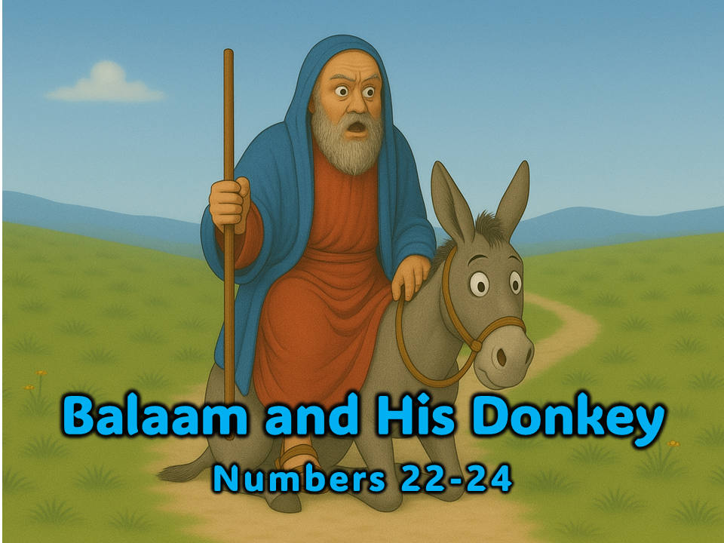
Notes:
1. Cover: Balaam and His Donkey (Numbers 22-24)

Slide 2

missionbibleclass.org Balaam and His Donkey
Notes:
2. The children of Israel were a mighty nation. As they wandered through the wilderness and the desert, many other nations came to fear them. They fought and won many battles. They captured cities and conquered the enemies of God who attacked them. One of the nations that wanted to hurt Israel was known as Moab. When the Moabites saw the great number of people and heard of their victories, they became very worried. The Moabite King was named Balak. He decided to do something about the Israelites.

Slide 3
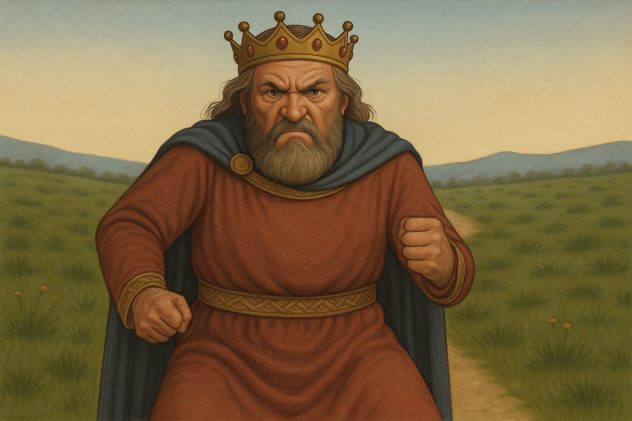
missionbibleclass.org Balaam and His Donkey
Notes:
3. In those days, people believed in magic, evil spirits, and curses. King Balak believed in these things. He knew of a sorcerer named Balaam who cursed people. That meant that he would say bad things and wish for bad things to happen to them. Many people believed that terrible things happened when Balaam cursed anyone.

Slide 4
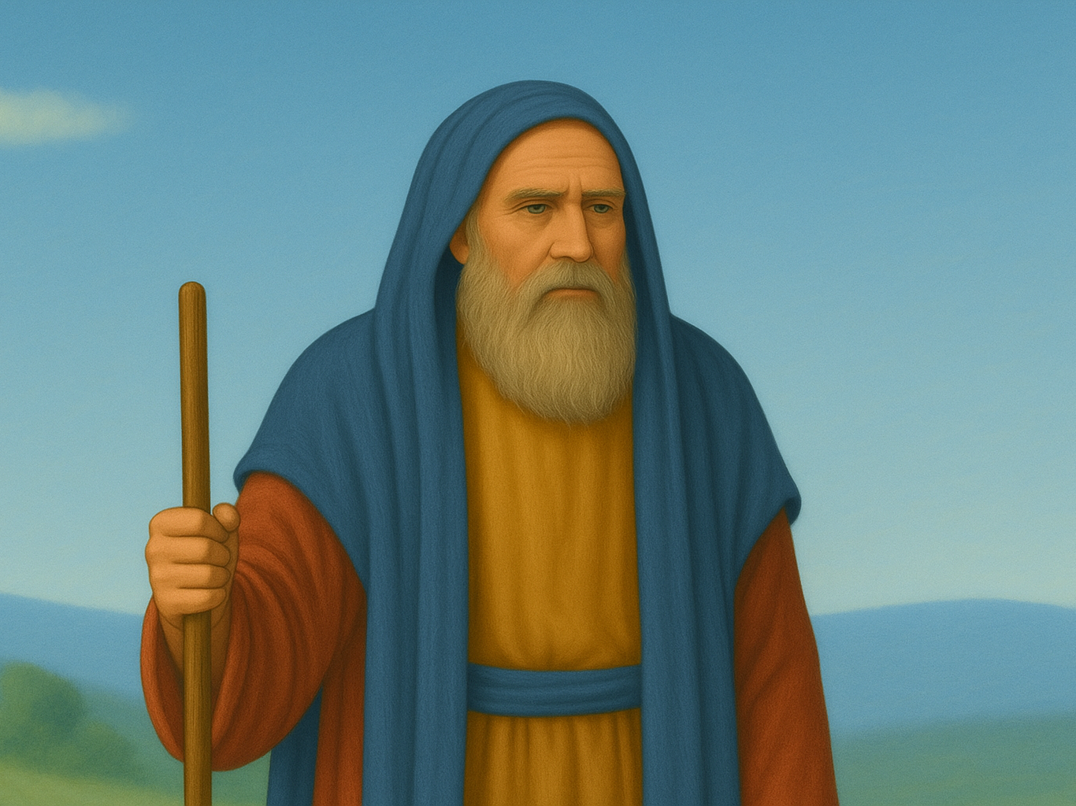
missionbibleclass.org Balaam and His Donkey
Notes:
4. King Balak sent men to ask Balaam to curse God’s people. The king’s men offered Balaam lots of money to come to the Israelite camp and curse them. Balaam wanted the money, so he told the king’s men he would ask the Lord.
Balaam probably did not believe in the Lord, but he wanted the men to believe that his curses worked.

Slide 5
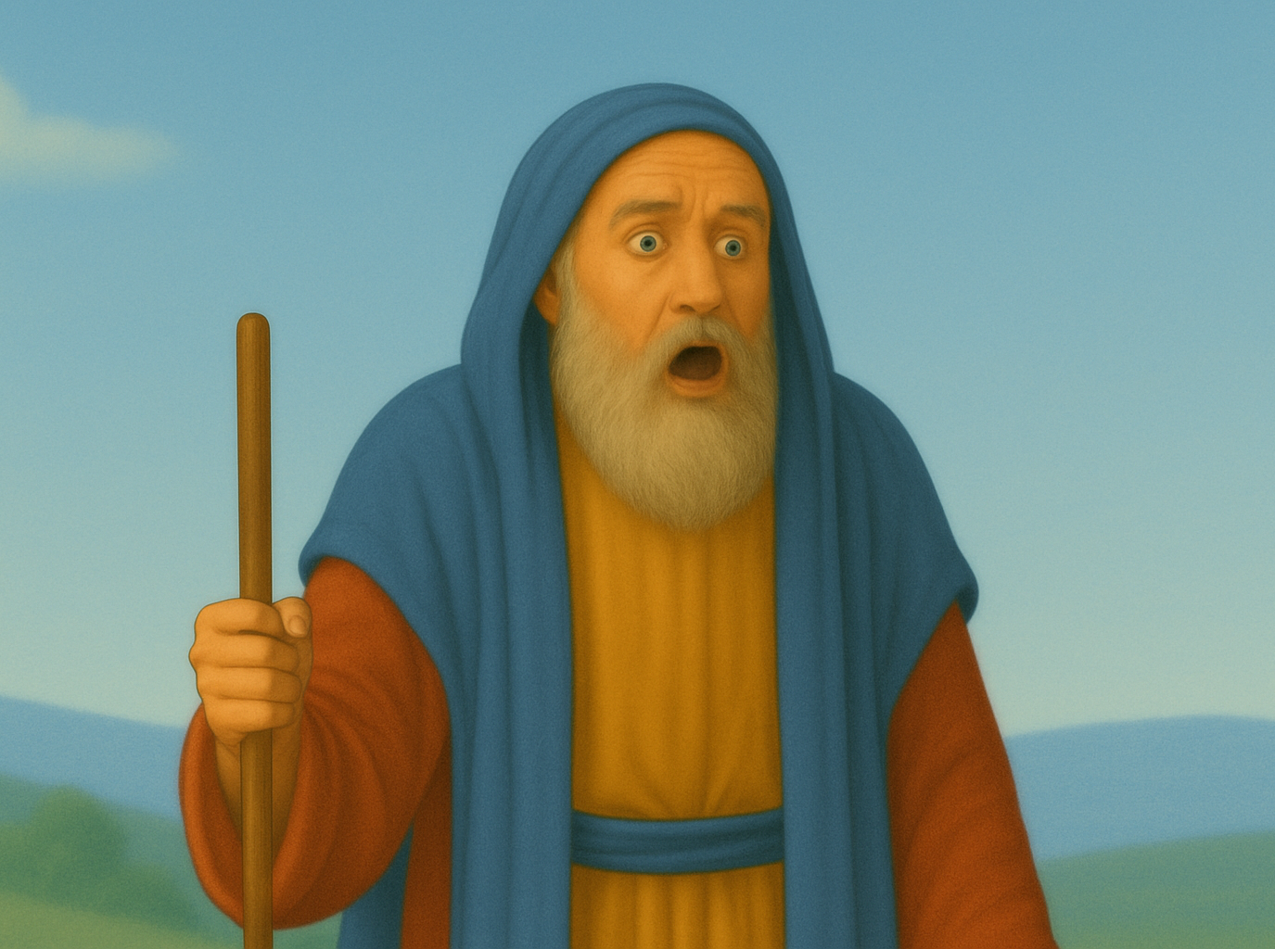
missionbibleclass.org Balaam and His Donkey
Notes:
5. Balaam must have been very surprised when the Lord did answer him! The Lord told Balaam not to take the money from King Balak. He did not want Balaam ever to say bad things about the Israelites. Balaam did not take the money or go with the king’s men.
When the king heard about this, he told the men to return to Balaam and offer him even more money. This time, the Lord told Balaam to go with the men.
The king’s men thought Balaam would curse the Israelites, but God had a special plan for Balaam. He wanted to show Balaam that the Lord is more awesome than magic or the evil spirits that Balaam said he believed in.

Slide 6
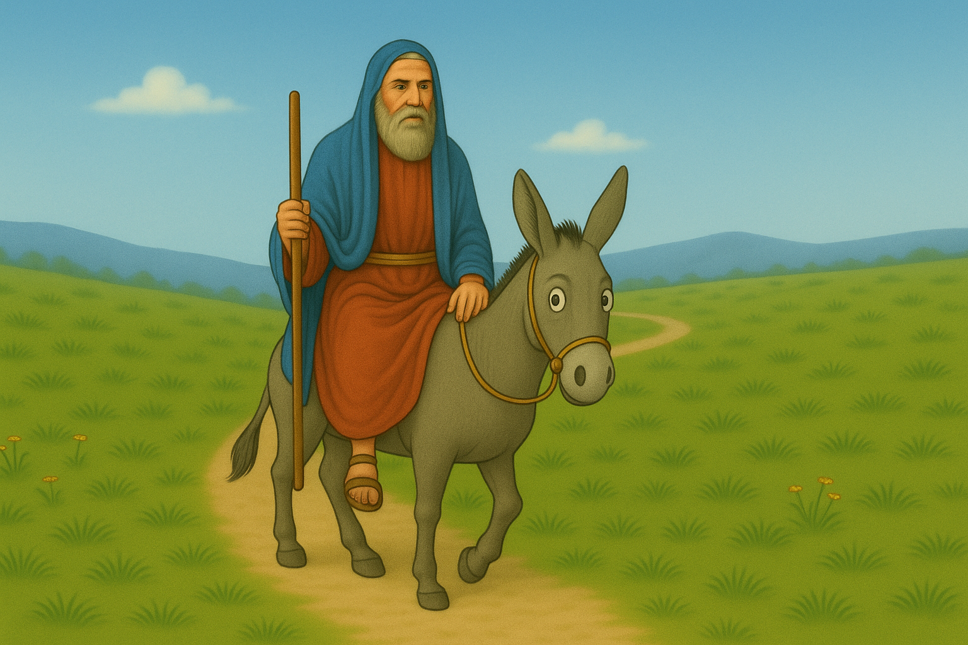
missionbibleclass.org Balaam and His Donkey
Notes:
6. Balaam saddled his donkey and began riding toward the Israelite camp. As Balaam and his donkey were travelling along, an angel stood in front of the donkey. Balaam could not see the angel, but the donkey could. The donkey walked off the path to avoid running into the angel. Balaam became angry, so he beat the donkey with a stick.

Slide 7
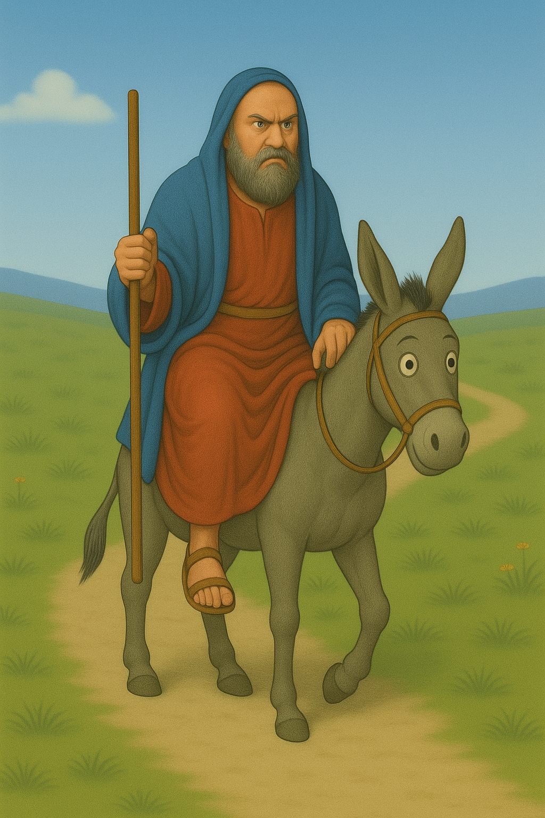
missionbibleclass.org Balaam and His Donkey
Notes:
7. After that, Balaam got back on his donkey and started riding again. Balaam’s donkey saw the angel again, but Balaam still could not see it. The angel had a sword in his hand, and the donkey pressed against a wall to escape. Balaam’s foot got caught against the wall and was crushed. He was even angrier at the donkey, so he beat her again.

Slide 8
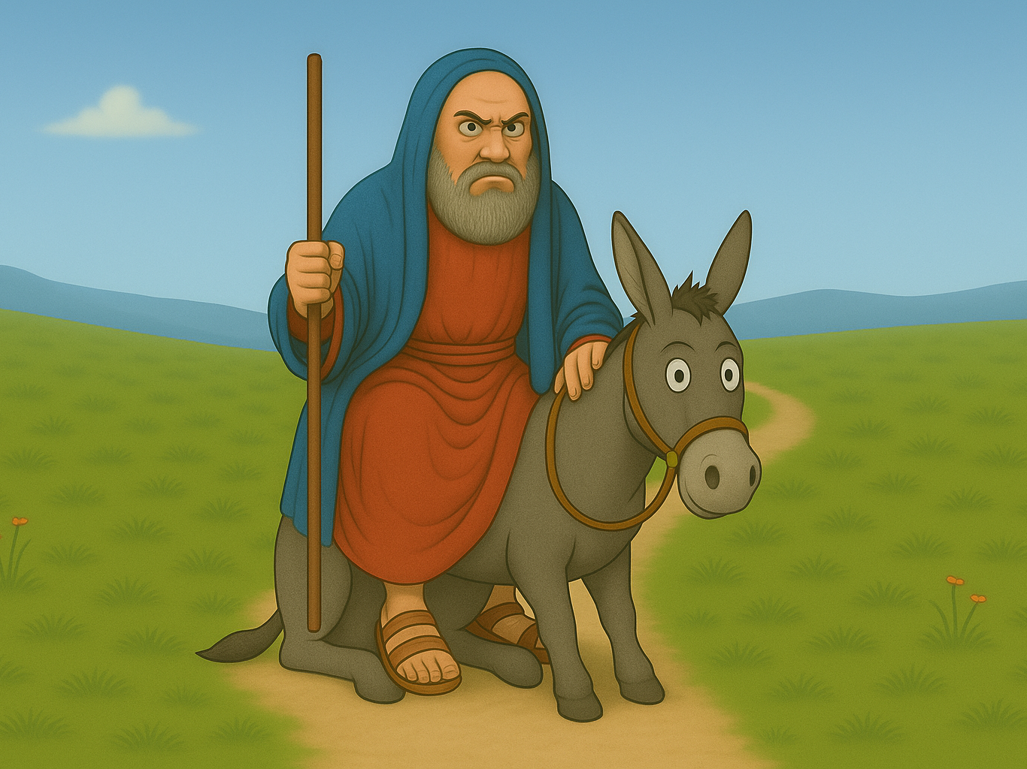
missionbibleclass.org Balaam and His Donkey
Notes:
8. Then Balaam got back on his donkey and rode on until they reached a narrow place in the road. The angel appeared to the donkey again. This time, there was no room to go anywhere, so the donkey just sat down in the middle of the path.

Slide 9
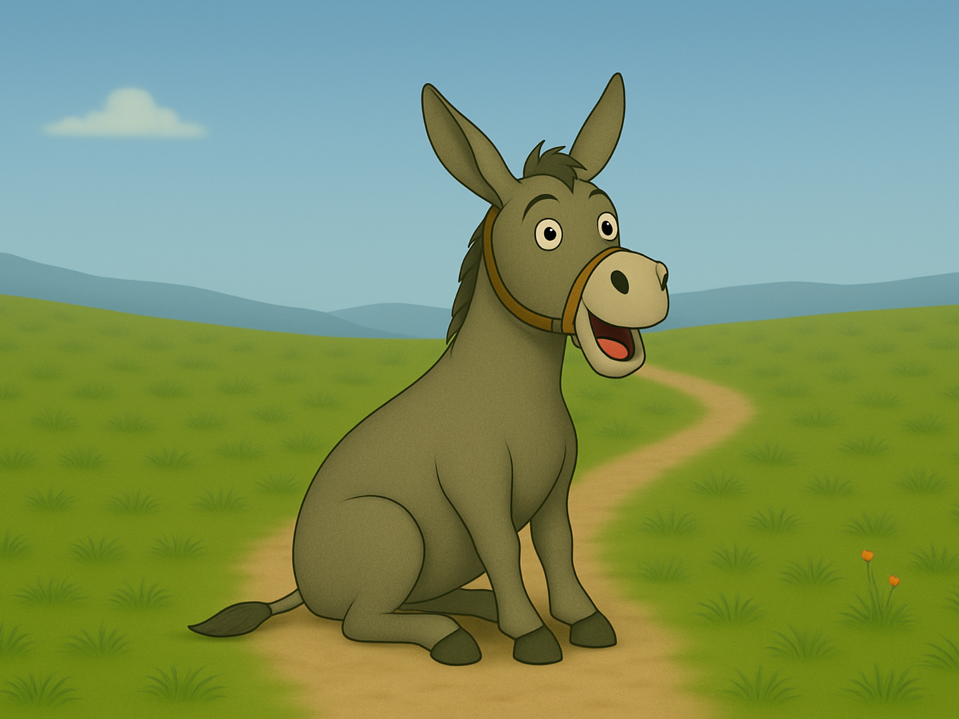
missionbibleclass.org Balaam and His Donkey
Notes:
9. Balaam could not believe it! What was wrong with his donkey? He was just about to hit the donkey again when an amazing thing happened. His donkey began to talk to him!
“What have I done to make you beat me three times?”

Slide 10
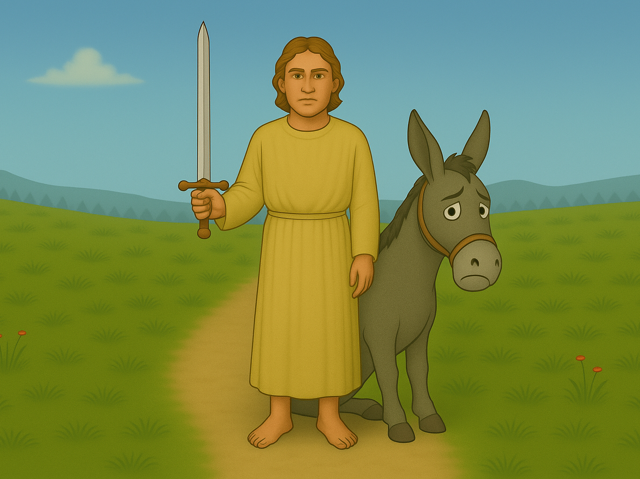
missionbibleclass.org Balaam and His Donkey
Notes:
10. The angel appeared to Balaam, too, and said, “Why do you keep beating your donkey? If your donkey had not stopped, I would have killed you by now.”
Only God could make a donkey talk, and an angel appeared! Balaam realized that the Lord was angry with him. Now, he would do exactly what the Lord said to do.

Slide 11
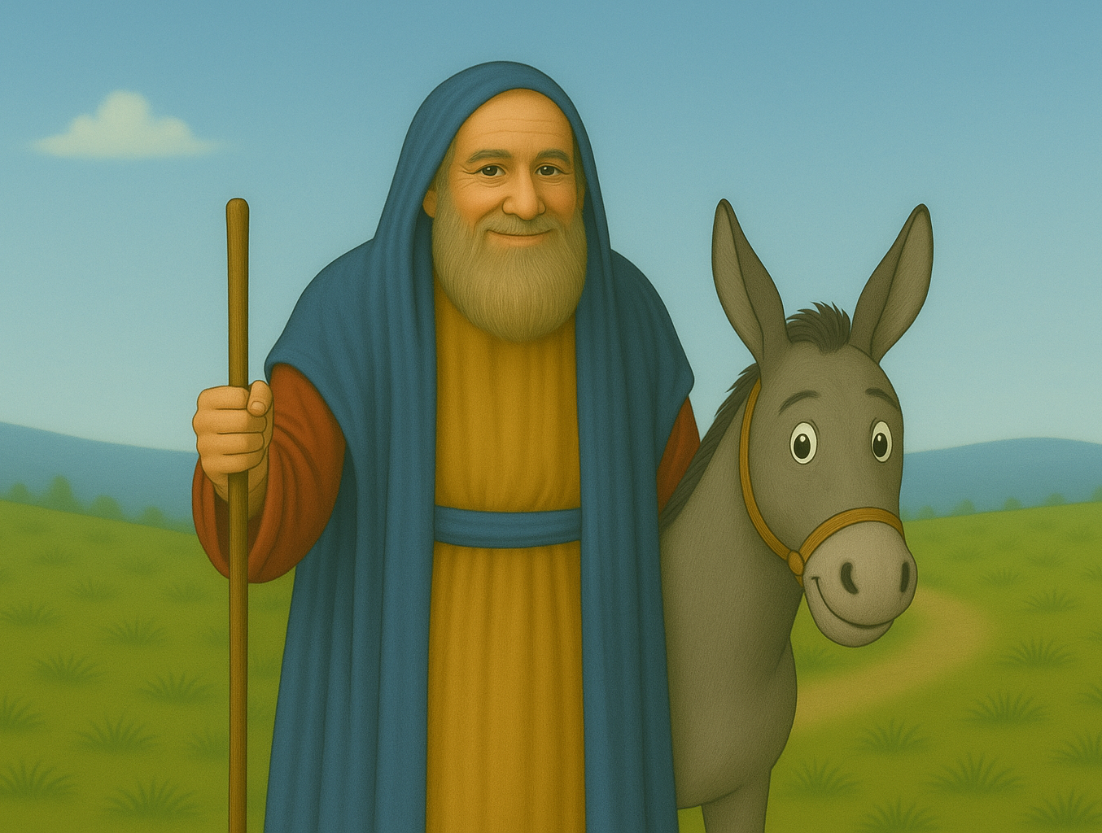
missionbibleclass.org Balaam and His Donkey
Notes:
11. Balaam did not curse the Israelites when he met King Balak at the Israelite camp. He only said good things about them. He blessed them and talked about how good the Lord was. He did not say one bad thing. He even had altars built so he could worship the Lord. King Balak was angry. This is not what he had planned at all! He wanted Balaam to say bad things but only good things.
King Balak was unhappy, but the Lord was pleased. He loved His people and wanted everyone to say good things about them.

Slide 12
Teacher Notes 1
1. Cover: Balaam and His Donkey (Numbers 22-24)
2. The children of Israel were a mighty nation. As they wandered through the wilderness and the desert, many other nations came to fear them. They fought and won many battles. They captured cities and conquered the enemies of God who attacked them. One of the nations that wanted to hurt Israel was known as Moab. When the Moabites saw the great number of people and heard of their victories, they became very worried. The Moabite King was named Balak. He decided to do something about the Israelites.
3. In those days, people believed in magic, evil spirits, and curses. King Balak believed in these things. He knew of a sorcerer named Balaam who cursed people. That meant that he would say bad things and wish for bad things to happen to them. Many people believed that terrible things happened when Balaam cursed anyone.
4. King Balak sent men to ask Balaam to curse God’s people. The king’s men offered Balaam lots of money to come to the Israelite camp and curse them. Balaam wanted the money, so he told the king’s men he would ask the Lord.
Balaam probably did not believe in the Lord, but he wanted the men to believe that his curses worked.
5. Balaam must have been very surprised when the Lord did answer him! The Lord told Balaam not to take the money from King Balak. He did not want Balaam ever to say bad things about the Israelites. Balaam did not take the money or go with the king’s men.
When the king heard about this, he told the men to return to Balaam and offer him even more money. This time, the Lord told Balaam to go with the men.
The king’s men thought Balaam would curse the Israelites, but God had a special plan for Balaam. He wanted to show Balaam that the Lord is more awesome than magic or the evil spirits that Balaam said he believed in.
6. Balaam saddled his donkey and began riding toward the Israelite camp. As Balaam and his donkey were travelling along, an angel stood in front of the donkey. Balaam could not see the angel, but the donkey could. The donkey walked off the path to avoid running into the angel. Balaam became angry, so he beat the donkey with a stick.
7. After that, Balaam got back on his donkey and started riding again. Balaam’s donkey saw the angel again, but Balaam still could not see it. The angel had a sword in his hand, and the donkey pressed against a wall to escape. Balaam’s foot got caught against the wall and was crushed. He was even angrier at the donkey, so he beat her again.
missionbibleclass.org Balaam and His Donkey

Slide 13
Teacher Notes 2
8. Then Balaam got back on his donkey and rode on until they reached a narrow place in the road. The angel appeared to the donkey again. This time, there was no room to go anywhere, so the donkey just sat down in the middle of the path.
9. Balaam could not believe it! What was wrong with his donkey? He was just about to hit the donkey again when an amazing thing happened. His donkey began to talk to him!
“What have I done to make you beat me three times?”
10. The angel appeared to Balaam, too, and said, “Why do you keep beating your donkey? If your donkey had not stopped, I would have killed you by now.”
Only God could make a donkey talk, and an angel appeared! Balaam realized that the Lord was angry with him. Now, he would do exactly what the Lord said to do.
11. Balaam did not curse the Israelites when he met King Balak at the Israelite camp. He only said good things about them. He blessed them and talked about how good the Lord was. He did not say one bad thing. He even had altars built so he could worship the Lord. King Balak was angry. This is not what he had planned at all! He wanted Balaam to say bad things but only good things.
King Balak was unhappy, but the Lord was pleased. He loved His people and wanted everyone to say good things about them.
missionbibleclass.org Balaam and His Donkey

Slide 14


This visual aid was constructed by Mary Nelson www.missionbibleclass.org using Ai, ChatGPT, May 2025. Text and slideshow compilation by Mary Nelson
Attribution-ShareAlike 3.0 Unported (CC BY-SA 3.0) https://creativecommons.org/licenses/by-sa/3.0/
User may reproduce it without permissions.
DOWNLOAD THIS SLIDESHOW FROM www.missionbibleclass.org
Please visit www.missionbibleclass.org to find this and many other free resources to help you teach the Bible to children.

