Slide 1
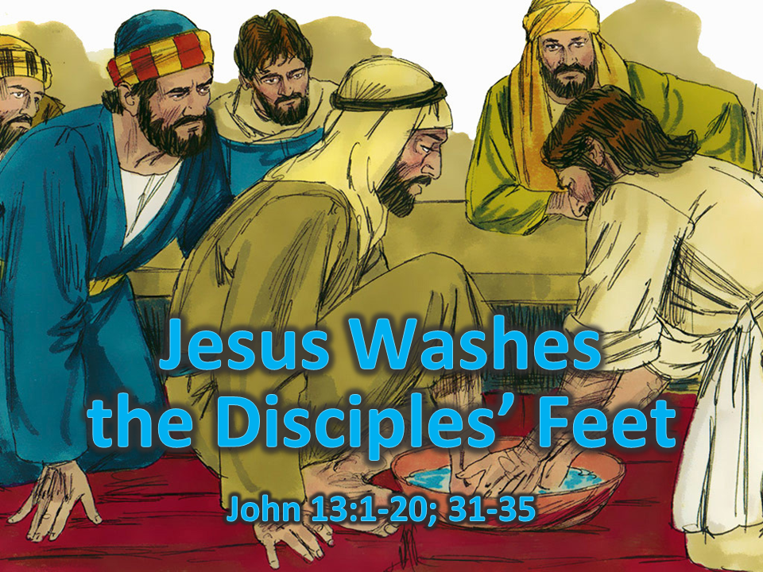
x
Notes:
1. Cover: Jesus Washes the Disciples’ Feet (John 13:1-20, 31-35)

Slide 2
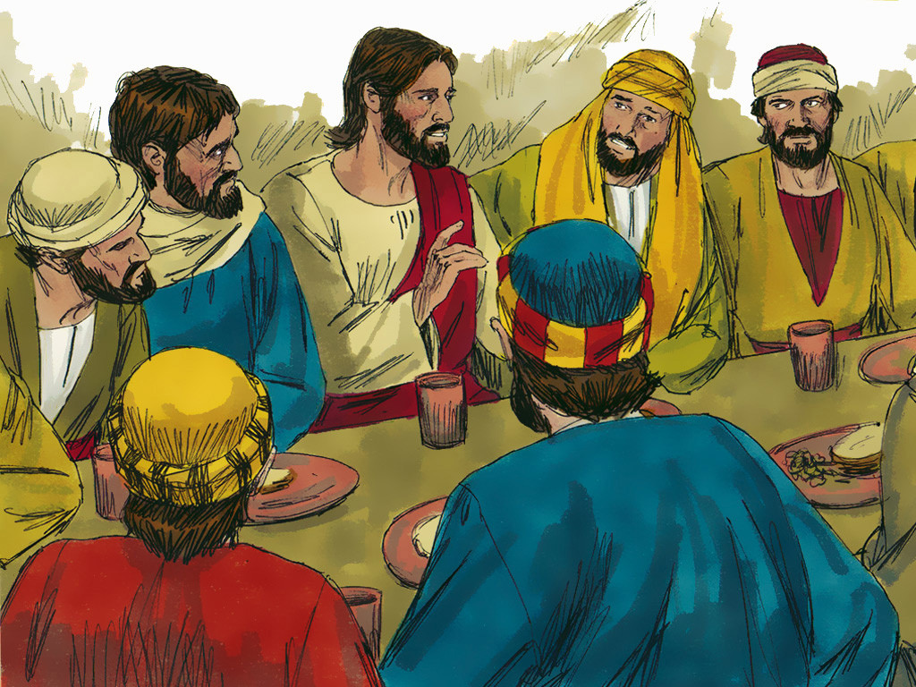
Notes:
2. Jesus had been teaching people but knew it was almost time to leave the earth. He gathered His closest followers to share a meal together.

Slide 3
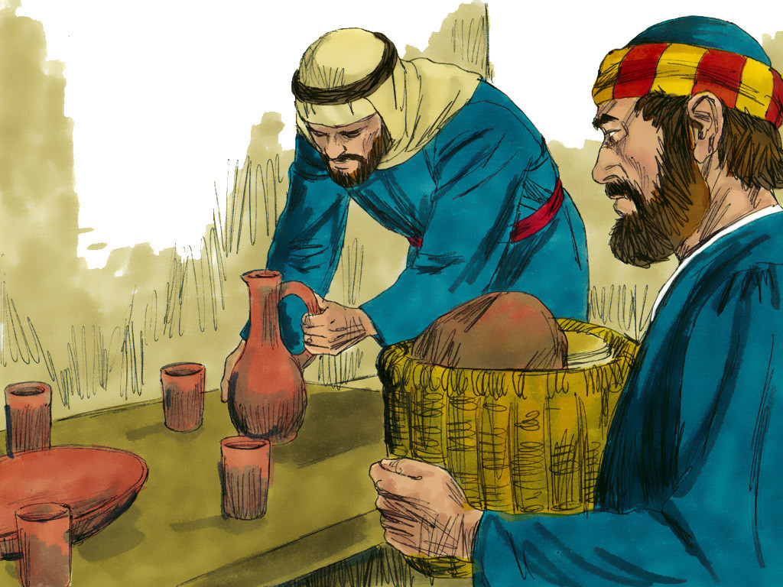
Notes:
3. Like we do today, the food was gathered, and the dishes were laid out. It was time to eat, but there was a problem.
The dishes were clean, and the cups were clean. The problem was that there was still something that was not clean. In those times, there was something else that should be cleaned before anyone else began to eat. Can you guess what else needed to be cleaned?
What do you think it was?

Slide 4
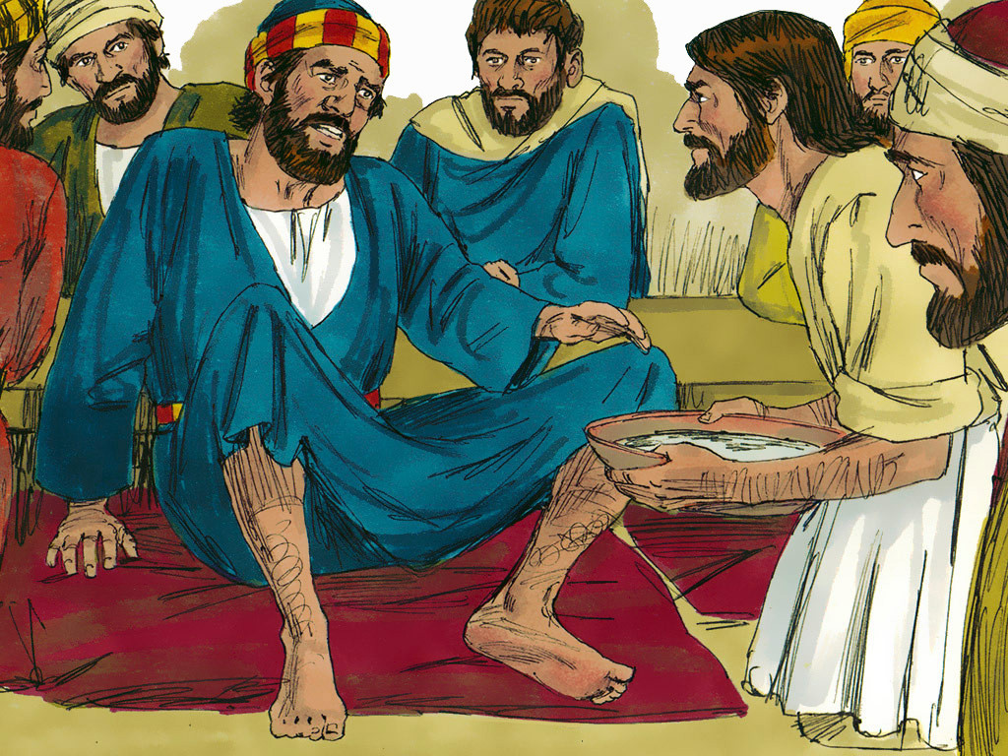
Notes:
4. If you guessed “feet”, then you are correct. In those days, washing your feet before the meal began was very important.
People wore sandals and walked in the very dirty streets at that time. Sometimes, animals used the street as a toilet, and sometimes, people threw their rubbish out into the street.
Jesus and His disciples would have been very close to each other during the meal, so this was a problem.
The disciples must have thought, “It is a servant’s job to wash our feet. We need our feet washed. Where is the servant?

Slide 5
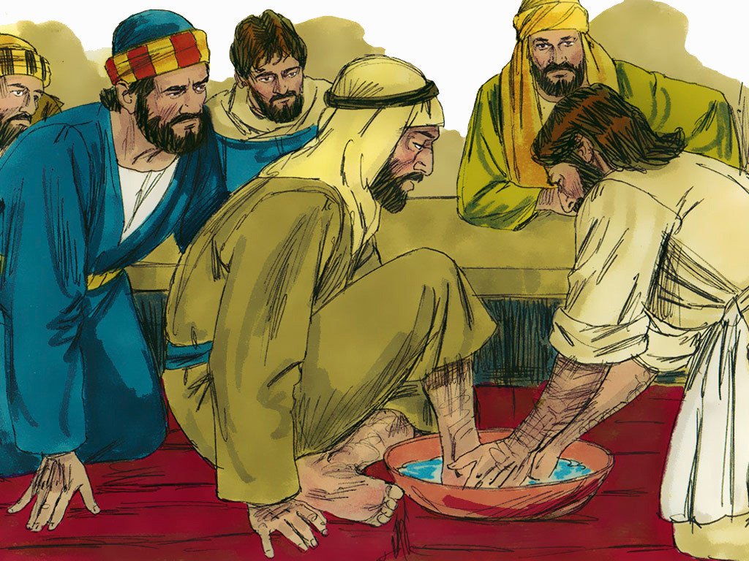
Notes:
5. But then something happened that they never expected. Jesus stood up and took off His outside clothes. He got a towel and a bowl of water and then bent down in front of each of the disciples to wash their feet.
Everyone was in shock! Jesus was their teacher! He was too important to do this job. This was a job for servants and not teachers!

Slide 6
Notes:
6. When Jesus came to Peter, Peter was shocked. “Stop, I will never allow you to wash my feet!”

Slide 7
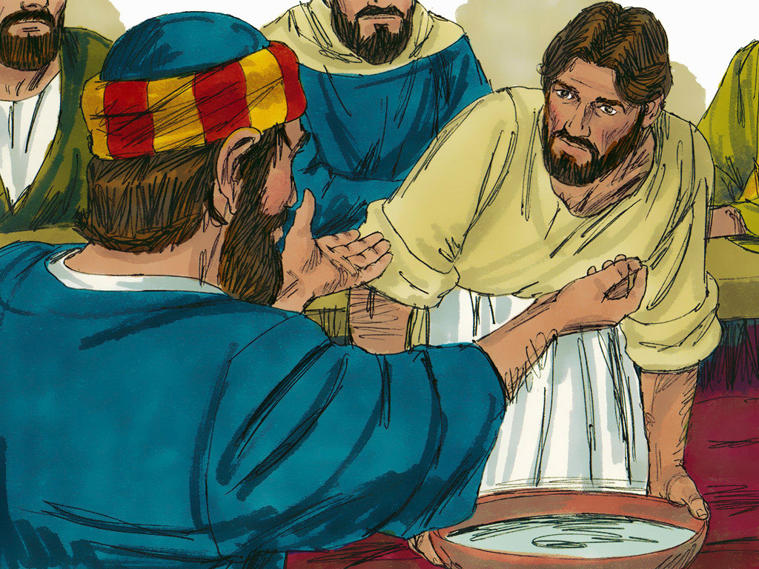
Notes:
7. But Jesus told Peter that it was all right. Jesus wanted Peter to know that good teachers and leaders love their friends and take care of them. They don’t have to act better than everyone else. Jesus was the teacher, but He was willing to be like a servant and show love to others.
Jesus told Peter that He wanted to show love to His people in this way. “Peter,” Jesus said, “if you do not let me wash your feet then you are not one of my people”.
Of course, Peter wanted to be one of Jesus’ people. He wanted this so much that he said, “If you want to, then you can wash my feet and my hands and even my head!”

Slide 8
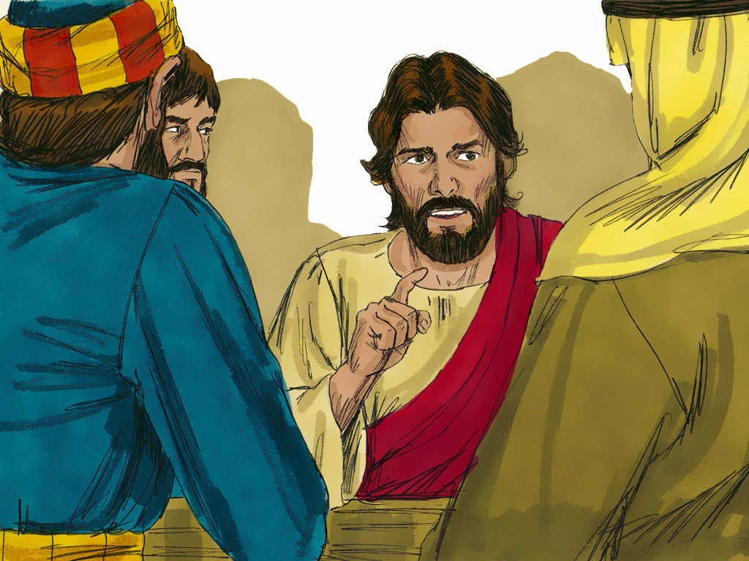
Notes:
8. Jesus taught His disciples many other things after this. He knew He would die on the cross, so He told them that He would have to go away. Jesus wanted His disciples always to remember that they should love one another. They should not act proud and try to be bossy. They should be like servants and help one another. If Jesus could do this, then so could they.

Slide 9
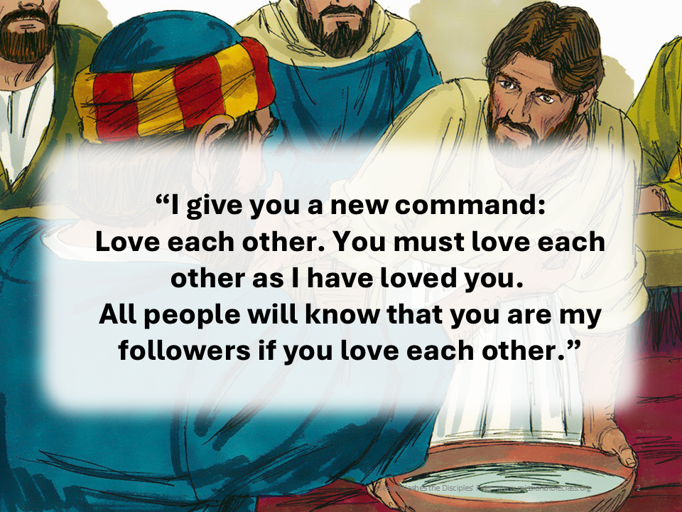
Notes:
9. We can read Jesus’ words in our Bibles. Jesus said, “I give you a new command: Love each other. You must love each other as I have loved you. All people will know that you are my followers if you love each other.”
Jesus showed love to His disciples and helped them. How can you show love to other people?

Slide 10
Teacher Notes Page 1
1. Cover: Jesus Washes the Disciples’ Feet (John 13:1-20, 31-35)
2. Jesus had been teaching people but knew it was almost time to leave the earth. He gathered His closest followers to share a meal together.
3. Like we do today, the food was gathered, and the dishes were laid out. It was time to eat, but there was a problem.
The dishes were clean, and the cups were clean. The problem was that there was still something that was not clean. In those times, there was something else that should be cleaned before anyone else began to eat. Can you guess what else needed to be cleaned?
What do you think it was?
4. If you guessed “feet”, then you are correct. In those days, washing your feet before the meal began was very important.
People wore sandals and walked in the very dirty streets at that time. Sometimes, animals used the street as a toilet, and sometimes, people threw their rubbish out into the street.
Jesus and His disciples would have been very close to each other during the meal, so this was a problem.
The disciples must have thought, “It is a servant’s job to wash our feet. We need our feet washed. Where is the servant?
5. But then something happened that they never expected. Jesus stood up and took off His outside clothes. He got a towel and a bowl of water and then bent down in front of each of the disciples to wash their feet.
Everyone was in shock! Jesus was their teacher! He was too important to do this job. This was a job for servants and not teachers!
6. When Jesus came to Peter, Peter was shocked. “Stop, I will never allow you to wash my feet!”
7. But Jesus told Peter that it was all right. Jesus wanted Peter to know that good teachers and leaders love their friends and take care of them. They don’t have to act better than everyone else. Jesus was the teacher, but He was willing to be like a servant and show love to others.
Jesus told Peter that He wanted to show love to His people in this way. “Peter,” Jesus said, “if you do not let me wash your feet then you are not one of my people”.
Of course, Peter wanted to be one of Jesus’ people. He wanted this so much that he said, “If you want to, then you can wash my feet and my hands and even my head!”

Slide 11
Teacher Notes Page 2
8. Jesus taught His disciples many other things after this. He knew He would die on the cross, so He told them that He would have to go away. Jesus wanted His disciples always to remember that they should love one another. They should not act proud and try to be bossy. They should be like servants and help one another. If Jesus could do this, then so could they.
9. We can read Jesus’ words in our Bibles. Jesus said, “I give you a new command: Love each other. You must love each other as I have loved you. All people will know that you are my followers if you love each other.”
Jesus showed love to His disciples and helped them. How can you show love to other people?

Slide 12


Attributions: This visual aid was constructed by Mary Nelson www.missionbibleclass.org using:
Text and slideshow compilation by Mary Nelson (updated 5/2025)
Illustrations by Sweet Publishing http://sweetpublishing.com/ As accessed through www.freebibleimages.org Notice of Alteration: Text added to cover slide and slide 9. Transparency used with image in slide 9.
Attribution-ShareAlike 3.0 Unported (CC BY-SA 3.0) https://creativecommons.org/licenses/by-sa/3.0/
User may reproduce it without permissions.
DOWNLOAD THIS SLIDESHOW FROM www.missionbibleclass.org
Please visit www.missionbibleclass.org to find this and many other free resources to help you teach the Bible to children.

