Slide 1
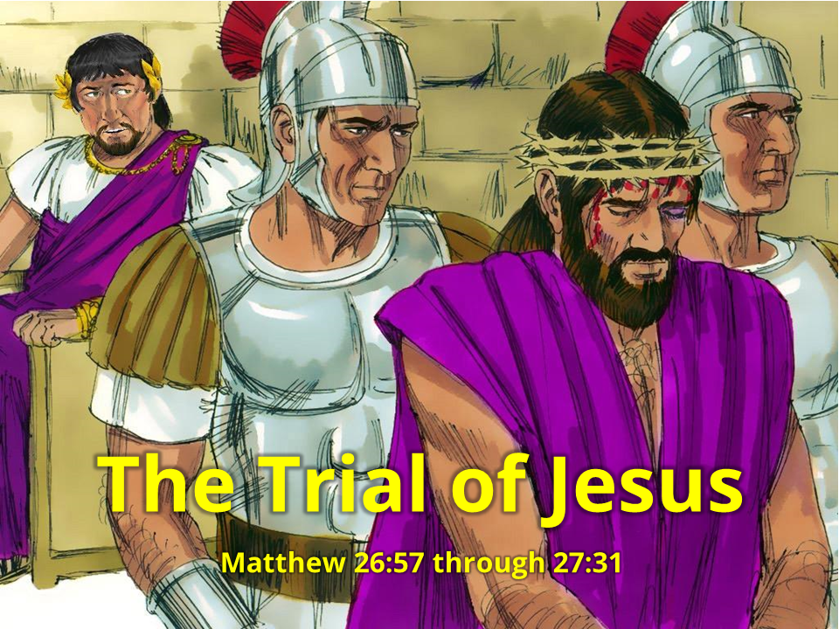
Notes:
1. Cover: The Trial of Jesus (Matthew 26:57-27:31)

Slide 2
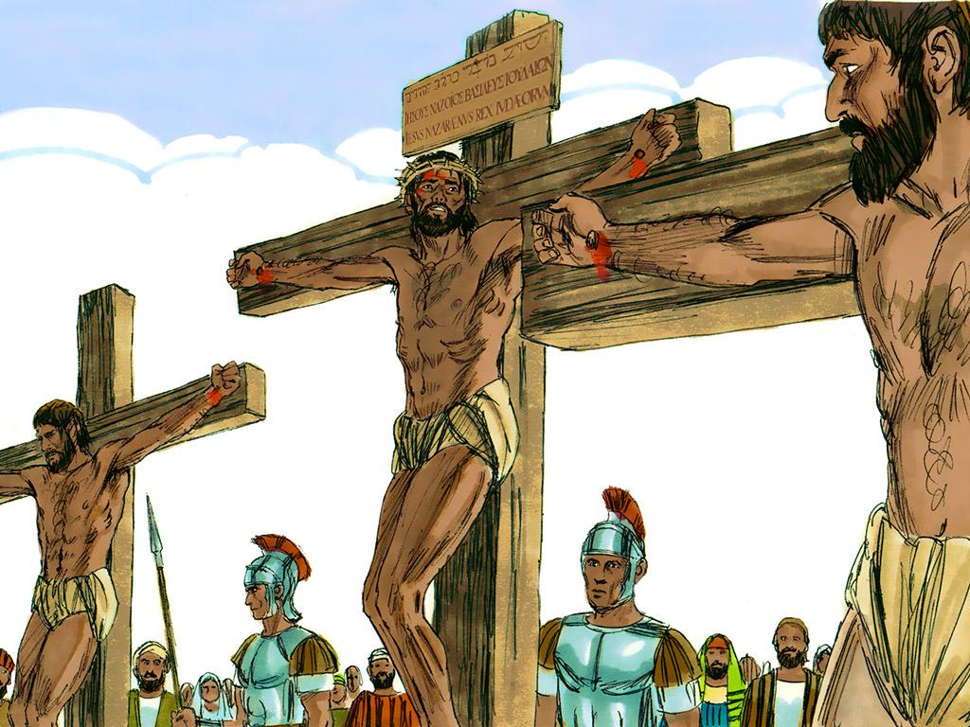
2
Notes:
2. Have you ever seen a picture of Jesus on the cross? Jesus was a good man, so who decided that He would die on the cross? How did this happen?
Today, let’s talk about how and why it was that Jesus came to die on the cross.

Slide 3
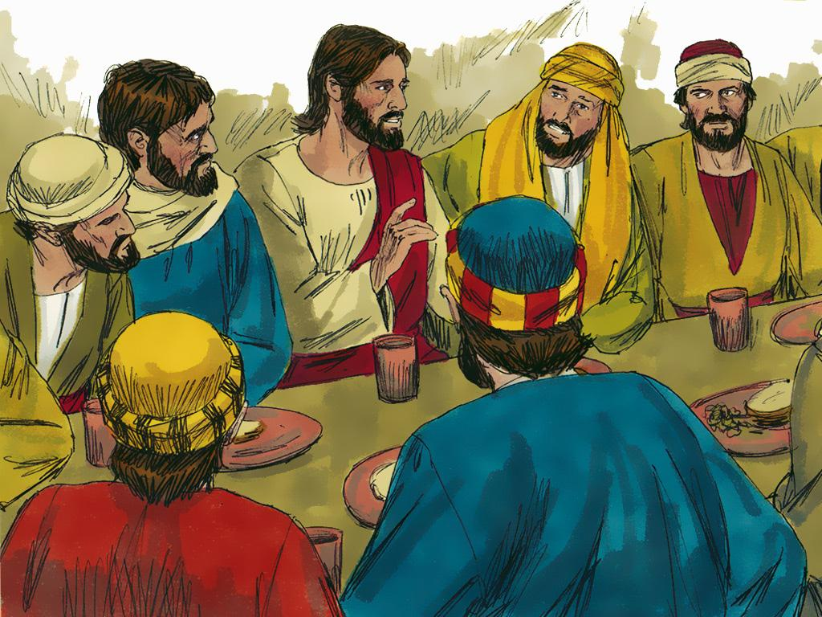
Notes:
3. Before He died on the cross, Jesus spent time with His friends and the apostles. One evening they shared a special dinner together. Since it was the last time they ate together, this meal is called the “Last Supper.”
At the supper, Jesus told His friends that He would soon die. Jesus told them that even though they were His friends even THEY would all run away when He got into trouble.
The apostles did not believe this could ever happen. Peter told Jesus that there was no way he would ever leave Jesus. Jesus told him to just wait and see. He said Peter would deny Him three times before he heard the sound of a rooster crowing. Peter just couldn’t believe this could ever happen.

Slide 4
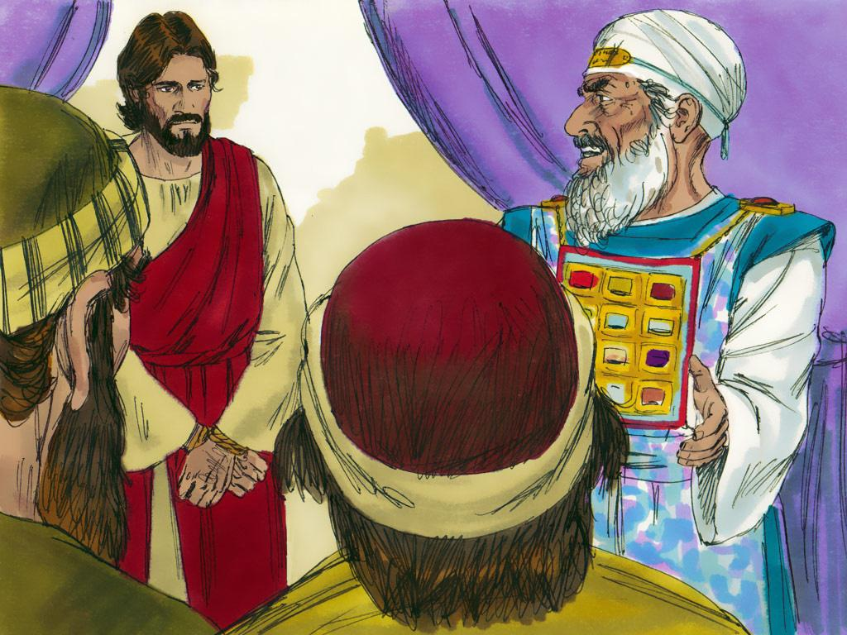
Notes:
4. Later, Jesus went to a garden to pray, and soldiers came and arrested Him. They tied Him up and took Him to the religious leaders. First to Annas and then to Caiaphas. Some people and religious leaders told lies and said Jesus had done many bad things. They did not like that Jesus said He was the king of the Jews.
The religious leaders were so angry at Jesus that they decided to take Him to the Roman Governor and tell Him to have Jesus killed.

Slide 5
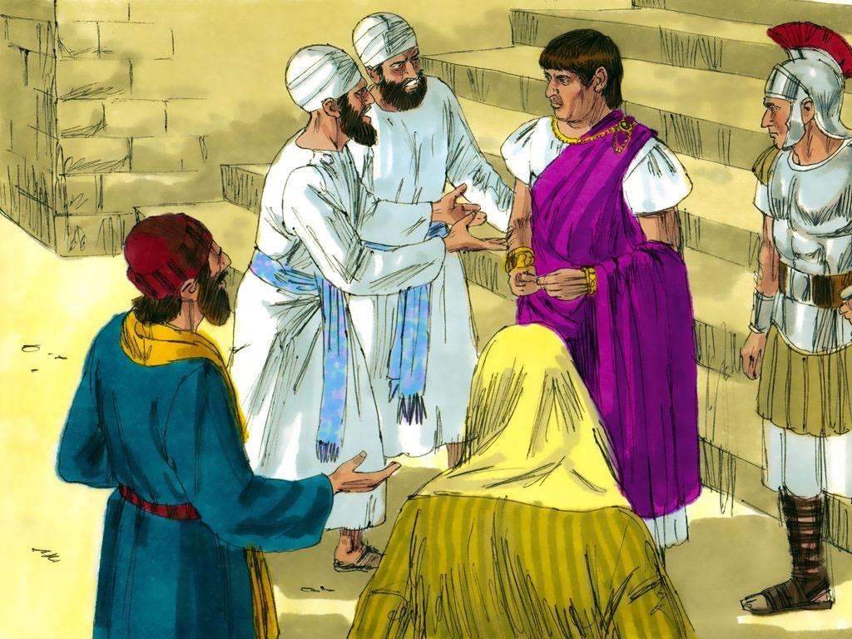
Notes:
5. The Roman Governor was called Pontius Pilate. The religious leaders said to Pilate, “We demand that Jesus be crucified!”
“Crucified?” Pilate thought, “Only the worst criminals were ever punished by being put on a cross and crucified to die.” Pilate kept asking Jesus questions about what the religious leaders were saying, but Jesus did not even try to defend Himself.
Pilate didn’t really want to crucify Jesus, so he told them to take Jesus to another governor, Herod Antipas.

Slide 6
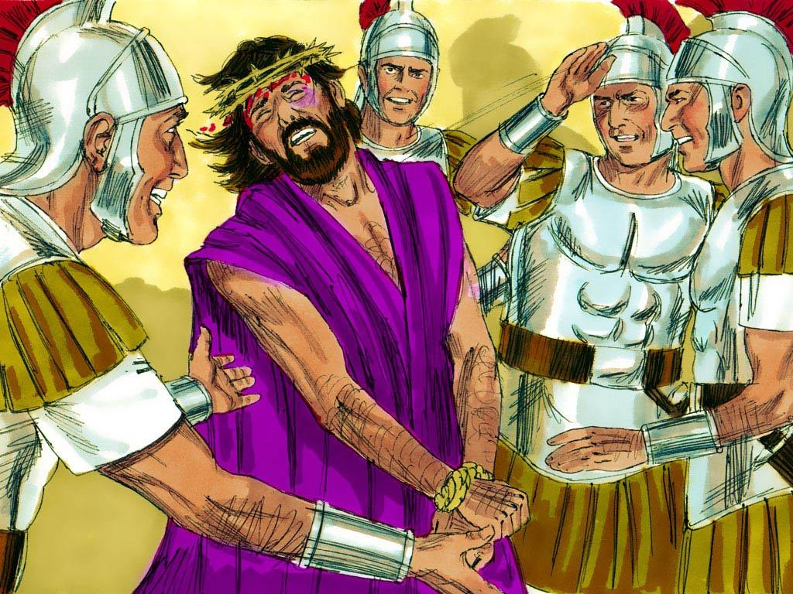
Notes:
6. Herod Antipas only made fun of Jesus. He and his soldiers made a crown from thorns and placed it on Jesus’ head. They also put a robe on Him to make fun of Him for being called the king of the Jews.

Slide 7
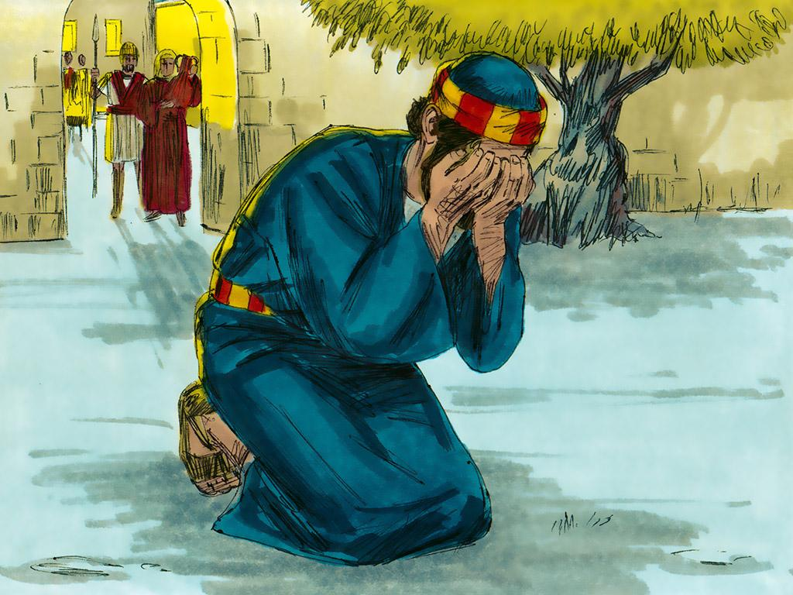
Notes:
7. While all of this was happening, where do you think Jesus’ friends were? Do you think they were trying to help Jesus?
No, they were just confused and afraid. Some people saw Peter and asked him if he knew Jesus. He was afraid that if he said he knew Jesus, then the people might hurt him just like they were hurting Jesus. So Peter denied he knew Jesus. Two other times, people noticed Peter and asked him if he knew Jesus. Each time he answered, “No.”
Finally, after the third time, guess what Peter heard? He heard a rooster crowing! It was just like Jesus said it would happen!

Slide 8
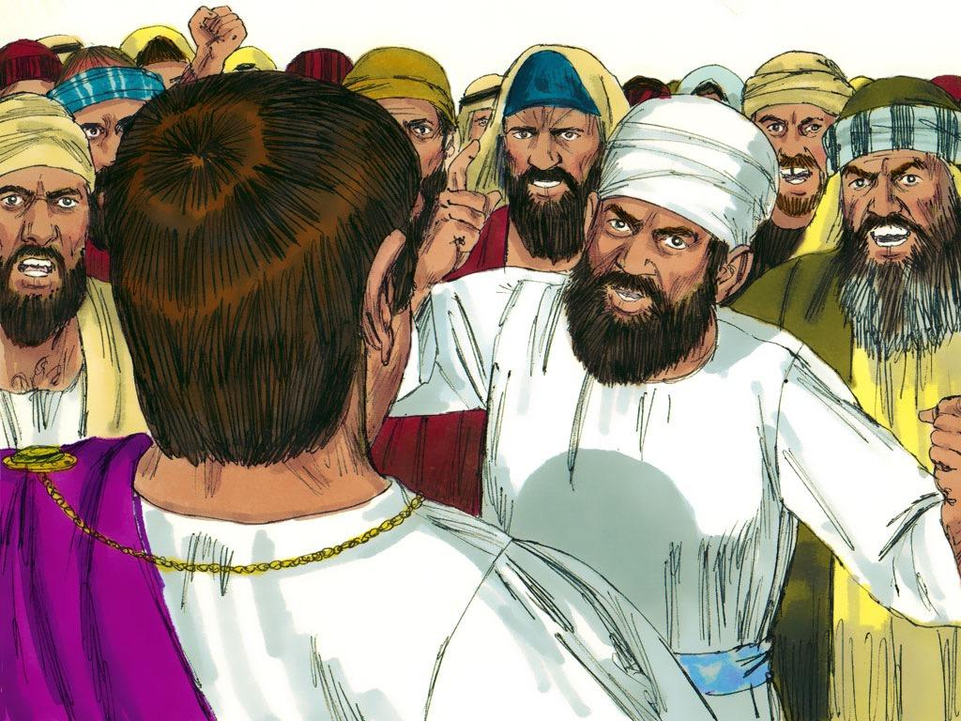
8
Notes:
8. Meanwhile, Jesus had been sent back to Pilate. The Jewish leaders and many people kept demanding that Jesus be crucified.
Pilate did not like so many people being angry and shouting. He had an idea. Pilate brought out a really bad prisoner named Barabbas. He put this really bad man next to Jesus and asked the crowd to choose which one should be set free. Surely the crowd would say that Jesus should be set free! But no, the crowd was so angry that they began yelling for the bad man to be set free and for Jesus to be crucified.
Pilate had finally had enough. He let Barabbas, the bad man, go free.

Slide 9
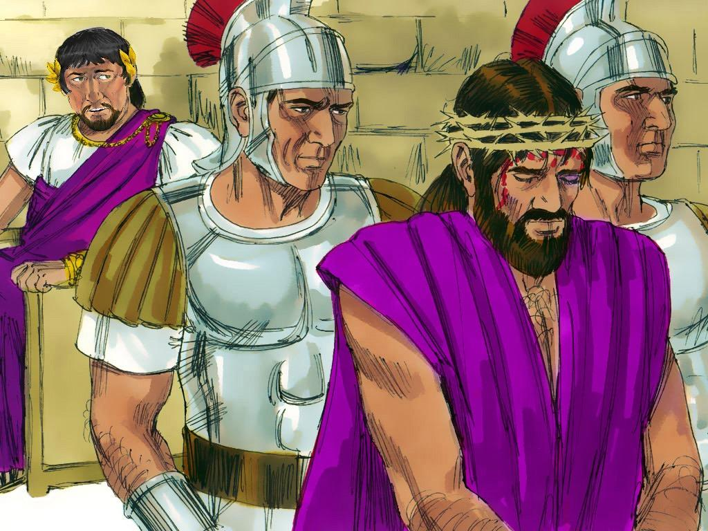
Notes:
9. Then Pilate called his soldiers. He said, “Take Jesus away. Beat His back with a whip and then put Him on a cross and leave Him there until he dies.”
Jesus has more power than Pilate, the angry people or even the soldiers. If Jesus had wanted to, He could have stopped everyone.
But Jesus did not stop them. He let the soldiers lead Him away; Jesus was thinking about everyone in the world who had ever done anything bad (sinned). Jesus loves everyone in the world very much!
EVERYONE who has ever sinned deserves to be punished. That even means you and me. But instead of letting everyone be punished, Jesus took one BIG punishment for all of us. Jesus died on the cross so that all of us could be forgiven of our sins instead of being punished for our sins.
And that’s how it happened that Jesus was sent to the cross.

Slide 10
Teacher Notes Page 1
1. Cover: The Trial of Jesus (Matthew 26:57-27:31)
2. Have you ever seen a picture of Jesus on the cross? Jesus was a good man, so who decided that He would die on the cross? How did this happen?
Today, let’s talk about how and why it was that Jesus came to die on the cross.
3. Before He died on the cross, Jesus spent time with His friends and the apostles. One evening they shared a special dinner together. Since it was the last time they ate together, this meal is called the “Last Supper.”
At the supper, Jesus told His friends that He would soon die. Jesus told them that even though they were His friends even THEY would all run away when He got into trouble.
The apostles did not believe this could ever happen. Peter told Jesus that there was no way he would ever leave Jesus. Jesus told him to just wait and see. He said Peter would deny Him three times before he heard the sound of a rooster crowing. Peter just couldn’t believe this could ever happen.
4. Later, Jesus went to a garden to pray, and soldiers came and arrested Him. They tied Him up and took Him to the religious leaders. First to Annas and then to Caiaphas. Some people and religious leaders told lies and said Jesus had done many bad things. They did not like that Jesus said He was the king of the Jews.
The religious leaders were so angry at Jesus that they decided to take Him to the Roman Governor and tell Him to have Jesus killed.
5. The Roman Governor was called Pontius Pilate. The religious leaders said to Pilate, “We demand that Jesus be crucified!”
“Crucified?” Pilate thought, “Only the worst criminals were ever punished by being put on a cross and crucified to die.” Pilate kept asking Jesus questions about what the religious leaders were saying, but Jesus did not even try to defend Himself.
Pilate didn’t really want to crucify Jesus, so he told them to take Jesus to another governor, Herod Antipas.
6. Herod Antipas only made fun of Jesus. He and his soldiers made a crown from thorns and placed it on Jesus’ head. They also put a robe on Him to make fun of Him for being called the king of the Jews.

Slide 11
Teacher Notes Page 2
7. While all of this was happening, where do you think Jesus’ friends were? Do you think they were trying to help Jesus?
No, they were just confused and afraid. Some people saw Peter and asked him if he knew Jesus. He was afraid that if he said he knew Jesus, then the people might hurt him just like they were hurting Jesus. So Peter denied he knew Jesus. Two other times, people noticed Peter and asked him if he knew Jesus. Each time he answered, “No.”
Finally, after the third time, guess what Peter heard? He heard a rooster crowing! It was just like Jesus said it would happen!
8. Meanwhile, Jesus had been sent back to Pilate. The Jewish leaders and many people kept demanding that Jesus be crucified.
Pilate did not like so many people being angry and shouting. He had an idea. Pilate brought out a really bad prisoner named Barabbas. He put this really bad man next to Jesus and asked the crowd to choose which one should be set free. Surely the crowd would say that Jesus should be set free! But no, the crowd was so angry that they began yelling for the bad man to be set free and for Jesus to be crucified.
Pilate had finally had enough. He let Barabbas, the bad man, go free.
9. Then Pilate called his soldiers. He said, “Take Jesus away. Beat His back with a whip and then put Him on a cross and leave Him there until he dies.”
Jesus has more power than Pilate, the angry people or even the soldiers. If Jesus had wanted to, He could have stopped everyone.
But Jesus did not stop them. He let the soldiers lead Him away; Jesus was thinking about everyone in the world who had ever done anything bad (sinned). Jesus loves everyone in the world very much!
EVERYONE who has ever sinned deserves to be punished. That even means you and me. But instead of letting everyone be punished, Jesus took one BIG punishment for all of us. Jesus died on the cross so that all of us could be forgiven of our sins instead of being punished for our sins.
And that’s how it happened that Jesus was sent to the cross.

Slide 12


Attributions: This visual aid was constructed by Mary Nelson www.missionbibleclass.org using:
Text and slideshow compilation by Mary Nelson (updated 5/2025)
Illustrations by Sweet Publishing http://sweetpublishing.com/ As accessed through www.freebibleimages.org Notice of Alteration: Text added to cover slide.
Attribution-ShareAlike 3.0 Unported (CC BY-SA 3.0) https://creativecommons.org/licenses/by-sa/3.0/
User may reproduce it without permissions.
DOWNLOAD THIS SLIDESHOW FROM www.missionbibleclass.org
Please visit www.missionbibleclass.org to find this and many other free resources to help you teach the Bible to children.

