Slide 1
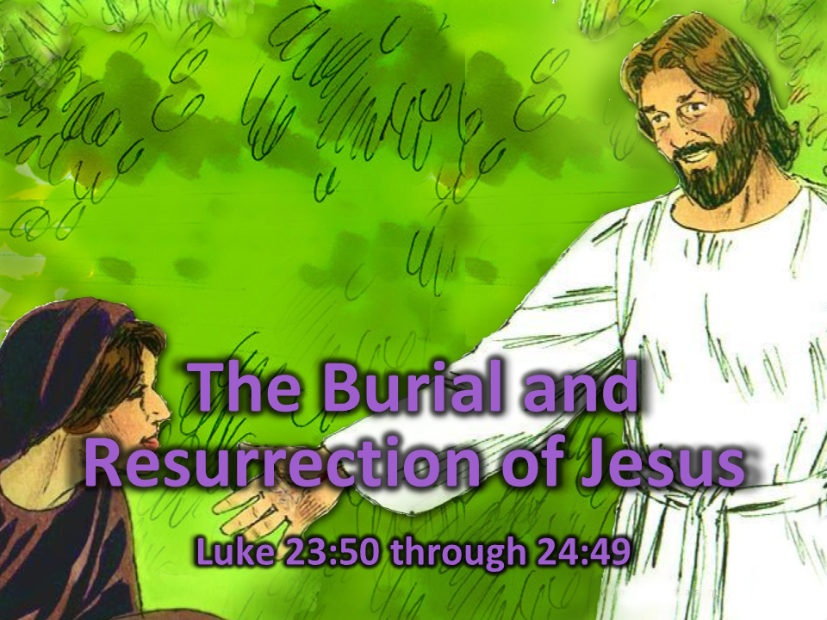
Notes:
1 Cover: The Burial and Resurrection of Jesus (Luke 23:50-24:49)

Slide 2
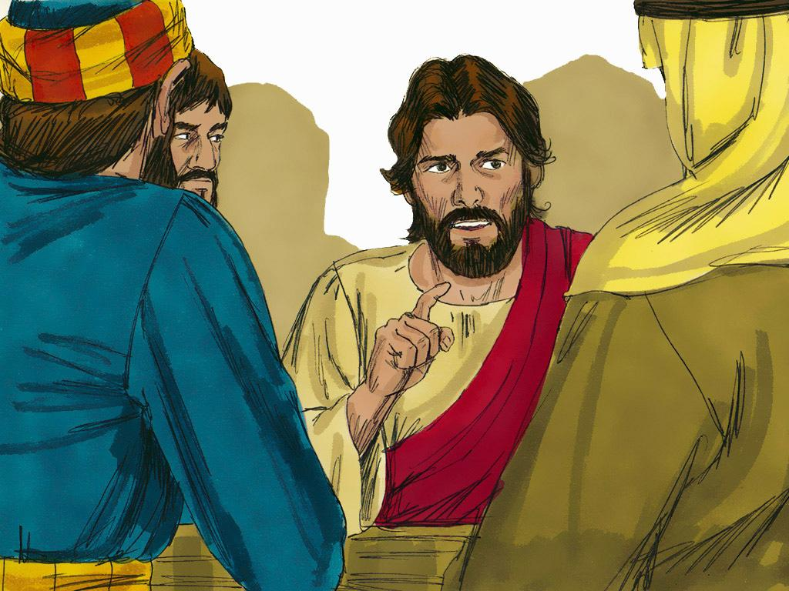
Notes:
2. The followers of Jesus were glad that Jesus was their friend. When they were with him they always felt better. They never wanted the days with Jesus to end.
Jesus was a very good teacher. He taught His followers many important things. Sometimes, His followers understood the teachings, and sometimes, they did not.
For example, they were confused when Jesus said He would die on the cross and then be raised up again on the third day. “Why would Jesus have to die on the cross?” they must have wondered. Only bad people had to die on crosses, and Jesus never did bad things.

Slide 3
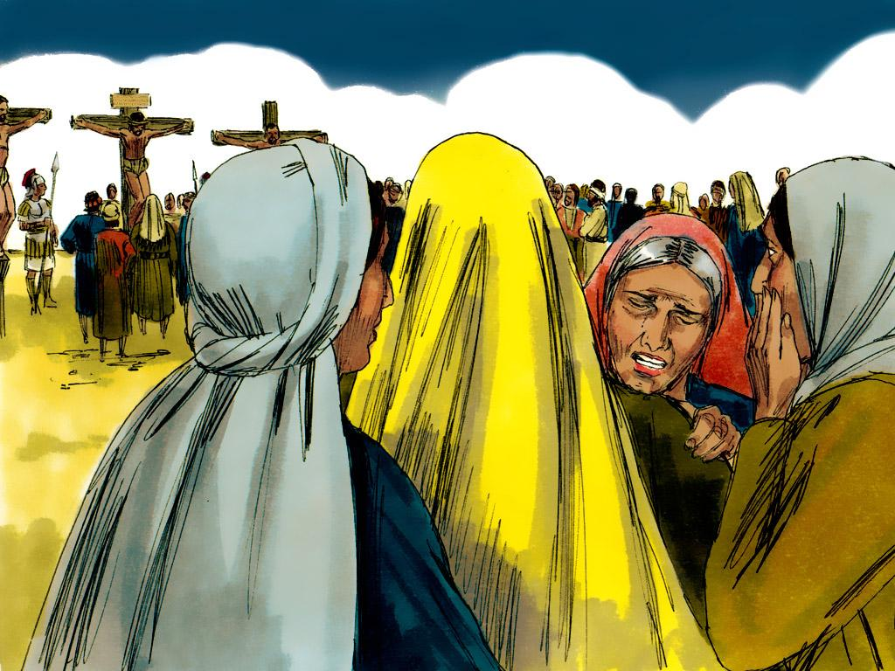
Notes:
3. But then, a day came when everything happened just as Jesus said it would. Jesus was killed on a cross. His followers were so very sad. It was the saddest day that had ever been. Jesus was dead.

Slide 4
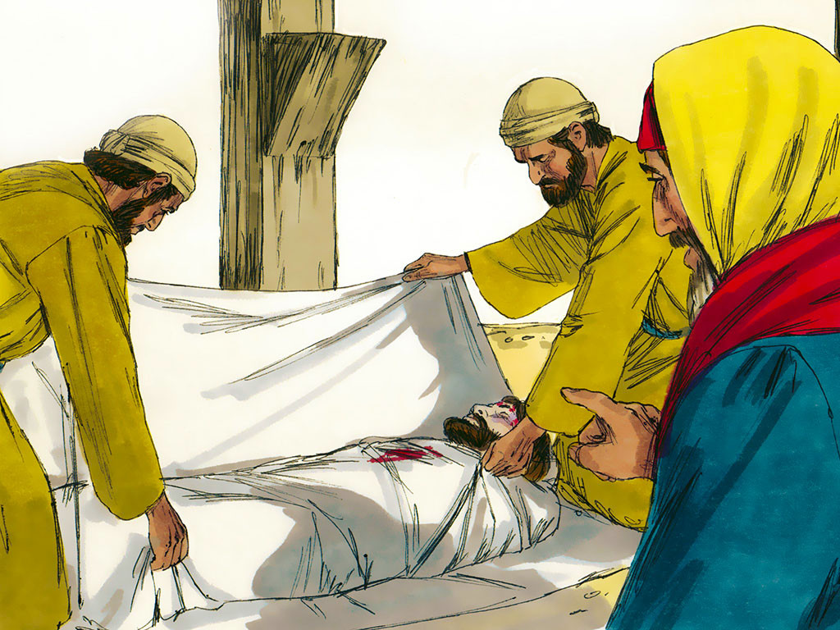
Notes:
4. A kind Jewish leader named Joseph (from Arimathea) saw Jesus die on the cross. He was sad that Jesus was dead, but he wanted to treat the body of Jesus with respect. Joseph asked for permission to take Jesus’ dead body down from the cross.
The Jewish teacher, Nicodemus, came with Joseph. Together, Joseph and Nicodemus washed Jesus’ body and wrapped it in long strips of cloth with lots and lots of spices in between the cloths.
Joseph and Nicodemus were sad. They knew that Jesus had been a great teacher. Now Jesus was dead.

Slide 5
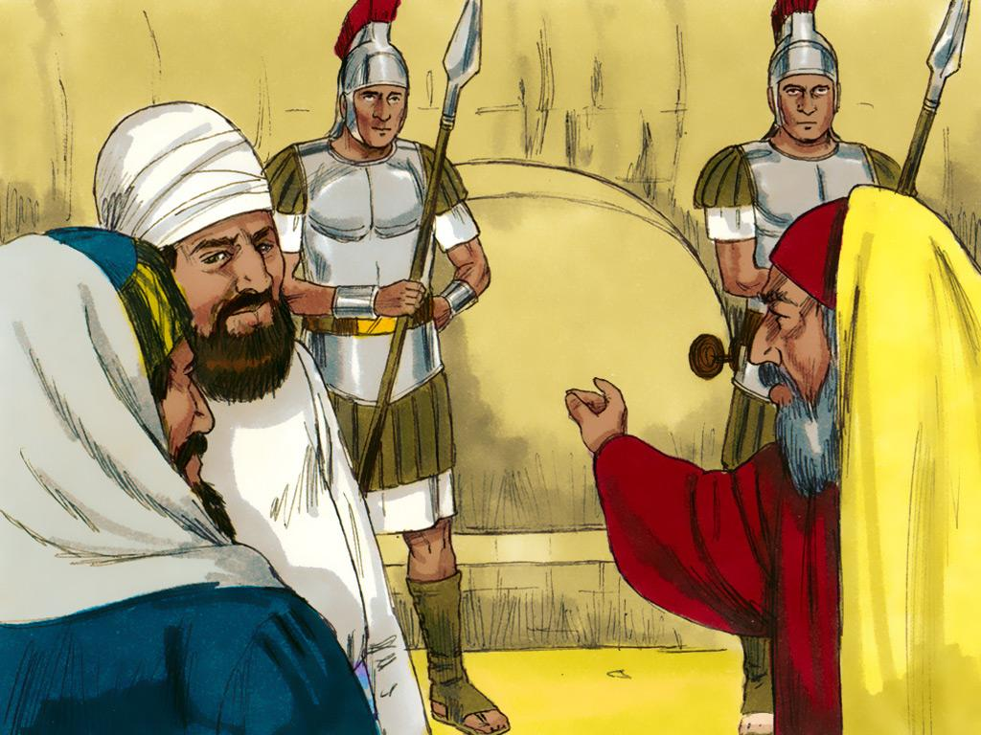
Notes:
5. Joseph put the body into a tomb carved out of solid rock. A big stone was rolled in front to block the opening of the tomb, and then guards came to stand in front of it.
Jesus had died on the cross and was buried in a tomb all on the same terrible day. That day was a Friday.

Slide 6
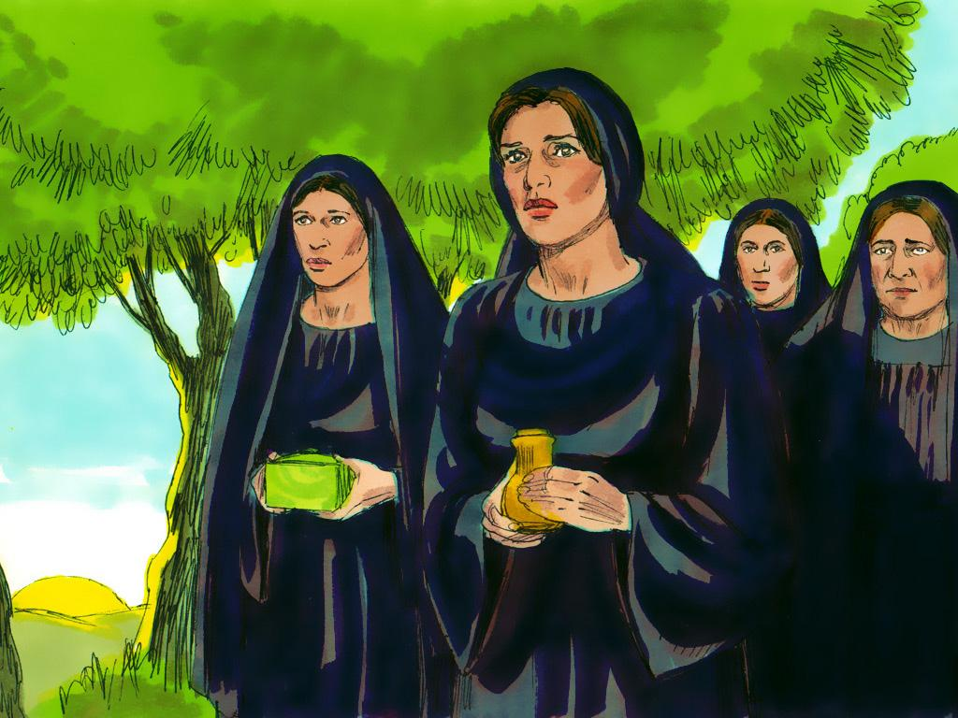
Notes:
6. Friday passed, and then Saturday passed. All was quiet. Then, early in the morning on the third day (Sunday), some women made their way to the tomb.
It was a custom for women to put sweet-smelling spices on the body of a person who died. But the women were worried. They had heard about the big stone in front of the tomb. Who would move the stone so they could put spices on the body of Jesus?

Slide 7
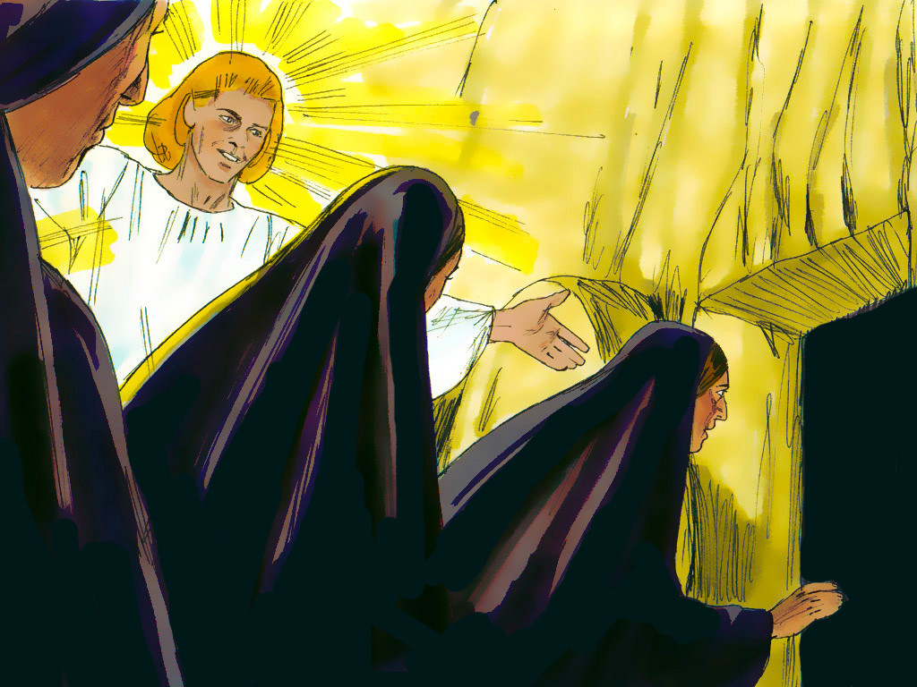
Notes:
7. When the women arrived at the tomb, they discovered that the stone had already been moved away from the opening. There were no soldiers nearby, so who could have moved the stone?
The women knew Jesus’ dead body had been placed in the tomb. But now, they were shocked to see that Jesus’ body was gone! The tomb was empty. Where was Jesus’ dead body?
As the women were thinking about this, two men in shining clothes appeared beside them. These men were angels.

Slide 8
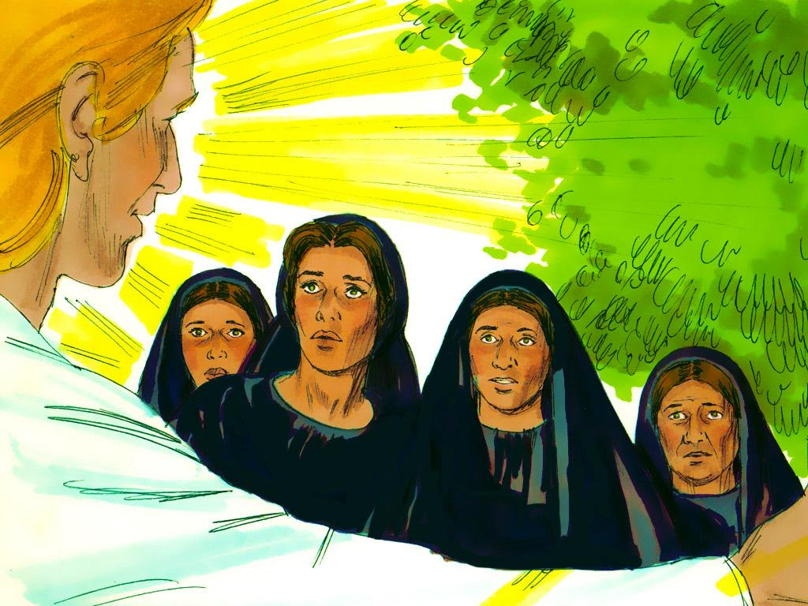
Notes:
8. Then, one of the angels asked them a very strange question. “This tomb is a place for dead people. Why are you looking here?” he asked.
Then the angel said something incredible, “Jesus is not here. He has risen from the dead!”
“Remember what Jesus said before?” the angel continued. “Jesus said He would be killed on a cross but then rise back alive on the third day. Today is the third day!”

Slide 9
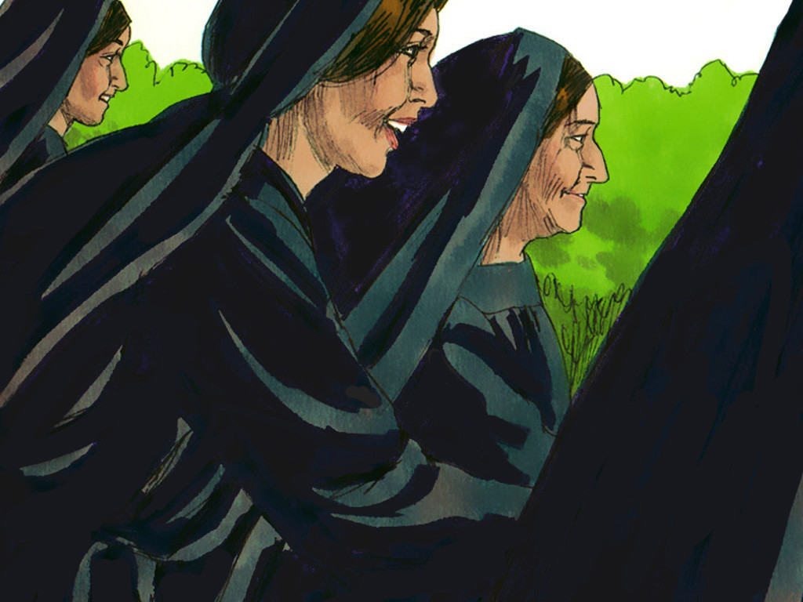
Notes:
9. Of course, that is what Jesus had said. How could anyone forget that? The women rushed away to tell the other followers that Jesus was not dead. Jesus was alive!

Slide 10
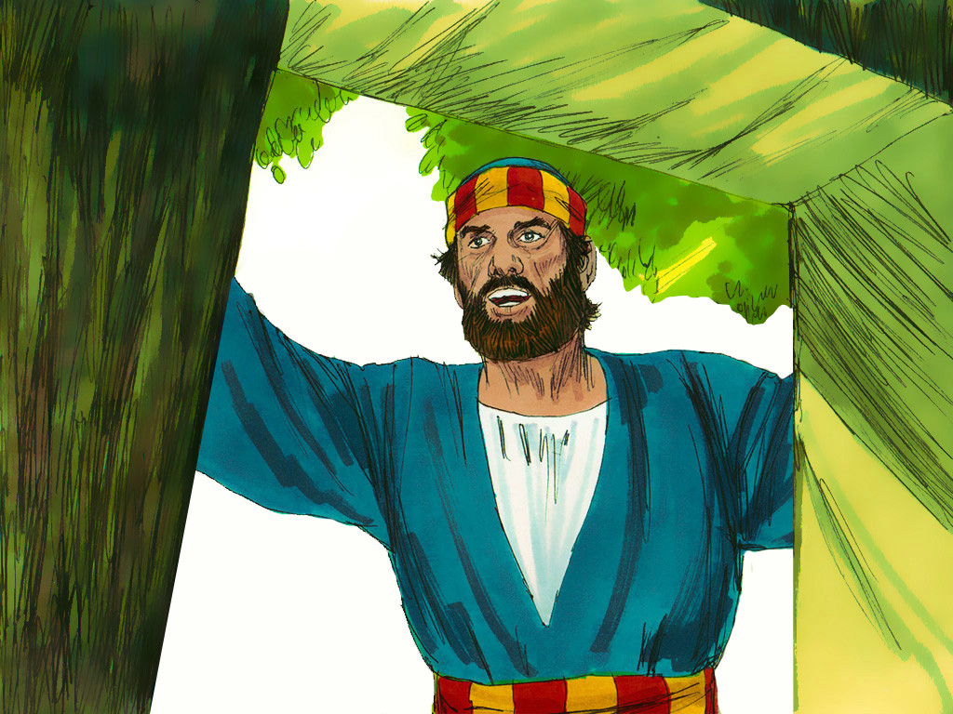
Notes:
10. But the followers had never heard such an amazing thing. They could not believe this could be true. Peter decided to come and see for himself. When he looked inside the tomb, he saw that it was empty. All that was left were the linen cloths that Jesus’ dead body had been wrapped in. Could this good news be true? Could Jesus be alive?

Slide 11
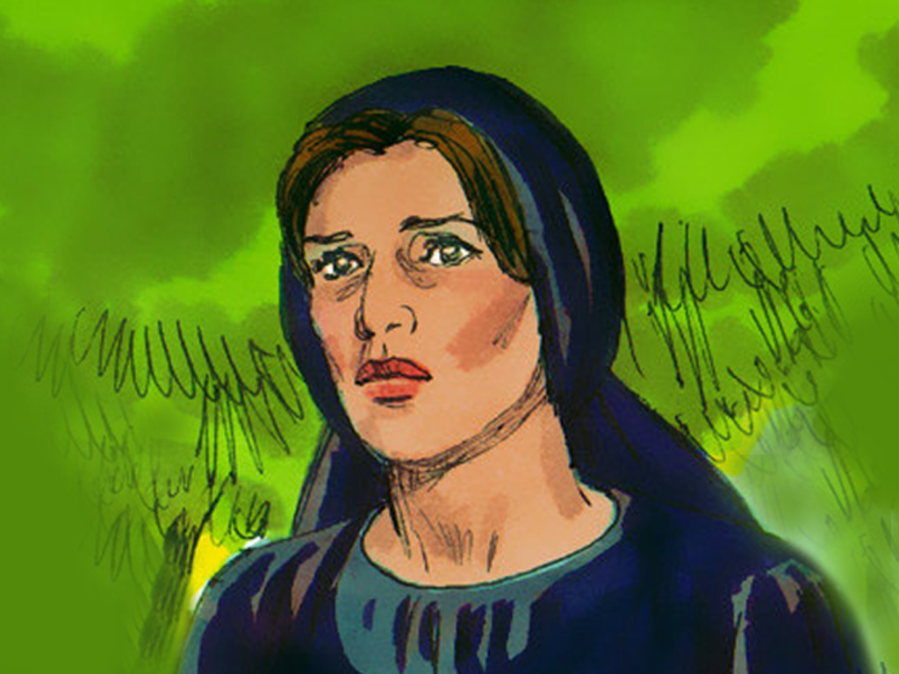
Notes:
11. Peter did not know it yet, but someone else had already seen Jesus before him.
Earlier, when the other women had gone, Mary Magdalene had stayed near where Jesus’ body had been. She was so sad and confused. “How could the tomb be empty?” she thought, “Maybe someone had come and stolen Jesus’ body.”
But Mary was not alone in the tomb. The two angels spoke to her and asked her why she was crying.
Mary began to explain, but then heard another voice. At first, she didn’t know who was speaking. Perhaps it was a man tending the garden.

Slide 12
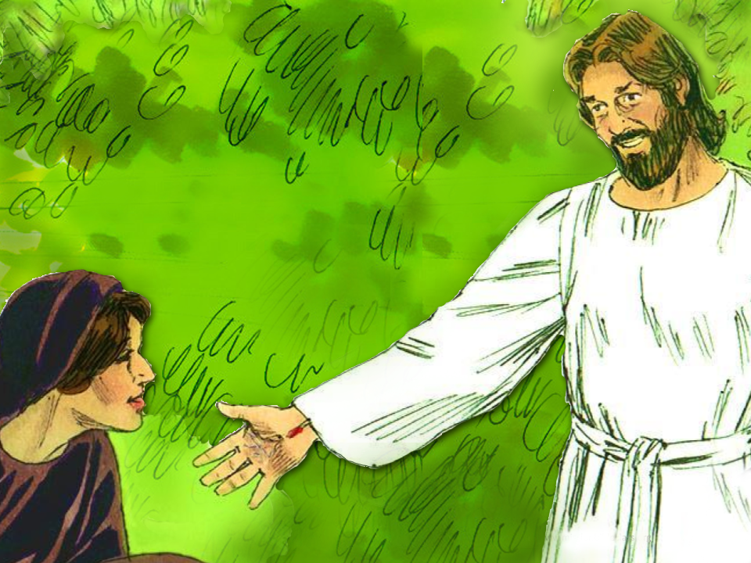
Notes:
12. Then she heard the voice say, “Mary.” When she heard that voice say her name, Mary knew it was JESUS, her teacher, speaking. Jesus really had come back from the dead!
Mary was so happy. Jesus told her to go and tell the others that He would spend some time on earth with them, but that He would return to His Father soon.

Slide 13
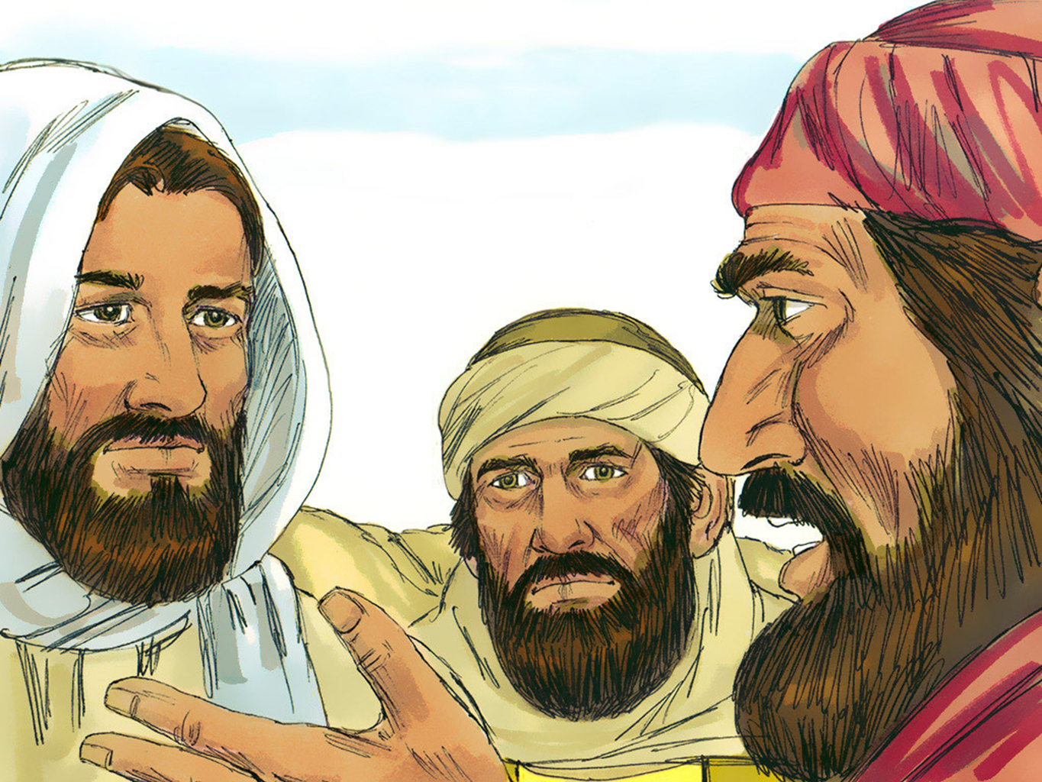
Notes:
13. After Jesus rose from the dead, He appeared to many people. Two men were walking along a road, talking about Jesus, when Jesus just appeared right there with them. At first, they did not recognise him.

Slide 14
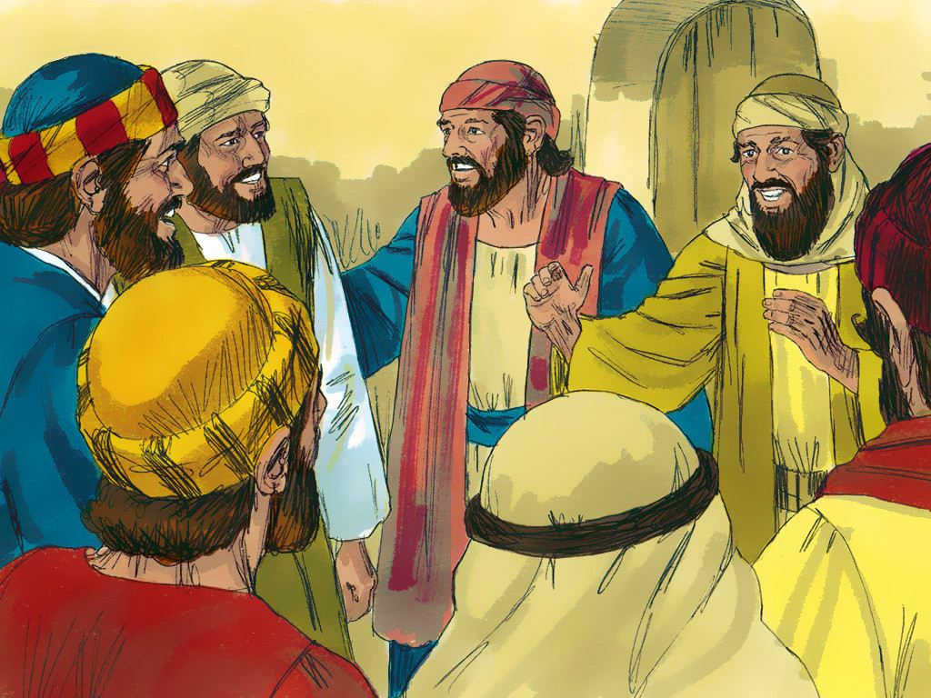
Notes:
14. Once the men knew it was Jesus, they rushed to tell the eleven disciples the good news.

Slide 15
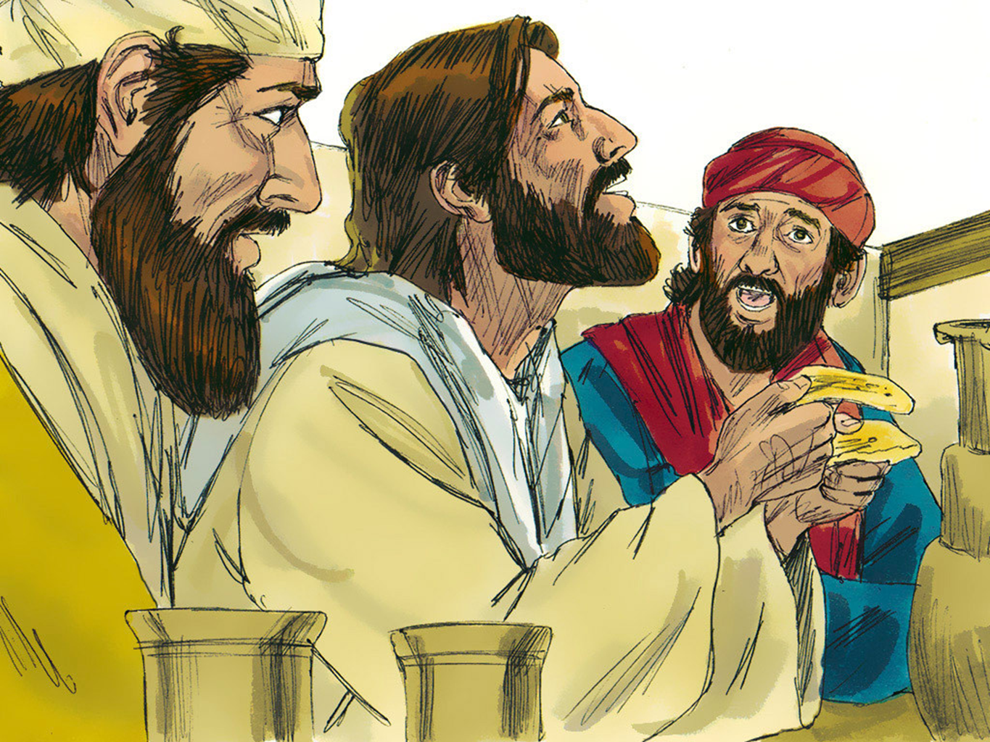
Notes:
15. As the two men told the apostles what they had seen, Jesus appeared in the room with them all.
At first, they thought they were seeing a ghost! But Jesus told them that He was real. He ate food with them and even let them touch the scars on His hands and feet from when He died on the cross.
And then Jesus reminded them about the things He had been teaching His followers all along.

Slide 16
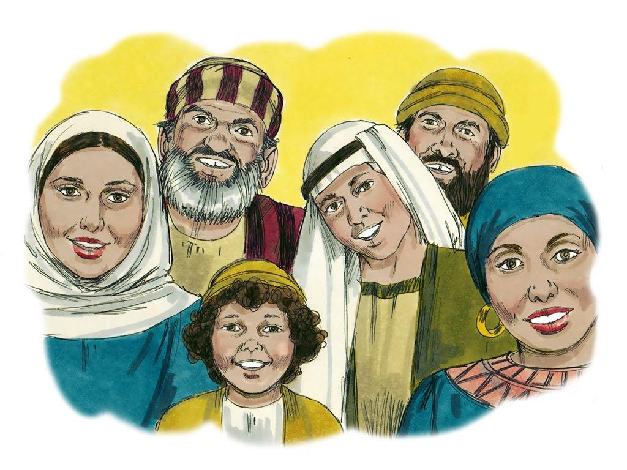
Notes:
16. People think that death is the very end, but God has power stronger than the power of death. God brought Jesus back to life.
And now, Jesus wants EVERYONE to have a new life. If people change their hearts and lives, they can start over and have a new life with Jesus.
Life with Jesus does not even stop if our body dies. Life with Jesus lasts forever.

Slide 17
Teacher Notes Page 1
1 Cover: The Burial and Resurrection of Jesus (Luke 23:50-24:49)
2. The followers of Jesus were glad that Jesus was their friend. When they were with him they always felt better. They never wanted the days with Jesus to end.
Jesus was a very good teacher. He taught His followers many important things. Sometimes, His followers understood the teachings, and sometimes, they did not.
For example, they were confused when Jesus said He would die on the cross and then be raised up again on the third day. “Why would Jesus have to die on the cross?” they must have wondered. Only bad people had to die on crosses, and Jesus never did bad things.
3. But then, a day came when everything happened just as Jesus said it would. Jesus was killed on a cross. His followers were so very sad. It was the saddest day that had ever been. Jesus was dead.
4. A kind Jewish leader named Joseph (from Arimathea) saw Jesus die on the cross. He was sad that Jesus was dead, but he wanted to treat the body of Jesus with respect. Joseph asked for permission to take Jesus’ dead body down from the cross.
The Jewish teacher, Nicodemus, came with Joseph. Together, Joseph and Nicodemus washed Jesus’ body and wrapped it in long strips of cloth with lots and lots of spices in between the cloths.
Joseph and Nicodemus were sad. They knew that Jesus had been a great teacher. Now Jesus was dead.
5. Joseph put the body into a tomb carved out of solid rock. A big stone was rolled in front to block the opening of the tomb, and then guards came to stand in front of it.
Jesus had died on the cross and was buried in a tomb all on the same terrible day. That day was a Friday.
6. Friday passed, and then Saturday passed. All was quiet. Then, early in the morning on the third day (Sunday), some women made their way to the tomb.
It was a custom for women to put sweet-smelling spices on the body of a person who died. But the women were worried. They had heard about the big stone in front of the tomb. Who would move the stone so they could put spices on the body of Jesus?
7. When the women arrived at the tomb, they discovered that the stone had already been moved away from the opening. There were no soldiers nearby, so who could have moved the stone?
The women knew Jesus’ dead body had been placed in the tomb. But now, they were shocked to see that Jesus’ body was gone! The tomb was empty. Where was Jesus’ dead body?
As the women were thinking about this, two men in shining clothes appeared beside them. These men were angels.

Slide 18
Teacher Notes Page 2
8. Then, one of the angels asked them a very strange question. “This tomb is a place for dead people. Why are you looking here?” he asked.
Then the angel said something incredible, “Jesus is not here. He has risen from the dead!”
“Remember what Jesus said before?” the angel continued. “Jesus said He would be killed on a cross but then rise back alive on the third day. Today is the third day!”
9. Of course, that is what Jesus had said. How could anyone forget that? The women rushed away to tell the other followers that Jesus was not dead. Jesus was alive!
10. But the followers had never heard such an amazing thing. They could not believe this could be true. Peter decided to come and see for himself. When he looked inside the tomb, he saw that it was empty. All that was left were the linen cloths that Jesus’ dead body had been wrapped in. Could this good news be true? Could Jesus be alive?
11. Peter did not know it yet, but someone else had already seen Jesus before him.
Earlier, when the other women had gone, Mary Magdalene had stayed near where Jesus’ body had been. She was so sad and confused. “How could the tomb be empty?” she thought, “Maybe someone had come and stolen Jesus’ body.”
But Mary was not alone in the tomb. The two angels spoke to her and asked her why she was crying.
Mary began to explain, but then heard another voice. At first, she didn’t know who was speaking. Perhaps it was a man tending the garden.
12. Then she heard the voice say, “Mary.” When she heard that voice say her name, Mary knew it was JESUS, her teacher, speaking. Jesus really had come back from the dead!
Mary was so happy. Jesus told her to go and tell the others that He would spend some time on earth with them, but that He would return to His Father soon.
13. After Jesus rose from the dead, He appeared to many people. Two men were walking along a road, talking about Jesus, when Jesus just appeared right there with them. At first, they did not recognise him.
14. Once the men knew it was Jesus, they rushed to tell the eleven disciples the good news.

Slide 19
Teacher Notes Page 3
15. As the two men told the apostles what they had seen, Jesus appeared in the room with them all.
At first, they thought they were seeing a ghost! But Jesus told them that He was real. He ate food with them and even let them touch the scars on His hands and feet from when He died on the cross.
And then Jesus reminded them about the things He had been teaching His followers all along.
16. People think that death is the very end, but God has power stronger than the power of death. God brought Jesus back to life.
And now, Jesus wants EVERYONE to have a new life. If people change their hearts and lives, they can start over and have a new life with Jesus.
Life with Jesus does not even stop if our body dies. Life with Jesus lasts forever.

Slide 20


Attributions: This visual aid was constructed by Mary Nelson www.missionbibleclass.org using:
Text and slideshow compilation by Mary Nelson (updated 5/2025)
Illustrations by Sweet Publishing http://sweetpublishing.com/ As accessed through www.freebibleimages.org Notice of Alteration: Slide 1 has text added. Slides 1 and 12 are made up of 2 merged slides. Text added to cover slide. Slide 11 is only a portion of the illustration.
Attribution-ShareAlike 3.0 Unported (CC BY-SA 3.0) https://creativecommons.org/licenses/by-sa/3.0/
User may reproduce it without permissions.
DOWNLOAD THIS SLIDESHOW FROM www.missionbibleclass.org
Please visit www.missionbibleclass.org to find this and many other free resources to help you teach the Bible to children.

