Slide 1
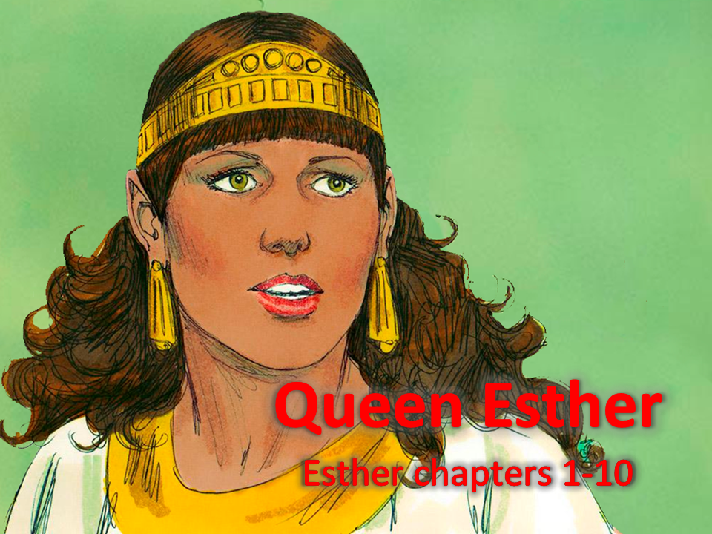
Notes:
1. Cover: Queen Esther (Esther chapters 1-10)

Slide 2
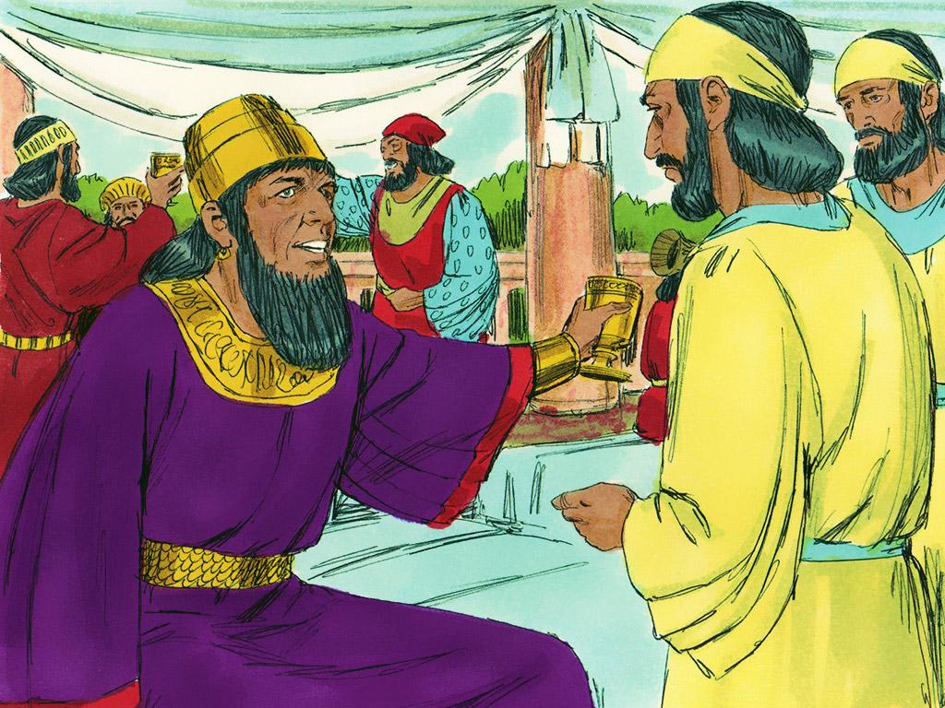
Notes:
2. King Xerxes was the King of the Persian Empire, which meant he was king of the biggest kingdom in the world at that time. King Xerxes was rich and powerful, but he did not believe in God.

Slide 3
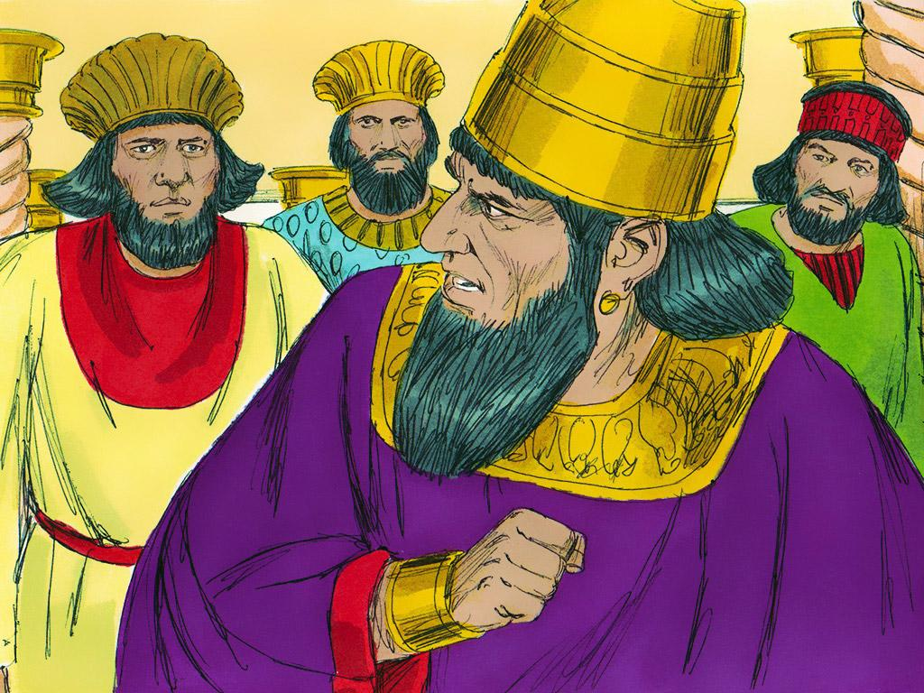
Notes:
3. The king did something very bad. He threw a big party and told his queen that she had to dance in front of everyone. Queen Vashti refused to obey the king, and he became so angry that he told her she would be banished. He never saw her again.

Slide 4
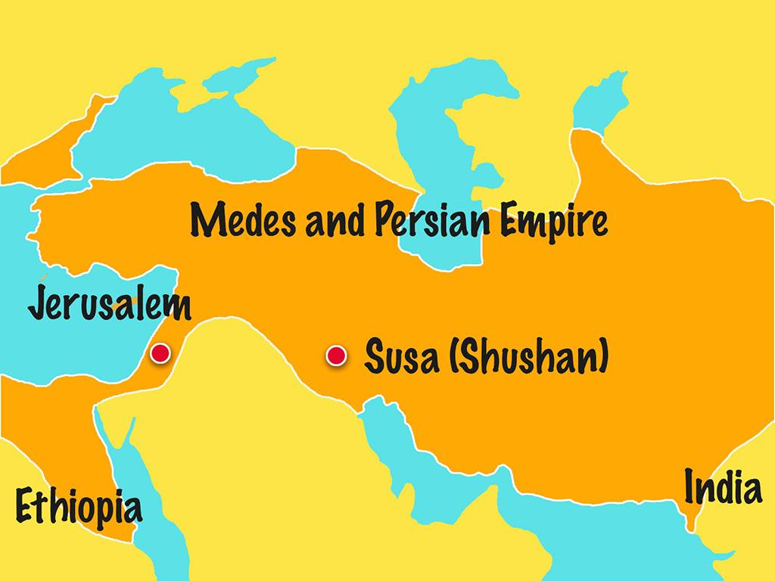
Notes:
4. The king’s helpers searched the whole kingdom to find the most beautiful girl to be the new queen.

Slide 5
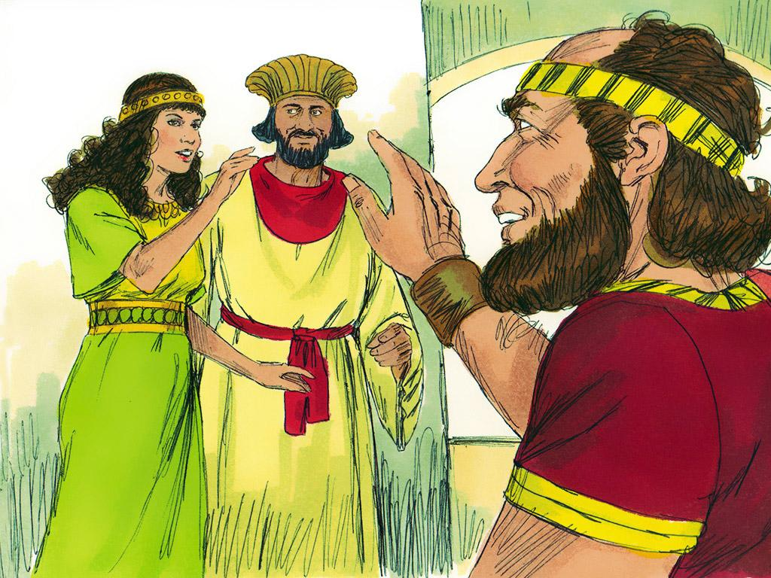
Notes:
5. The girls were brought to the palace, given the best makeup and perfumes, and spent a whole year learning how to be queens.
One of the girls was Esther. Esther did not have a father or a mother, so her cousin, Mordecai, raised her and treated her like a daughter. Mordecai told Esther that she should not tell anyone at the palace that she was Jewish. Jewish people were captives, and the people in charge would not want a captive to be queen.

Slide 6
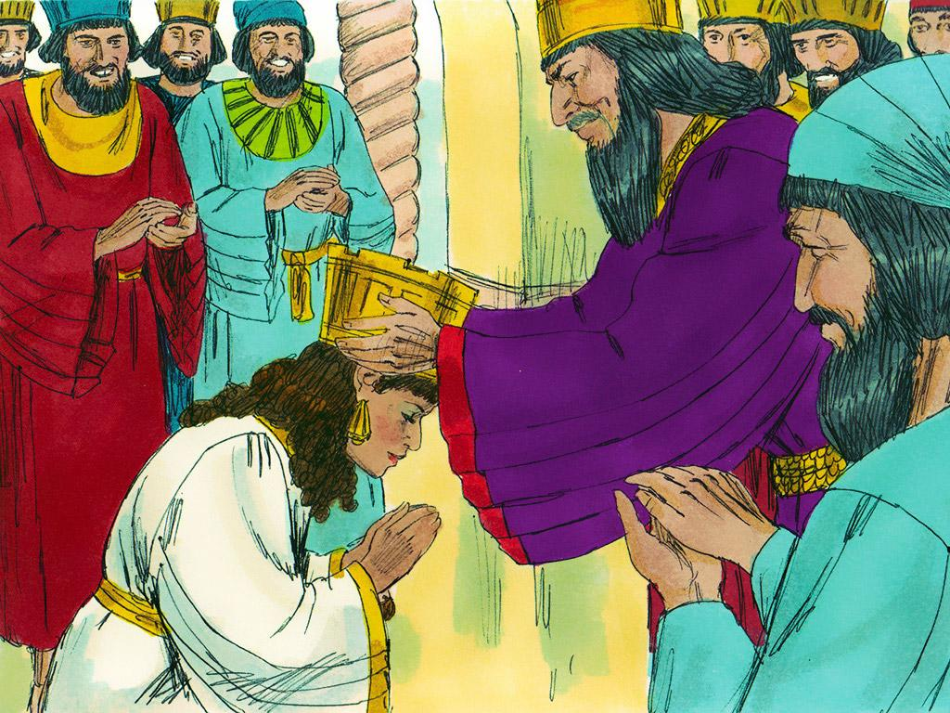
Notes:
6. When it came time to choose the new queen, the king chose Esther over all of the other girls. Esther became the queen. The king did not believe in God, but Esther did. But Esther always kept this secret. Even the king did not know.
She never forgot her cousin Mordecai or that she was one of God’s people. Sometimes, it was hard for Esther because the other Jews were treated badly. They did not have the riches that Queen Esther had.

Slide 7
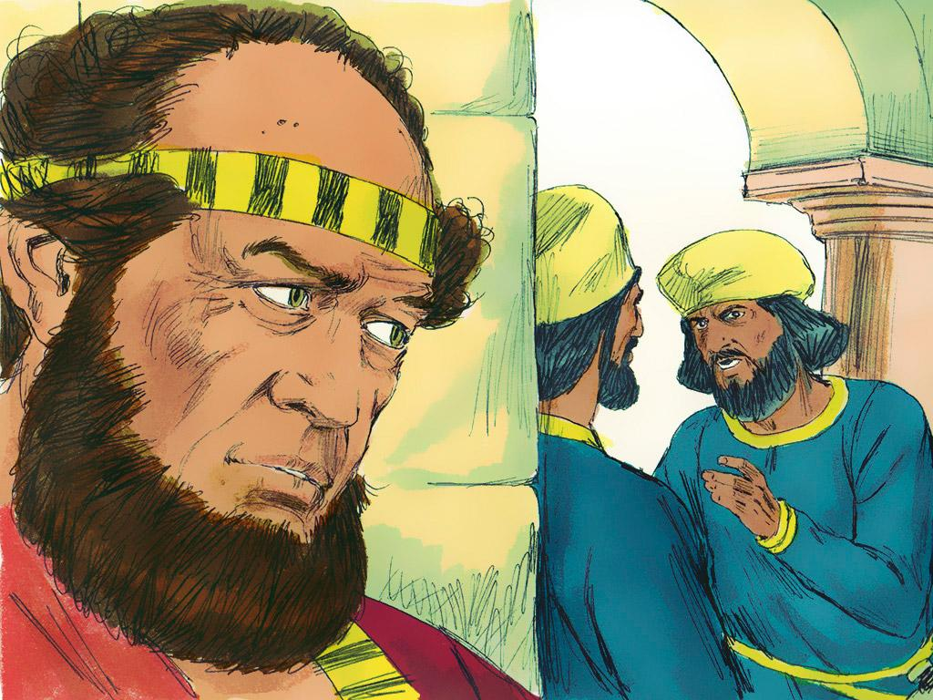
Notes:
7. But Esther did help her people. One time, Mordecai heard that someone was trying to kill the king. He told Esther about it, and she told the king.

Slide 8
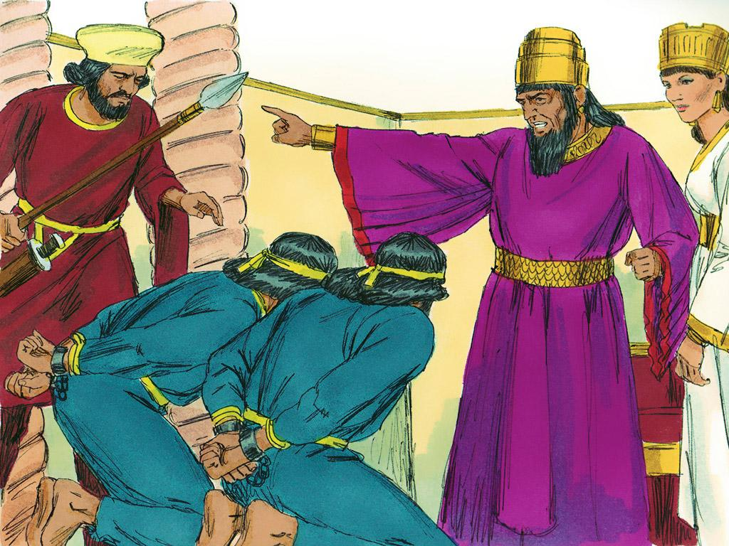
Notes:
8. The plan was stopped. Mordecai saved the king’s life! This was very special and was written in the king’s record book.

Slide 9
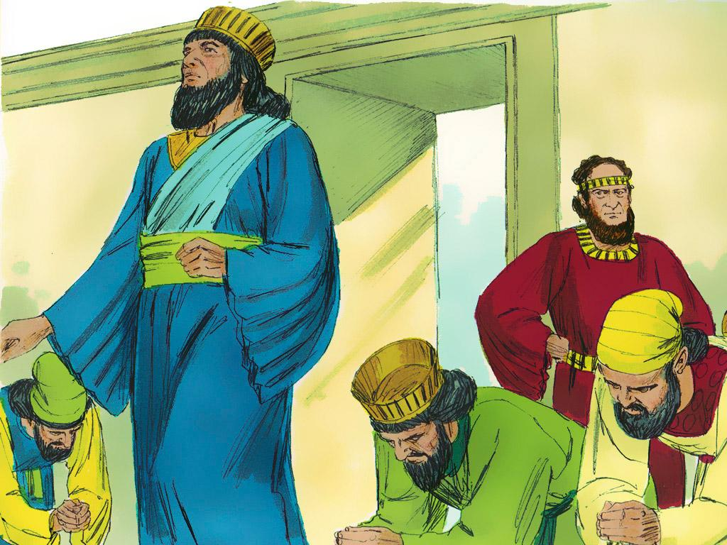
Notes:
9. As time passed, a man called “Haman” became famous in the kingdom. The king thought Haman was a good man, but he was actually very bad. The king ordered everyone in the kingdom to bow down to Haman, but Mordecai knew he was bad and would not bow.

Slide 10
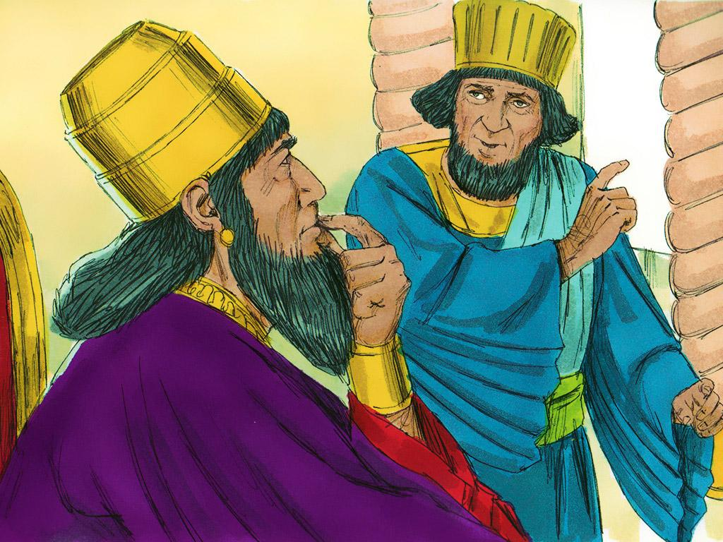
Notes:
10. Haman was so angry that he planned a way to kill Mordecai and all of the Jews. When Haman told the king that the Jews were bad, the king believed him.

Slide 11
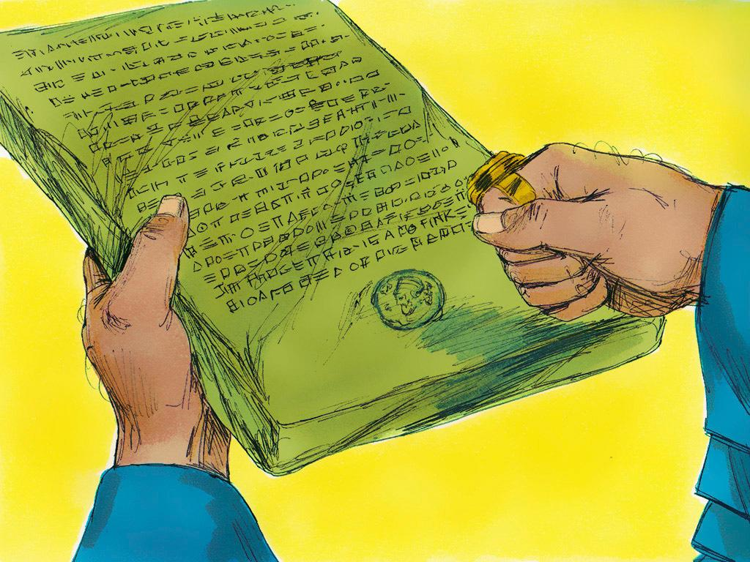
Notes:
11. The king made a law that people could kill the Jews and not get in trouble. Haman was glad. Now he could hurt Mordecai too. Now, he could even have Mordecai hang to death and no one could stop him.

Slide 12
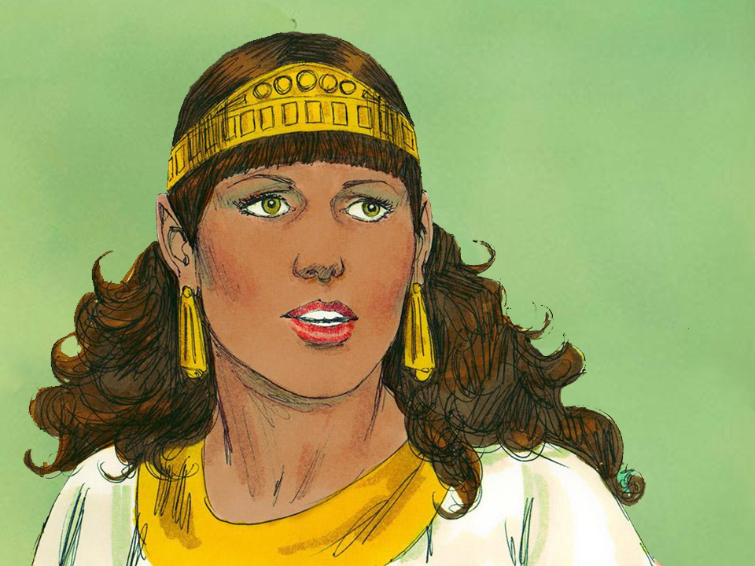
Notes:
12. When Mordecai heard about the plan, he told Esther. “God has blessed you, Esther. Now it is time for you to use these blessings to help others. Maybe God let you become queen so that you could save our people.”
Esther was very frightened. She had never told the king that she was a Jew. Would he be mad at her like he was mad at the first queen? Esther knew that even the queen could not go to the king without an invitation. He could even have her put to death. So she asked Mordecai to have all the Jews in Susa fast and pray, and she and her servants also fasted and prayed for three days.

Slide 13
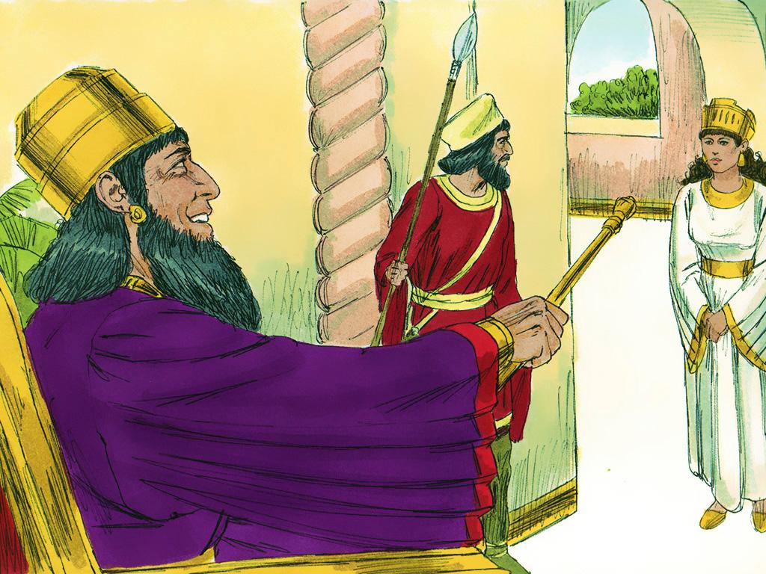
Notes:
13. After three days, Esther went to the king. She was so relieved when he pointed his sceptre at her and told her to come to him.

Slide 14
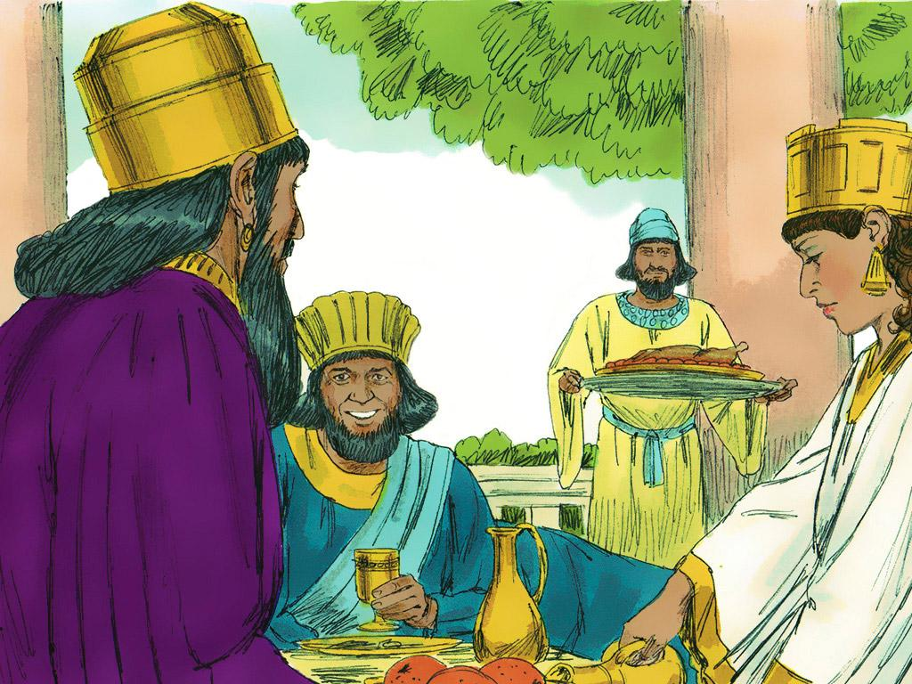
Notes:
14. Esther had a plan. She told the king that she wanted a special feast just for the two of them and Haman. Esther and the king planned the feast for the very next day. Haman did not know Queen Esther had a plan. He was just happy to be invited to a feast with the King and Queen.

Slide 15
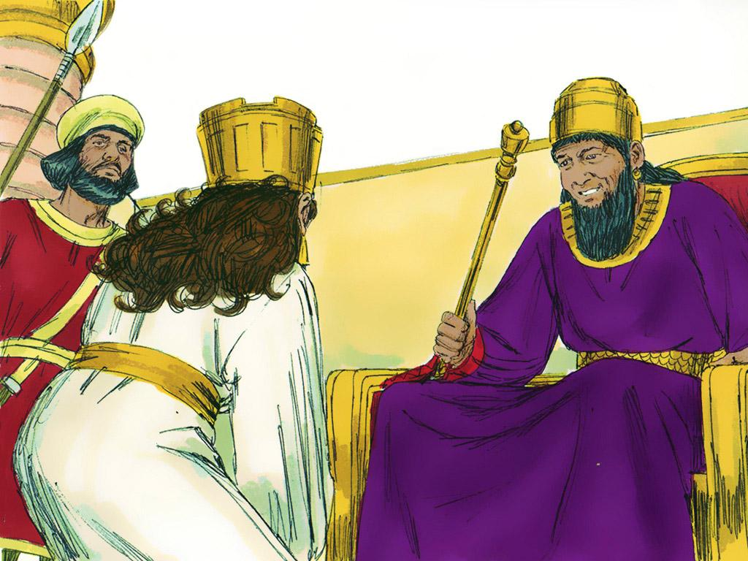
Notes:
15. The king liked Esther. At the feast he told her she could have anything she wanted. So Esther told the king that she would like to have another feast with the king and Haman the very next day. At the next feast she would say what her wish was.

Slide 16
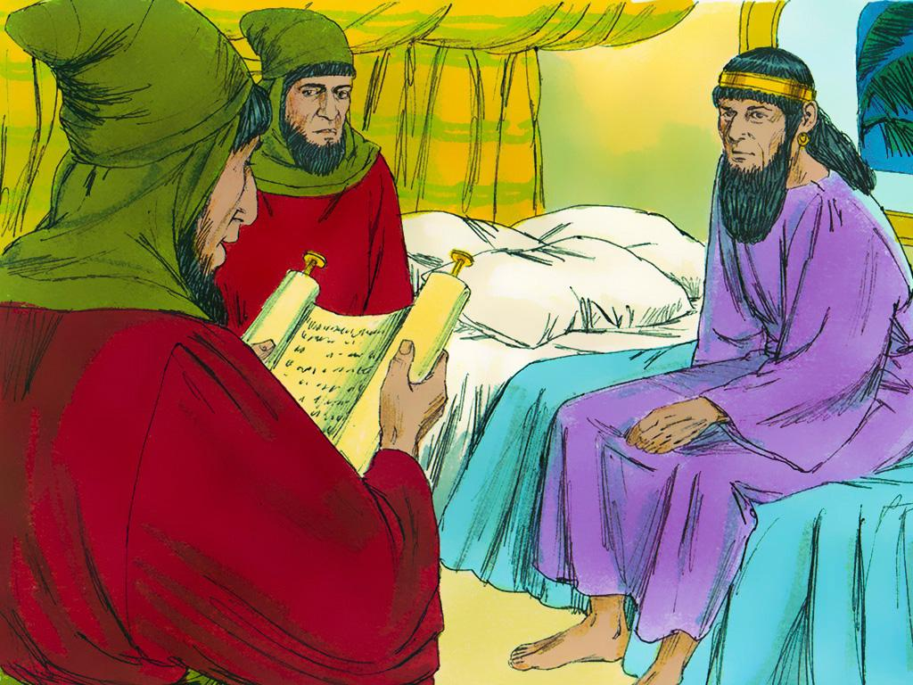
Notes:
16. The king went to bed that night, but he could not sleep. Sometimes, reading a book helps you sleep. So the king asked one of his helpers to bring one of the old record books. The helper brought the book and began to read to the king about things that had happened long ago. He read about the time Mordecai had saved the king’s life! The king got very excited. He wanted to do something special for Mordecai.

Slide 17
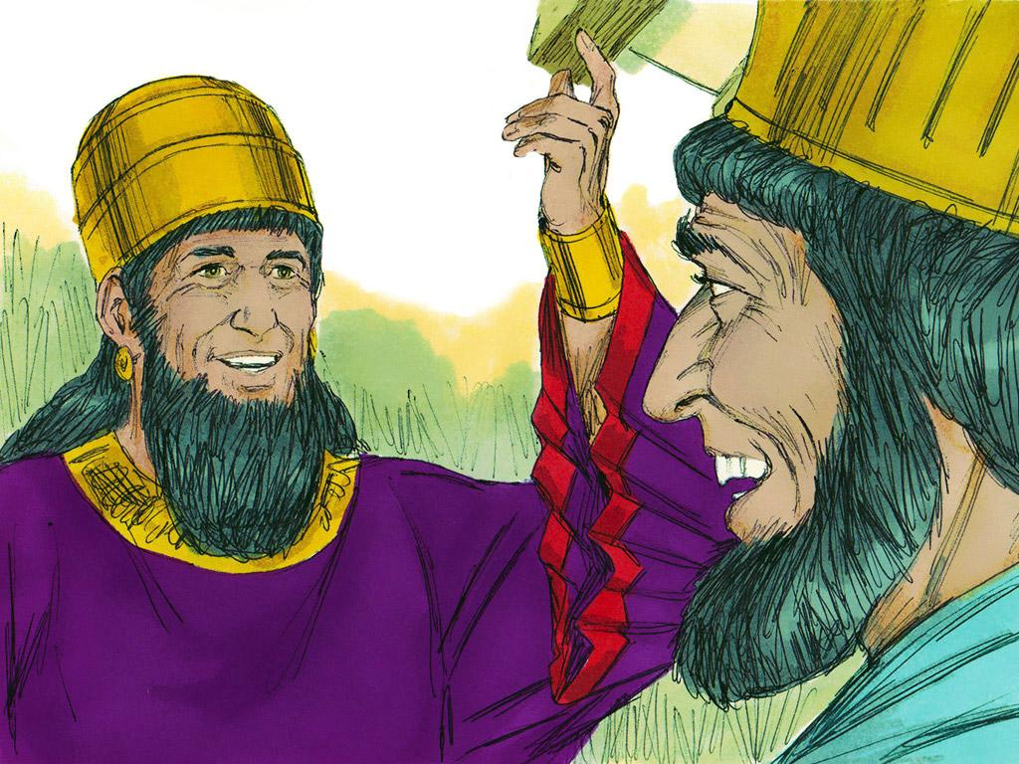
Notes:
17. Haman was nearby, so the king called for Haman to come into his chamber. Haman was happy because he thought the king would do something nice for HIM. The king asked Haman what should be done for someone who deserved honour. Haman thought the king was about to honour him, so he said: “That person should be given a royal robe and one of the king’s horses. They should be led through the streets so everyone knows the king likes them.”
“That is a great idea,” said the king. “Go and do those things for Mordecai!”

Slide 18
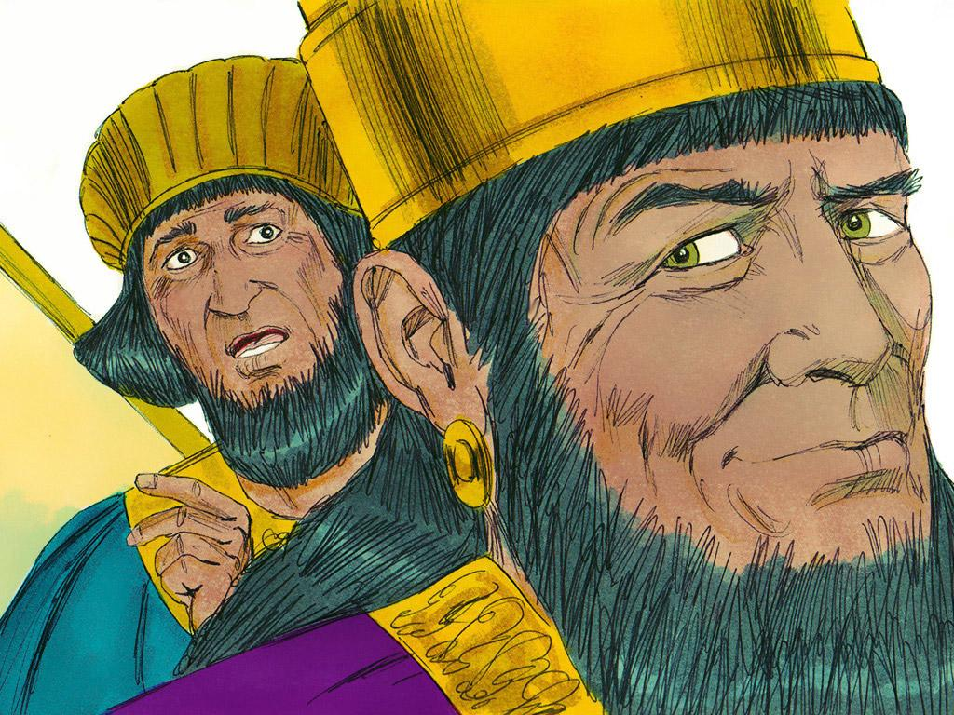
Notes:
18. Haman was shocked! He could not believe that the king liked Mordecai. Now, Haman knew he had a big problem. The king liked Mordecai, but Haman was trying to kill him. What would the king do when he found out?

Slide 19
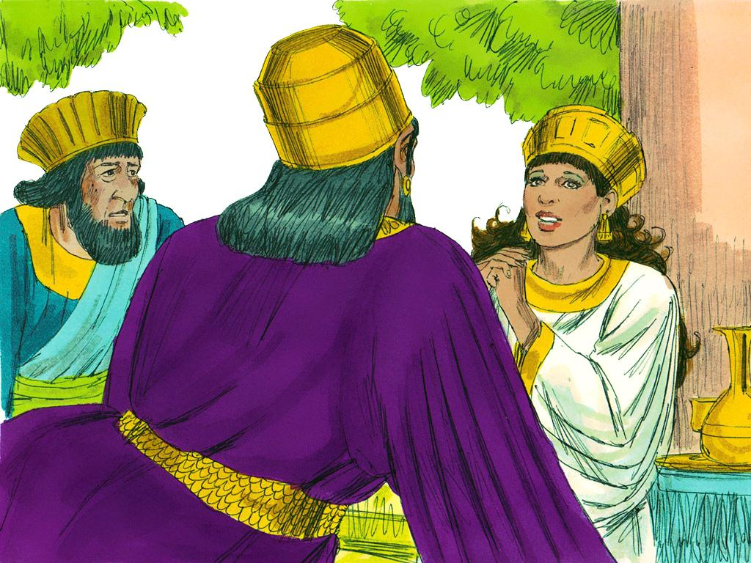
Notes:
19. And the king DID find out! The next day, when Haman went to the special feast with Esther and the King, Esther told the king everything.
First, she told the king that she was a Jew and that Haman had tricked the king into making a law that said people could kill Jews. Then she told the king that someone was trying to kill the good man, Mordecai. When he heard this, the king was very angry. He said that the man should be put to death.
“Haman is the one trying to kill Mordecai!” Esther told the king.

Slide 20
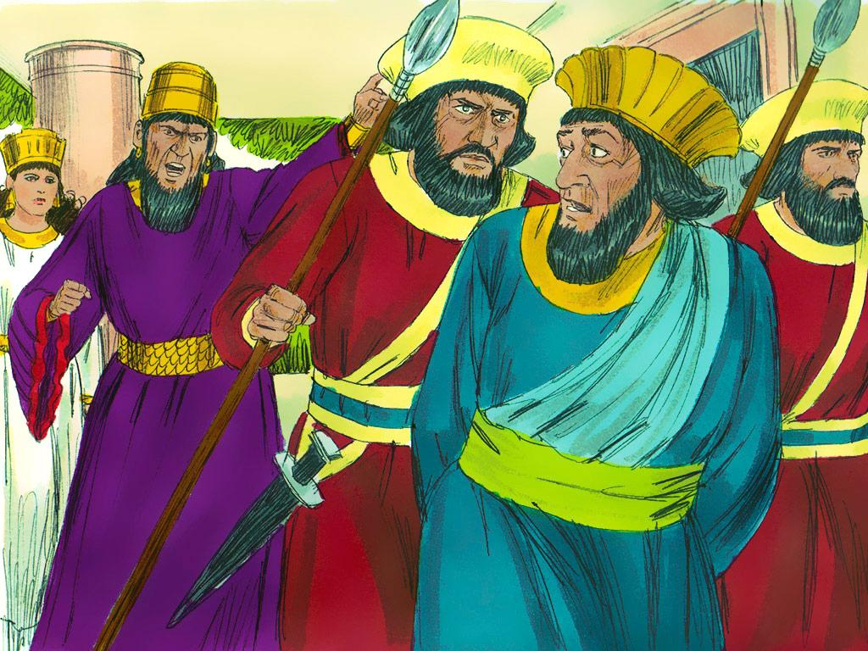
Notes:
20. The king was very angry. How dare Haman try to hurt the man who had saved the king’s life? How dare he trick the king into making a bad law about the Queen’s people?
The king ordered Haman to be put to death. He was to be hung on the very gallows that he had built for Mordecai.

Slide 21
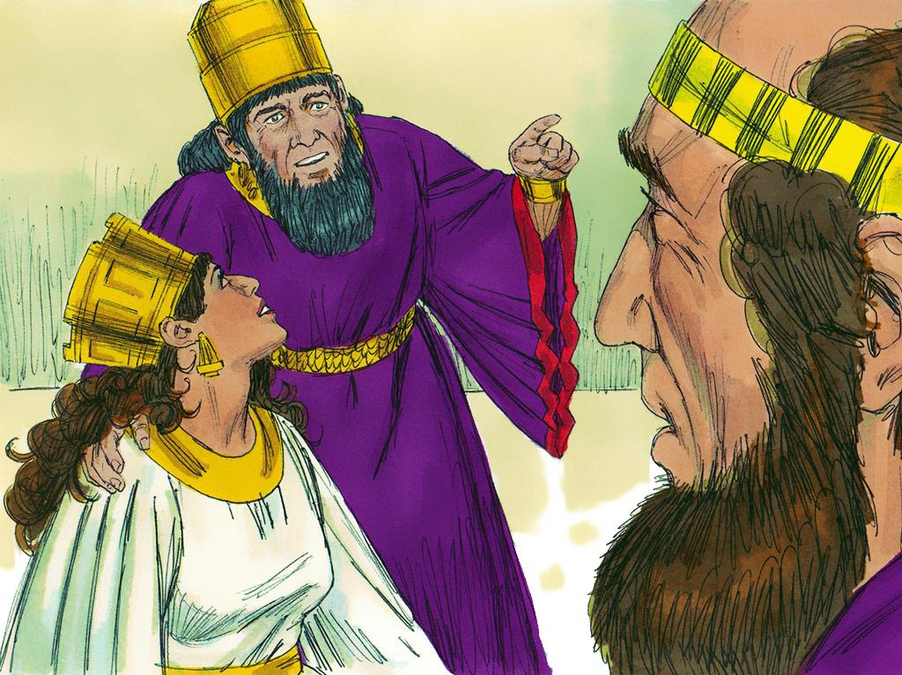
Notes:
21. The king was very sorry that he had made the law that anyone could kill the Jews. Even the king could not change the law.

Slide 22
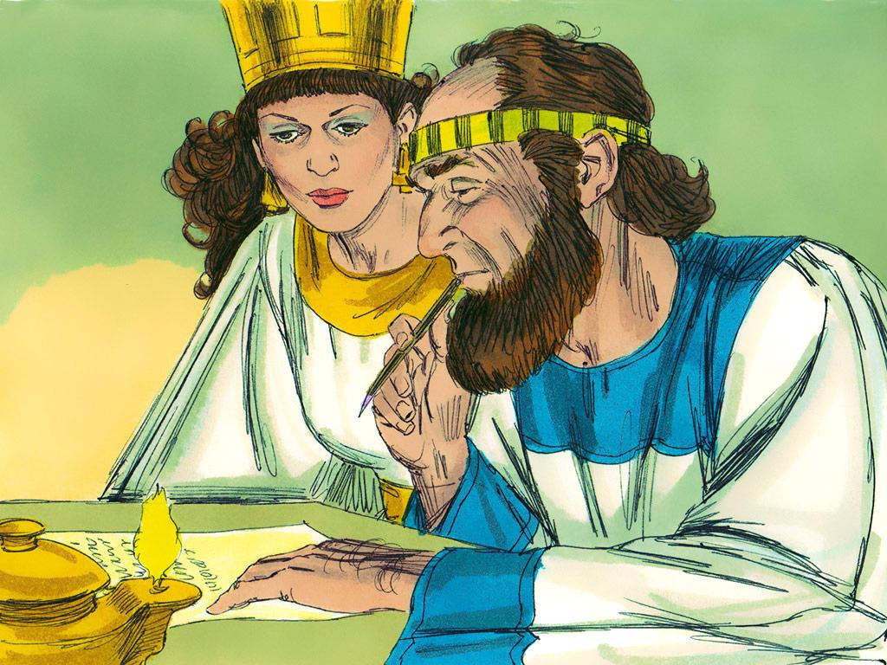
Notes:
22. So Queen Esther asked the king to make another law – a law that said the Jews could fight back if someone tried to kill them. From then on, if someone tried to hurt the Jews, then the Jews fought back. Soon, no one wanted to hurt the Jews anymore.

Slide 23
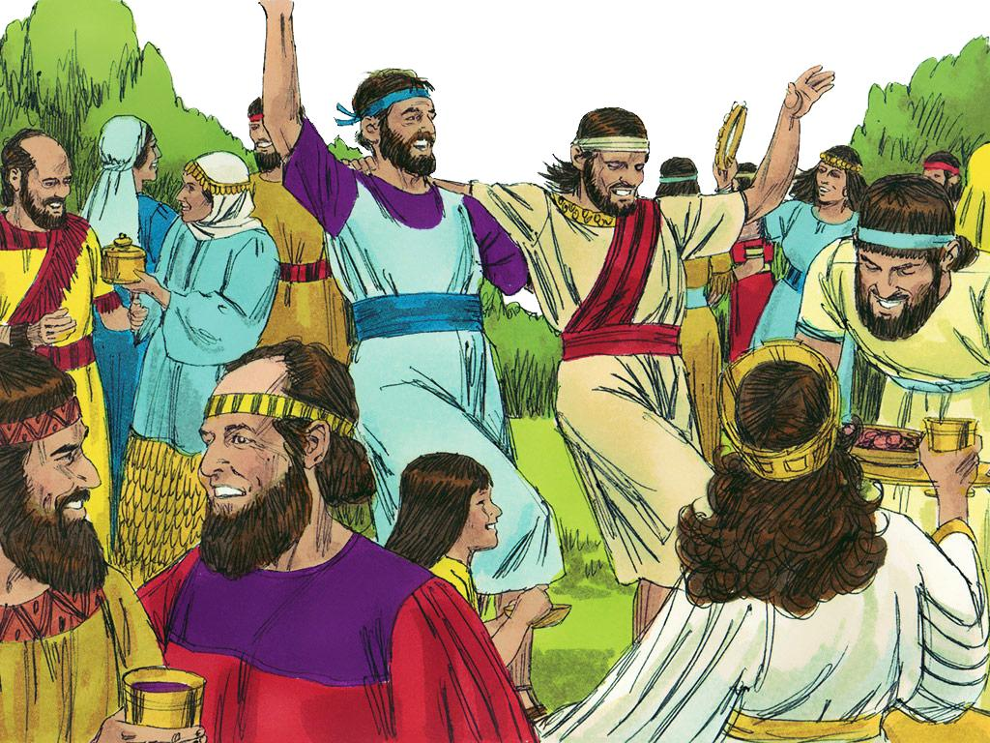
Notes:
23. Mordecai and all of the Jews were saved because of Esther.

Slide 24
Teacher Notes Page 1
1. Cover: Queen Esther (Esther chapters 1-10)
2. King Xerxes was the King of the Persian Empire, which meant he was king of the biggest kingdom in the world at that time. King Xerxes was rich and powerful, but he did not believe in God.
3. The king did something very bad. He threw a big party and told his queen that she had to dance in front of everyone. Queen Vashti refused to obey the king, and he became so angry that he told her she would be banished. He never saw her again.
4. The king’s helpers searched the whole kingdom to find the most beautiful girl to be the new queen.
5. The girls were brought to the palace, given the best makeup and perfumes, and spent a whole year learning how to be queens.
One of the girls was Esther. Esther did not have a father or a mother, so her cousin, Mordecai, raised her and treated her like a daughter. Mordecai told Esther that she should not tell anyone at the palace that she was Jewish. Jewish people were captives, and the people in charge would not want a captive to be queen.
6. When it came time to choose the new queen, the king chose Esther over all of the other girls. Esther became the queen. The king did not believe in God, but Esther did. But Esther always kept this secret. Even the king did not know.
She never forgot her cousin Mordecai or that she was one of God’s people. Sometimes, it was hard for Esther because the other Jews were treated badly. They did not have the riches that Queen Esther had.
7. But Esther did help her people. One time, Mordecai heard that someone was trying to kill the king. He told Esther about it, and she told the king.
8. The plan was stopped. Mordecai saved the king’s life! This was very special and was written in the king’s record book.
9. As time passed, a man called “Haman” became famous in the kingdom. The king thought Haman was a good man, but he was actually very bad. The king ordered everyone in the kingdom to bow down to Haman, but Mordecai knew he was bad and would not bow.
10. Haman was so angry that he planned a way to kill Mordecai and all of the Jews. When Haman told the king that the Jews were bad, the king believed him.

Slide 25
Teacher Notes Page 2
11. The king made a law that people could kill the Jews and not get in trouble. Haman was glad. Now he could hurt Mordecai too. Now, he could even have Mordecai hang to death and no one could stop him.
12. When Mordecai heard about the plan, he told Esther. “God has blessed you, Esther. Now it is time for you to use these blessings to help others. Maybe God let you become queen so that you could save our people.”
Esther was very frightened. She had never told the king that she was a Jew. Would he be mad at her like he was mad at the first queen? Esther knew that even the queen could not go to the king without an invitation. He could even have her put to death. So she asked Mordecai to have all the Jews in Susa fast and pray, and she and her servants also fasted and prayed for three days.
13. After three days, Esther went to the king. She was so relieved when he pointed his sceptre at her and told her to come to him.
14. Esther had a plan. She told the king that she wanted a special feast just for the two of them and Haman. Esther and the king planned the feast for the very next day. Haman did not know Queen Esther had a plan. He was just happy to be invited to a feast with the King and Queen.
15. The king liked Esther. At the feast he told her she could have anything she wanted. So Esther told the king that she would like to have another feast with the king and Haman the very next day. At the next feast she would say what her wish was.
16. The king went to bed that night, but he could not sleep. Sometimes, reading a book helps you sleep. So the king asked one of his helpers to bring one of the old record books. The helper brought the book and began to read to the king about things that had happened long ago. He read about the time Mordecai had saved the king’s life! The king got very excited. He wanted to do something special for Mordecai.
17. Haman was nearby, so the king called for Haman to come into his chamber. Haman was happy because he thought the king would do something nice for HIM. The king asked Haman what should be done for someone who deserved honour. Haman thought the king was about to honour him, so he said: “That person should be given a royal robe and one of the king’s horses. They should be led through the streets so everyone knows the king likes them.”
“That is a great idea,” said the king. “Go and do those things for Mordecai!”

Slide 26
Teacher Notes Page 3
18. Haman was shocked! He could not believe that the king liked Mordecai. Now, Haman knew he had a big problem. The king liked Mordecai, but Haman was trying to kill him. What would the king do when he found out?
19. And the king DID find out! The next day, when Haman went to the special feast with Esther and the King, Esther told the king everything.
First, she told the king that she was a Jew and that Haman had tricked the king into making a law that said people could kill Jews. Then she told the king that someone was trying to kill the good man, Mordecai. When he heard this, the king was very angry. He said that the man should be put to death.
“Haman is the one trying to kill Mordecai!” Esther told the king.
20. The king was very angry. How dare Haman try to hurt the man who had saved the king’s life? How dare he trick the king into making a bad law about the Queen’s people?
The king ordered Haman to be put to death. He was to be hung on the very gallows that he had built for Mordecai.
21. The king was very sorry that he had made the law that anyone could kill the Jews. Even the king could not change the law.
22. So Queen Esther asked the king to make another law – a law that said the Jews could fight back if someone tried to kill them. From then on, if someone tried to hurt the Jews, then the Jews fought back. Soon, no one wanted to hurt the Jews anymore.
23. Mordecai and all of the Jews were saved because of Esther.

Slide 27


Attributions: This visual aid was constructed by Mary Nelson www.missionbibleclass.org using:
Text and slideshow compilation by Mary Nelson
Illustrations by Sweet Publishing http://sweetpublishing.com/ As accessed through www.freebibleimages.org Notice of Alteration: Text added to cover slide. Part of illustration removed from cover and slide 12.
Attribution-ShareAlike 3.0 Unported (CC BY-SA 3.0) https://creativecommons.org/licenses/by-sa/3.0/
User may reproduce it without permissions.
DOWNLOAD THIS SLIDESHOW FROM www.missionbibleclass.org
Please visit www.missionbibleclass.org to find this and many other free resources to help you teach the Bible to children.

