Slide 1
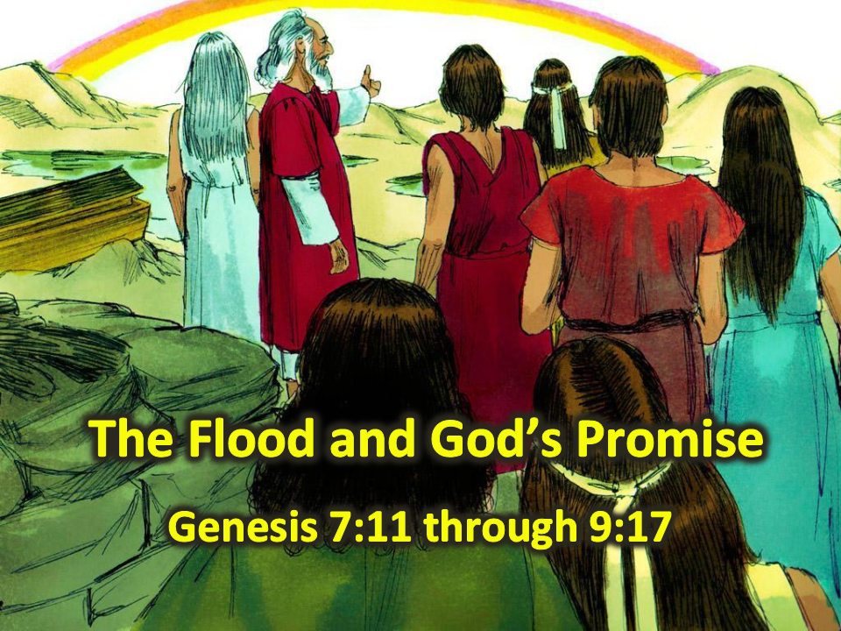
Notes:
1. Cover: The Flood and God’s Promise (Genesis 7:11 through 9:17)

Slide 2
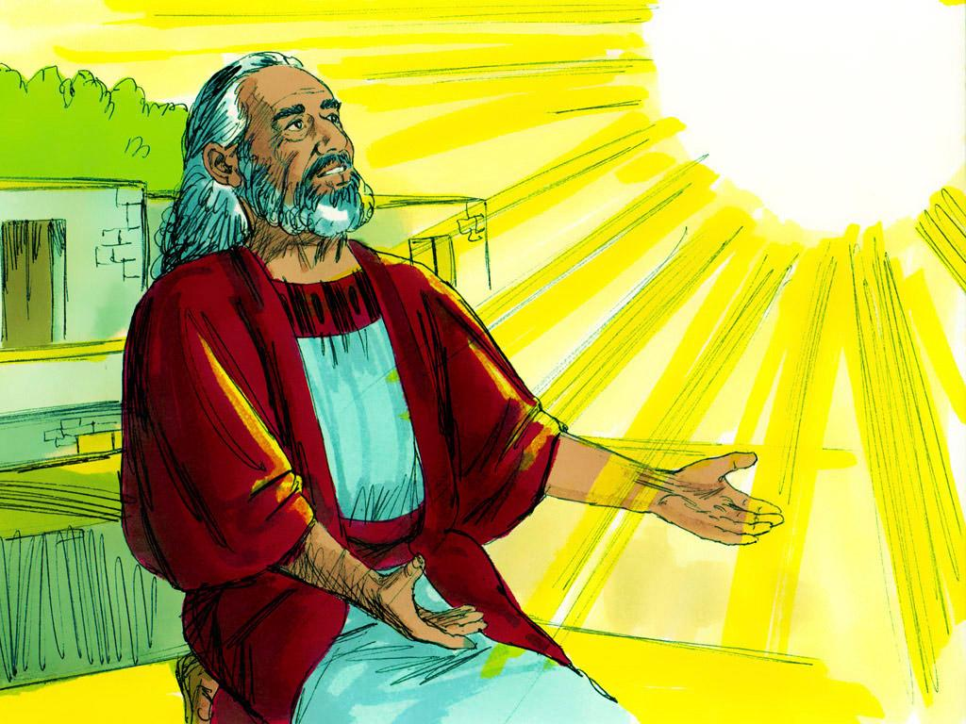
Notes:
2. Noah was a man who followed God. He tried to be a good person, and this made God happy.

Slide 3
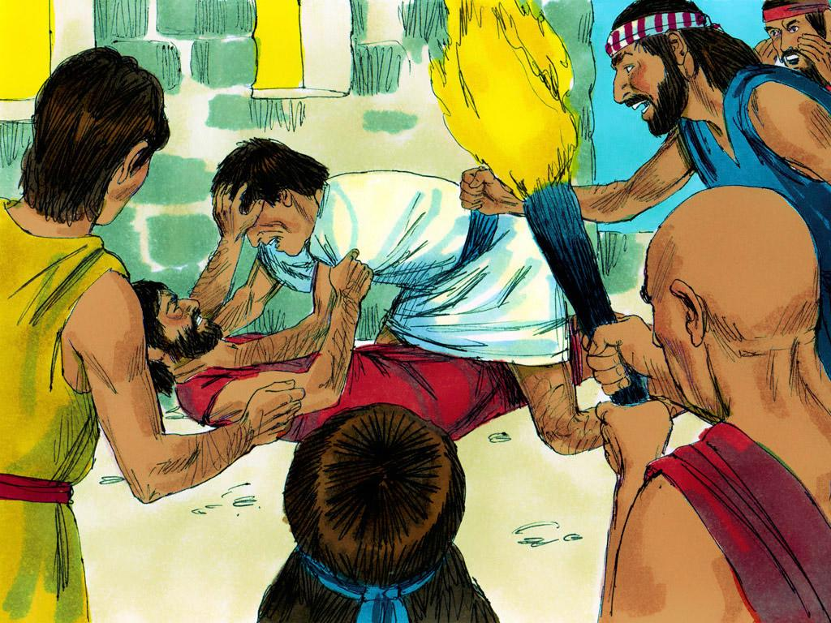
Notes:
3. But Noah was the ONLY one who followed God. In fact, he was the only one in the whole world. In the Bible, we read that everyone else was bad. Everyone around Noah only ever did bad things and thought bad thoughts. People wanted to hurt each other and even kill each other. If this continued, then the world would soon be destroyed.

Slide 4
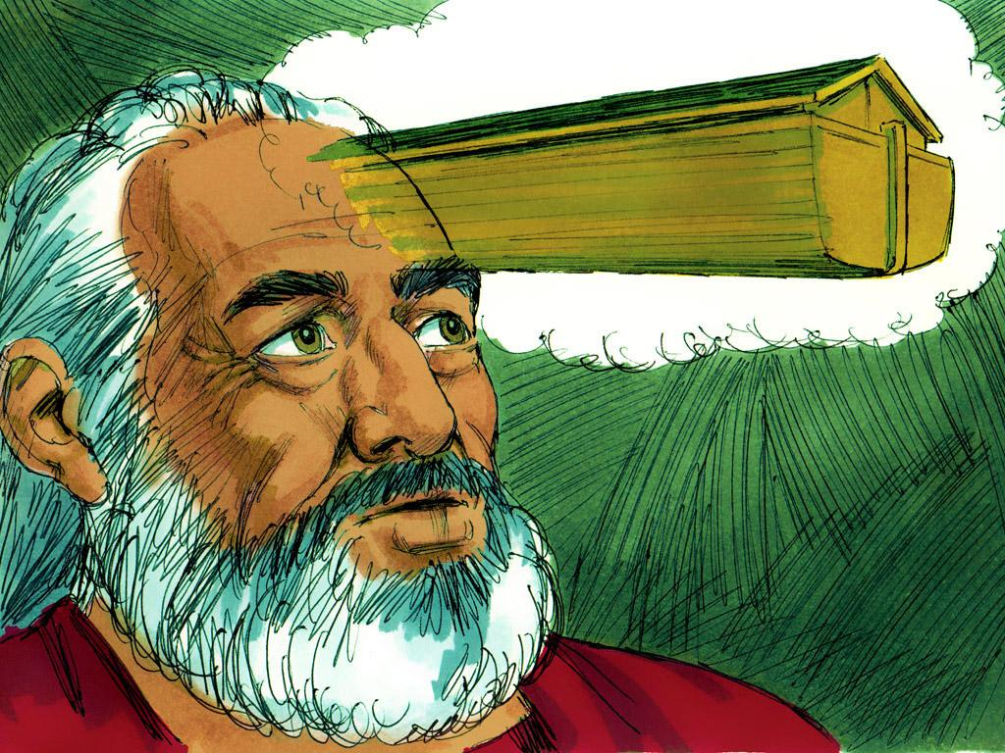
Notes:
4. But God had a plan. Since Noah was the last good person, God would use him to save the world. God told Noah to build a huge boat.

Slide 5
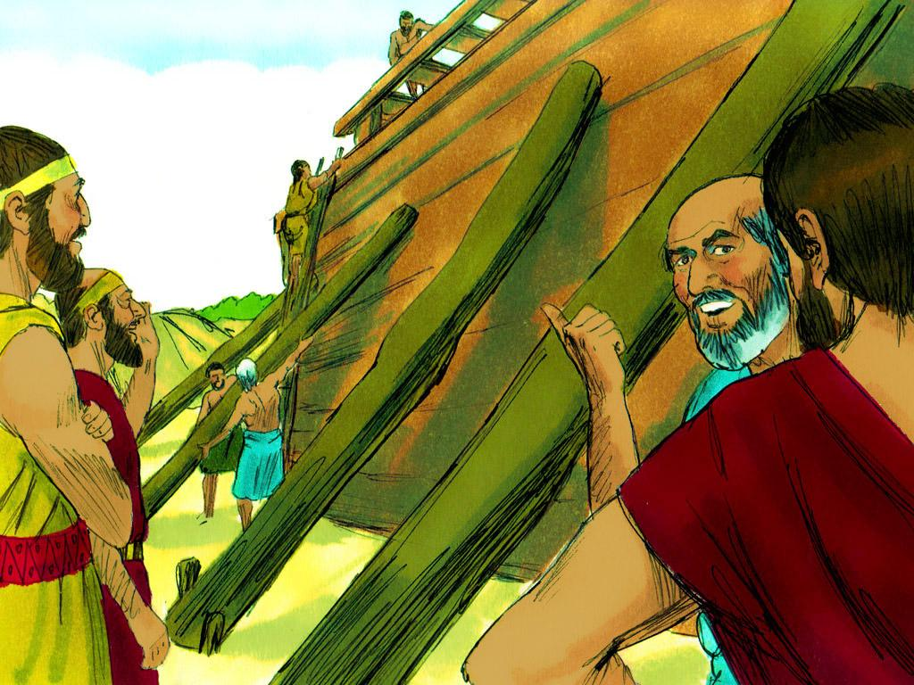
Notes:
5. This must have seemed strange to Noah, but Noah did exactly as God asked. God told him the design plans, the exact measurements and even what kind of wood to use. Noah followed all of the instructions God gave him.
Eight people were to go into this ark. They were Noah, his wife, their three sons and their wives. But why was the ark so big? Eventually, Noah learned that the ark needed to be big because some other passengers would join him and his family in the ark.

Slide 6
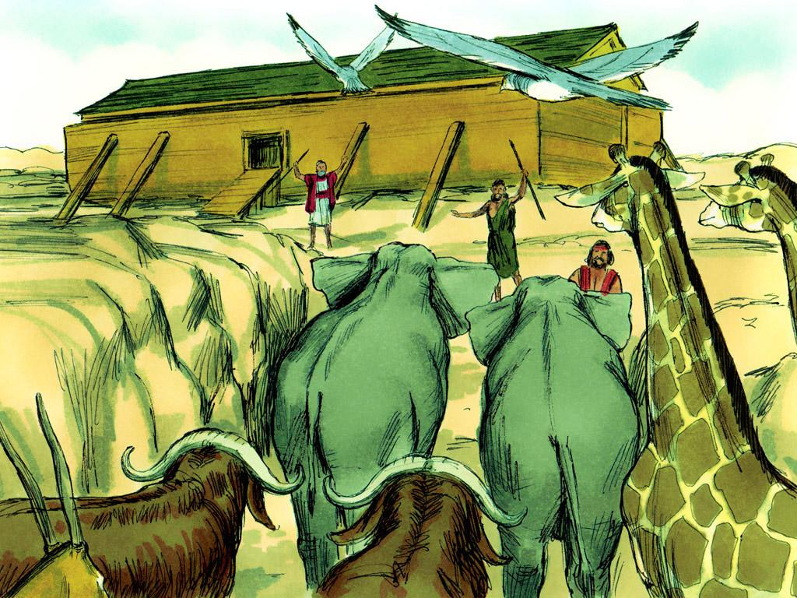
Notes:
6. And the other passengers were animals. God sent a male and female of every kind of animal to Noah. He even sent seven pairs of some kinds of animals. Now Noah knew why the ark needed to be so big!
Noah loaded his family, food and all of these animals into the ark just as God told him to. And then God closed the door.

Slide 7
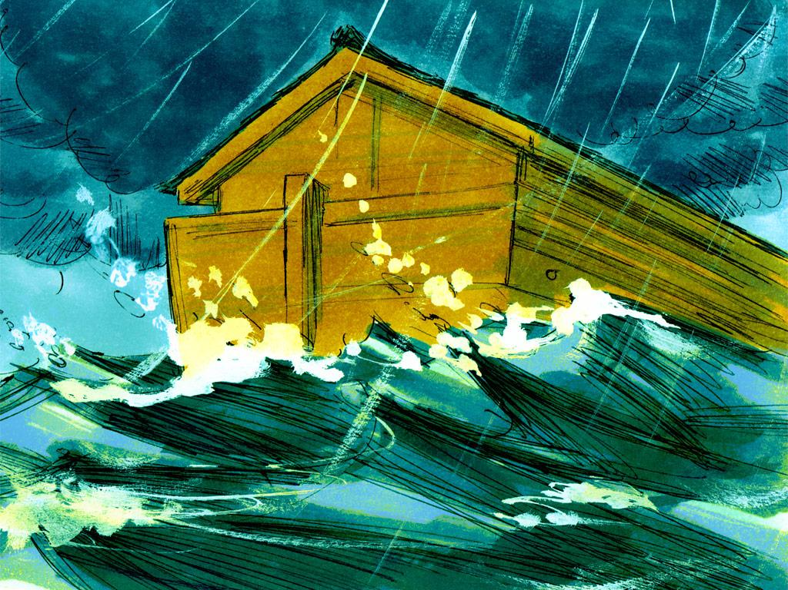
Notes:
7. After God closed the door, the rain started. Springs of water began to come up from under the earth as well. The rain came down for forty days and forty nights, and the flood waters rose. Only Noah and his family and the animals inside the ark were safe.

Slide 8
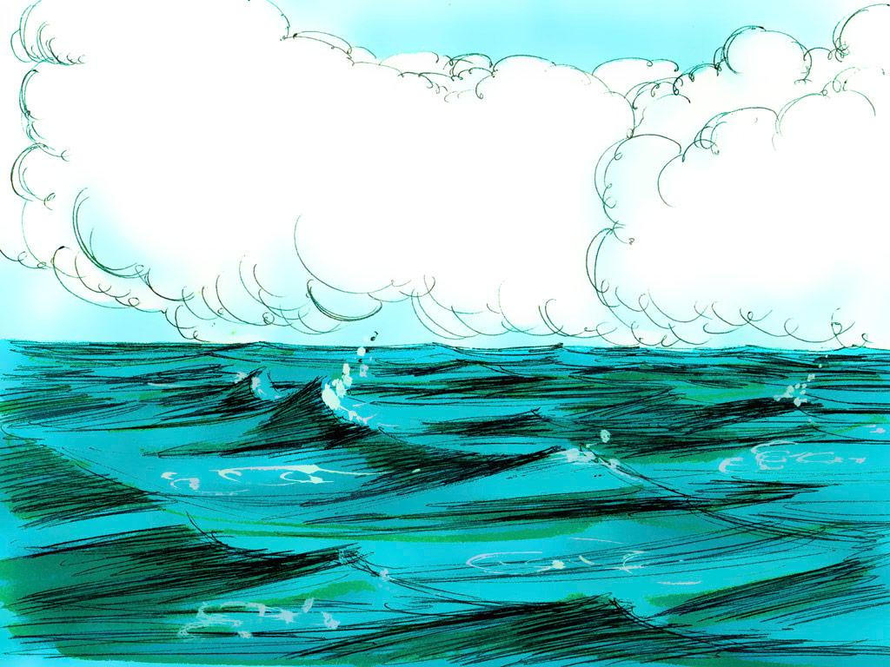
Notes:
8. Finally, after forty days, the rain stopped. Water covered the entire earth, and no land was visible.
The ark continued to float with everyone inside. Then, one day, the people and animals on the ark would have felt a bump. The bottom of the ark had settled on the top of a mountain!

Slide 9
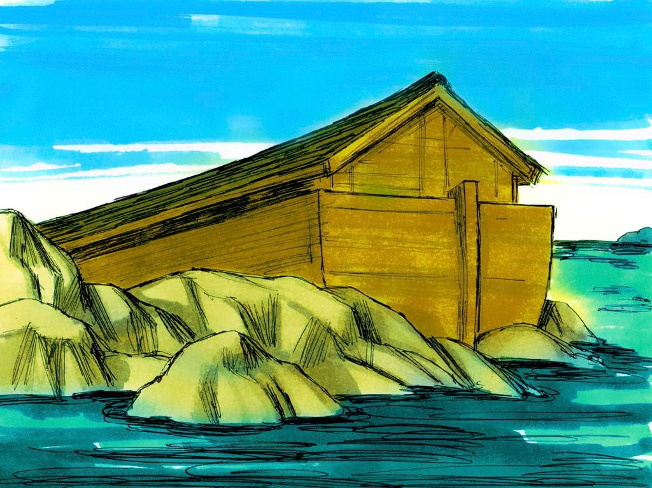
Notes:
9. Still, it took many weeks for all of the flood water to recede and the tops of that and other mountains to appear above the water.

Slide 10
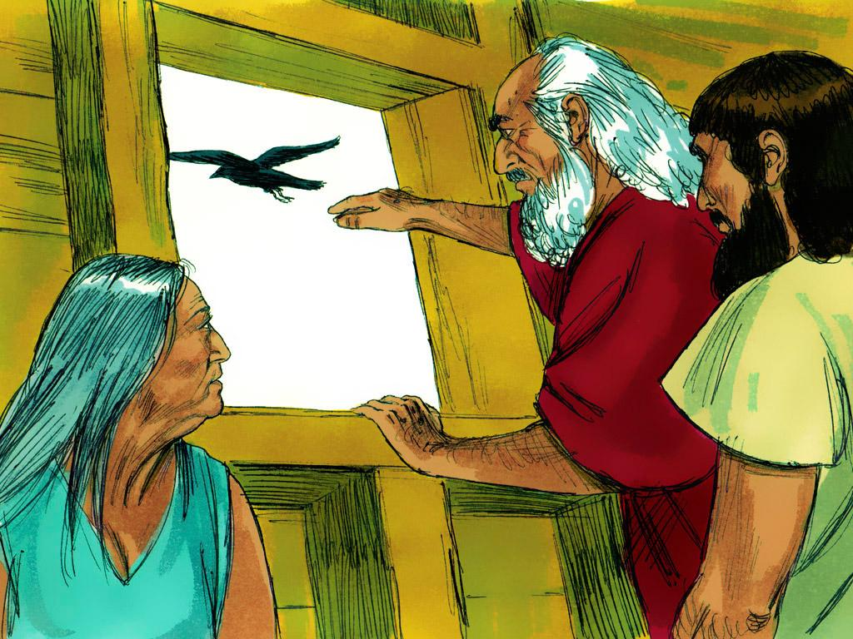
Notes:
10. Noah waited over a month, then opened the window and sent a bird called a raven out to fly around. The raven flew here and there, but the land had not dried up yet.

Slide 11
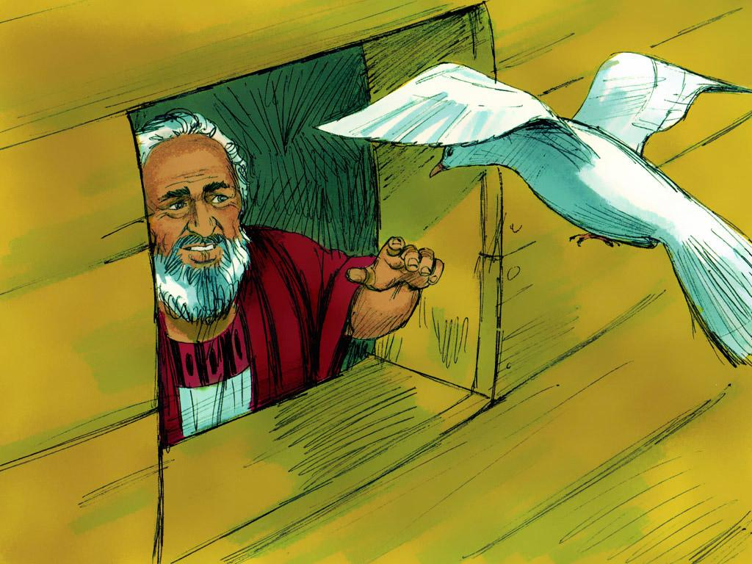
Notes:
11. Next, Noah sent a dove out. The dove flew around but then came back to Noah.

Slide 12
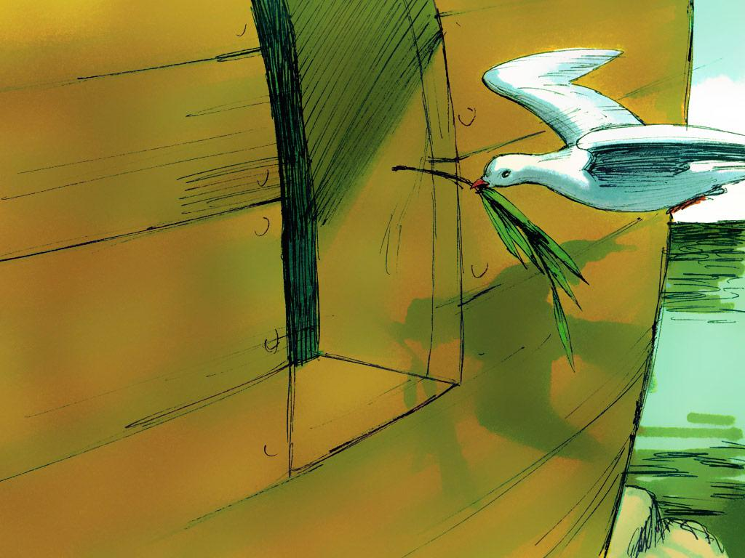
Notes:
12. Seven days later, Noah sent the dove back again. This time, when the dove came back to Noah, it had a fresh olive leaf in its beak. Noah and his family must have been excited. The olive leaf meant that plants were beginning to grow again.

Slide 13
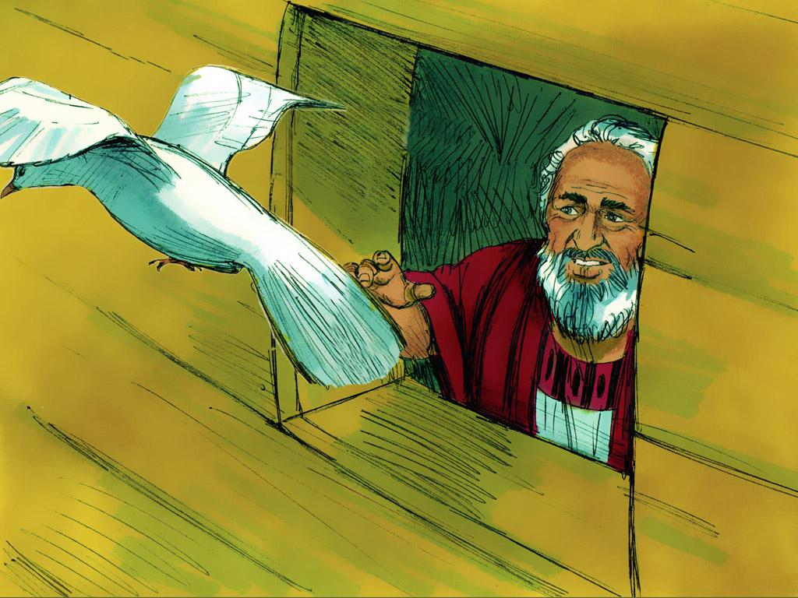
Notes:
13. Noah sent the dove out a third time seven days later. The final time, the dove did not come back. Perhaps it had found a new home. Soon, the earth would be ready for people, too.

Slide 14
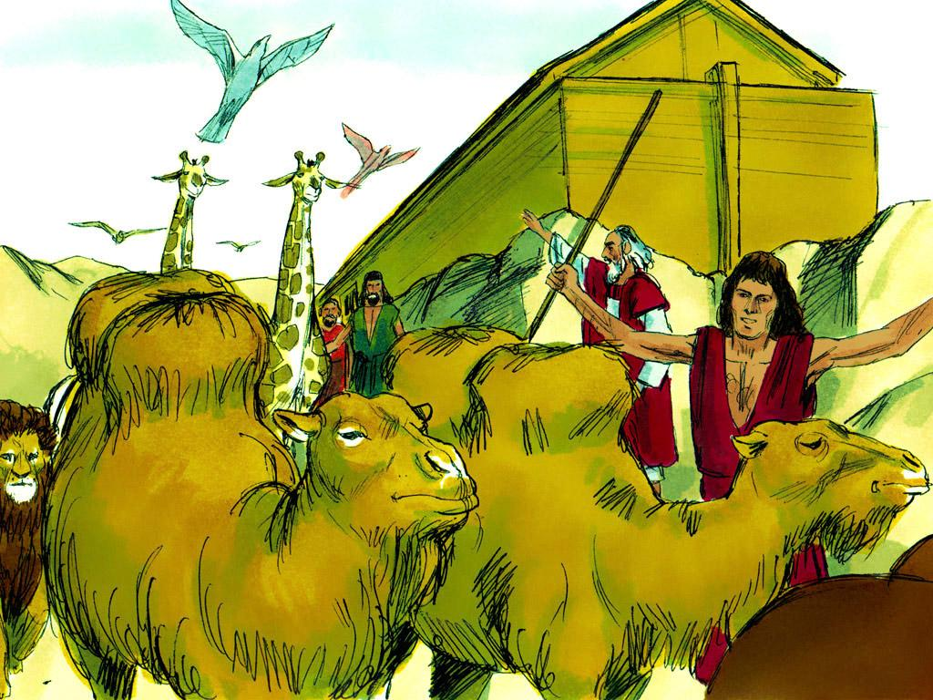
Notes:
14. Over a year had passed since everyone had boarded the ark. God told Noah it was time for everyone to come out. The animals would go and have babies, and the earth would be full of animals again.

Slide 15
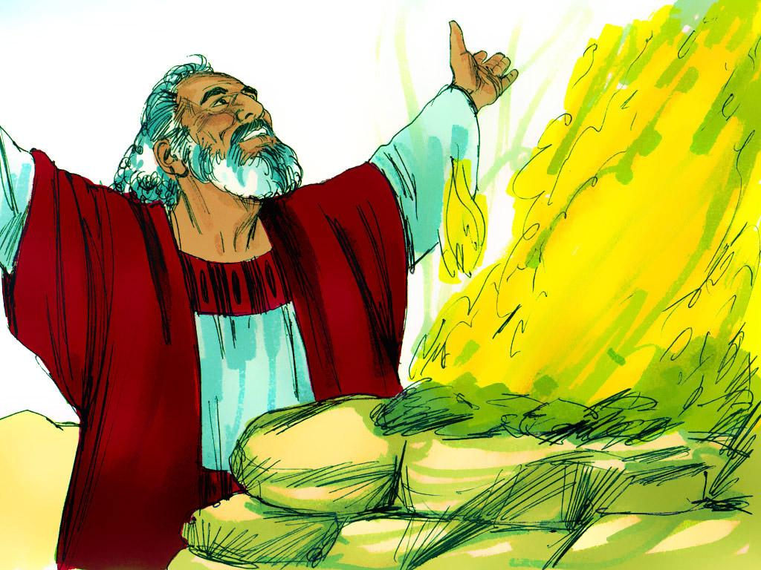
Notes:
15. Noah built an altar and worshipped God. He was thankful that God had brought them through this terrible flood safely.

Slide 16
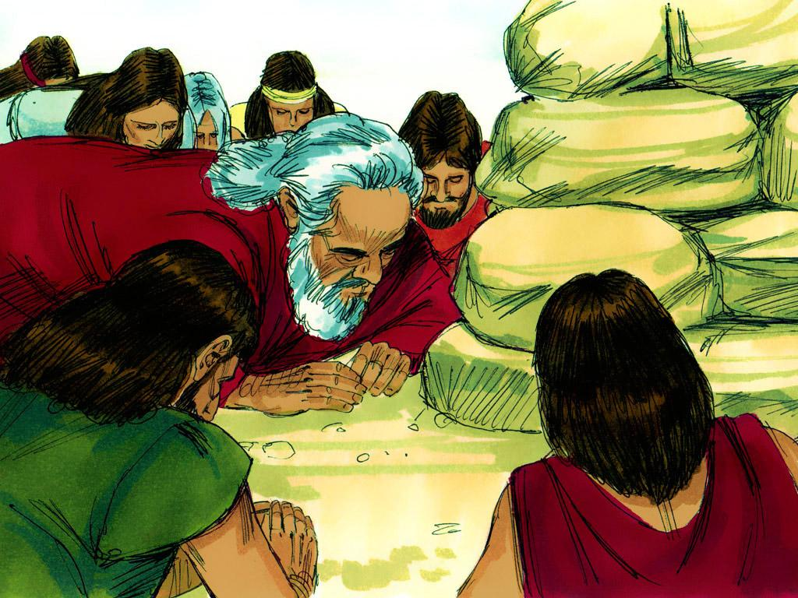
Notes:
16. And God had something to say to Noah, too. Noah and his family would grow bigger and bigger, and God wanted to make an agreement with them. The agreement would be between God and all the earth. God agreed never to send a flood like this again.

Slide 17
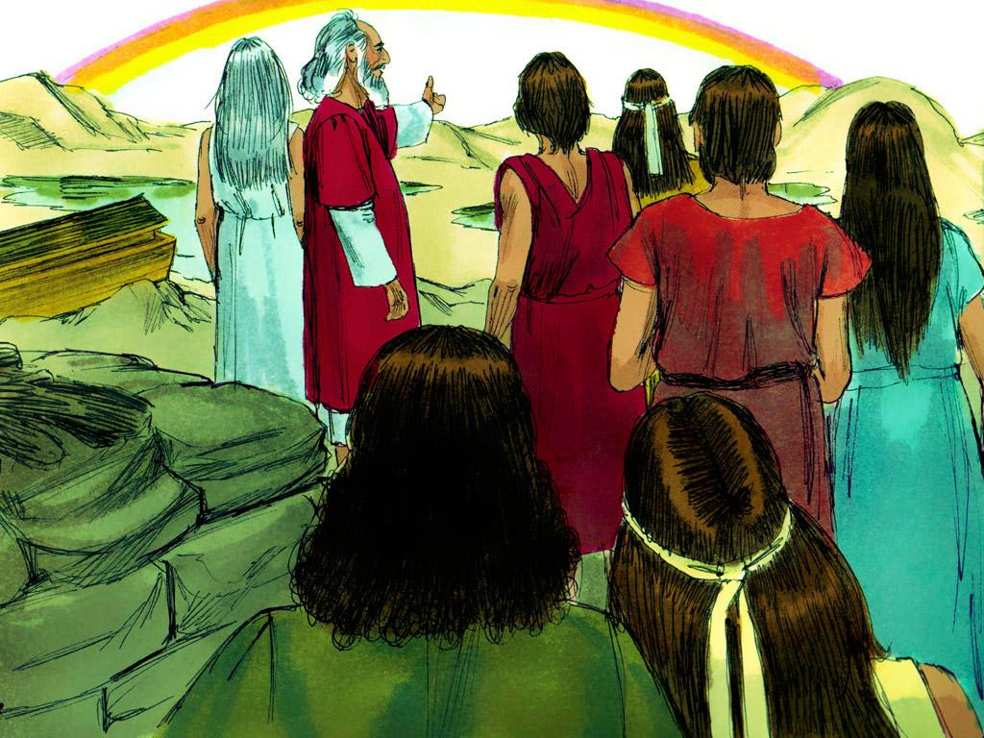
Notes:
17. At that time, a rainbow appeared in the sky. God said to Noah, “That rainbow is a sign. It is the sign of the agreement that I made with all living things on earth.” The rainbow is a reminder that God will keep His agreement and never flood the earth again.
Have you ever seen a rainbow? The next time you see a rainbow, you can remember that God always keeps his agreements.

Slide 18
Teacher Notes 1
1. Cover: The Flood and God’s Promise (Genesis 7:11 through 9:17)
2. Noah was a man who followed God. He tried to be a good person, and this made God happy.
3. But Noah was the ONLY one who followed God. In fact, he was the only one in the whole world. In the Bible, we read that everyone else was bad. Everyone around Noah only ever did bad things and thought bad thoughts. People wanted to hurt each other and even kill each other. If this continued, then the world would soon be destroyed.
4. But God had a plan. Since Noah was the last good person, God would use him to save the world. God told Noah to build a huge boat.
5. This must have seemed strange to Noah, but Noah did exactly as God asked. God told him the design plans, the exact measurements and even what kind of wood to use. Noah followed all of the instructions God gave him.
Eight people were to go into this ark. They were Noah, his wife, their three sons and their wives. But why was the ark so big? Eventually, Noah learned that the ark needed to be big because some other passengers would join him and his family in the ark.
6. And the other passengers were animals. God sent a male and female of every kind of animal to Noah. He even sent seven pairs of some kinds of animals. Now Noah knew why the ark needed to be so big!
Noah loaded his family, food and all of these animals into the ark just as God told him to. And then God closed the door.
7. After God closed the door, the rain started. Springs of water began to come up from under the earth as well. The rain came down for forty days and forty nights, and the flood waters rose. Only Noah and his family and the animals inside the ark were safe.
8. Finally, after forty days, the rain stopped. Water covered the entire earth, and no land was visible.
The ark continued to float with everyone inside. Then, one day, the people and animals on the ark would have felt a bump. The bottom of the ark had settled on the top of a mountain!
9. Still, it took many weeks for all of the flood water to recede and the tops of that and other mountains to appear above the water.
10. Noah waited over a month, then opened the window and sent a bird called a raven out to fly around. The raven flew here and there, but the land had not dried up yet.
11. Next, Noah sent a dove out. The dove flew around but then came back to Noah.
12. Seven days later, Noah sent the dove back again. This time, when the dove came back to Noah, it had a fresh olive leaf in its beak. Noah and his family must have been excited. The olive leaf meant that plants were beginning to grow again.
13. Noah sent the dove out a third time seven days later. The final time, the dove did not come back. Perhaps it had found a new home. Soon, the earth would be ready for people, too.

Slide 19
Teacher Notes 2
14. Over a year had passed since everyone had boarded the ark. God told Noah it was time for everyone to come out. The animals would go and have babies, and the earth would be full of animals again.
15. Noah built an altar and worshipped God. He was thankful that God had brought them through this terrible flood safely.
16. And God had something to say to Noah, too. Noah and his family would grow bigger and bigger, and God wanted to make an agreement with them. The agreement would be between God and all the earth. God agreed never to send a flood like this again.
17. At that time, a rainbow appeared in the sky. God said to Noah, “That rainbow is a sign. It is the sign of the agreement that I made with all living things on earth.” The rainbow is a reminder that God will keep His agreement and never flood the earth again.
Have you ever seen a rainbow? The next time you see a rainbow, you can remember that God always keeps his agreements.

Slide 20


Attributions: This visual aid was constructed by Mary Nelson www.missionbiblelessons.org using:
Text and slideshow compilation by Mary Nelson
Illustrations by Sweet Publishing http://sweetpublishing.com/ As accessed through www.freebibleimages.org Notice of Alteration: Text added to cover slide.
Attribution-ShareAlike 3.0 Unported (CC BY-SA 3.0) https://creativecommons.org/licenses/by-sa/3.0/
User may reproduce it without permissions.
DOWNLOAD THIS SLIDESHOW FROM www.missionbiblelessons.org
Please visit www.missionbiblelessons.org to find this and many other free resources to help you teach the Bible to children.

