Slide 1
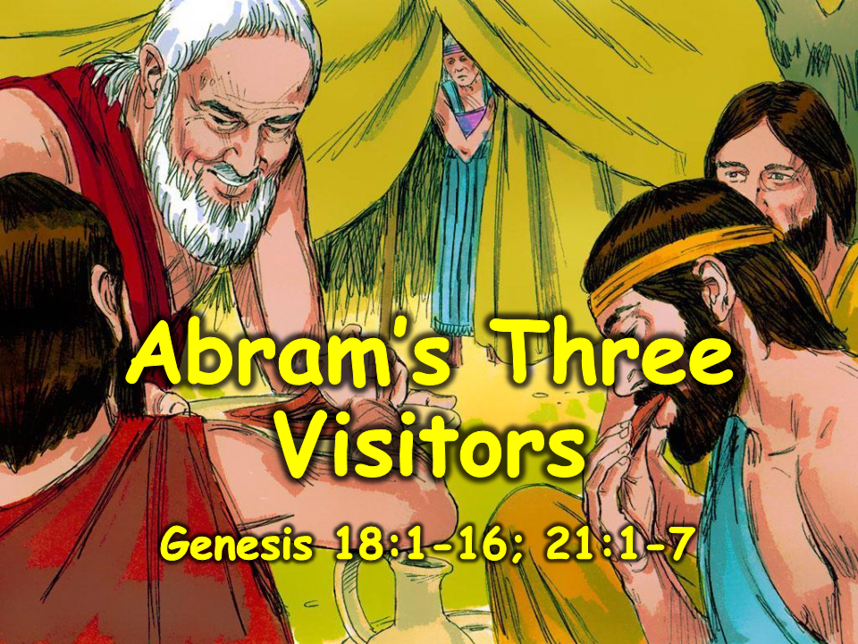
Notes:
1. Cover: Abram’s Three Visitors (Genesis 18:1-16; 21:1-7)

Slide 2
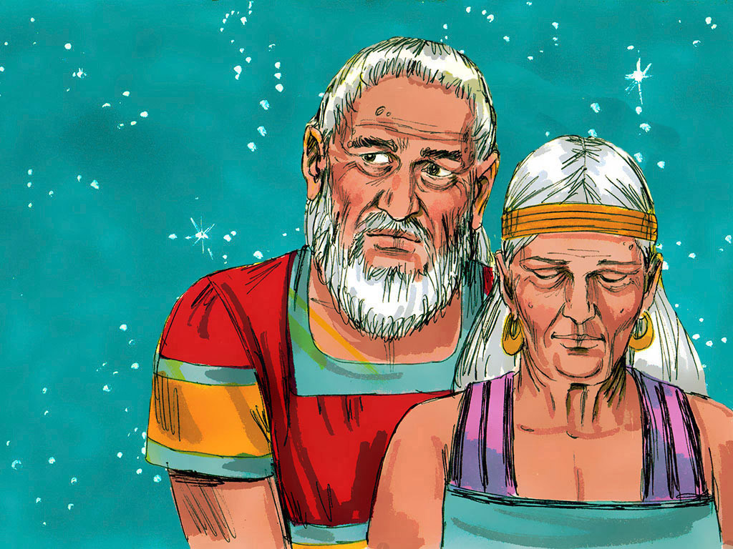
Notes:
2. Abram and Sarai had brand new names. God told them to change their names to Abraham and Sarah. Once, Abraham sat by his tent, wishing again that he and Sarah had a son of their own. He remembered that God had promised, “I am going to give you children, Abraham.” But that was such a long time ago. Would God keep His promise? Abraham hoped so. He wanted a son very much.
Abraham’s wife, Sarah, wanted a son, too. But she didn’t think God would keep His promise. “I’m too old to have a baby,” she said to herself. “I’m almost 90 years old.”

Slide 3
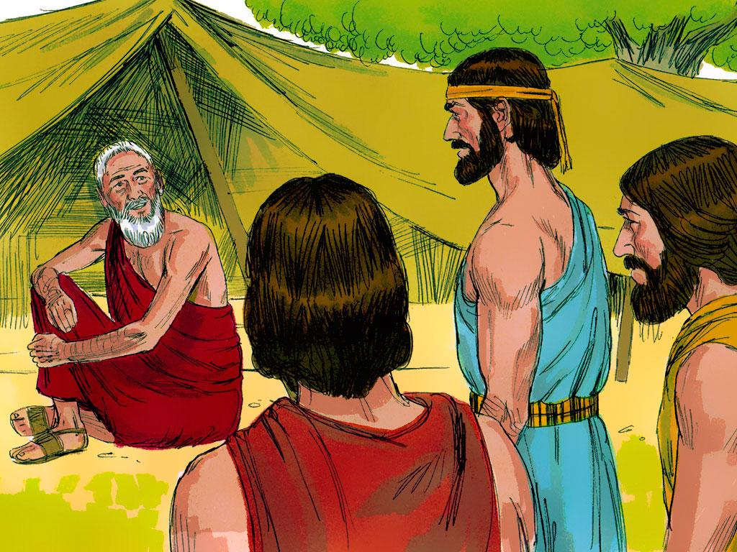
Notes:
3. It was a very hot day! The sun was beating down, and no breeze was blowing. Suddenly, Abraham looked up and saw three travellers coming toward his tent. Abraham bowed to the travellers and said, “Hello! Please stay awhile and rest under these trees near my tent. It’s cool and shady here. And if you rest awhile, I’ll bring you water to wash your tired, dusty feet and give you something to eat and drink.”

Slide 4
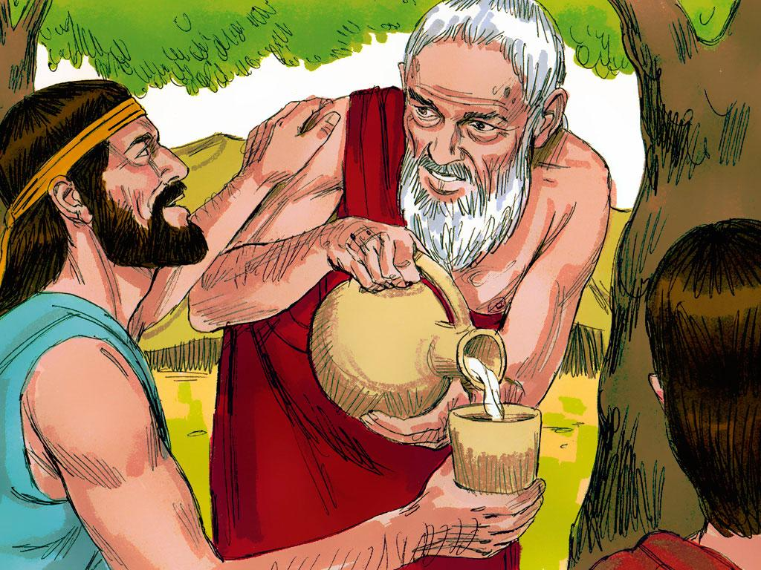
Notes:
4. Then, the visitors accepted Abraham’s kind offer and settled in the shade of the trees.
“Thank you,” they said.

Slide 5
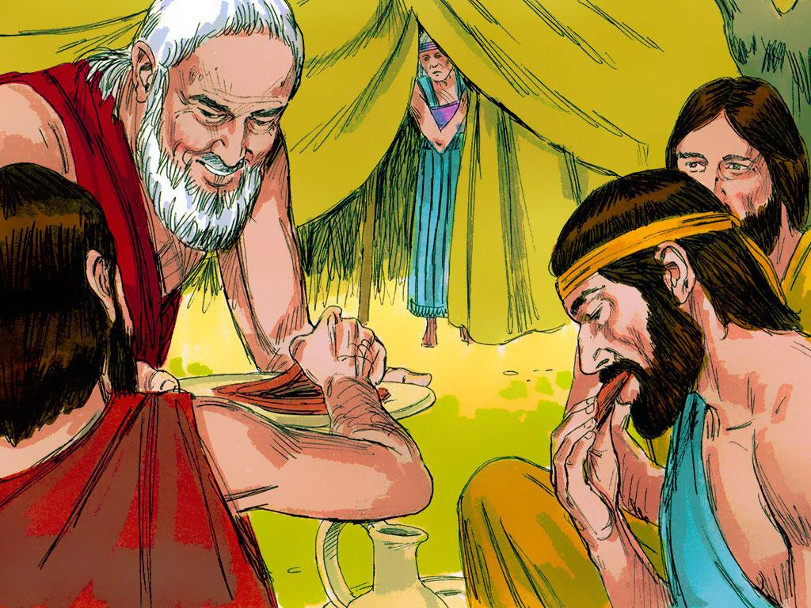
Notes:
5. Abraham hurried into the tent. “Sarah!” he cried, “We have visitors! Quickly bake some bread for them while I see to the preparing of the meat for their dinner.”
Later, Abraham brought milk, cheese, and meat for the visitors. While they ate, Abraham stood nearby. One visitor told Abraham, “God is going to keep His promise to you. When I come to visit you next year, Sarah will have a baby boy.”

Slide 6
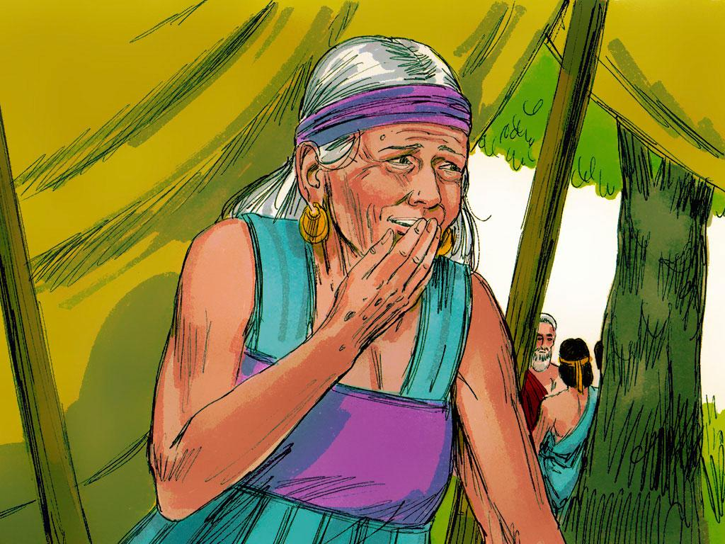
Notes:
6. Sarah was inside the tent, listening to the men talk. She laughed to herself. “That’s impossible!” she thought. “Abraham and I are much too old to have children.”

Slide 7
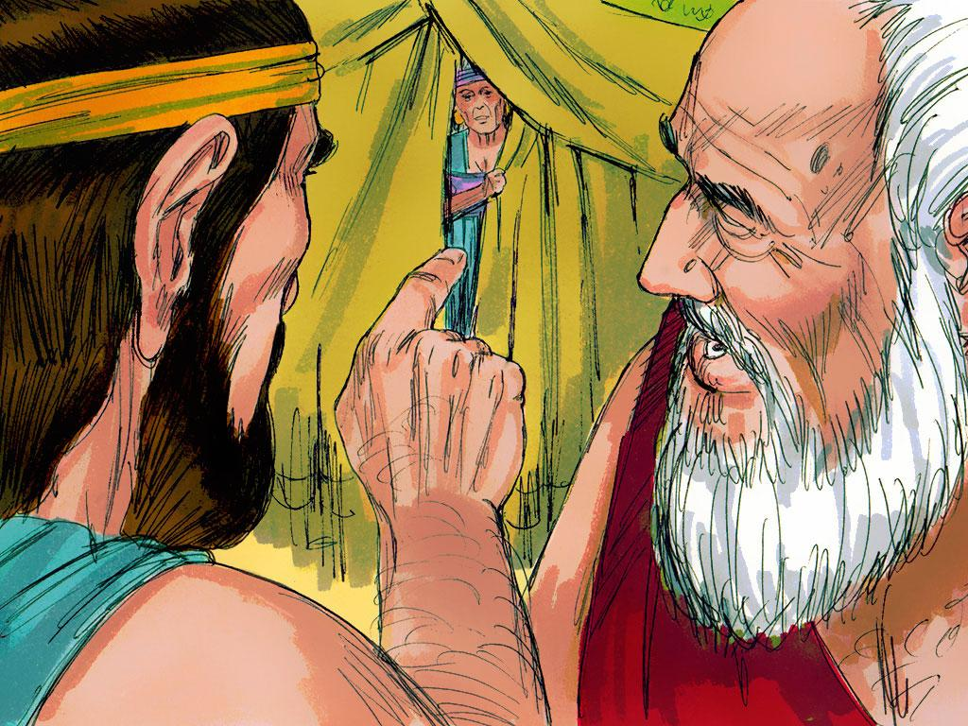
Notes:
7. The man said, “Why did Sarah laugh? Is anything too hard for God to do? When I come back next year, Sarah will have a son. You can always trust what God says.”
Sarah was very surprised that the visitors knew what she was thinking. She hadn’t said anything out loud, yet they knew what she said to herself! These were not just ordinary visitors. One of the visitors was the Lord, and the other two were angels.
What do you think Abraham thought when he heard this good news? He was very happy. He knew his time of waiting would soon be over. He knew he could trust what God had said.

Slide 8
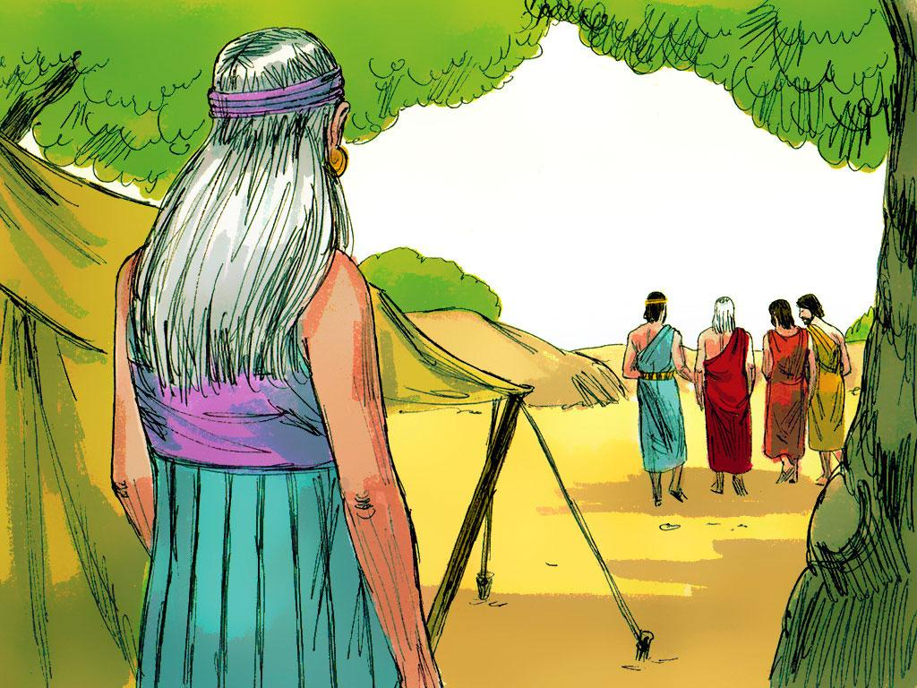
Notes:
8. Why did the visitors come? Because God wanted Abraham to know about the baby. God wanted Abraham and Sarah to learn that they could trust what He said about a baby and what He said about other things.

Slide 9
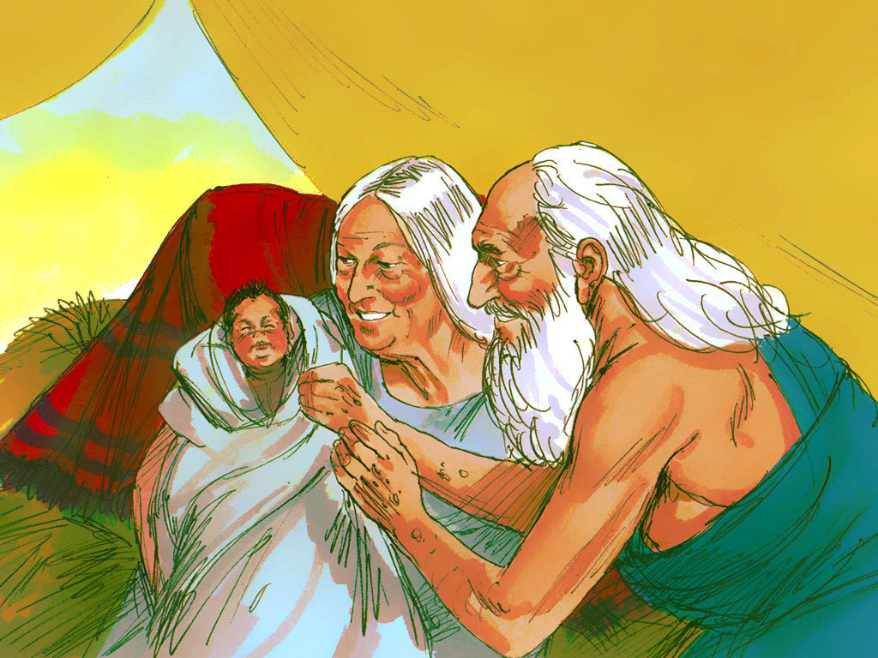
Notes:
9. A year later, Sarah held a little baby boy in her arms. The baby’s name was Isaac. Sarah was so happy, she laughed. She had the little baby she had always wanted. Abraham was 100 years old when Isaac was born, and Sarah was 90.
Abraham was happy, too. “God did what He said He would do,” Abraham said. “We can always trust what God says. He has given us a fine baby boy.”

Slide 10
Teacher Notes 1
1. Cover: Abram’s Three Visitors (Genesis 18:1-16; 21:1-7)
2. Abram and Sarai had brand new names. God told them to change their names to Abraham and Sarah. Once, Abraham sat by his tent, wishing again that he and Sarah had a son of their own. He remembered that God had promised, “I am going to give you children, Abraham.” But that was such a long time ago. Would God keep His promise? Abraham hoped so. He wanted a son very much.
Abraham’s wife, Sarah, wanted a son, too. But she didn’t think God would keep His promise. “I’m too old to have a baby,” she said to herself. “I’m almost 90 years old.”
3. It was a very hot day! The sun was beating down, and no breeze was blowing. Suddenly, Abraham looked up and saw three travellers coming toward his tent. Abraham bowed to the travellers and said, “Hello! Please stay awhile and rest under these trees near my tent. It’s cool and shady here. And if you rest awhile, I’ll bring you water to wash your tired, dusty feet and give you something to eat and drink.”
4. Then, the visitors accepted Abraham’s kind offer and settled in the shade of the trees.
“Thank you,” they said.
5. Abraham hurried into the tent. “Sarah!” he cried, “We have visitors! Quickly bake some bread for them while I see to the preparing of the meat for their dinner.”
Later, Abraham brought milk, cheese, and meat for the visitors. While they ate, Abraham stood nearby. One visitor told Abraham, “God is going to keep His promise to you. When I come to visit you next year, Sarah will have a baby boy.”
6. Sarah was inside the tent, listening to the men talk. She laughed to herself. “That’s impossible!” she thought. “Abraham and I are much too old to have children.”
7. The man said, “Why did Sarah laugh? Is anything too hard for God to do? When I come back next year, Sarah will have a son. You can always trust what God says.”
Sarah was very surprised that the visitors knew what she was thinking. She hadn’t said anything out loud, yet they knew what she said to herself! These were not just ordinary visitors. One of the visitors was the Lord, and the other two were angels.
What do you think Abraham thought when he heard this good news? He was very happy. He knew his time of waiting would soon be over. He knew he could trust what God had said.
8. Why did the visitors come? Because God wanted Abraham to know about the baby. God wanted Abraham and Sarah to learn that they could trust what He said about a baby and what He said about other things.

Slide 11
Teacher Notes 2
9. A year later, Sarah held a little baby boy in her arms. The baby’s name was Isaac. Sarah was so happy, she laughed. She had the little baby she had always wanted. Abraham was 100 years old when Isaac was born, and Sarah was 90.
Abraham was happy, too. “God did what He said He would do,” Abraham said. “We can always trust what God says. He has given us a fine baby boy.”

Slide 12


Attributions: This visual aid was constructed by Mary Nelson missionbiblelessons.org using:
Text and slideshow compilation by Mary Nelson
Illustrations by Sweet Publishing http://sweetpublishing.com/
As accessed through www.freebibleimages.org
Notice of Alteration: Text added to cover slide.
Attribution-ShareAlike 3.0 Unported (CC BY-SA 3.0) https://creativecommons.org/licenses/by-sa/3.0/
User may reproduce it without permissions.
DOWNLOAD THIS SLIDESHOW FROM www.missionbibleclass.org
Please visit missionbiblelessons.org to find this and many other free resources to help you
teach the Bible to children.

