Slide 1
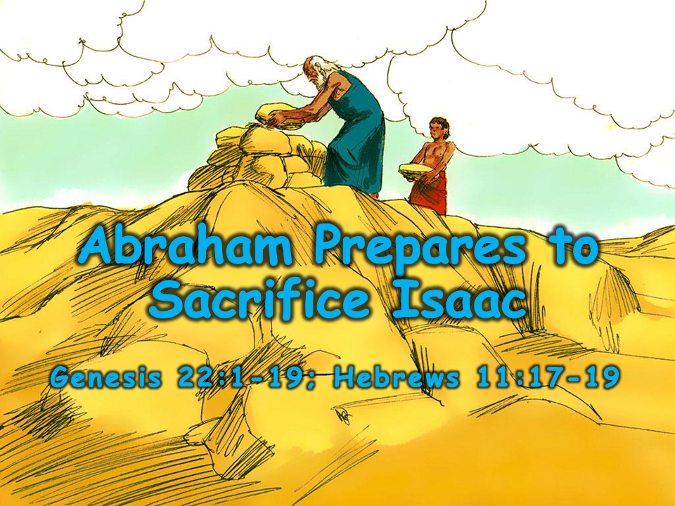
Notes:
1. Cover: Abraham’s Sacrifice (Genesis 22:1-19 and Hebrews 11:17-19)

Slide 2
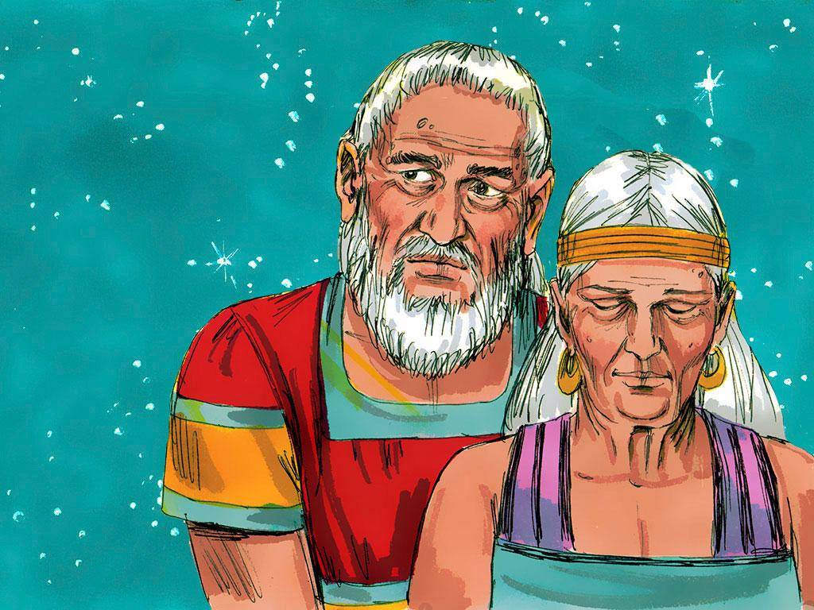
Notes:
2. Many years ago, God decided to build a great nation so that this nation could follow Him and bless the world. God chose Abraham to begin this nation.
Have you ever tried to count how many stars there are in the sky at night? There are too many to count! Well, God told Abraham that counting his descendants would be like trying to count stars. He would have so many grandchildren, great-grandchildren, great-great-grandchildren, and great-great-great-grandchildren that no one could even count them.
Abraham believed in God, but as the years went by, he and his wife, Sarah, wondered how God would make this happen. They were getting older and older and still had no children together.

Slide 3
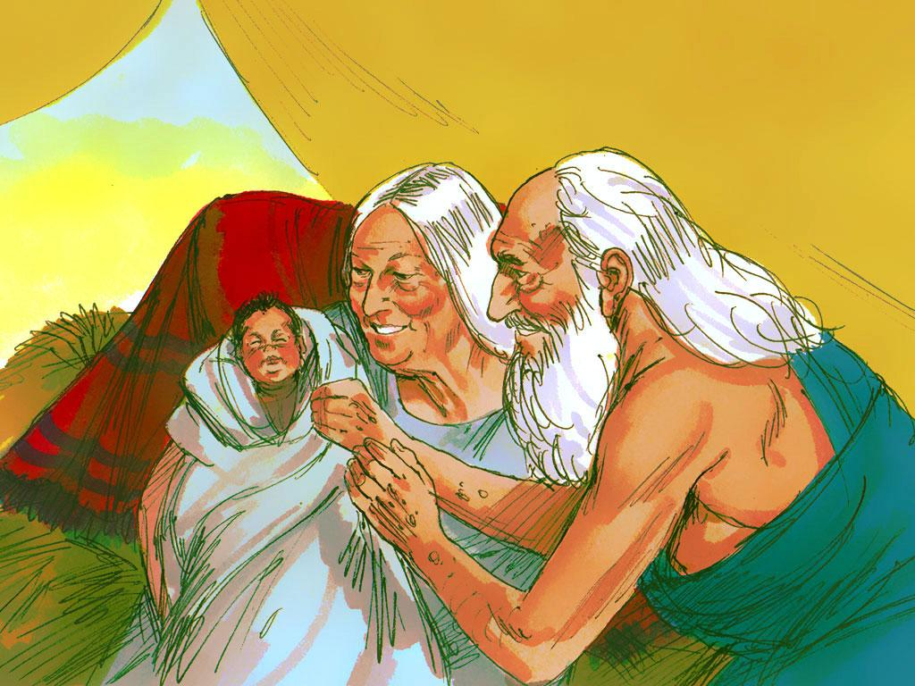
Notes:
3. But, of course, God kept His promise!
Finally, when Abraham was 100 years old, and Sarah was 90 years old, they had a baby. They named their son Isaac.

Slide 4
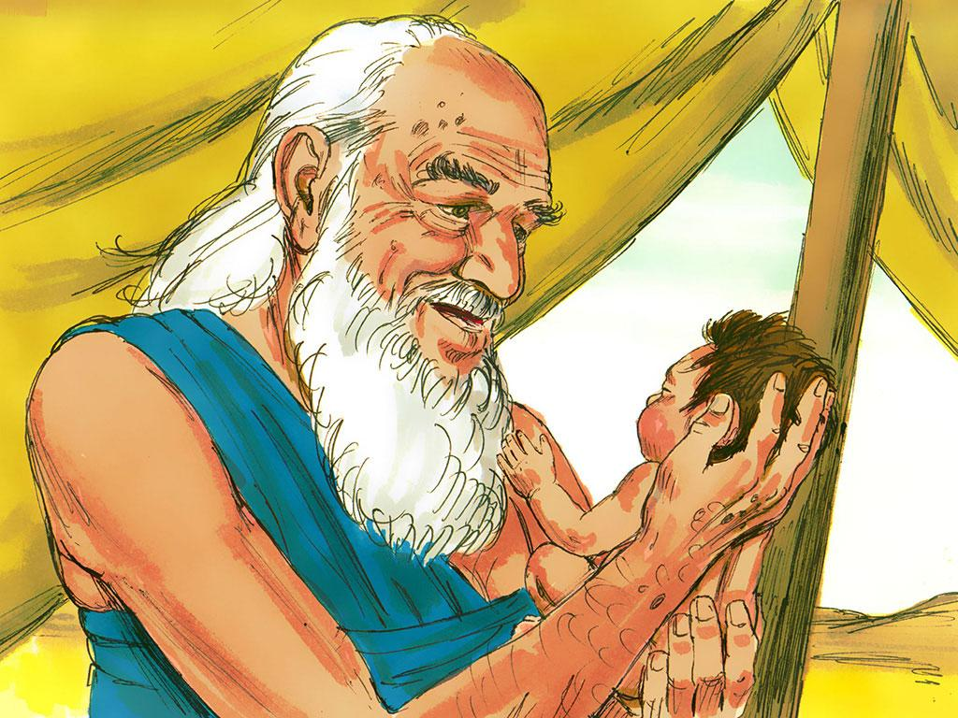
Notes:
4. Abraham and Sarah loved Isaac very much and looked forward to the day Isaac would marry and have children. Then those children would grow up and have children, and then those children would grow up and have children.

Slide 5
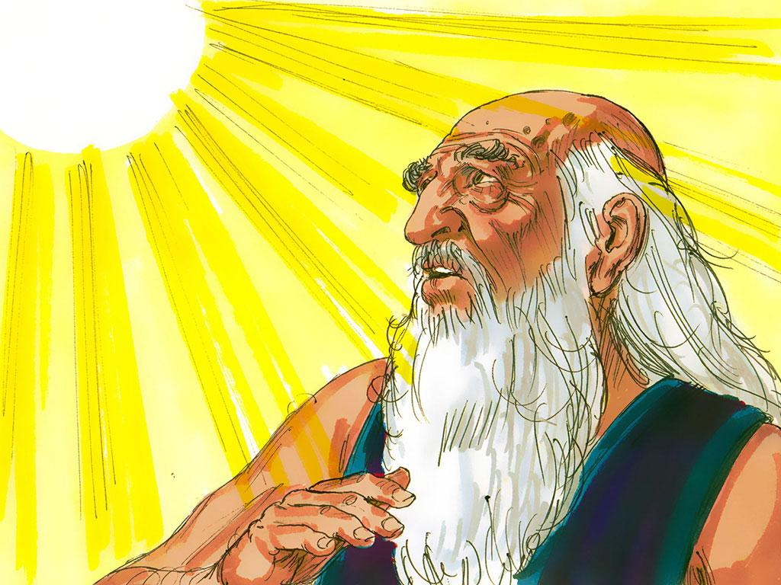
Notes:
5. Abraham loved his son and loved God. Even though Abraham loved God and believed what God said, a day came when Abraham was tested. The testing day was the day God asked Abraham to do a very difficult thing.

Slide 6
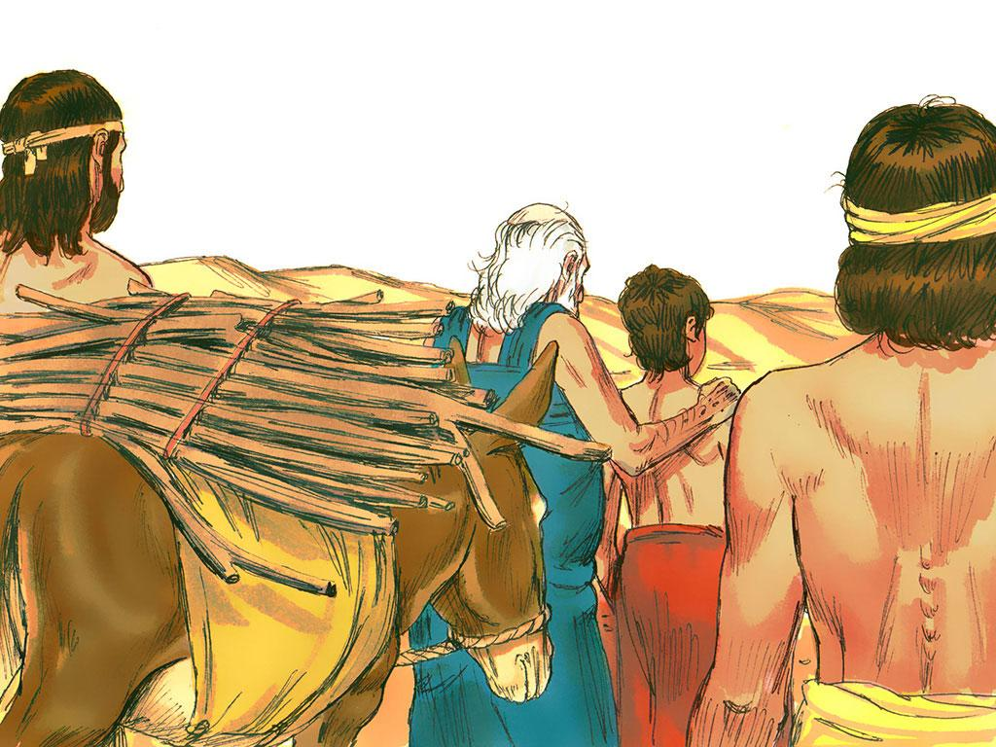
Notes:
6. During the time of Abraham, people showed their devotion to God by placing food or sometimes an animal they had killed on an altar and burning it up. This was called a “sacrifice.”
Even though Abraham knew about this kind of sacrifice, he had never heard about the kind of sacrifice that God asked of him on this testing day.
God said, “Take your only son, Isaac, the son you love. Go to the land of Moriah. There kill him and offer him as a whole burnt offering. Do this on one of the mountains there. I will tell you which one.

Slide 7
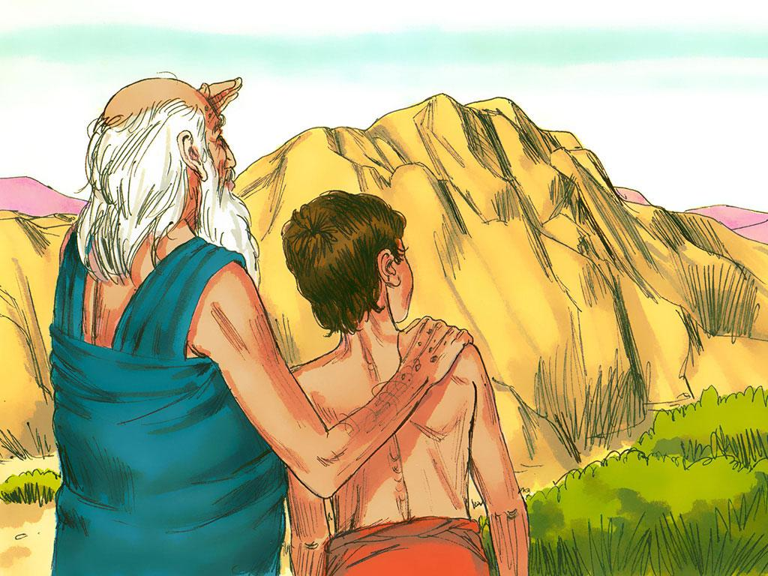
Notes:
7. Most people would have just said, “NO WAY, GOD!” After all, Abraham loved Isaac. Besides, Isaac was his only son. God had promised him that Isaac would grow up and have children, and his children would grow up and have children so that one day, God’s people would be so many that no one could count them. If Isaac had died, this could never have happened.

Slide 8
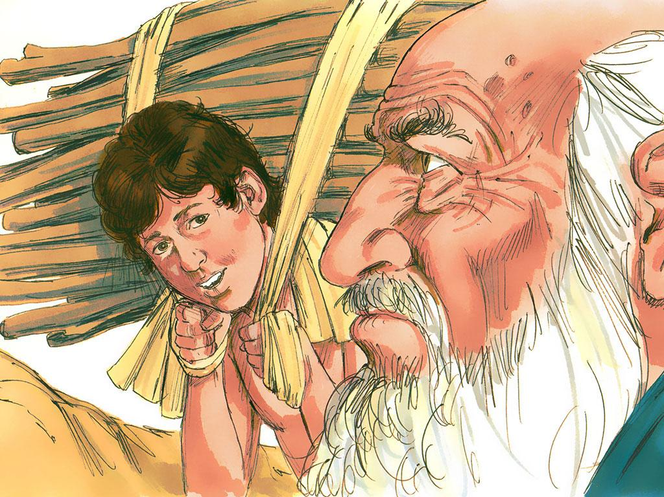
Notes:
8. That is when Abraham realised something very important. God would always do the right thing. If he obeyed God, even in this very hard situation, God would make it all right in the end. He thought that maybe God would let Isaac die, but then would bring him back to life.
Abraham did not understand exactly what would happen, but he had faith in God. He would do what God said.

Slide 9
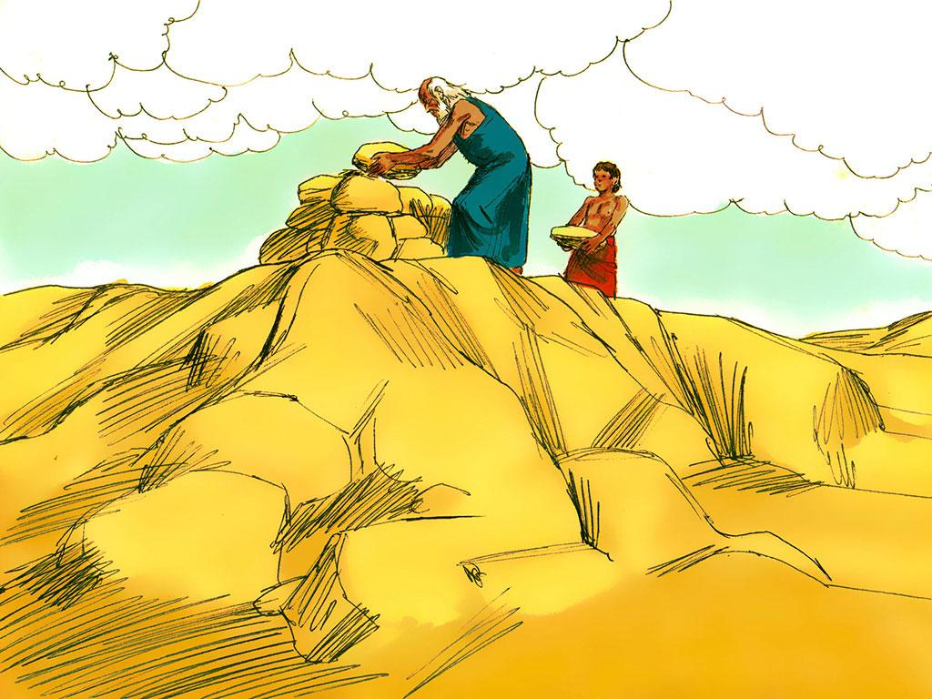
Notes:
9. When Abraham and his son got to the top of the mountain, they stacked stones on top of stones to build an altar. Isaac asked his father what animal they would put on the altar. Only Abraham knew that Isaac would be the one on the altar instead of an animal.

Slide 10
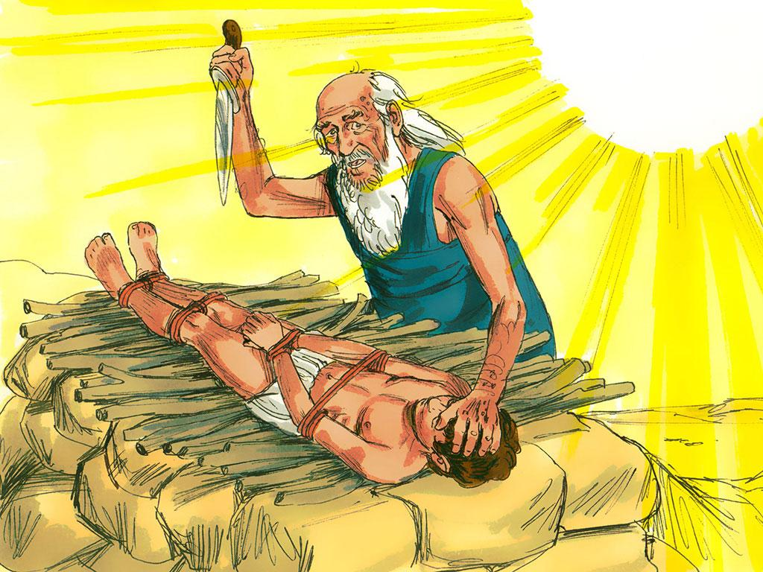
Notes:
10. The time came for Abraham to do what God said and kill his son. But do you think Abraham actually killed his son? No, he did not. At the last minute, an angel called out in a loud voice and told Abraham to stop. Even though God knew that Abraham had enough faith to obey him, God did not want him actually to kill Isaac.

Slide 11
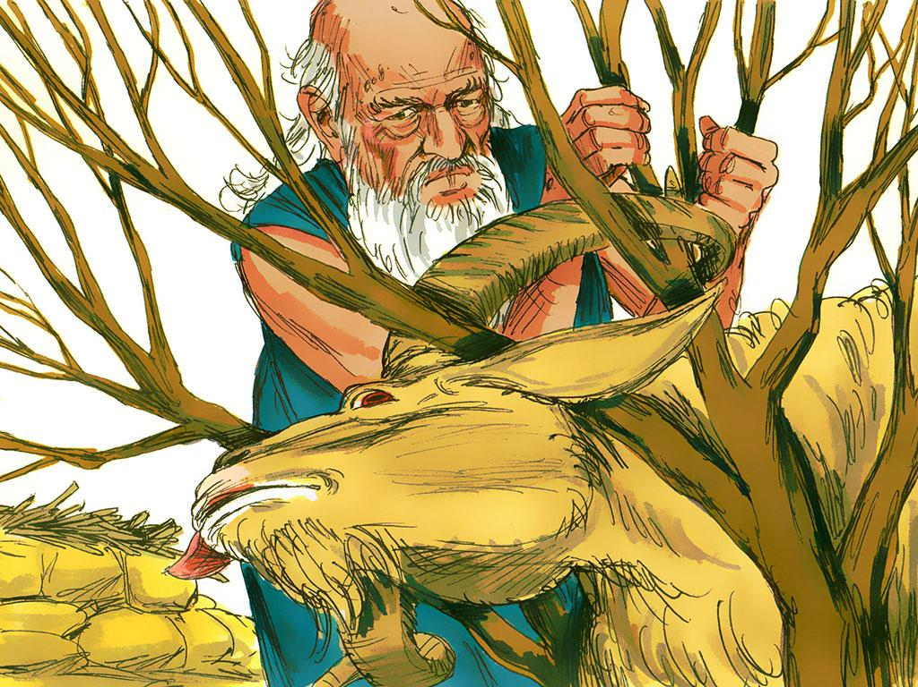
Notes:
11. What a relief! God would never want a person to be killed and burned on an altar. Abraham looked up and saw a ram caught in some bushes. He and Isaac offered the ram as a sacrifice on the altar.

Slide 12
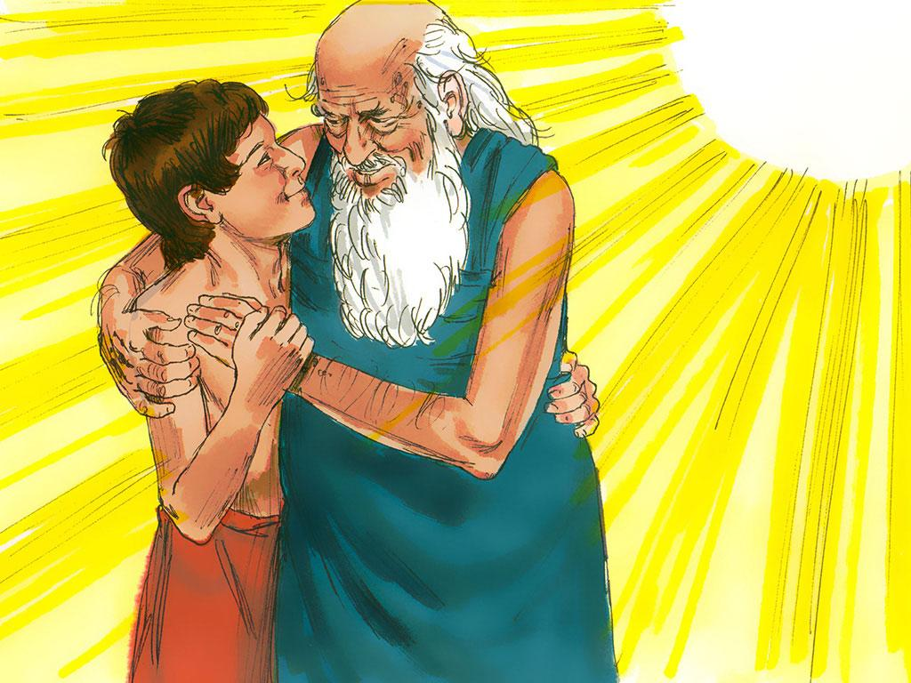
Notes:
12. That day, Abraham learned he loved God more than anything else. He would always have faith in God.
And Isaac continued to grow up and follow God. And guess what? He had children, and then they had children, and then they had children…
As years passed, the number of Abraham’s descendants became so many that they were as difficult to count as the number of stars in the sky.

Slide 13
Teacher Notes 1
1. Cover: Abraham’s Sacrifice (Genesis 22:1-19 and Hebrews 11:17-19)
2. Many years ago, God decided to build a great nation so that this nation could follow Him and bless the world. God chose Abraham to begin this nation.
Have you ever tried to count how many stars there are in the sky at night? There are too many to count! Well, God told Abraham that counting his descendants would be like trying to count stars. He would have so many grandchildren, great-grandchildren, great-great-grandchildren, and great-great-great-grandchildren that no one could even count them.
Abraham believed in God, but as the years went by, he and his wife, Sarah, wondered how God would make this happen. They were getting older and older and still had no children together.
3. But, of course, God kept His promise!
Finally, when Abraham was 100 years old, and Sarah was 90 years old, they had a baby. They named their son Isaac.
4. Abraham and Sarah loved Isaac very much and looked forward to the day Isaac would marry and have children. Then those children would grow up and have children, and then those children would grow up and have children.
5. Abraham loved his son and loved God. Even though Abraham loved God and believed what God said, a day came when Abraham was tested. The testing day was the day God asked Abraham to do a very difficult thing.
6. During the time of Abraham, people showed their devotion to God by placing food or sometimes an animal they had killed on an altar and burning it up. This was called a “sacrifice.”
Even though Abraham knew about this kind of sacrifice, he had never heard about the kind of sacrifice that God asked of him on this testing day.
God said, “Take your only son, Isaac, the son you love. Go to the land of Moriah. There kill him and offer him as a whole burnt offering. Do this on one of the mountains there. I will tell you which one.
7. Most people would have just said, “NO WAY, GOD!” After all, Abraham loved Isaac. Besides, Isaac was his only son. God had promised him that Isaac would grow up and have children, and his children would grow up and have children so that one day, God’s people would be so many that no one could count them. If Isaac had died, this could never have happened.
8. That is when Abraham realised something very important. God would always do the right thing. If he obeyed God, even in this very hard situation, God would make it all right in the end. He thought that maybe God would let Isaac die, but then would bring him back to life.
Abraham did not understand exactly what would happen, but he had faith in God. He would do what God said.

Slide 14
Teacher Notes 2
9. When Abraham and his son got to the top of the mountain, they stacked stones on top of stones to build an altar. Isaac asked his father what animal they would put on the altar. Only Abraham knew that Isaac would be the one on the altar instead of an animal.
10. The time came for Abraham to do what God said and kill his son. But do you think Abraham actually killed his son? No, he did not. At the last minute, an angel called out in a loud voice and told Abraham to stop. Even though God knew that Abraham had enough faith to obey him, God did not want him actually to kill Isaac.
11. What a relief! God would never want a person to be killed and burned on an altar. Abraham looked up and saw a ram caught in some bushes. He and Isaac offered the ram as a sacrifice on the altar.
12. That day, Abraham learned he loved God more than anything else. He would always have faith in God.
And Isaac continued to grow up and follow God. And guess what? He had children, and then they had children, and then they had children…
As years passed, the number of Abraham’s descendants became so many that they were as difficult to count as the number of stars in the sky.

Slide 15


Attributions: This visual aid was constructed by Mary Nelson missionbiblelessons.org using:
Text and slideshow compilation by Mary Nelson
Illustrations by Sweet Publishing http://sweetpublishing.com/
As accessed through www.freebibleimages.org
Notice of Alteration: Text added to cover slide.
Attribution-ShareAlike 3.0 Unported (CC BY-SA 3.0) https://creativecommons.org/licenses/by-sa/3.0/
User may reproduce it without permissions.
DOWNLOAD THIS SLIDESHOW FROM www.missionbibleclass.org
Please visit missionbiblelessons.org to find this and many other free resources to help you
teach the Bible to children.

