Slide 1


God Rested
Notes:
1. Cover: Day 7: God Rested (Genesis 1:1 and 2:1-3)

Slide 2
Notes:
2. In the beginning, before there was anything, there was nothing. Nothing. No sky. No sea. No trees. No animals and not even any people.

Slide 3
In the beginning God created the sky and the earth.
Genesis 1:1
Notes:
3. If you turn to the beginning of your Bible, the first book is Genesis. The very first verse of the Bible’s very first book talks about the world’s beginning.
This is the first thing written in your Bible. “In the beginning, God created the sky and the earth.” That is in Genesis chapter one and verse one.

Slide 4


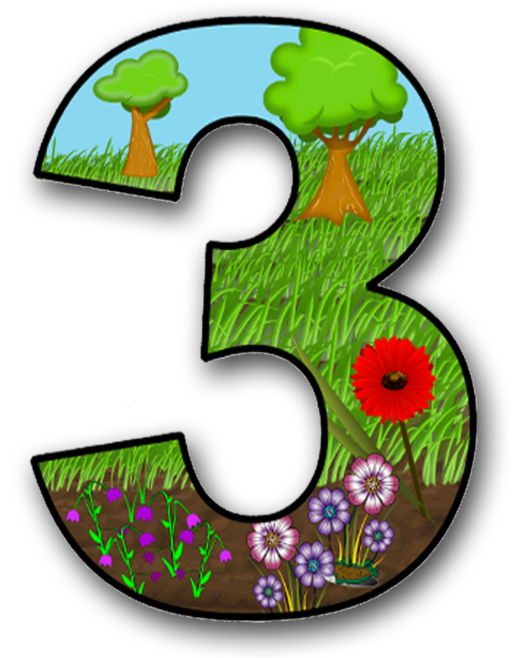

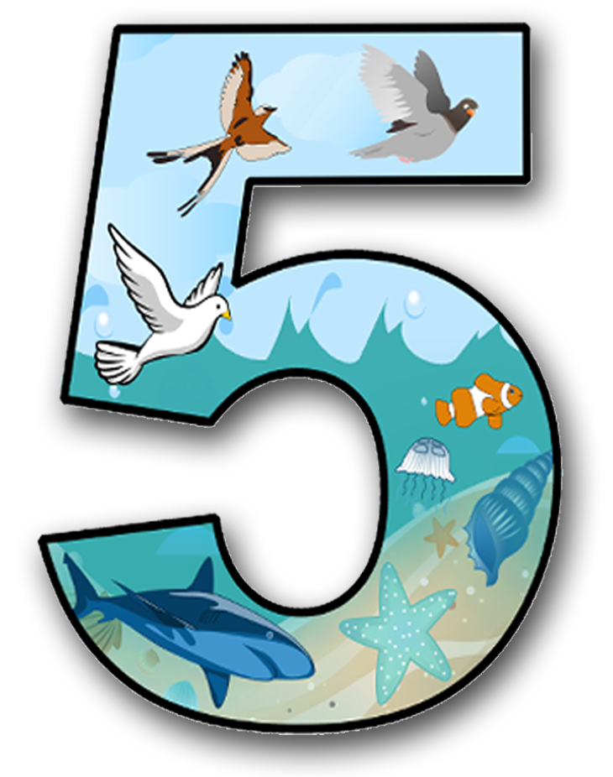
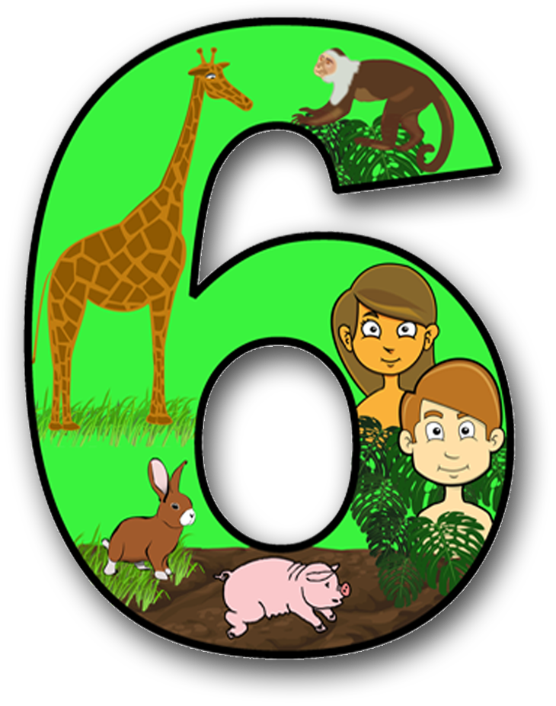
Notes:
4. And that began the first week. Each day in the first week of creation was filled with amazing things. Let’s talk about those.
Before the beginning of our world, there was nothing, but God created light on the first day of creation. Before that, there was not even light.
On the second day of creation, God separated water into two parts. The water below was the sea, and the small particles above made up what we know as air (or sky or atmosphere).
On the third day of creation, God caused dry land to rise from the water. God then created all kinds of plants since there was dirt, including bushes, trees, and vines. The world was becoming a beautiful and lush garden called “the Garden of Eden.”
On the fourth day of creation, it was time to look up. God placed the sun in the day sky and the moon and the stars in the night sky. For the rest of time, everyone could see the beauty of God’s creation.
On the fifth day, God looked down at the sea and placed fish and every creature swimming in it. There were all sorts of fish: big fish, little fish, and fish of all colours.
And God filled the sky with all kinds of birds.

Slide 5
Notes:
5. But what was missing? The sixth day was even more amazing! On the sixth day of creation, God made animals.
He made a boy and girl of every animal. There were two giraffes, two rhinoceros, two lions, dogs, cats… He made a boy and girl of every kind of animal so that they could go on to have a family with a mother, father and babies. Soon, the earth would be filled with even more animals.

Slide 6
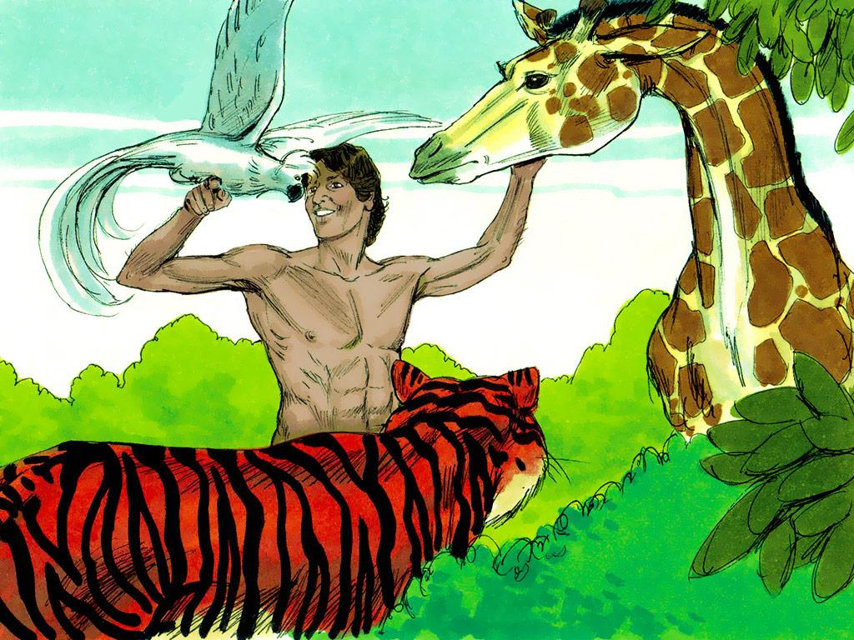
Notes:
6. And that is not all God created on the sixth day. God also created a man. The very first man! And He called the man “Adam.” This man was special and different from the animals. He was more like God than any other part of the creation. That is because he was made in “the image of God.” He was special, and God gave him special responsibilities. He was to care for this beautiful garden. God also told Adam to give names to all of the animals.
As Adam was naming the animals, he noticed something. None of the animals seemed to match him. There were two of every kind of animal, but there was only one Adam. There was a boy and girl lion and a boy and girl tiger, but only one Adam. No one was like him, so how would Adam ever have a family?

Slide 7
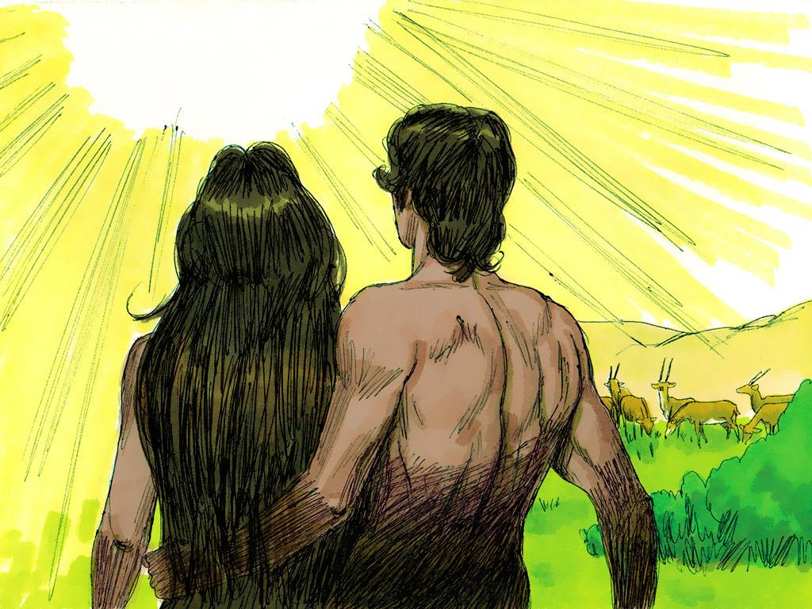
Notes:
7. But, of course, God had already thought of that. His plan was just as amazing as all the other things He had been doing each day. On this sixth day, God caused Adam to go into a deep sleep. While Adam was sleeping, He took one of Adam’s rib bones and created a perfect match for Adam. God created the very first woman, and her name was Eve.
Finally, Adam had someone like himself. Adam and Eve could have a family. In the years to come, there will be more and more people.

Slide 8

Notes:
8. God’s world was amazing and wonderful. And this is what the Bible says happened next.
“So the sky, the earth and all that filled them were finished. By the seventh day God finished the work he had been doing. So on the seventh day he rested from all of his work. God blessed the seventh day and made it a holy day. He made it holy because on that day he rested. He rested from all the work he had done in creating the world.”
God’s world was beautiful, just as He wanted it to be. He said that it was “good.”

Slide 9
God blessed the seventh day and made it a holy day. He made it holy because on that day he rested. He rested from all the work he had done in creating the world.
Genesis 2:3
Notes:
9. It was time to think about and enjoy everything He had created. So, that is precisely what God did on the seventh day. He rested.

Slide 10
God was not TIRED
God was FINISHED
Notes:
10. God did not rest because He was tired. God does not ever get tired. God never runs out of energy. Instead, God rested because He was finished. He had finished creating our amazing world. This was now the time to rest, look at everything and think about what He had done. He could rest because He didn’t need to add anything or take anything away. The creation was perfect and just the way He wanted it to be.

Slide 11
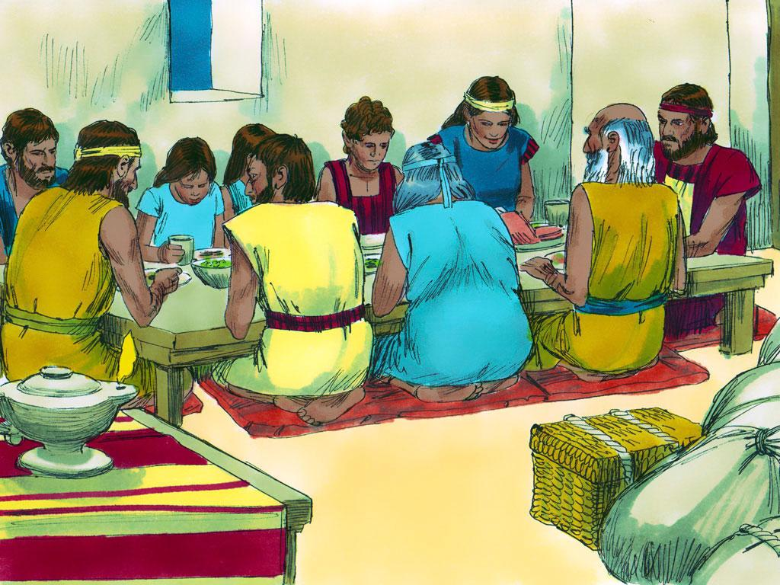
Sabbath
Notes:
11. Did you know that God wants people to rest like He did? We read in the Old Testament part of our Bible that years later, God commanded His people to make the seventh day of the week a special day of rest. This day was called the “Sabbath.”
God told His people that the Sabbath was a holy day because it was God’s day.

Slide 12
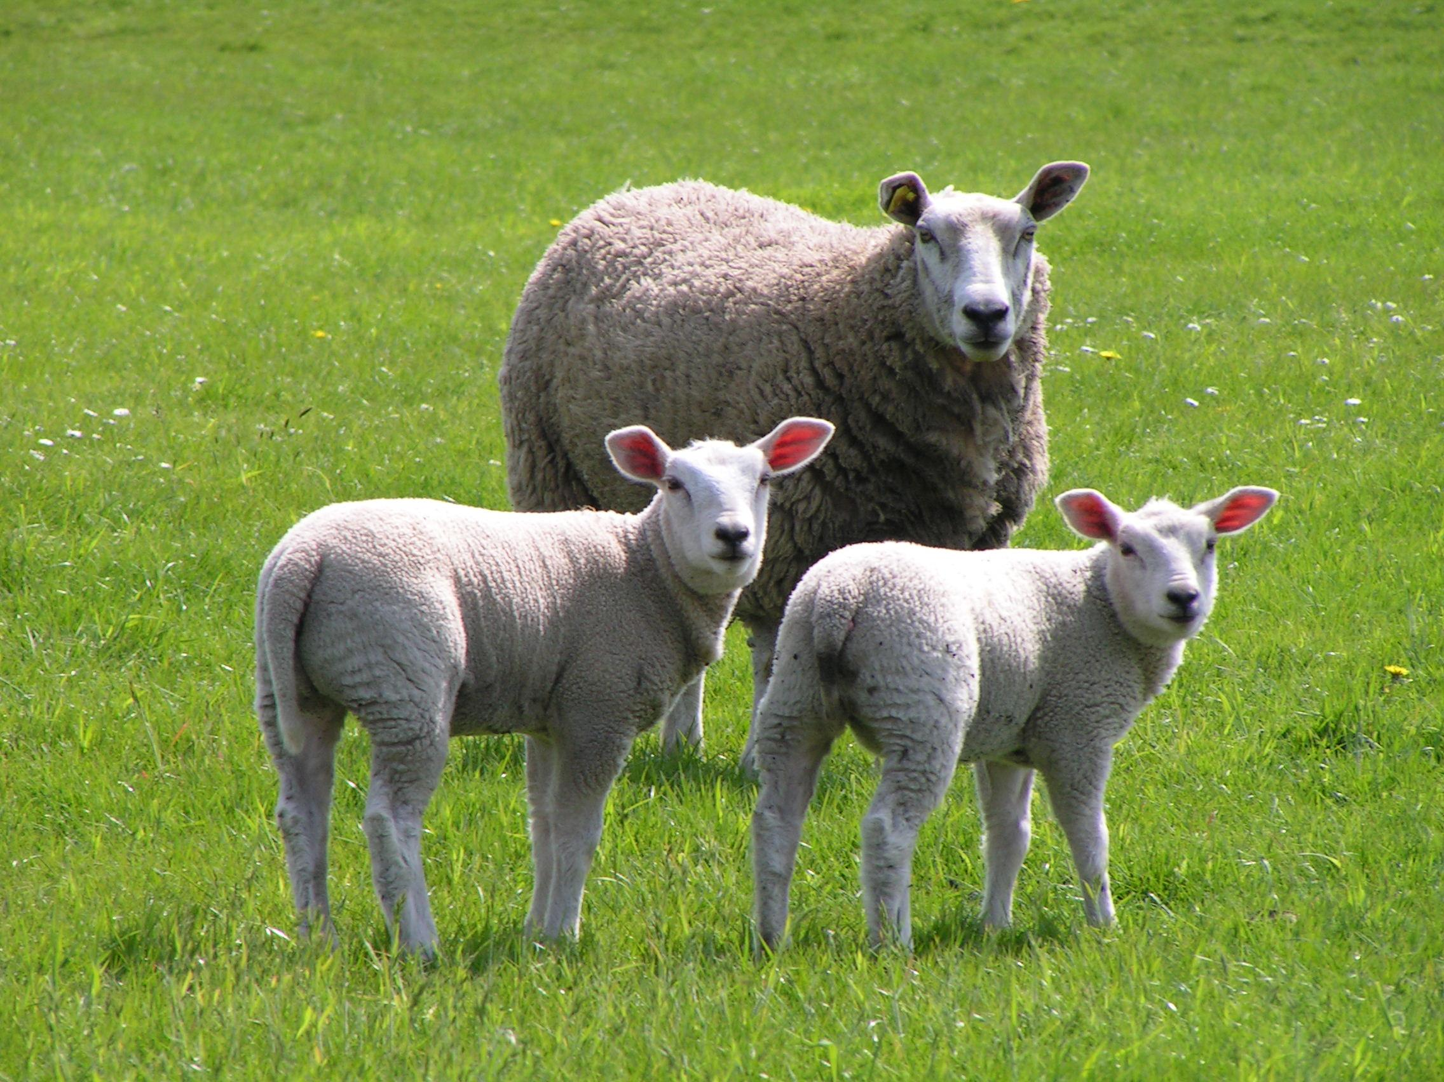
Notes:
12. And God wants people to rest in other ways. He wants people to be safe and enjoy life because they belong to Him. In fact, in Psalm 23, we read, “The Lord is my shepherd. I have everything I need. He gives me rest in green pastures.” (Psalm 23:1-2a ICB)
Just like sheep rest when their shepherd takes care of them, God wants us to rest in Him and trust that He will take care of us.

Slide 13
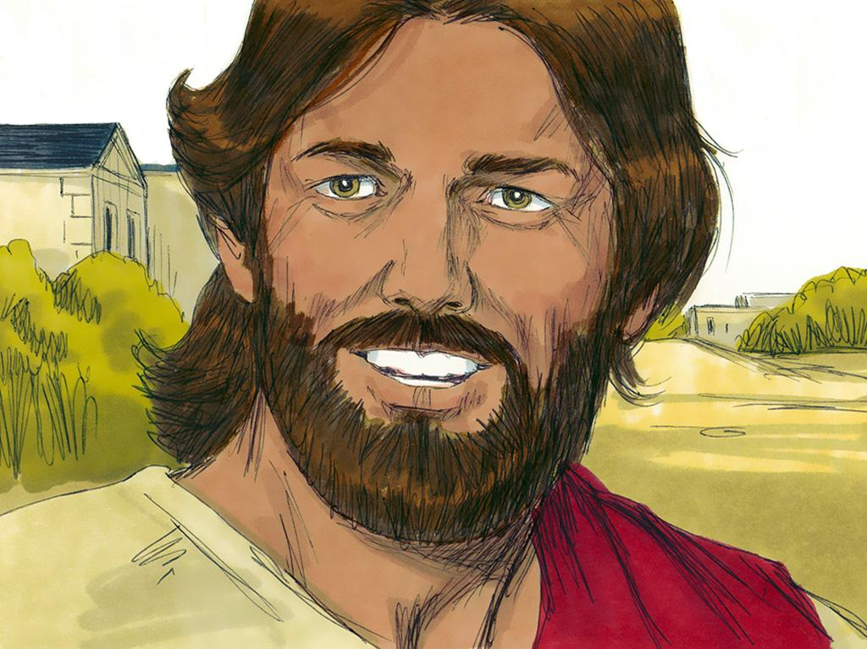
Notes:
13. Jesus wants people to rest. When Jesus was on earth, He met many people. People often had many problems and felt very sad.
Maybe some of us feel sad right now. But Jesus had something very important to say. He said, “Come to me, all of you who are tired and have heavy loads. I will give you rest” (Matthew 11:28, ICB). Jesus wants you to rest.

Slide 14
Rest
Notes:
14. So, how about resting today? Let’s take a deep breath, relax, and forget what is troubling us. Just think about God. Think about all of the work God has done in the creation. Think about how He cares for us and has done so much work for us. It is time to stop and rest.
Tonight, as you lie in bed, think about God and His beautiful creation. Remember that God rested on the seventh day, and He wants you to rest in Him.

Slide 15
Teacher Notes 1
1. Cover: Day 7: God Rested (Genesis 1:1 and 2:1-3)
2. (This slide is black) n the beginning, before there was anything, there was nothing. Nothing. No sky. No sea. No trees. No animals and not even any people.
3. If you turn to the beginning of your Bible, the first book is Genesis. The very first verse of the Bible’s very first book talks about the world’s beginning.
This is the first thing written in your Bible. “In the beginning, God created the sky and the earth.” That is in Genesis chapter one and verse one.
4. And that began the first week. Each day in the first week of creation was filled with amazing things. Let’s talk about those.
Before the beginning of our world, there was nothing, but God created light on the first day of creation. Before that, there was not even light.
On the second day of creation, God separated water into two parts. The water below was the sea, and the small particles above made up what we know as air (or sky or atmosphere).
On the third day of creation, God caused dry land to rise from the water. God then created all kinds of plants since there was dirt, including bushes, trees, and vines. The world was becoming a beautiful and lush garden called “the Garden of Eden.”
On the fourth day of creation, it was time to look up. God placed the sun in the day sky and the moon and the stars in the night sky. For the rest of time, everyone could see the beauty of God’s creation.
On the fifth day, God looked down at the sea and placed fish and every creature swimming in it. There were all sorts of fish: big fish, little fish, and fish of all colours.
And God filled the sky with all kinds of birds.

Slide 16
Teacher Notes 2
5. But what was missing? The sixth day was even more amazing! On the sixth day of creation, God made animals.
He made a boy and girl of every animal. There were two giraffes, two rhinoceros, two lions, dogs, cats… He made a boy and girl of every kind of animal so that they could go on to have a family with a mother, father and babies. Soon, the earth would be filled with even more animals.
6. And that is not all God created on the sixth day. God also created a man. The very first man! And He called the man “Adam.” This man was special and different from the animals. He was more like God than any other part of the creation. That is because he was made in “the image of God.” He was special, and God gave him special responsibilities. He was to care for this beautiful garden. God also told Adam to give names to all of the animals.
As Adam was naming the animals, he noticed something. None of the animals seemed to match him. There were two of every kind of animal, but there was only one Adam. There was a boy and girl lion and a boy and girl tiger, but only one Adam. No one was like him, so how would Adam ever have a family?
7. But, of course, God had already thought of that. His plan was just as amazing as all the other things He had been doing each day. On this sixth day, God caused Adam to go into a deep sleep. While Adam was sleeping, He took one of Adam’s rib bones and created a perfect match for Adam. God created the very first woman, and her name was Eve.
Finally, Adam had someone like himself. Adam and Eve could have a family. In the years to come, there will be more and more people.
8. God’s world was amazing and wonderful. And this is what the Bible says happened next.
“So the sky, the earth and all that filled them were finished. By the seventh day God finished the work he had been doing. So on the seventh day he rested from all of his work. God blessed the seventh day and made it a holy day. He made it holy because on that day he rested. He rested from all the work he had done in creating the world.”
God’s world was beautiful, just as He wanted it to be. He said that it was “good.”
9. It was time to think about and enjoy everything He had created. So, that is precisely what God did on the seventh day. He rested.
10. God did not rest because He was tired. God does not ever get tired. God never runs out of energy. Instead, God rested because He was finished. He had finished creating our amazing world. This was now the time to rest, look at everything and think about what He had done. He could rest because He didn’t need to add anything or take anything away. The creation was perfect and just the way He wanted it to be.
11. Did you know that God wants people to rest like He did? We read in the Old Testament part of our Bible that years later, God commanded His people to make the seventh day of the week a special day of rest. This day was called the “Sabbath.”
God told His people that the Sabbath was a holy day because it was God’s day.

Slide 17
Teacher Notes 3
12. And God wants people to rest in other ways. He wants people to be safe and enjoy life because they belong to Him. In fact, in Psalm 23, we read, “The Lord is my shepherd. I have everything I need. He gives me rest in green pastures.” (Psalm 23:1-2a ICB)
Just like sheep rest when their shepherd takes care of them, God wants us to rest in Him and trust that He will take care of us.
13. Jesus wants people to rest. When Jesus was on earth, He met many people. People often had many problems and felt very sad.
Maybe some of us feel sad right now. But Jesus had something very important to say. He said, “Come to me, all of you who are tired and have heavy loads. I will give you rest” (Matthew 11:28, ICB). Jesus wants you to rest.
14. So, how about resting today? Let’s take a deep breath, relax, and forget what is troubling us. Just think about God. Think about all of the work God has done in the creation. Think about how He cares for us and has done so much work for us. It is time to stop and rest.
Tonight, as you lie in bed, think about God and His beautiful creation. Remember that God rested on the seventh day, and He wants you to rest in Him.

Slide 18


Attributions: This visual aid was constructed by Mary Nelson missionbiblelessons.org using:
Text, slideshow compilation, photography and illustrations by Mary Nelson
Illustrations on slides 6,7,11,13 from Sweet Publishing http://sweetpublishing.com/ accessed through www.freebibleimages.org.
Sheep photo (slide 12) by Marrit and Planet Earth by Monique72 accessed through https://www.freeimages.com/photo/cow-and-sheep-1397872
Alterations: Text added to slide 11.
Attribution-ShareAlike 3.0 Unported (CC BY-SA 3.0) https://creativecommons.org/licenses/by-sa/3.0/
User may reproduce it without permissions.
DOWNLOAD THIS SLIDESHOW FROM www.missionbiblelessons.org
Please visit missionbiblelessons.org to find this and many other free resources to help you teach the Bible to children.

