Slide 1
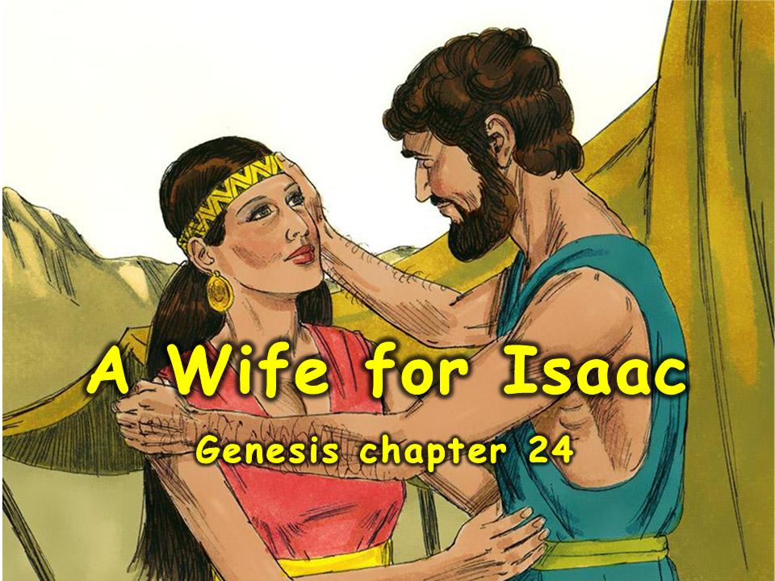
Notes:
1. Cover: A Wife for Isaac (Genesis chapter 24)

Slide 2
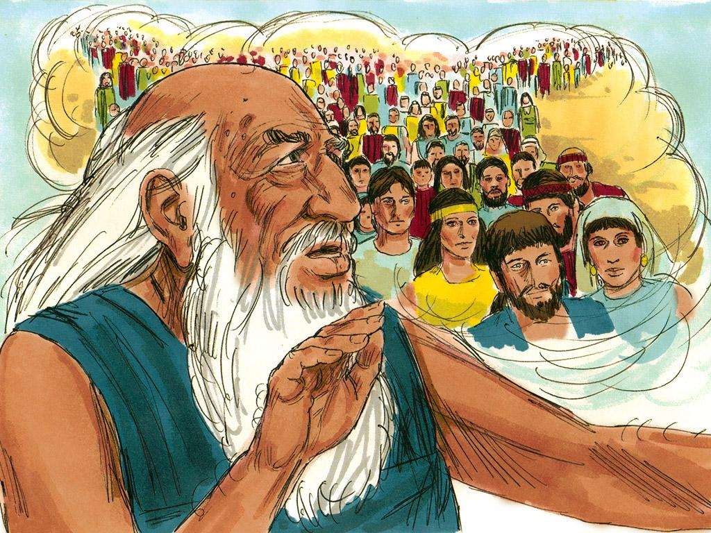
2. Abraham was a great man of God. God had promised Abraham that someday he would have grandchildren and then they would have children and then they would have children. God promised Abraham that he would have many many descendants. God wanted Abraham’s descendants to love him just as much as Abraham did.
Notes:
2. Abraham was a great man of God. God had promised Abraham that someday he would have grandchildren, and then they would have children, and then they would have children. God promised Abraham that he would have many, many descendants. God wanted Abraham’s descendants to love him just as much as Abraham did.

Slide 3
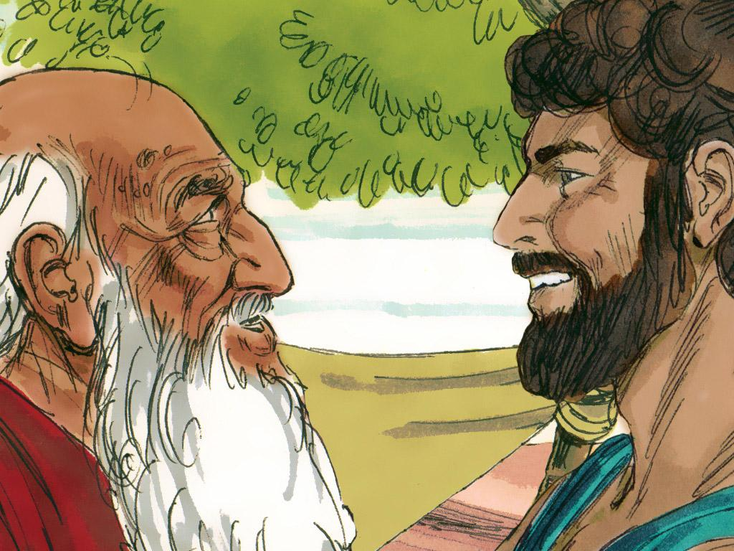
3. But Abraham’s son, Isaac was not even married yet. Abraham knew it was time to find a wife for Isaac. But not just any woman would do. Abraham wanted Isaac to marry a woman who believed in God. Then Isaac and his wife could have children and teach them to love God too.
Notes:
3. But Abraham’s son, Isaac, was not even married yet. Abraham knew it was time to find a wife for Isaac.
But not just any woman would do. Abraham wanted Isaac to marry a woman who believed in God. Then Isaac and his wife could have children and teach them to love God, too.

Slide 4
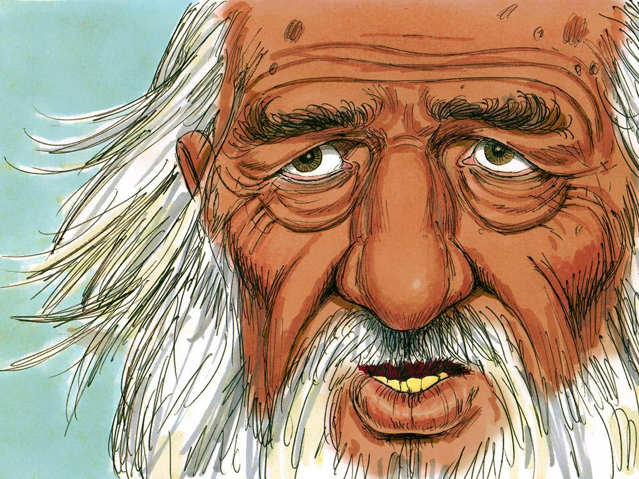
4. Abraham thought about all the women who lived nearby in Canaan. They did not love God. They worshiped false gods and bowed down to them. Abraham did not want Isaac to marry a woman from Canaan. He remembered when he used to live in Haran. Many of Abraham’s relatives still lived near Haran in a place called “Nahor”. His relatives believed in God. This would be the perfect place to find a wife for Isaac.
Notes:
4. Abraham thought about all the women who lived nearby in Canaan. They did not love God. They worshipped false gods and bowed down to them. Abraham did not want Isaac to marry a woman from Canaan. He remembered when he used to live in Haran. Many of Abraham’s relatives still lived near Haran in a place called “Nahor.” His relatives believed in the true and living God. This would be the perfect place to find a wife for Isaac.

Slide 5
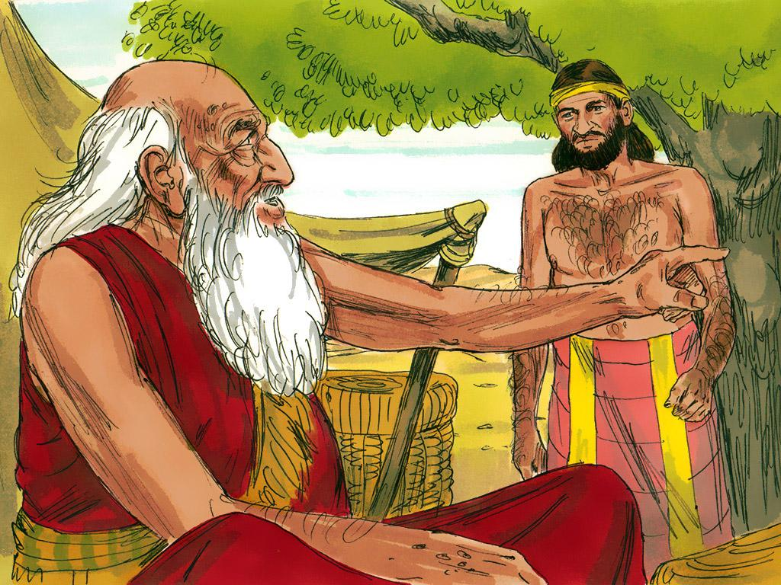
5. So Abraham called in his most trusted servant and said, “Promise me that you will find a wife for Isaac. Make sure that she is not a Canaanite. Go to my home country, to my relatives, and find Isaac a wife there.”
Notes:
5. So Abraham called in his most trusted servant, saying, “Promise me that you will find a wife for Isaac. Make sure that she is not a Canaanite. Go to my home country, to my relatives, and find Isaac a wife there.”

Slide 6
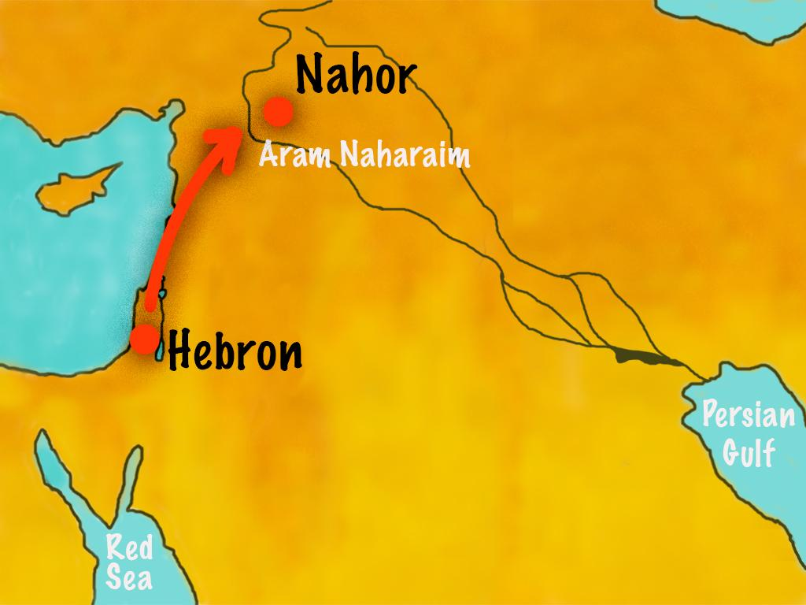
6. The servant did as Abraham asked. He took along camels loaded with gifts to give to the father of whoever the bride would be. The servant travelled a long time before he came to Haran, the place where Abraham’s family lived.
Notes:
6. The servant did as Abraham asked. He took along camels loaded with gifts to give to the father of whoever the bride would be. The servant travelled a long time before coming to Haran, where Abraham’s family lived.

Slide 7
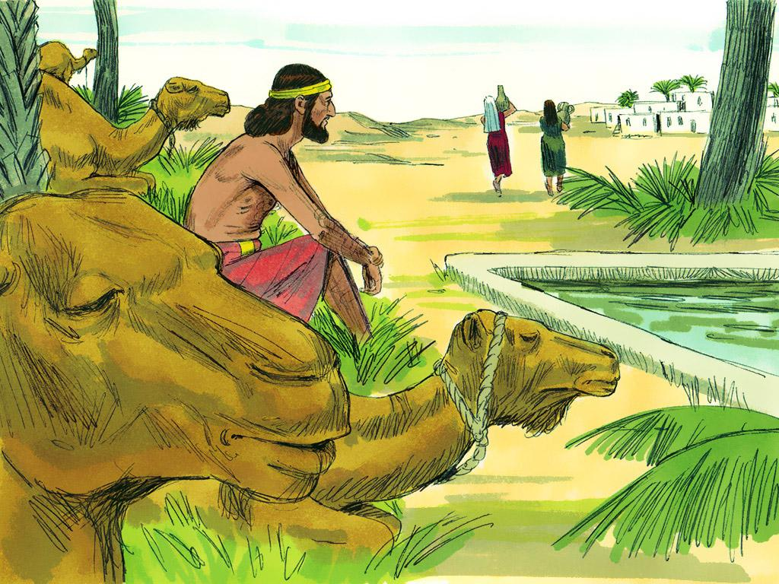
7. When the servant arrived he decided to go to a place where the young women of the city went every day. He took his camels and waited beside the spring of waters where the girls came to get water for their families.
Notes:
7. When the servant arrived, he decided to go to a place where the city’s young women went every day. He took his camels and waited beside the spring of waters where the girls came to get water for their families.

Slide 8
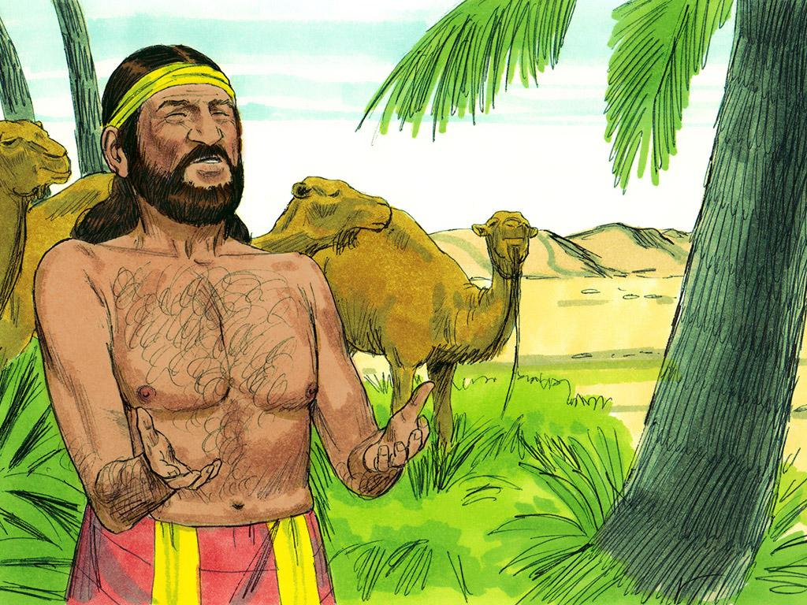
8. He prayed, “O Lord God, be kind to me and to Abraham today. I’m going to stand here to watch the young women come to get water. I will say, ‘May I have a drink.’ May the one who answers, ‘Have a drink and I will water your camels too,’ be the one You have chosen for Isaac’s wife.”
Notes:
8. He prayed, “O Lord God, be kind to me and to Abraham today. I’m going to stand here to watch the young women come to get water. I will say, ‘May I have a drink.’
May the one who answers, ‘Have a drink, and I will water your camels too,’ be the one You have chosen for Isaac’s wife.”

Slide 9
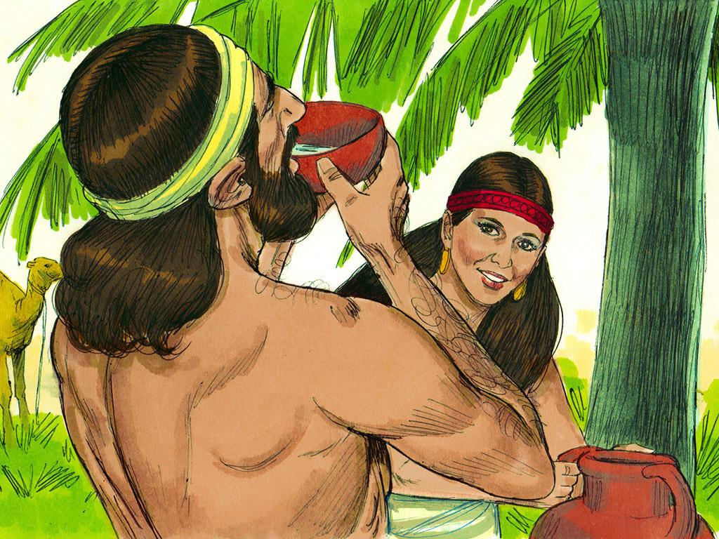
9. The servant had not even finished his prayer when a beautiful and kind girl named Rebekah came to the well to get water. The servant said, “Please, give me a drink.” “Of course, take some of my water.” Then Rebekah saw his thirsty camels and said, “I’ll get water for your camels too.” It was hard work but Rebekah ran back and forth to the well to get water for the thirsty camels. Finally, all the camels had plenty of water to drink.
Notes:
9. The servant had not even finished his prayer when a beautiful and kind girl named Rebekah came to the well to get water.
The servant said, “Please, give me a drink.”
“Of course, take some of my water.”
Then Rebekah saw his thirsty camels and said, “I’ll get water for your camels too.”
It was hard work, but Rebekah ran back and forth to the well to get water for the thirsty camels. Finally, all the camels had plenty of water to drink.

Slide 10
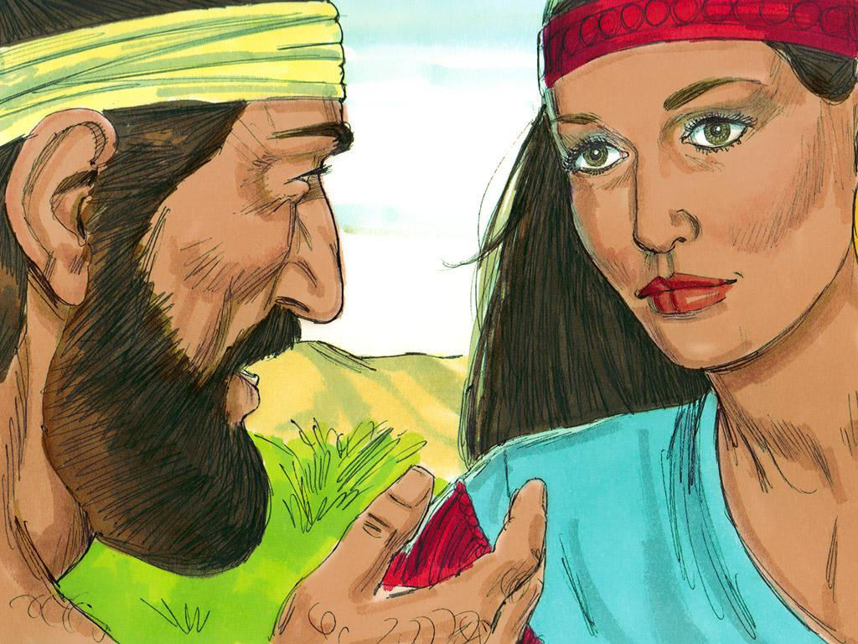
10. Abraham’s servant was so happy! God had answered his prayer. He knew Rebekah was the right wife for Isaac. The servant gave Rebekah two gold bracelets and a gold nose ring. “Whose daughter are you? Is there room for my camels and me to stay overnight at your house?” he asked. “My father is Bethuel the son of Nahor. Yes, there is room at our house. I will go and tell my family.” How thankful the servant was. Of all the people he could meet on his journey God had led him straight to Abraham’s relatives!
Notes:
10. Abraham’s servant was so happy! God had answered his prayer. He knew Rebekah was the right wife for Isaac. The servant gave Rebekah two gold bracelets and a gold nose ring.
“Whose daughter are you? Is there room for my camels and me to stay overnight at your house?” he asked.
“My father is Bethuel the son of Nahor. Yes, there is room at our house. I will go and tell my family.”
How thankful the servant was. Of all the people he could meet on his journey, God had led him straight to Abraham’s relatives!

Slide 11
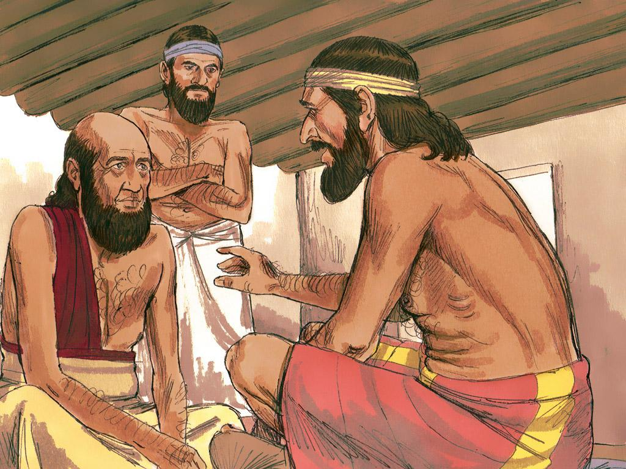
11. The servant went to Rebekah’s home and explained who he was and why he was there. Rebekah’s father, Bethuel, and brother, Laban, listened carefully to the servant explain how God had led him to their house and to Rebekah. Everyone was amazed at this. And they were also happy when they heard how God had blessed their relative, Abraham. He had left them long ago and they were so happy that he still loved God like they did. Then the servant asked an important question, “Will you let Rebekah travel with me back to Canaan to marry Isaac?” Bethuel agreed that this was what God would want so they said “yes”. Abraham’s servant wanted to leave right away but Rebekah’s family did not want her to go yet. They finally said, “We will let Rebekah decide.”
Notes:
11. The servant went to Rebekah’s home and explained who he was and why he was there. Rebekah’s father, Bethuel, and brother, Laban, listened carefully to the servant explain how God had led him to their house and to Rebekah. Everyone was amazed at this. And they were also happy when they heard how God had blessed their relative, Abraham. He had left them long ago, and they were so happy that he still loved God as they did.
Then the servant asked an important question, “Will you let Rebekah travel with me back to Canaan to marry Isaac?”
Bethuel agreed that this was what God would want, so they said “yes.” Abraham’s servant wanted to leave right away, but Rebekah’s family did not want her to go yet. They finally said, “We will let Rebekah decide.”

Slide 12
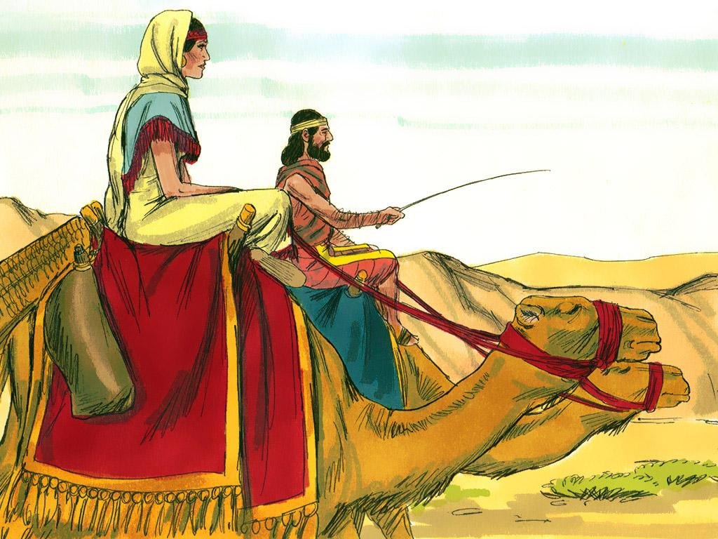
12. Rebekah thought about how God had led the servant to her family and to her. She wanted to marry someone who obeyed God like her family did. Rebekah said, “Yes, I will go.” Abraham’s servant was so happy! He gave Rebekah and her family even more rich gifts and prepared to go.
Notes:
12. Rebekah thought about how God had led the servant to her family and to her. She wanted to marry someone who obeyed God like her family did. Rebekah said, “Yes, I will go.”
Abraham’s servant was so happy! He gave Rebekah and her family even richer gifts and prepared to go.
Rebekah and the servant had to travel a long way before their journey was complete.

Slide 13
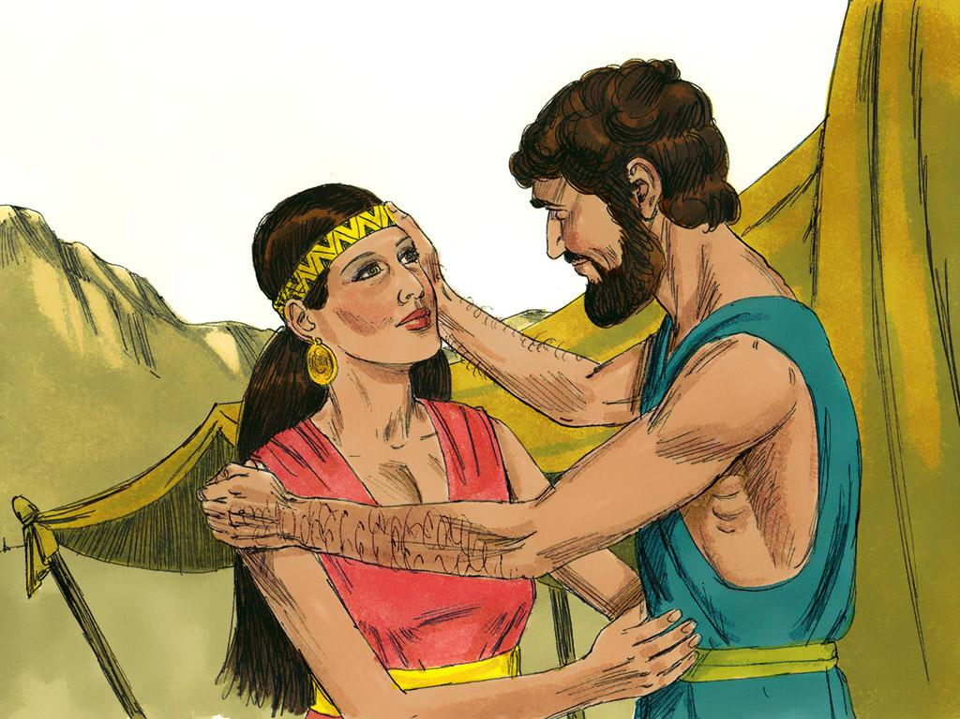
13. Rebekah and the servant had to travel a long way before their journey was complete. She and Isaac were very happy when they saw each other. They got married and Isaac loved Rebekah very much.
Notes:
13. Rebekah and Isaac were very happy when they saw each other. They got married, and Isaac loved Rebekah very much.

Slide 14
Teacher Notes 1
1. Cover: A Wife for Isaac (Genesis chapter 24)
2. Abraham was a great man of God. God had promised Abraham that someday he would have grandchildren, and then they would have children, and then they would have children. God promised Abraham that he would have many, many descendants. God wanted Abraham’s descendants to love him just as much as Abraham did.
3. But Abraham’s son, Isaac, was not even married yet. Abraham knew it was time to find a wife for Isaac.
But not just any woman would do. Abraham wanted Isaac to marry a woman who believed in God. Then Isaac and his wife could have children and teach them to love God, too.
4. Abraham thought about all the women who lived nearby in Canaan. They did not love God. They worshipped false gods and bowed down to them. Abraham did not want Isaac to marry a woman from Canaan. He remembered when he used to live in Haran. Many of Abraham’s relatives still lived near Haran in a place called “Nahor.” His relatives believed in the true and living God. This would be the perfect place to find a wife for Isaac.
5. So Abraham called in his most trusted servant, saying, “Promise me that you will find a wife for Isaac. Make sure that she is not a Canaanite. Go to my home country, to my relatives, and find Isaac a wife there.”
6. The servant did as Abraham asked. He took along camels loaded with gifts to give to the father of whoever the bride would be. The servant travelled a long time before coming to Haran, where Abraham’s family lived.
7. When the servant arrived, he decided to go to a place where the city’s young women went every day. He took his camels and waited beside the spring of waters where the girls came to get water for their families.
8. He prayed, “O Lord God, be kind to me and to Abraham today. I’m going to stand here to watch the young women come to get water. I will say, ‘May I have a drink.’
May the one who answers, ‘Have a drink, and I will water your camels too,’ be the one You have chosen for Isaac’s wife.”
9. The servant had not even finished his prayer when a beautiful and kind girl named Rebekah came to the well to get water.
The servant said, “Please, give me a drink.”
“Of course, take some of my water.”
Then Rebekah saw his thirsty camels and said, “I’ll get water for your camels too.”
It was hard work, but Rebekah ran back and forth to the well to get water for the thirsty camels. Finally, all the camels had plenty of water to drink.

Slide 15
Teacher Notes 2
10. Abraham’s servant was so happy! God had answered his prayer. He knew Rebekah was the right wife for Isaac. The servant gave Rebekah two gold bracelets and a gold nose ring.
“Whose daughter are you? Is there room for my camels and me to stay overnight at your house?” he asked.
“My father is Bethuel the son of Nahor. Yes, there is room at our house. I will go and tell my family.”
How thankful the servant was. Of all the people he could meet on his journey, God had led him straight to Abraham’s relatives!
11. The servant went to Rebekah’s home and explained who he was and why he was there. Rebekah’s father, Bethuel, and brother, Laban, listened carefully to the servant explain how God had led him to their house and to Rebekah. Everyone was amazed at this. And they were also happy when they heard how God had blessed their relative, Abraham. He had left them long ago, and they were so happy that he still loved God as they did.
Then the servant asked an important question, “Will you let Rebekah travel with me back to Canaan to marry Isaac?”
Bethuel agreed that this was what God would want, so they said “yes.” Abraham’s servant wanted to leave right away, but Rebekah’s family did not want her to go yet. They finally said, “We will let Rebekah decide.”
11. The servant went to Rebekah’s home and explained who he was and why he was there. Rebekah’s father, Bethuel, and brother, Laban, listened carefully to the servant explain how God had led him to their house and to Rebekah. Everyone was amazed at this. And they were also happy when they heard how God had blessed their relative, Abraham. He had left them long ago, and they were so happy that he still loved God as they did.
Then the servant asked an important question, “Will you let Rebekah travel with me back to Canaan to marry Isaac?”
Bethuel agreed that this was what God would want, so they said “yes.” Abraham’s servant wanted to leave right away, but Rebekah’s family did not want her to go yet. They finally said, “We will let Rebekah decide.”
12. Rebekah thought about how God had led the servant to her family and to her. She wanted to marry someone who obeyed God like her family did. Rebekah said, “Yes, I will go.”
Abraham’s servant was so happy! He gave Rebekah and her family even richer gifts and prepared to go.
Rebekah and the servant had to travel a long way before their journey was complete.
13. Rebekah and Isaac were very happy when they saw each other. They got married, and Isaac loved Rebekah very much.

Slide 16


Attributions: This visual aid was constructed by Mary Nelson missionbiblelessons.org using:
Text and slideshow compilation by Mary Nelson
Illustrations by Sweet Publishing http://sweetpublishing.com/ As accessed through www.freebibleimages.org
Notice of Alteration: Text added to cover slide.
Attribution-ShareAlike 3.0 Unported (CC BY-SA 3.0) https://creativecommons.org/licenses/by-sa/3.0/
User may reproduce it without permissions.
DOWNLOAD THIS SLIDESHOW FROM www.missionbibleclass.org
Please visit missionbiblelessons.org to find this and many other free resources to help you teach the Bible to children.

