Slide 1
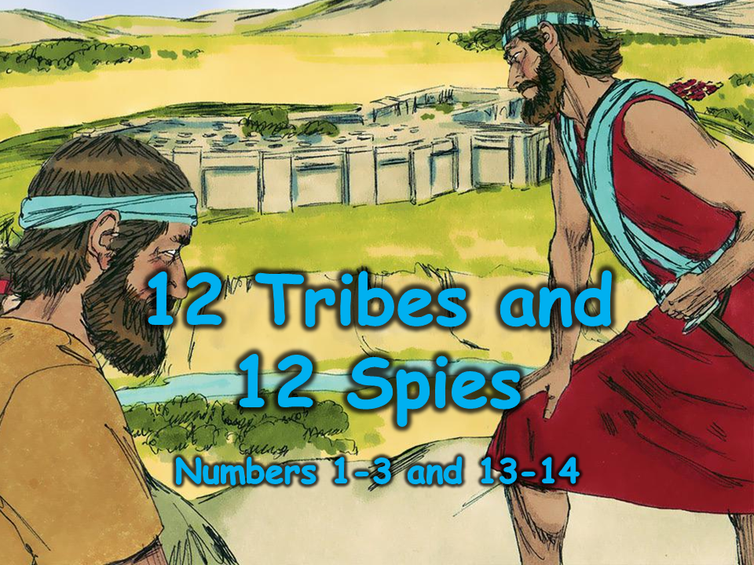
Notes:
1. Cover: Twelve Tribes and Twelve Spies (Numbers 1-3, 13-14)

Slide 2
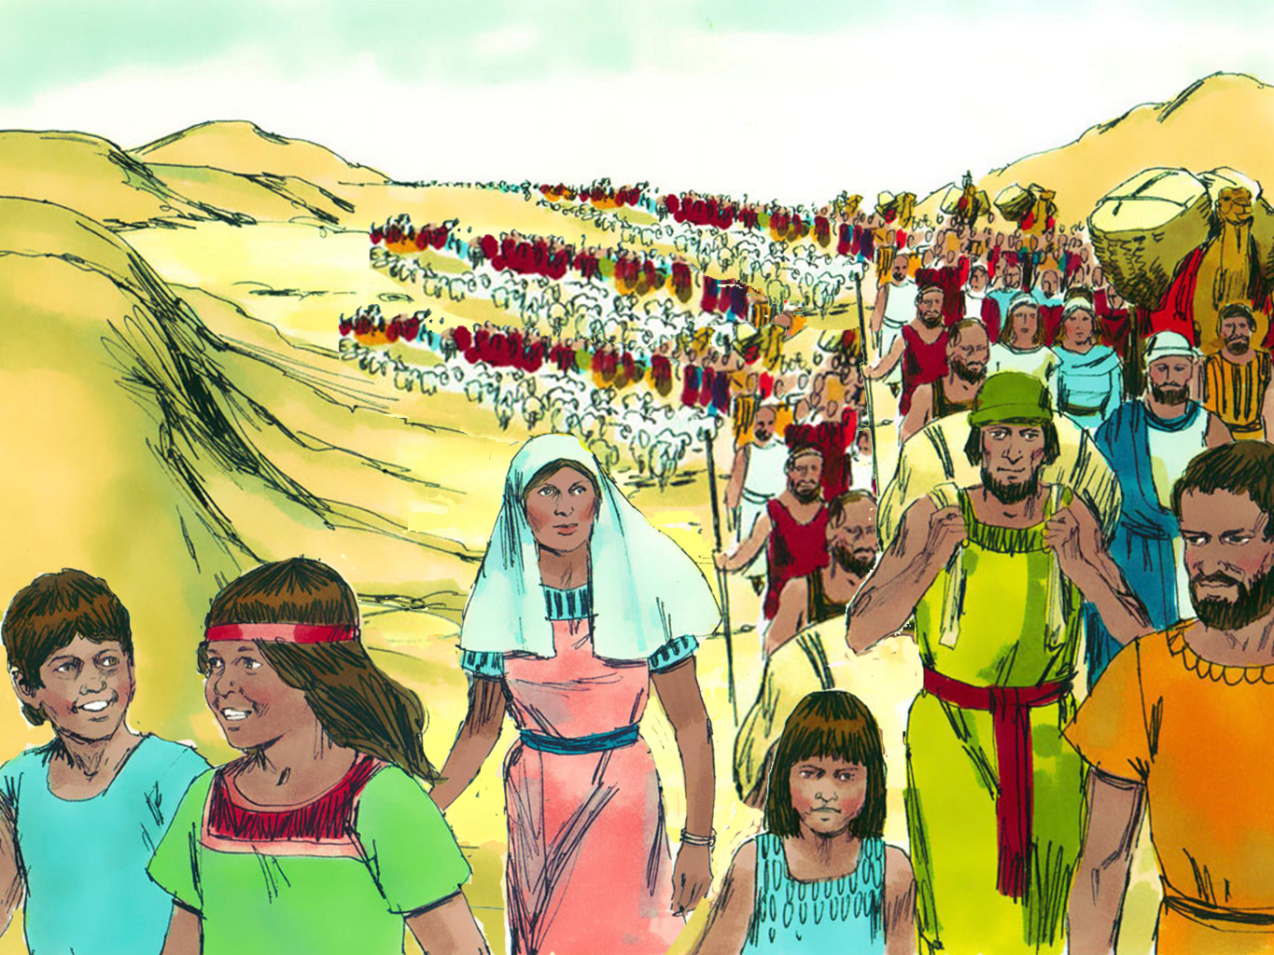
Notes:
2. Today’s Bible lesson is found in the Book of Numbers. If you enjoy mathematics or counting, you will probably enjoy the Book of Numbers. God told the leader of the people, Moses, to count all of the people. Moses’ brother, Aaron, helped him count because there were thousands and thousands of people.

Slide 3
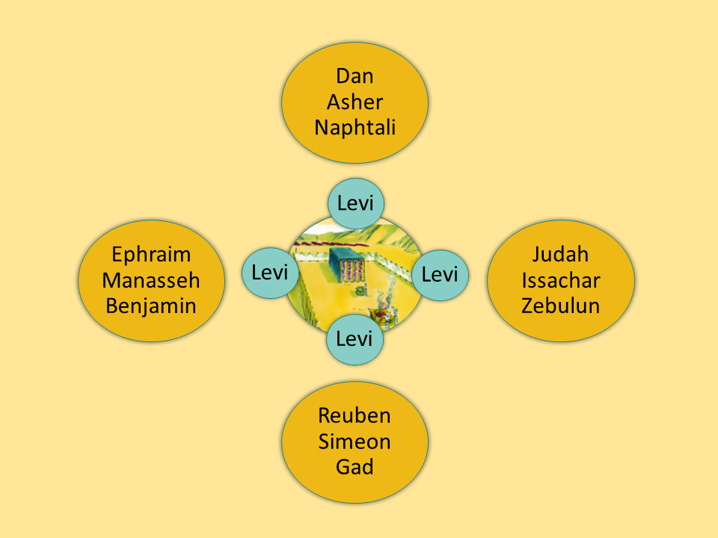

Notes:
3. The number of God’s people was so big that God asked Moses (their leader) to divide them into groups called “tribes.”
When it came time to camp, each tribe would gather together in their own place. Each tribe even had their own flag.
If you were to look at a map of the camp, you would see God’s very important tent, the Tabernacle, in the centre. Nearby, the tabernacle would be the Levites. They were in charge of taking care of the Tabernacle and leading worship.
The tents of the twelve tribes were located on the camp’s north, south, east, and west edges.

Slide 4
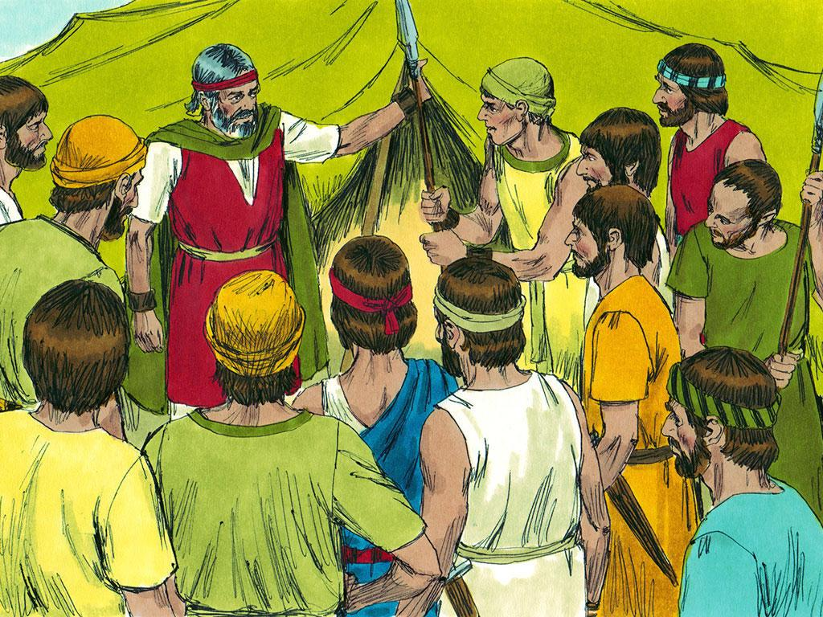
Notes:
4. Once the Israelites were organised into 12 tribes, God told Moses it was time to get ready to enter the land He had promised to His people. The new land might be dangerous, so some Israelites should go quietly into the land to see what was there before they made a plan.
Moses chose one man from each tribe to be a spy to “spy out the land.”

Slide 5
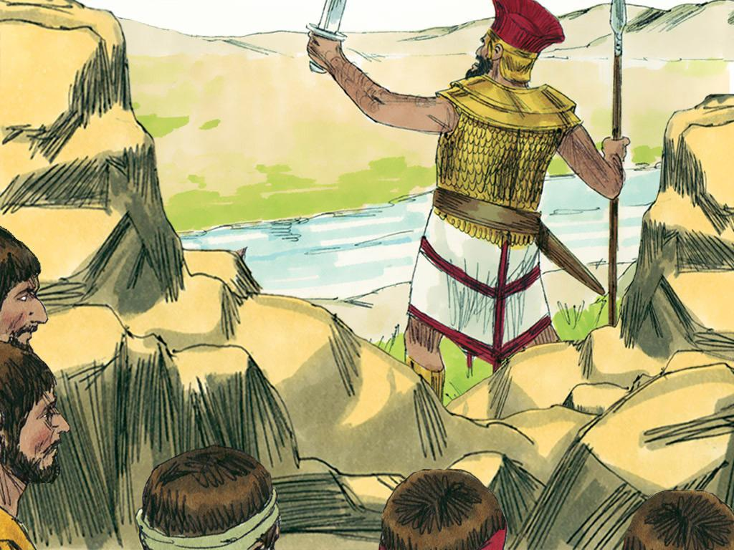
Notes:
5. The twelve spies quietly went around the promised land, finding as much information as they could without being seen. They saw big fighting men in the land, and some began to feel nervous. Would they have to fight these men before they could live in the new land?

Slide 6
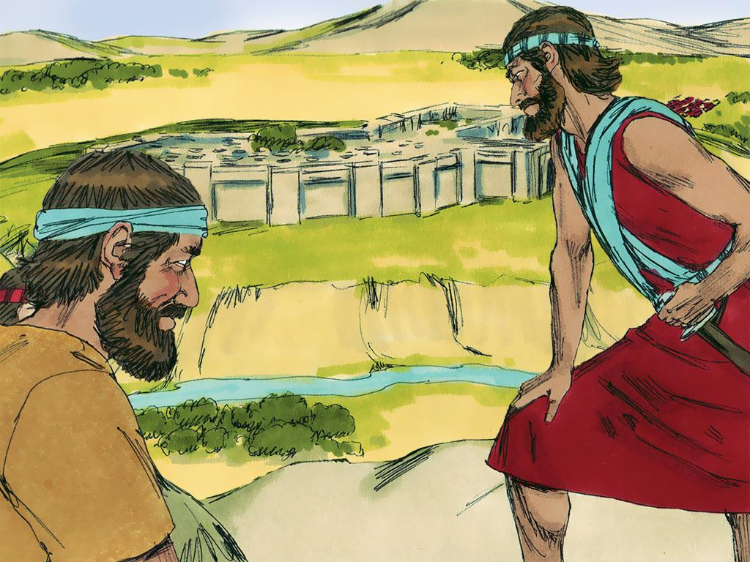
Notes:
6. There were also big cities in the land, and they had strong walls built around them. The spies began to realise that this was going to be very difficult. Would God be strong enough to help them win against these people?

Slide 7
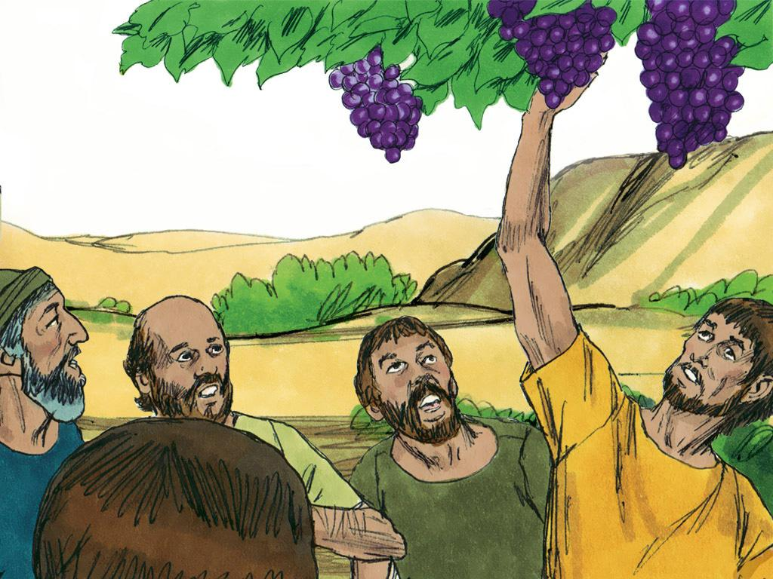
Notes:
7. But the 12 spies also saw that the land God had promised was amazing. They saw grapes, pomegranates, and figs. The spies cut off one branch of a grapevine and put it on a pole to carry back to show Moses and the people. The grapes were so big and heavy that it took two men to carry the pole.

Slide 8
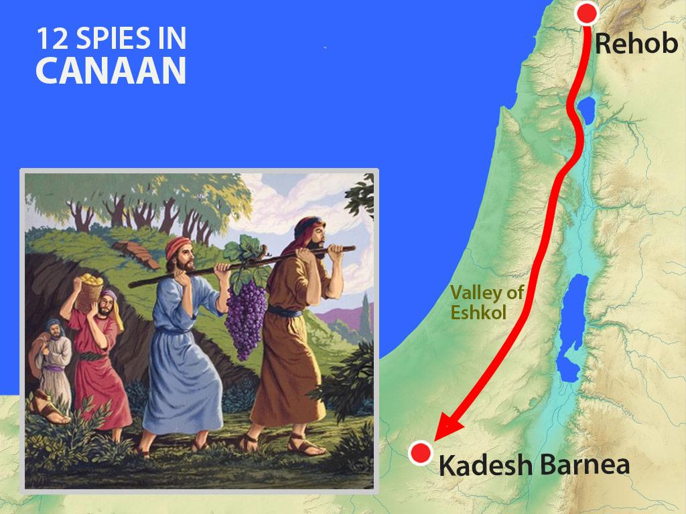
Notes:
8. After spending 40 days spying out the land, these men knew it was time to return to the camp and give their report to Moses and all of the people.

Slide 9
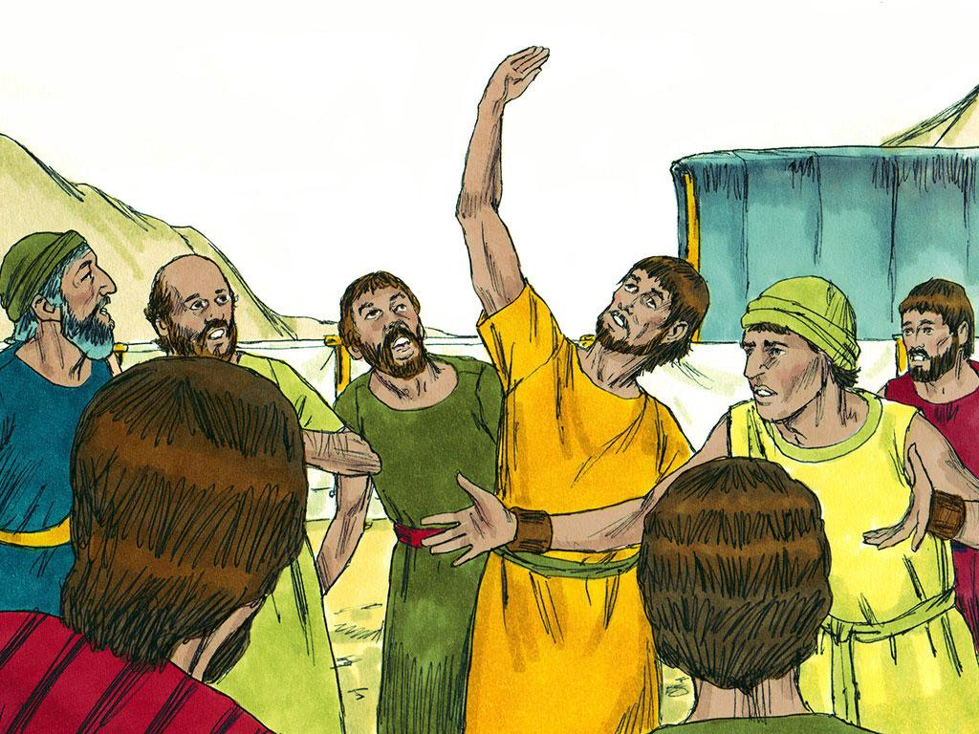
Notes:
9. Even though the spies had seen many good things in the land, some just wanted to talk about the BAD things. Ten spies told Moses and the people that entering the promised land would be too hard. There were giant fighting men, and many cities had strong walls. The ten spies gave such a bad report that they said, “The fighting men there are so big that we just look like little grasshoppers compared to them!” The people were so discouraged.

Slide 10
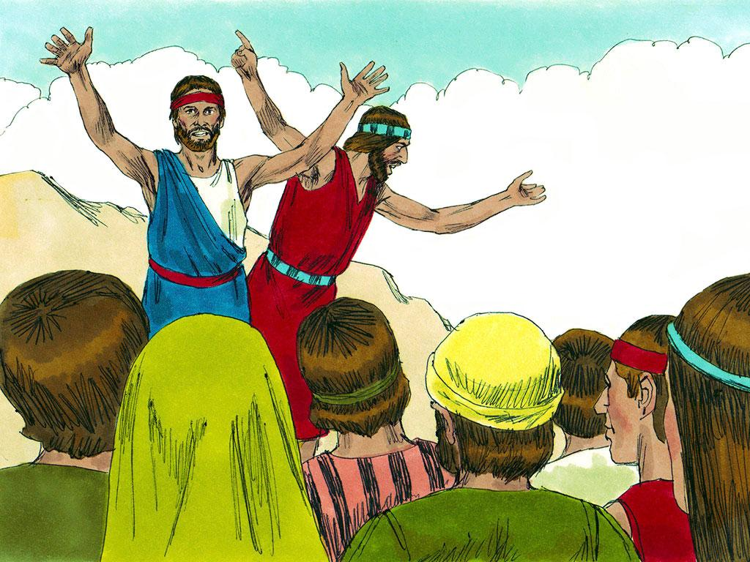
Notes:
10. All the people were beginning to think they should not enter the promised land. However, two spies (Joshua and Caleb) had a different report to give Moses and the people. They told the other ten spies to stop saying it was too hard and scary. Caleb said, “We should go and take the land for ourselves. We can do it!”

Slide 11
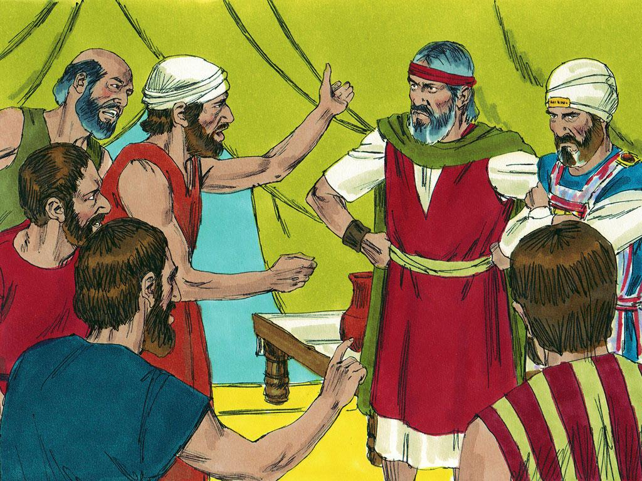
Notes:
11. But the people listened to the ten spies more. There was much arguing, and people began to get very angry. Some even said that God’s promises were not good. They said, “God promised we could have our own land, but He can’t help us beat giants! We never should have followed God. We should have stayed in Egypt.

Slide 12
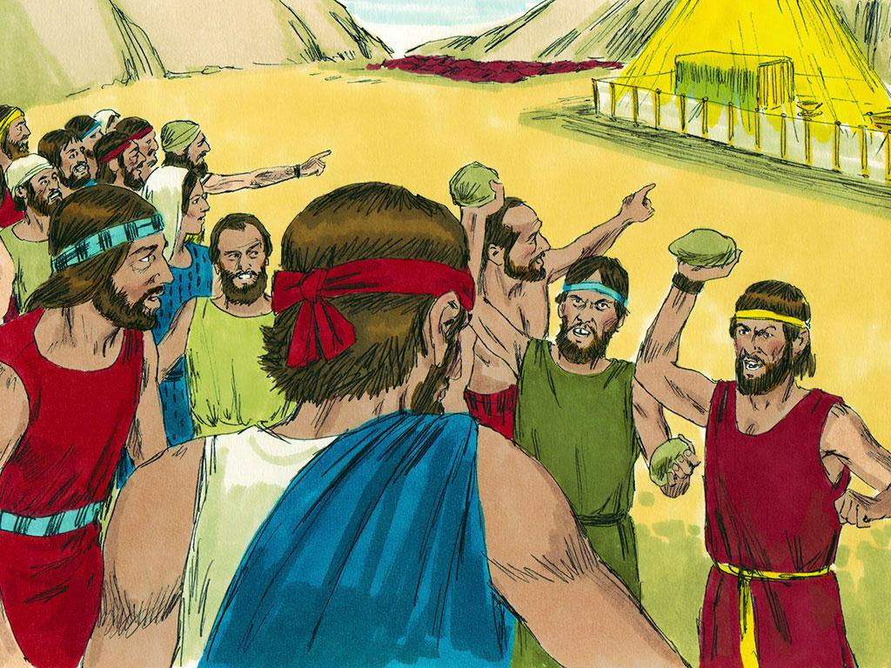
Notes:
12. Moses and Aaron and Joshua and Caleb were shocked. Go back to Egypt? They had been slaves in Egypt. Why wouldn’t the people believe in God’s promise? God was stronger than any giants or strong walls. Moses, Aaron, Joshua, and Caleb begged the people, “Please, don’t be afraid! God will protect us. Just trust in God.”
But the people did not listen. They just kept getting more and more angry. They were so angry that they were just about to throw stones at the men to kill them.

Slide 13
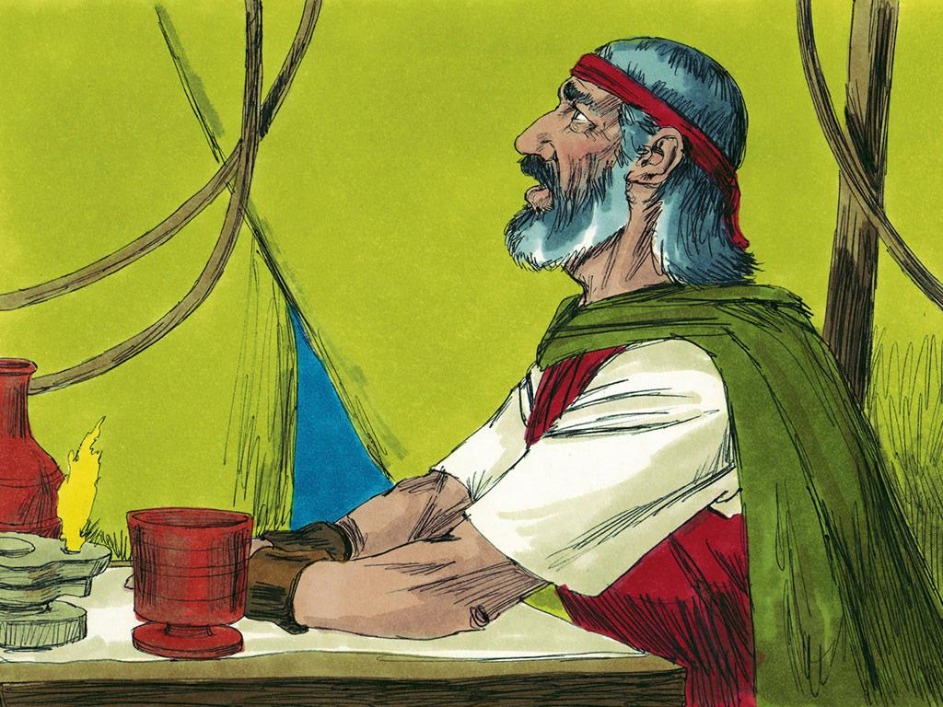
Notes:
13. Moses talked to God. The people were angry, but God was also angry. He had done so much for the people. He had saved them from slavery in Egypt. He had parted the Red Sea so they could cross through it safely. He had given them the Ten Commandments, food in the desert and even a beautiful place to worship. He had chosen a beautiful land for them to live in. All they had to do was enter into the land. He would keep His promise and protect them from all enemies. Why didn’t they believe Him?

Slide 14
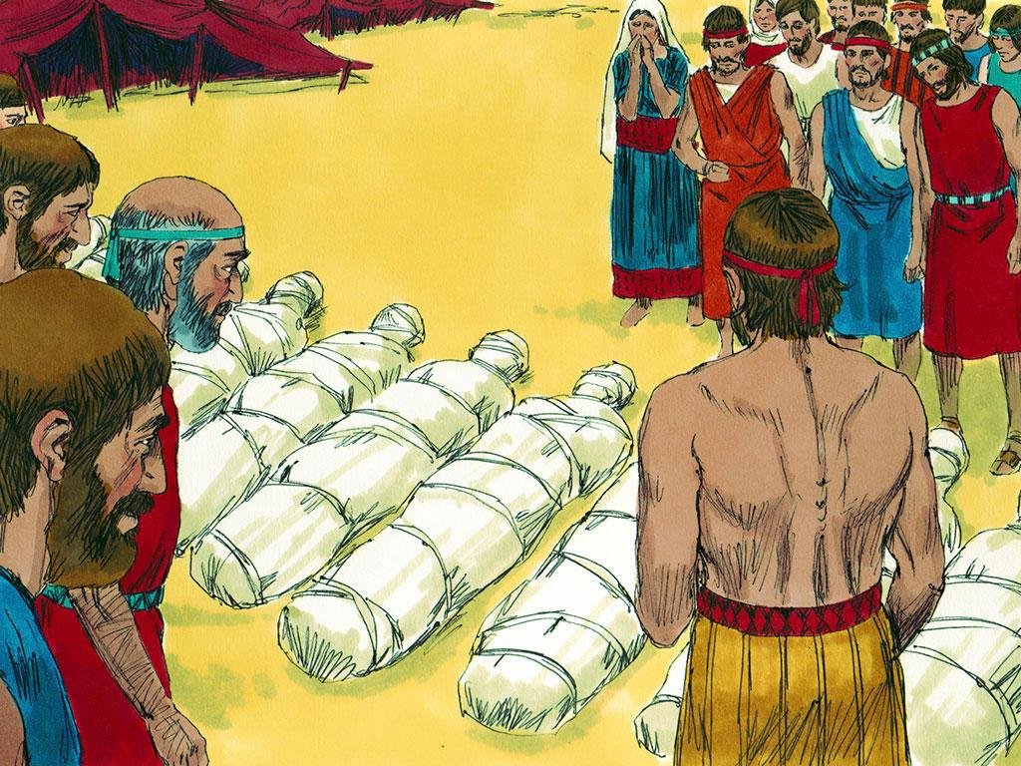
Notes:
14. Turning away from God was extremely serious. Now, there would be a sad punishment so that everyone would learn a lesson for the future.
If they had trusted God, they could have entered the land immediately. Now, they would have to live in the desert for forty more years before they entered the land. This was one year for each forty days the spies had spent spying out the land.
The people who complained and wanted to return to Egypt would suffer punishment. They would not live past the next forty years and would not have the joy of entering the promised land when the time finally came.
And finally, there was a punishment for the ten spies that convinced all the people to turn away from God. These ten men were overcome with a terrible sickness and died.
In all of this, God remembered Joshua and Caleb’s faithfulness. They were the only two of the twelve spies who did not die. And even though they had to wait forty years with the rest of the people, they would someday have the joy of entering the promised land.

Slide 15
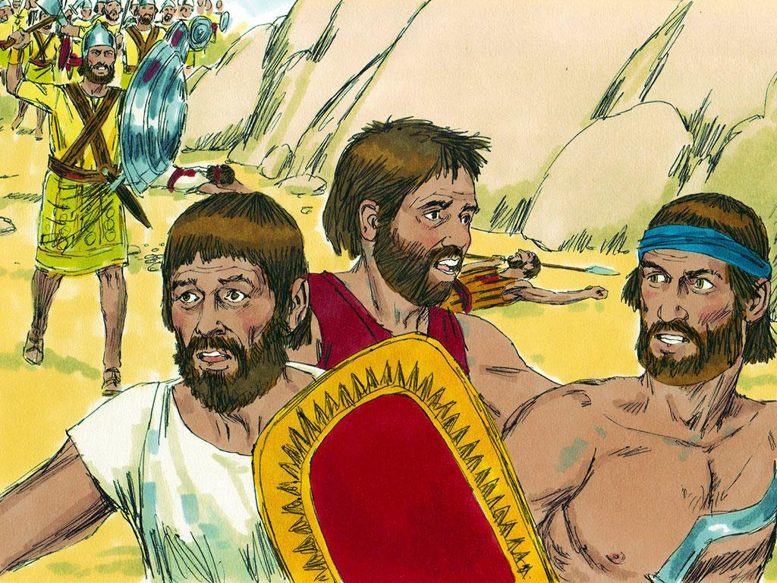
Notes:
15. It may seem incredible, but some of the people still didn’t listen to God! They didn’t want to wait forty years, so they tried to enter the land anyway.
But it did not matter how strong they were or how hard they fought. They could never win without God on their side. Instead, they returned to camp defeated.

Slide 16
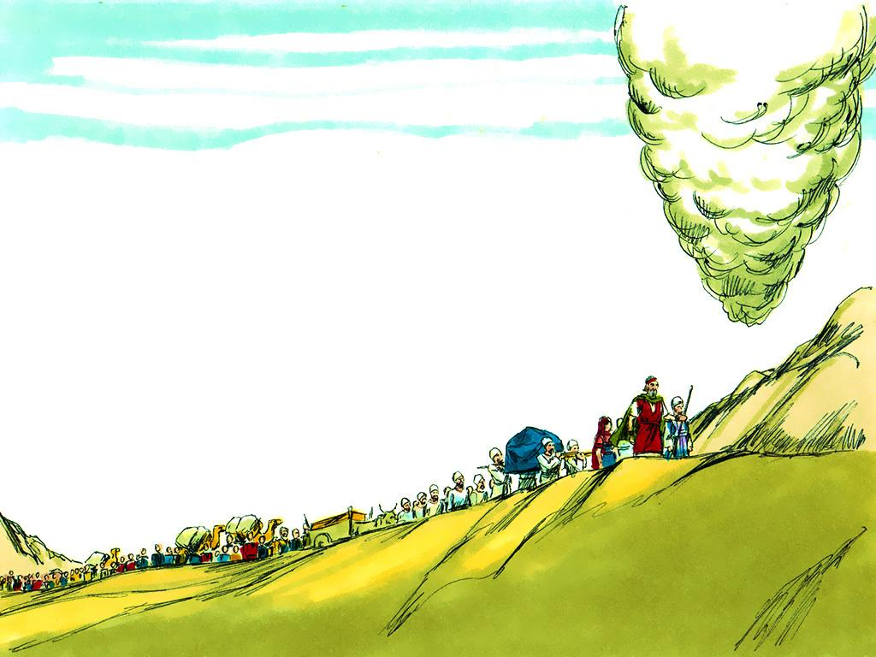
Notes:
16. So it was back into the desert again. God continued to lead them, but they would have to wait forty years before He would lead them to the promised land again.
Now, what about you? If you had been one of the people, would you have listened to the ten spies, or would you have listened to the two spies?

Slide 17
Teacher Notes 1
1. Cover: Twelve Tribes and Twelve Spies (Numbers 1-3, 13-14)
2. Today’s Bible lesson is found in the Book of Numbers. If you enjoy mathematics or counting, you will probably enjoy the Book of Numbers. God told the leader of the people, Moses, to count all of the people. Moses’ brother, Aaron, helped him count because there were thousands and thousands of people.
3. The number of God’s people was so big that God asked Moses (their leader) to divide them into groups called “tribes.”
When it came time to camp, each tribe would gather together in their own place. Each tribe even had their own flag.
If you were to look at a map of the camp, you would see God’s very important tent, the Tabernacle, in the centre. Nearby, the tabernacle would be the Levites. They were in charge of taking care of the Tabernacle and leading worship.
The tents of the twelve tribes were located on the camp’s north, south, east, and west edges.
4. Once the Israelites were organised into 12 tribes, God told Moses it was time to get ready to enter the land He had promised to His people. The new land might be dangerous, so some Israelites should go quietly into the land to see what was there before they made a plan.
Moses chose one man from each tribe to be a spy to “spy out the land.”
5. The twelve spies quietly went around the promised land, finding as much information as they could without being seen. They saw big fighting men in the land, and some began to feel nervous. Would they have to fight these men before they could live in the new land?
6. There were also big cities in the land, and they had strong walls built around them. The spies began to realise that this was going to be very difficult. Would God be strong enough to help them win against these people?
7. But the 12 spies also saw that the land God had promised was amazing. They saw grapes, pomegranates, and figs. The spies cut off one branch of a grapevine and put it on a pole to carry back to show Moses and the people. The grapes were so big and heavy that it took two men to carry the pole.
8. After spending 40 days spying out the land, these men knew it was time to return to the camp and give their report to Moses and all of the people.
9. Even though the spies had seen many good things in the land, some just wanted to talk about the BAD things. Ten spies told Moses and the people that entering the promised land would be too hard. There were giant fighting men, and many cities had strong walls. The ten spies gave such a bad report that they said, “The fighting men there are so big that we just look like little grasshoppers compared to them!” The people were so discouraged.

Slide 18
Teacher Notes 2
10. All the people were beginning to think they should not enter the promised land. However, two spies (Joshua and Caleb) had a different report to give Moses and the people. They told the other ten spies to stop saying it was too hard and scary. Caleb said, “We should go and take the land for ourselves. We can do it!”
11. But the people listened to the ten spies more. There was much arguing, and people began to get very angry. Some even said that God’s promises were not good. They said, “God promised we could have our own land, but He can’t help us beat giants! We never should have followed God. We should have stayed in Egypt.
12. Moses and Aaron and Joshua and Caleb were shocked. Go back to Egypt? They had been slaves in Egypt. Why wouldn’t the people believe in God’s promise? God was stronger than any giants or strong walls. Moses, Aaron, Joshua, and Caleb begged the people, “Please, don’t be afraid! God will protect us. Just trust in God.”
But the people did not listen. They just kept getting more and more angry. They were so angry that they were just about to throw stones at the men to kill them.
13. Moses talked to God. The people were angry, but God was also angry. He had done so much for the people. He had saved them from slavery in Egypt. He had parted the Red Sea so they could cross through it safely. He had given them the Ten Commandments, food in the desert and even a beautiful place to worship. He had chosen a beautiful land for them to live in. All they had to do was enter into the land. He would keep His promise and protect them from all enemies. Why didn’t they believe Him?
14. Turning away from God was extremely serious. Now, there would be a sad punishment so that everyone would learn a lesson for the future.
If they had trusted God, they could have entered the land immediately. Now, they would have to live in the desert for forty more years before they entered the land. This was one year for each forty days the spies had spent spying out the land.
The people who complained and wanted to return to Egypt would suffer punishment. They would not live past the next forty years and would not have the joy of entering the promised land when the time finally came.
And finally, there was a punishment for the ten spies that convinced all the people to turn away from God. These ten men were overcome with a terrible sickness and died.
In all of this, God remembered Joshua and Caleb’s faithfulness. They were the only two of the twelve spies who did not die. And even though they had to wait forty years with the rest of the people, they would someday have the joy of entering the promised land.
15. It may seem incredible, but some of the people still didn’t listen to God! They didn’t want to wait forty years, so they tried to enter the land anyway.
But it did not matter how strong they were or how hard they fought. They could never win without God on their side. Instead, they returned to camp defeated.

Slide 19
Teacher Notes 3
16. So it was back into the desert again. God continued to lead them, but they would have to wait forty years before He would lead them to the promised land again.
Now, what about you? If you had been one of the people, would you have listened to the ten spies, or would you have listened to the two spies?

Slide 20


Attributions: This visual aid was constructed by Mary Nelson missionbiblelessons.org using:
Text and slideshow compilation by Mary Nelson.
Illustrations by Sweet Publishing http://sweetpublishing.com/ As accessed through www.freebibleimages.org
Notice of Alteration:
Text added to cover slide.
Slide 2 was formed by combining 2 illustrations.
Only portion of illustration used in slide 3. Chart by Mary Nelson.
Attribution-ShareAlike 3.0 Unported (CC BY-SA 3.0) https://creativecommons.org/licenses/by-sa/3.0/
User may reproduce it without permissions.
DOWNLOAD THIS SLIDESHOW FROM www.missionbibleclass.org
Please visit missionbiblelessons.org to find this and many other free resources to help you teach the Bible to children.

