Slide 1
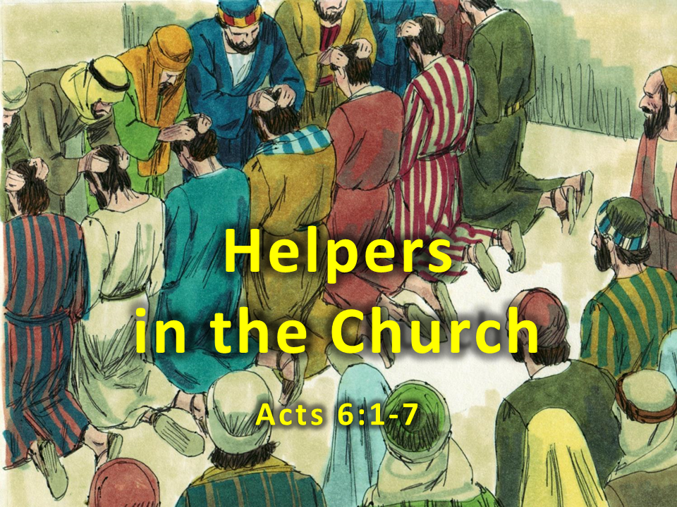
Notes:
1. Cover: The First Deacons
Acts 6:1-7

Slide 2
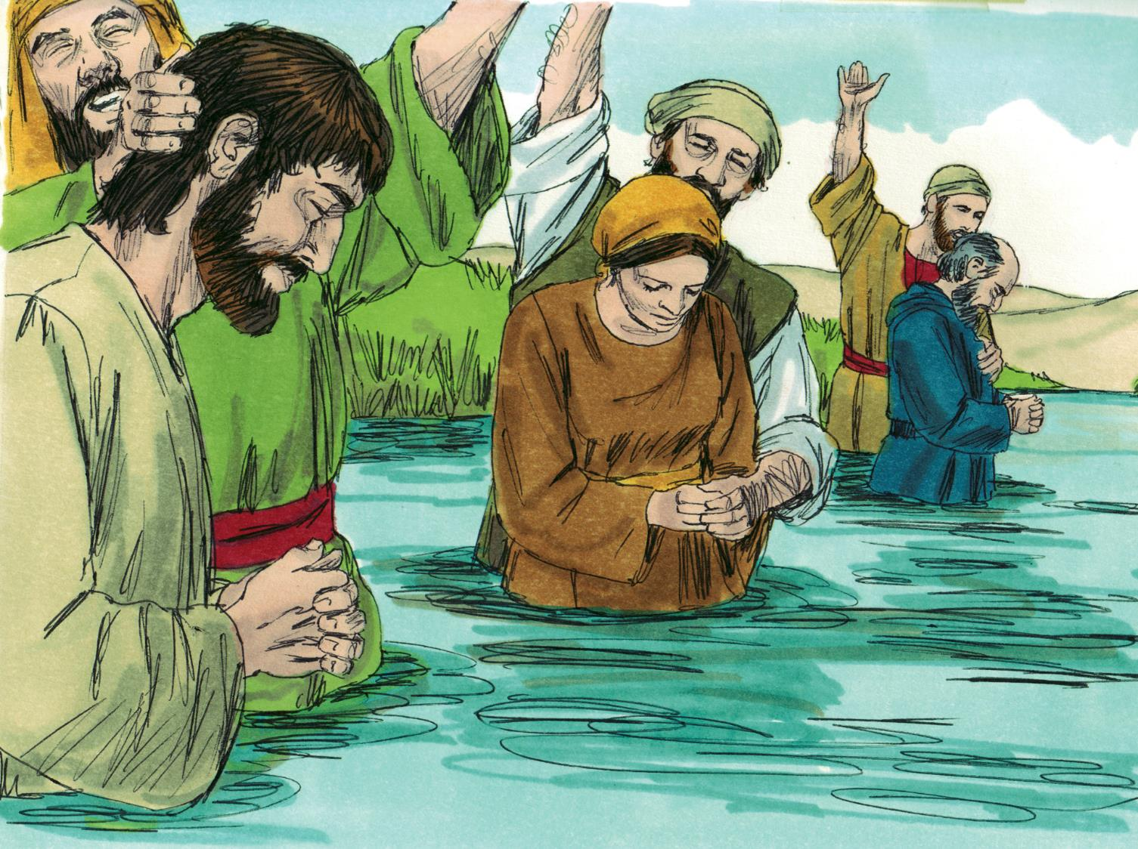
2. The church in Jerusalem grew bigger and bigger every day. People heard about Jesus and then told other people. Soon hundreds and hundreds and even thousands of people decided to follow Jesus and were baptised.
Notes:
2. The church in Jerusalem grew bigger and bigger every day. People heard about Jesus and then told other people. Soon hundreds and hundreds and even thousands of people decided to follow Jesus and were baptised..

Slide 3
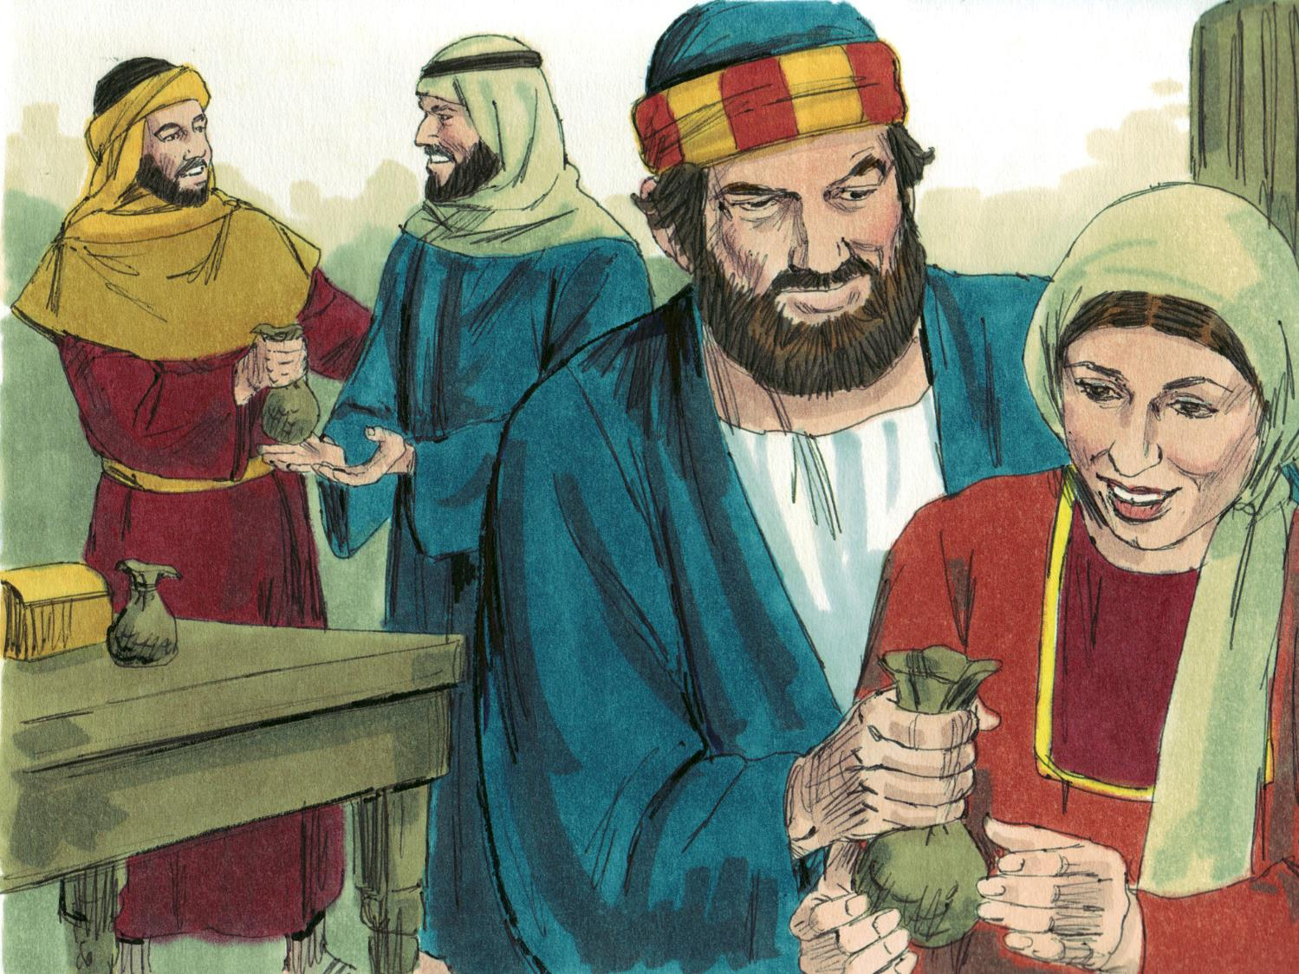
3. The Apostles were very busy praying, preaching and teaching every day. They wanted everyone to know about Jesus!
But they were also very busy helping people. Christians brought money to the Apostles and the Apostles, in turn, would buy food and give it out to those who were hungry. This was very important because some people did not have any family to take care of them. One group of people who didn’t have family were the widows. A widow is a woman whose husband has died. The Apostles gave food to the widows to help them.
Notes:
3. The Apostles were very busy praying, preaching and teaching every day. They wanted everyone to know about Jesus!
But they were also very busy helping people. Christians brought money to the Apostles and the Apostles, in turn, would buy food and give it out to those who were hungry. This was very important because some people did not have any family to take care of them. One group of people who didn’t have a family were the widows. A widow is a woman whose husband has died. The Apostles gave food to the widows to help them.

Slide 4
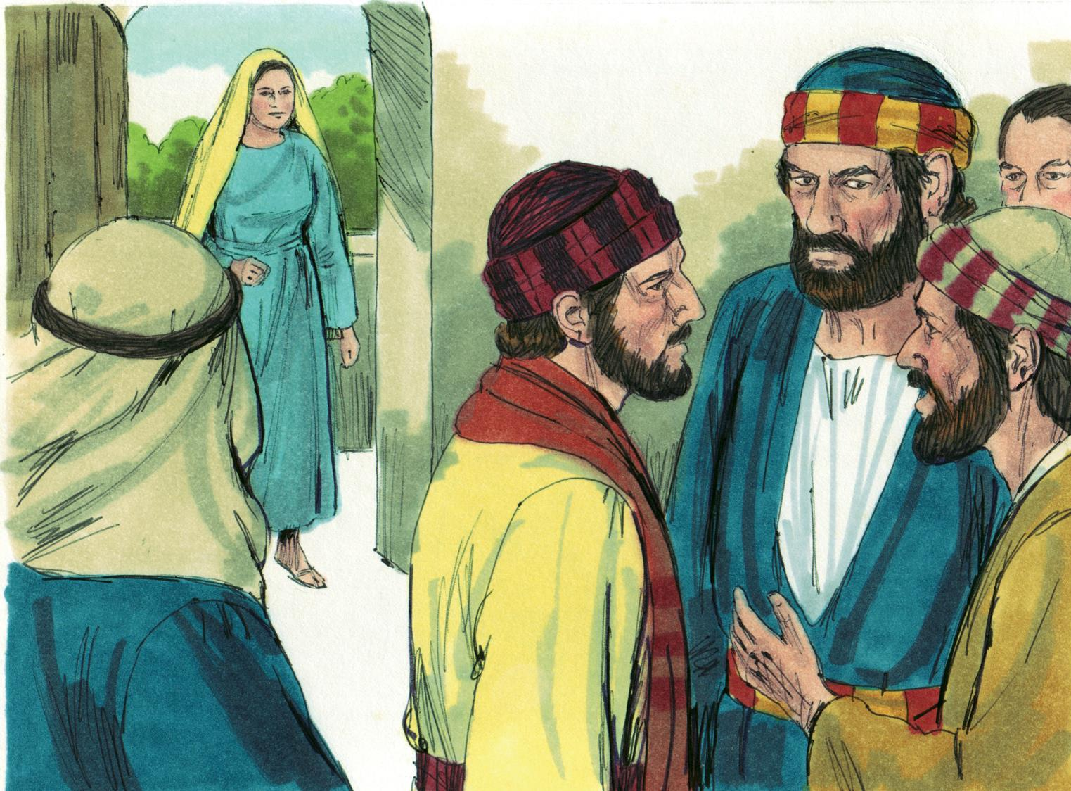
4. But there was a problem. The Apostles were so busy that sometimes they couldn’t get to everyone. Some widows were missing out and going hungry. The Jews that had traveled from far away said, “The widows in our group are not getting enough food! The other widows are getting the food first.”
Many people were unhappy so the Apostles gathered everyone together. They said, “We don’t want anyone to miss out on the food. But it takes a lot of time to buy the food and pass it out to everyone. If we spend all of our time passing out food then we won’t have enough time to pray and to teach about Jesus. It would not be right to stop teaching about Jesus.”
Notes:
4. But there was a problem. The Apostles were so busy that sometimes they couldn’t get to everyone. Some widows were missing out and going hungry. The Jews that had travelled from far away said, “The widows in our group are not getting enough food! The other widows are getting the food first.”
Many people were unhappy so the Apostles gathered everyone together. They said, “We don’t want anyone to miss out on the food. But it takes a lot of time to buy the food and pass it out to everyone. If we spend all of our time passing out food then we won’t have enough time to pray and to teach about Jesus. It would not be right to stop teaching about Jesus.”

Slide 5
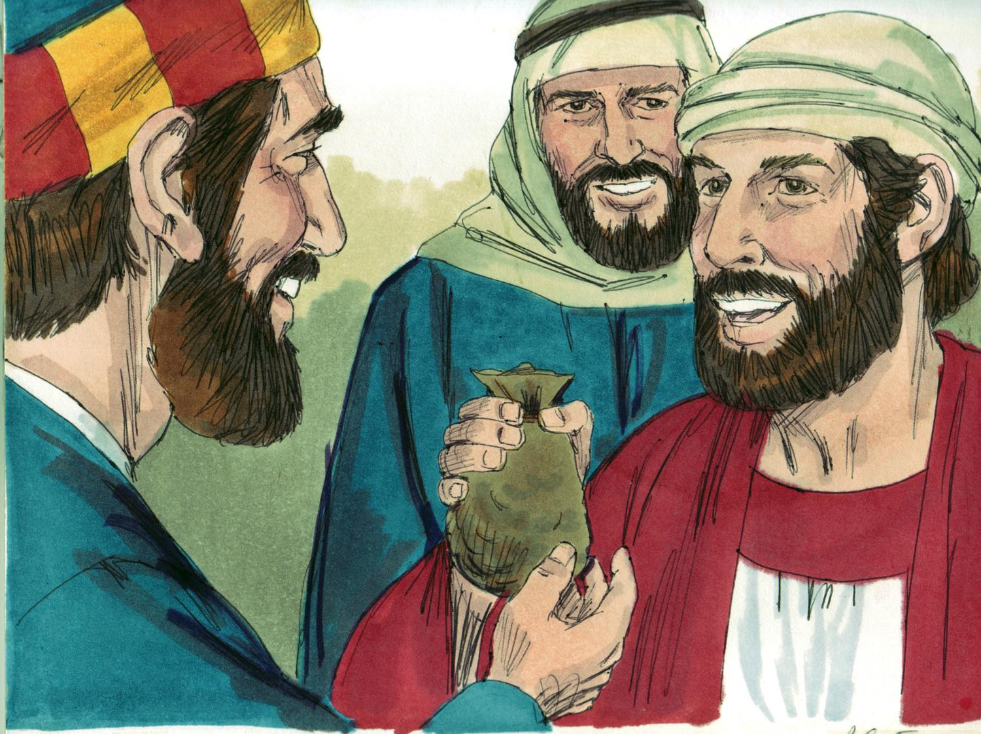
5. “We have an idea. We Apostles will stop distributing food and spend our time praying, preaching and teaching. We want everyone to choose seven other men to be in charge of passing out the food. Make sure these men are faithful to God and the Spirit. Choose men who are wise because it will be their job to make sure everything is fair and that none of the widows misses out.”
Notes:
5. “We have an idea. We Apostles will stop distributing food so that we can spend our time praying, preaching and teaching. We want everyone to choose seven other men to be in charge of passing out the food. Make sure these men are faithful to God and full of the Spirit. Choose men who are wise because it will be their job to make sure everything is fair and that none of the widows misses out.”

Slide 6
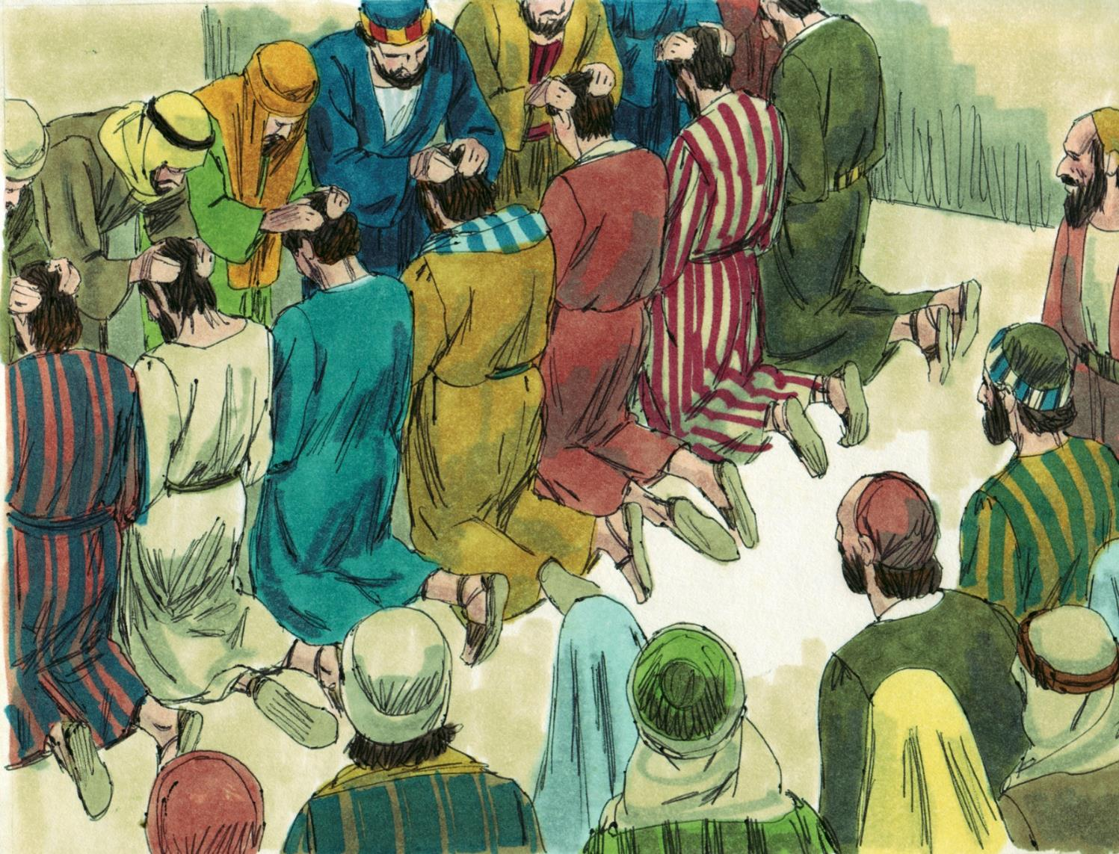
6. Everyone thought this was a really good idea so they chose seven men: Stephen, Philip, Procorus, Nicanor, Timon, Parmenas and Nicolas. The Apostles prayed for these men and they began their work.
Notes:
6. Everyone thought this was a really good idea so they chose seven men: Stephen, Philip, Procorus, Nicanor, Timon, Parmenas and Nicolas. The Apostles prayed for these men and they began their work.

Slide 7
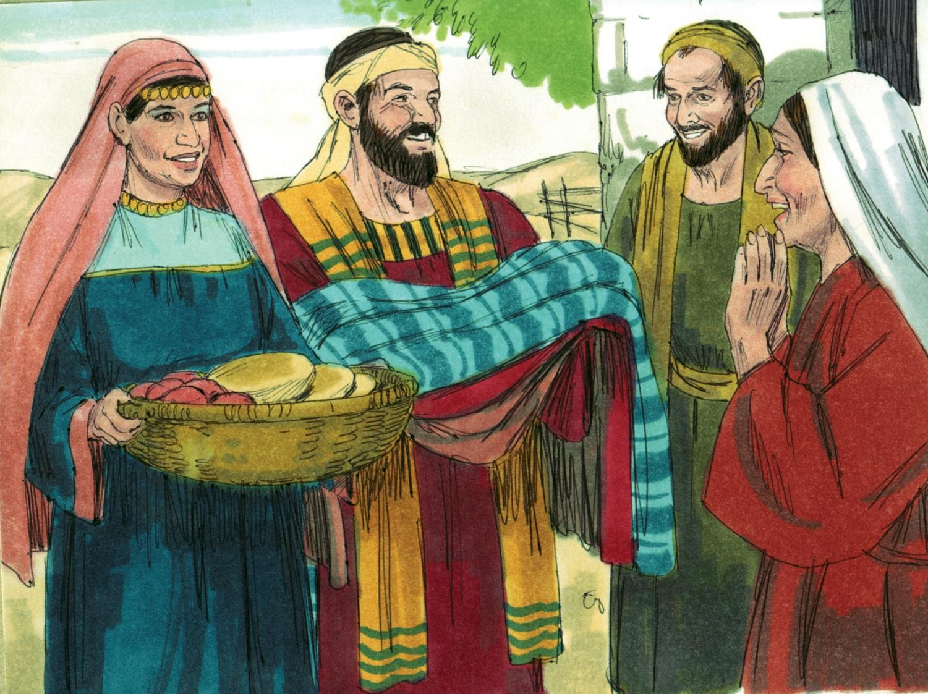
7. From then on the widows and everyone else received their fair share of food and the Apostles taught even more people about Jesus. Now that everyone was sharing in the work, the church grew bigger and bigger every day.
Notes:
7. From then on the widows and everyone else received their fair share of food and the Apostles taught even more people about Jesus. Now that everyone was sharing in the work, the church grew bigger and bigger every day.

Slide 8
8. What jobs do people do in your church? Are there elders and preachers? Are there deacons or men and women who serve the church in special ways? What ways do you help the church?
My
Church
Notes:
8. What jobs do people do in your church? Are there elders and preachers? Are there deacons or men and women who serve the church in special ways? In what ways do you help the church?C

Slide 9
Teacher Notes Page
1. Cover: Helpers in the Church
Acts 6:1-7
2. The church in Jerusalem grew bigger and bigger every day. People heard about Jesus and then told other people. Soon hundreds and hundreds and even thousands of people decided to follow Jesus and were baptised..
3. The Apostles were very busy praying, preaching and teaching every day. They wanted everyone to know about Jesus!
But they were also very busy helping people. Christians brought money to the Apostles and the Apostles, in turn, would buy food and give it out to those who were hungry. This was very important because some people did not have any family to take care of them. One group of people who didn’t have a family were the widows. A widow is a woman whose husband has died. The Apostles gave food to the widows to help them.
4. But there was a problem. The Apostles were so busy that sometimes they couldn’t get to everyone. Some widows were missing out and going hungry. The Jews that had travelled from far away said, “The widows in our group are not getting enough food! The other widows are getting the food first.”
Many people were unhappy so the Apostles gathered everyone together. They said, “We don’t want anyone to miss out on the food. But it takes a lot of time to buy the food and pass it out to everyone. If we spend all of our time passing out food then we won’t have enough time to pray and to teach about Jesus. It would not be right to stop teaching about Jesus.”
5. “We have an idea. We Apostles will stop distributing food so that we can spend our time praying, preaching and teaching. We want everyone to choose seven other men to be in charge of passing out the food. Make sure these men are faithful to God and full of the Spirit. Choose men who are wise because it will be their job to make sure everything is fair and that none of the widows misses out.”
6. Everyone thought this was a really good idea so they chose seven men: Stephen, Philip, Procorus, Nicanor, Timon, Parmenas and Nicolas. The Apostles prayed for these men and they began their work.
7. From then on the widows and everyone else received their fair share of food and the Apostles taught even more people about Jesus. Now that everyone was sharing in the work, the church grew bigger and bigger every day.
8. What jobs do people do in your church? Are there elders and preachers? Are there deacons or men and women who serve the church in special ways? In what ways do you help the church?

Slide 10


Attributions: This visual aid was constructed by Mary Nelson www.missionbibleclass.org using:
Text and slideshow compilation by Mary Nelson
Illustrations by Sweet Publishing http://sweetpublishing.com/
As accessed through www.freebibleimages.org
Notice of Alteration: Text added to cover slide.
Attribution-ShareAlike 3.0 Unported (CC BY-SA 3.0) https://creativecommons.org/licenses/by-sa/3.0/
User may reproduce it without permissions.
DOWNLOAD THIS SLIDESHOW FROM www.missionbibleclass.org
Please visit www.missionbibleclass.org to find this and many other free resources to help you
teach the Bible to children.

