Slide 1
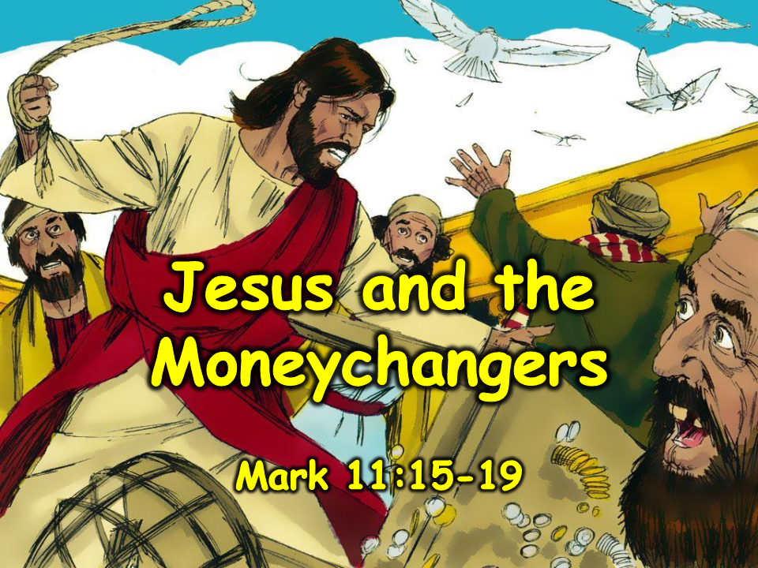
Notes:
1. Cover: Jesus and the Moneychangers (John 2:12-17)

Slide 2
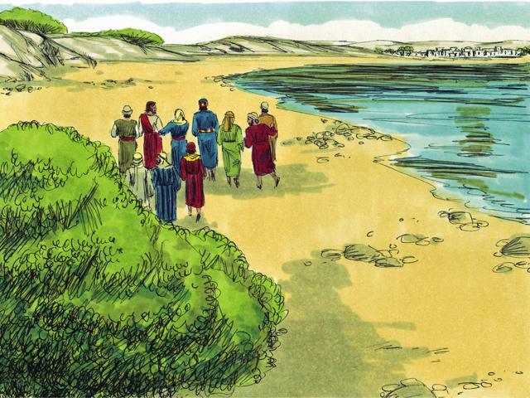
Notes:
2. Jesus and His disciples travelled from place to place, teaching people about God. At the time of the special Jewish feast of Passover, they travelled to Jerusalem to worship God and take part in special ceremonies at the Temple. Mary and some of Jesus’ brothers went along, too. They all looked forward to a special time in Jerusalem. They thought about the beautiful Temple. They thought about how people would be worshipping God at the Temple.

Slide 3
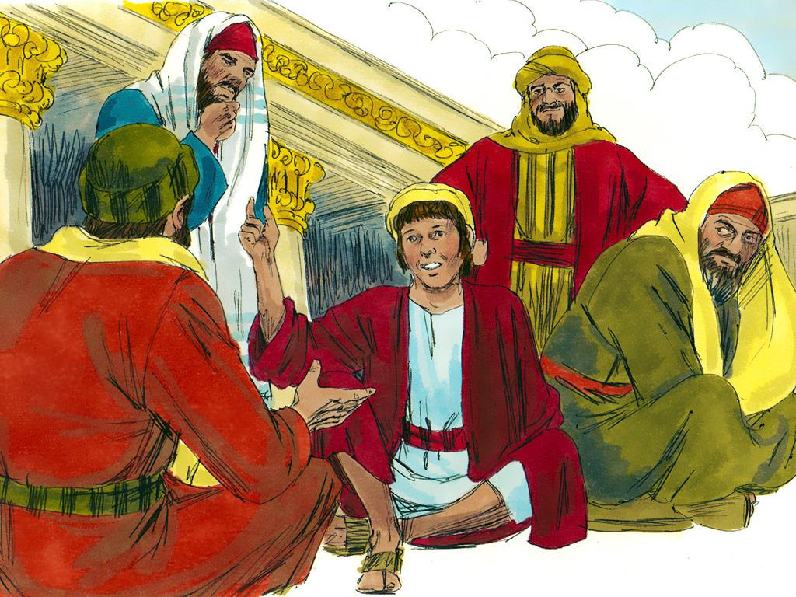
Notes:
3. Ever since He was a young boy, Jesus had been taught by His parents that the Temple of God in Jerusalem was a very important place. This was a place where people came to worship God and offer sacrifices. At the Temple, everyone was supposed to think and talk about God.

Slide 4
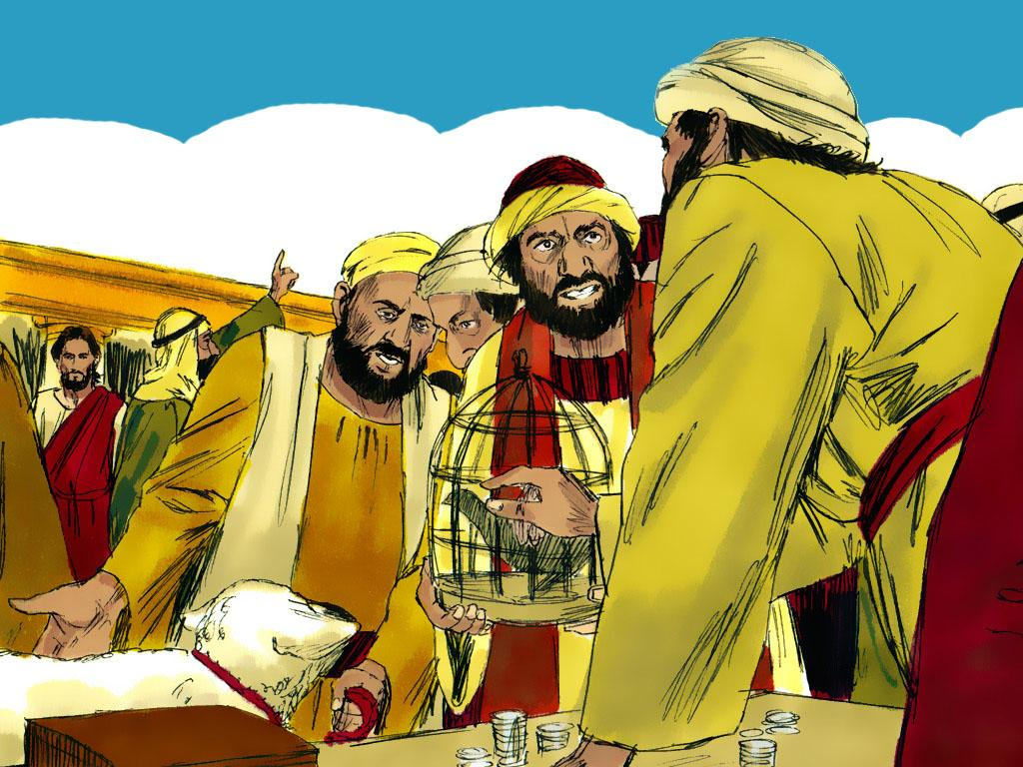
Notes:
4. But when they arrived at the Temple, it did not seem as if people were there to worship God at all. The people were not treating the Temple like a special place of God. Instead, the Temple looked like a big market! Animals were making loud noises. Jesus heard cattle, sheep and doves. Some people exchange money and try to cheat others. The people were not thinking about God at all.

Slide 5
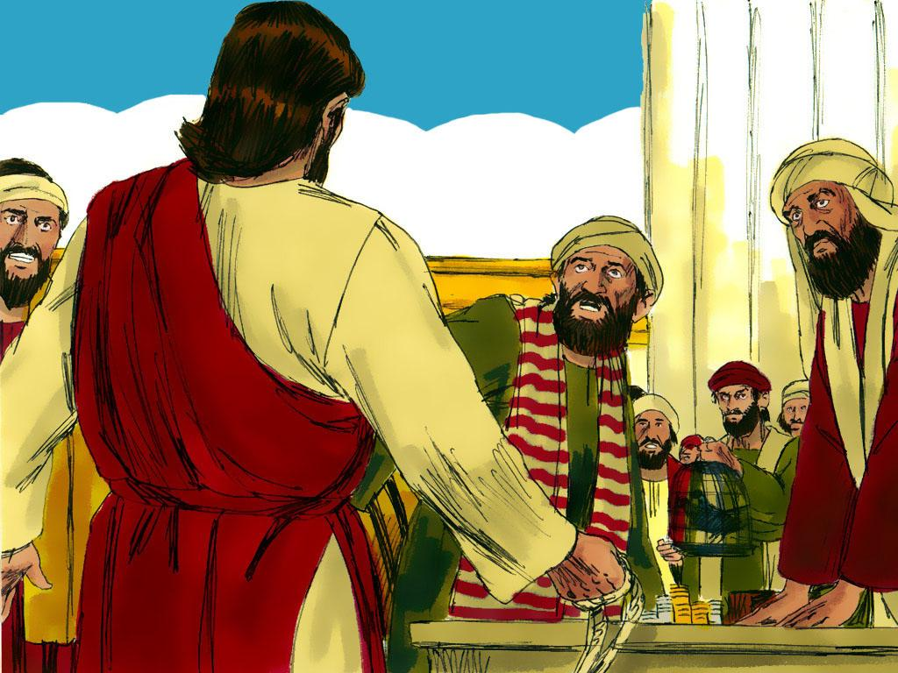
Notes:
5. Jesus was very sad and angry at how people treated God and God’s special place. Jesus is the son of God, so the Temple was His Father’s house. He loved His Father, and He loved His Father’s house! Jesus knew He needed to do something very drastic so that everyone would understand how serious this was.

Slide 6
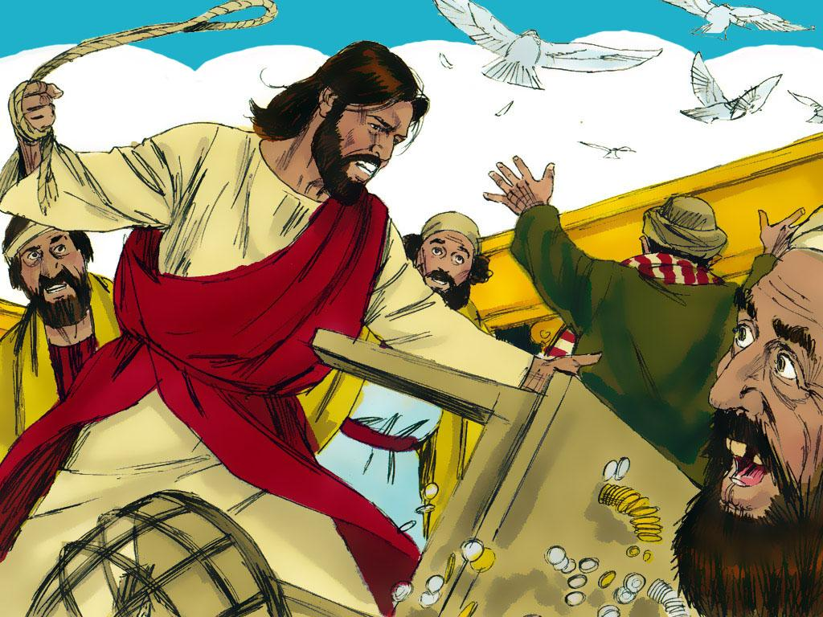
Notes:
6. So Jesus did something that shocked everyone. He tied cords of rope together to make a whip to swing around. Then He began swinging the rope and turning over the tables that people had put in the wrong places in the Temple. He shooed the birds and animals away and caused the money that people were cheating with to fall all over the ground. Jesus said, “Get those things out of here! How dare you turn my Father’s house into a market!”

Slide 7
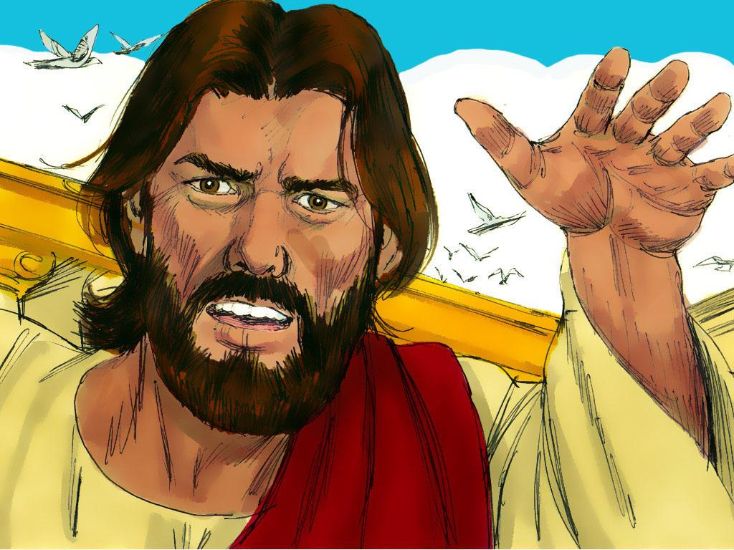
Notes:
7. Before this, everyone was thinking about money and the market. Now, people finally had time to stop and think about what Jesus had been teaching. It was time to love and respect God at His Temple, just like Jesus did.

Slide 8
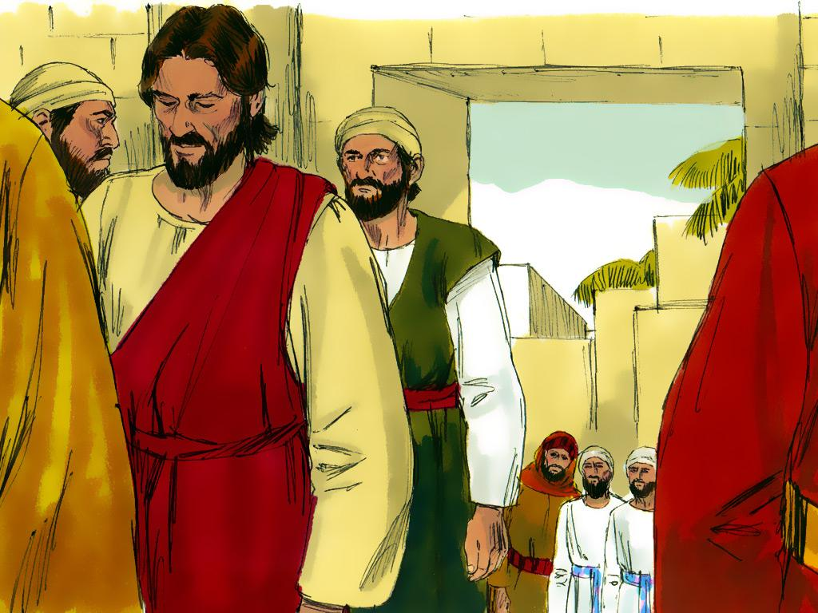
Notes:
8. By the time Jesus left, many people were talking about Him. Some had learned to love God more because of what Jesus said. Some got angry and began to say bad things about Jesus.
What would you have done if you had been there that day?

Slide 9
Teacher Notes
1. Cover: Jesus and the Moneychangers (Mark 11:15:19)
2. Jesus and His disciples travelled from place to place, teaching people about God. At the time of the special Jewish feast of Passover, they travelled to Jerusalem to worship God and take part in special ceremonies at the Temple. Mary and some of Jesus’ brothers went along, too. They all looked forward to a special time in Jerusalem. They thought about the beautiful Temple. They thought about how people would be worshipping God at the Temple.
3. Ever since He was a young boy, Jesus had been taught by His parents that the Temple of God in Jerusalem was a very important place. This was a place where people came to worship God and offer sacrifices. At the Temple, everyone was supposed to think and talk about God.
4. But when they arrived at the Temple, it did not seem as if people were there to worship God at all. The people were not treating the Temple like a special place of God. Instead, the Temple looked like a big market! Animals were making loud noises. Jesus heard cattle, sheep and doves. Some people exchange money and try to cheat others. The people were not thinking about God at all.
5. Jesus was very sad and angry at how people treated God and God’s special place. Jesus is the son of God, so the Temple was His Father’s house. He loved His Father, and He loved His Father’s house! Jesus knew He needed to do something very drastic so that everyone would understand how serious this was.
6. So Jesus did something that shocked everyone. He tied cords of rope together to make a whip to swing around. Then He began swinging the rope and turning over the tables that people had put in the wrong places in the Temple. He shooed the birds and animals away and caused the money that people were cheating with to fall all over the ground. Jesus said, “Get those things out of here! How dare you turn my Father’s house into a market!”
7. Before this, everyone was thinking about money and the market. Now, people finally had time to stop and think about what Jesus had been teaching. It was time to love and respect God at His Temple, just like Jesus did.
8. By the time Jesus left, many people were talking about Him. Some had learned to love God more because of what Jesus said. Some got angry and began to say bad things about Jesus.
What would you have done if you had been there that day?

Slide 10


Attributions: This visual aid was constructed by Mary Nelson www.missionbibleclass.org using:
Text and slideshow compilation by Mary Nelson (updated April 2025)
Illustrations by Sweet Publishing http://sweetpublishing.com/
As accessed through www.freebibleimages.org
Notice of Alteration: Text added to cover slide.
Attribution-ShareAlike 3.0 Unported (CC BY-SA 3.0) https://creativecommons.org/licenses/by-sa/3.0/
User may reproduce it without permissions.
DOWNLOAD THIS SLIDESHOW FROM www.missionbibleclass.org
Please visit www.missionbibleclass.org to find this and many other free resources to help you
teach the Bible to children.

