Slide 1
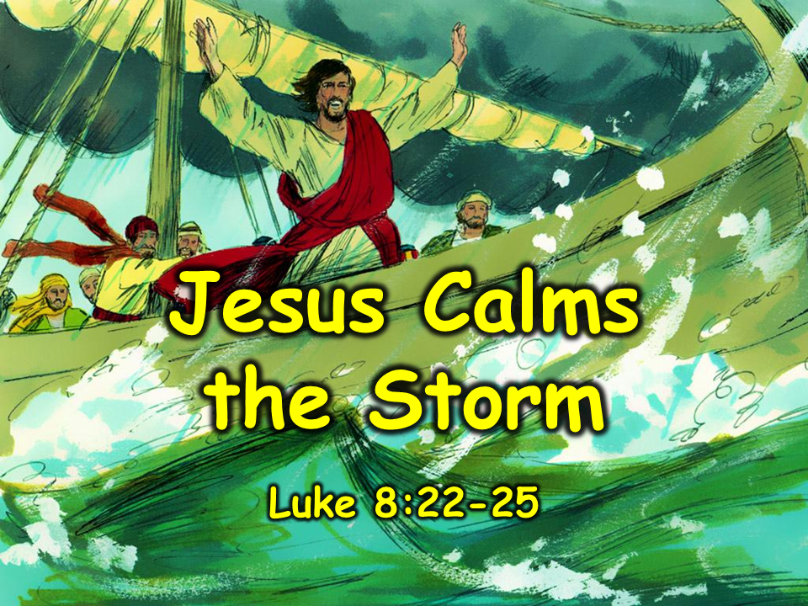
Notes:
1. Cover: Jesus Calms the Storm (Luke 8:22-25)

Slide 2
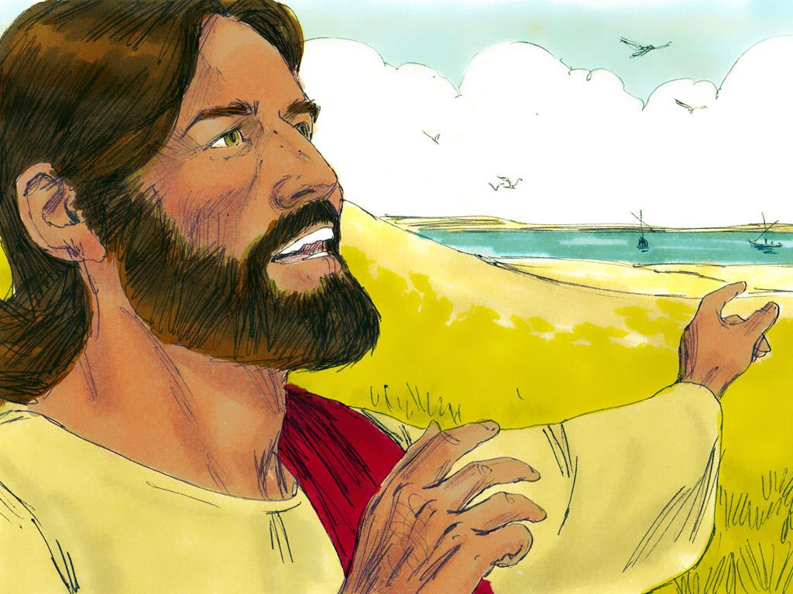
Notes:
2. People loved to hear Jesus speak.

Slide 3
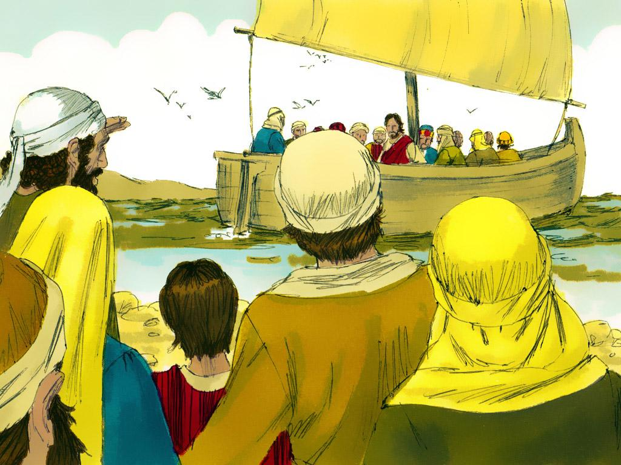
Notes:
3. Sometimes, huge crowds gathered to hear Him. Once, He was preaching by the Sea of Galilee, and many people crowded around Him. The crowd was so large that He got into the boat and preached to the people still standing on the shore.

Slide 4
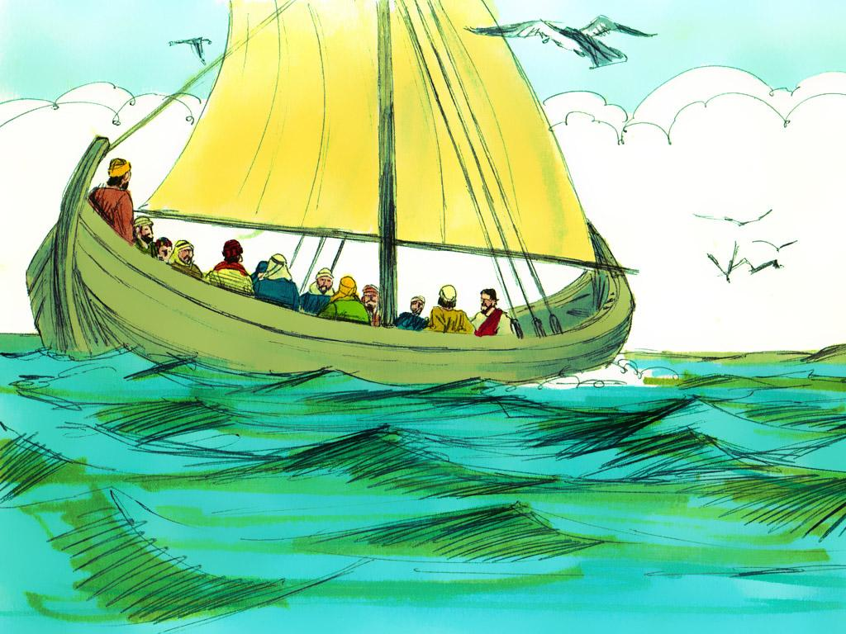
Notes:
4. At the end of the day, Jesus and His disciples said goodbye to the people, then sailed out onto the Sea of Galilee. Jesus was so tired that He found a bed cushion and fell asleep.

Slide 5
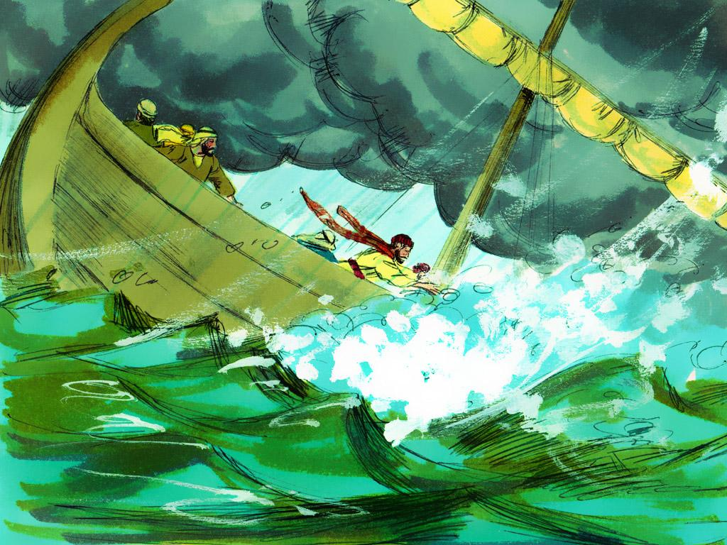
Notes:
5. Some of the other men on the boat were fishermen. They knew all about sailing a boat. They were happy that the water was nice and calm and peaceful. They could relax.
But soon, things began to change. The wind began to blow, and the waves pushed the boat around. This was a very bad storm. The waves became so big that they were filling the boat with water. The storm became so violent that the men began to think that the boat would sink. They thought they might all drown.

Slide 6
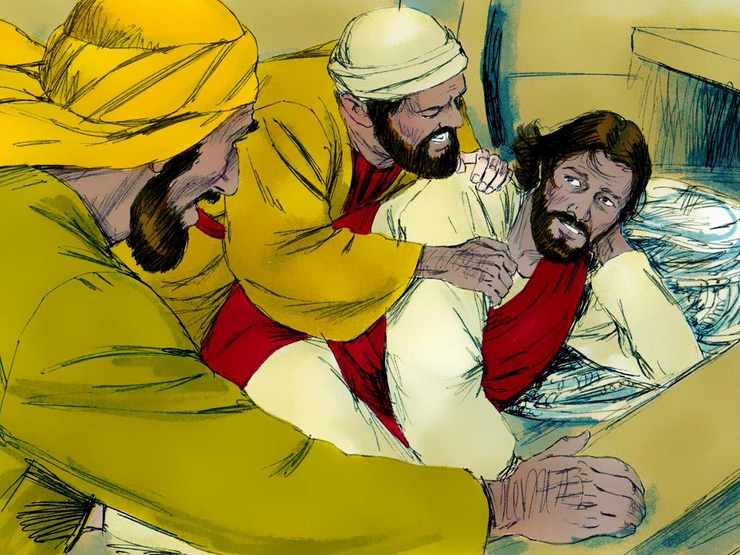
Notes:
6. Amid all the excitement, only one person on the boat was not worried. Guess who that was? Jesus! He was not worried because He was fast asleep.
The disciples woke Jesus and excitedly told Him that they were going to drown. "Master, please save us!", they cried out to Jesus over the sound of the storm.

Slide 7
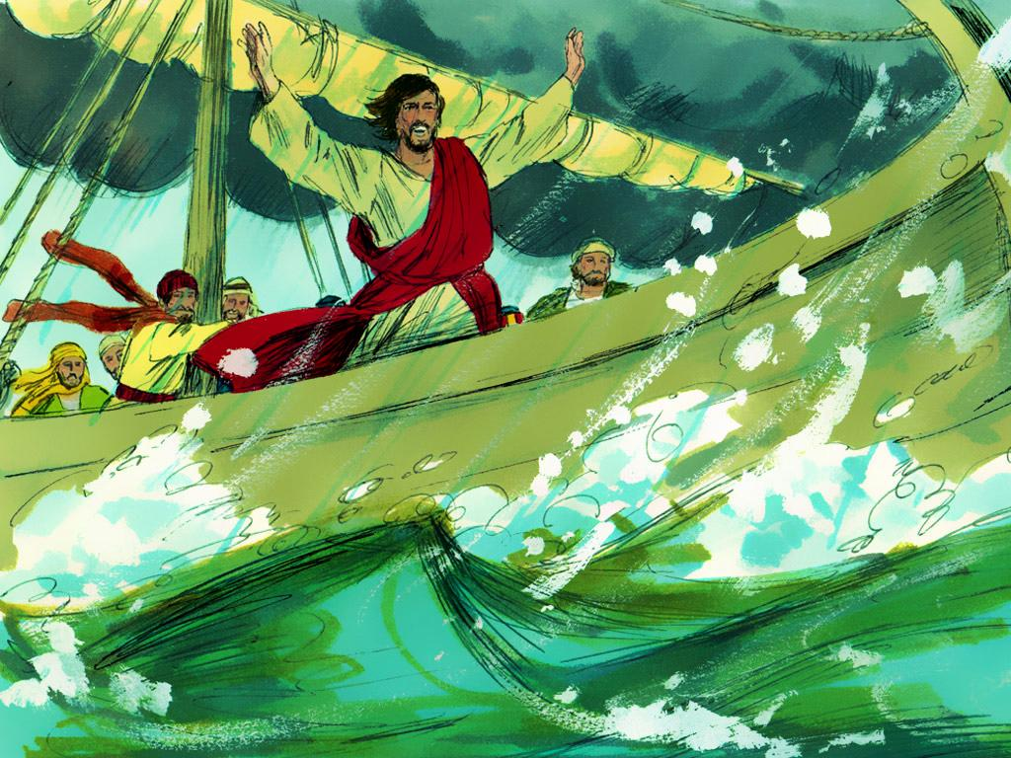
Notes:
7. When Jesus saw the storm, He was not afraid at all. He looked at the waves and the water and said, “Quiet, be still!” And guess what? The storm stopped. The water became calm, and the wind stopped blowing.

Slide 8
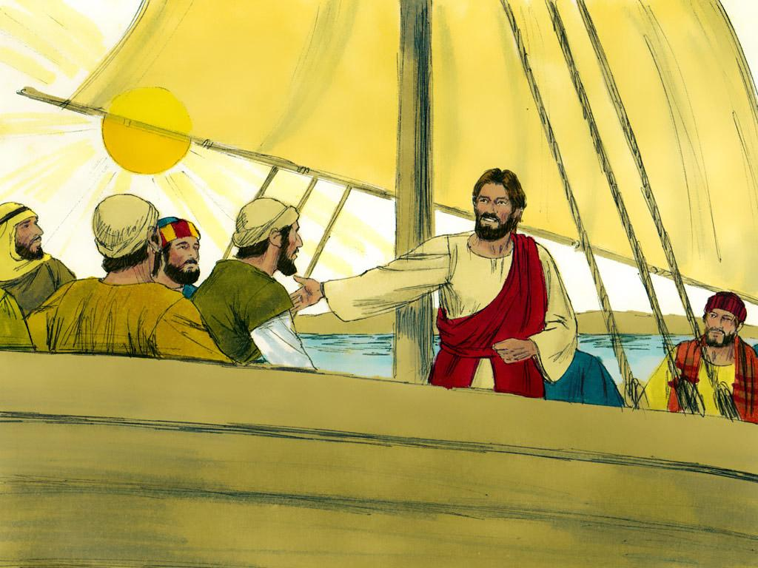
Notes:
8. Jesus looked at the disciples and said, “Why are you so afraid? Where is your faith?”

Slide 9
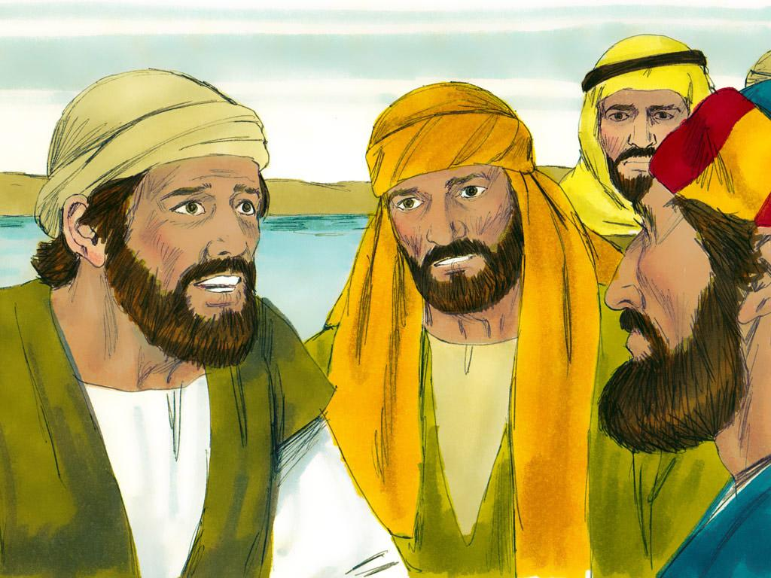
Notes:
9. The disciples were amazed. They knew that Jesus was very special. Jesus was the only one who could make even a storm obey him.
Storms are very strong, but Jesus can even make a storm stop. Jesus is the Son of God.

Slide 10
Teacher Notes 1
1. Cover: Jesus Calms the Storm (Luke 8:22-25)
2. People loved to hear Jesus speak.
3. Sometimes, huge crowds gathered to hear Him. Once, He was preaching by the Sea of Galilee, and many people crowded around Him. The crowd was so large that He got into the boat and preached to the people still standing on the shore.
4. At the end of the day, Jesus and His disciples said goodbye to the people, then sailed out onto the Sea of Galilee. Jesus was so tired that He found a bed cushion and fell asleep.
5. Some of the other men on the boat were fishermen. They knew all about sailing a boat. They were happy that the water was nice and calm and peaceful. They could relax.
But soon, things began to change. The wind began to blow, and the waves pushed the boat around. This was a very bad storm. The waves became so big that they were filling the boat with water. The storm became so violent that the men began to think that the boat would sink. They thought they might all drown.
6. Amid all the excitement, only one person on the boat was not worried. Guess who that was? Jesus! He was not worried because He was fast asleep.
The disciples woke Jesus and excitedly told Him that they were going to drown. "Master, please save us!", they cried out to Jesus over the sound of the storm.
7. When Jesus saw the storm, He was not afraid at all. He looked at the waves and the water and said, “Quiet, be still!” And guess what? The storm stopped. The water became calm, and the wind stopped blowing.
8. Jesus looked at the disciples and said, “Why are you so afraid? Where is your faith?”
9. The disciples were amazed. They knew that Jesus was very special. Jesus was the only one who could make even a storm obey him.
Storms are very strong, but Jesus can even make a storm stop. Jesus is the Son of God.

Slide 11


Attributions: This visual aid was constructed by Mary Nelson www.missionbibleclass.org using:
Text and slideshow compilation by Mary Nelson
Illustrations by Sweet Publishing http://sweetpublishing.com/ As accessed through www.freebibleimages.org Notice of Alteration: Text added to cover slide.
Attribution-ShareAlike 3.0 Unported (CC BY-SA 3.0) https://creativecommons.org/licenses/by-sa/3.0/
User may reproduce it without permissions.
DOWNLOAD THIS SLIDESHOW FROM www.missionbibleclass.org
Please visit www.missionbibleclass.org to find this and many other free resources to help you teach the Bible to children.

