Slide 1
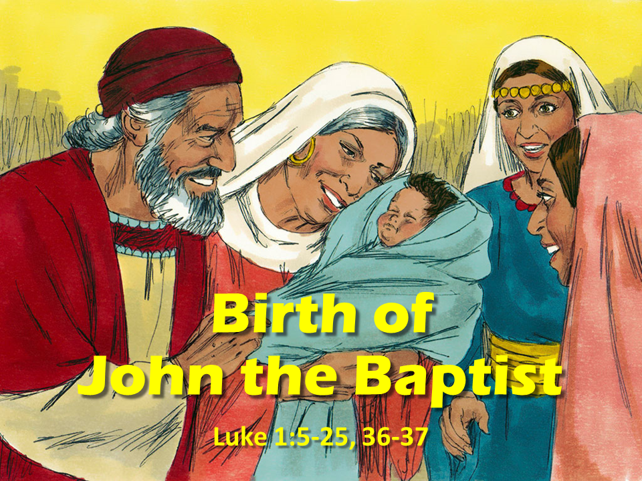
Notes:
1.Cover: Birth of John the Baptist Luke 1:5-25, 36-37

Slide 2
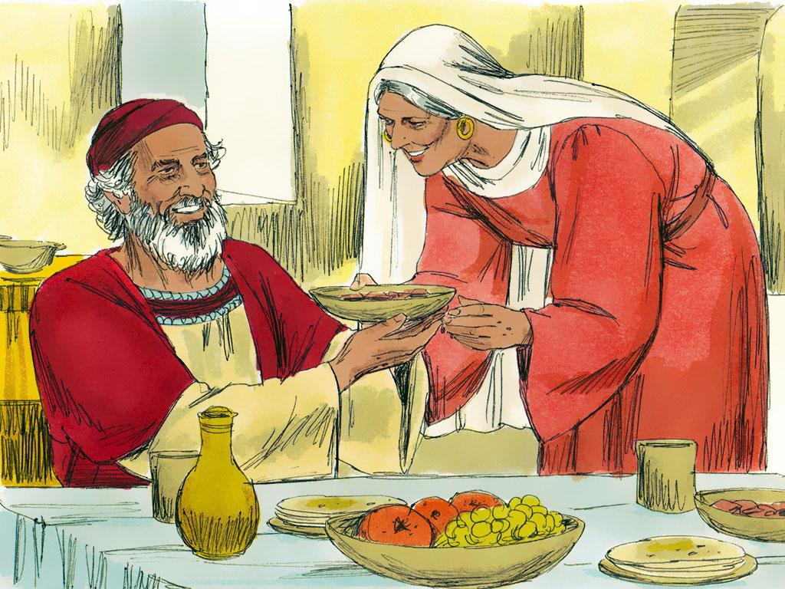
Notes:
2. Zechariah and his wife Elizabeth were two old people---like grandparents---except that Zechariah and Elizabeth were not grandparents. They weren’t even parents. They had no children, and that made them sad. But all their lives they had followed God’s commands, and that had made their lives happy.

Slide 3
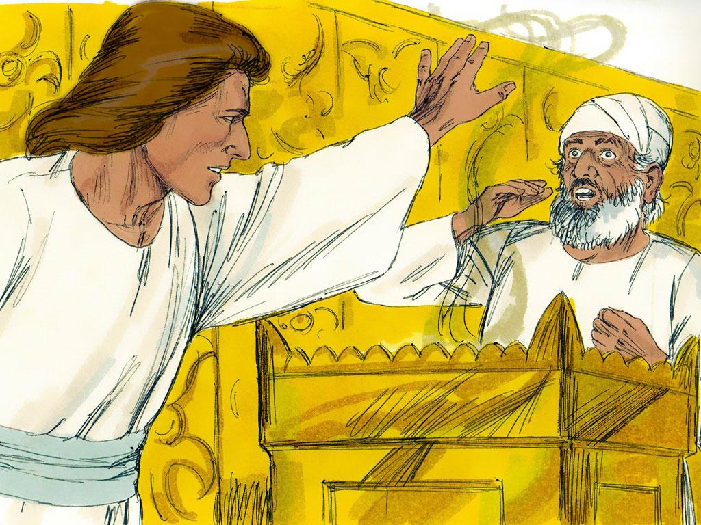
Notes:
3. Zechariah was a priest who helped in God’s temple. One day a very special thing happened to him. He was chosen to be the one priest to go inside the temple and burn incense while the people stood outside and prayed. Zechariah must have felt especially happy as he entered the temple.
Suddenly an angel appeared in front of him! Zechariah was terrified. The angel comforted him, “don’t be afraid, Zechariah. God has heard your prayer. Your wife Elizabeth will have a son. You will name him John. He will help people follow God’s chosen leader.

Slide 4
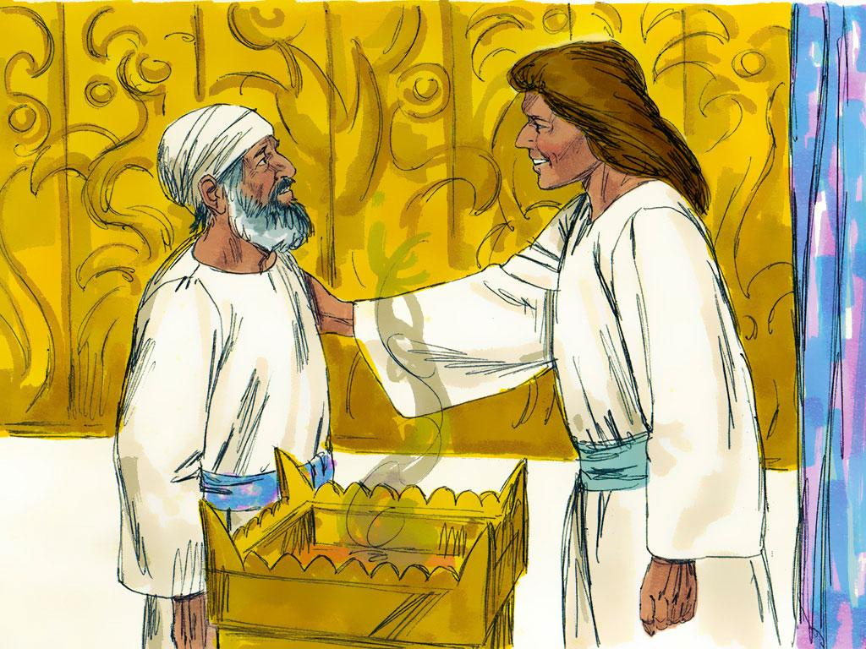
Notes:
4. That seems impossible doesn’t it? Can old people have babies? Only God could make that happen! Zechariah should have believed the angel and rejoiced. But he didn’t. “How can this happen?” he asked. “My wife and I are old.”
“I am the angel Gabriel. God sent me to deliver this good news to you. But now, since you did not believe my news, you will not be able to talk until my words come true.

Slide 5
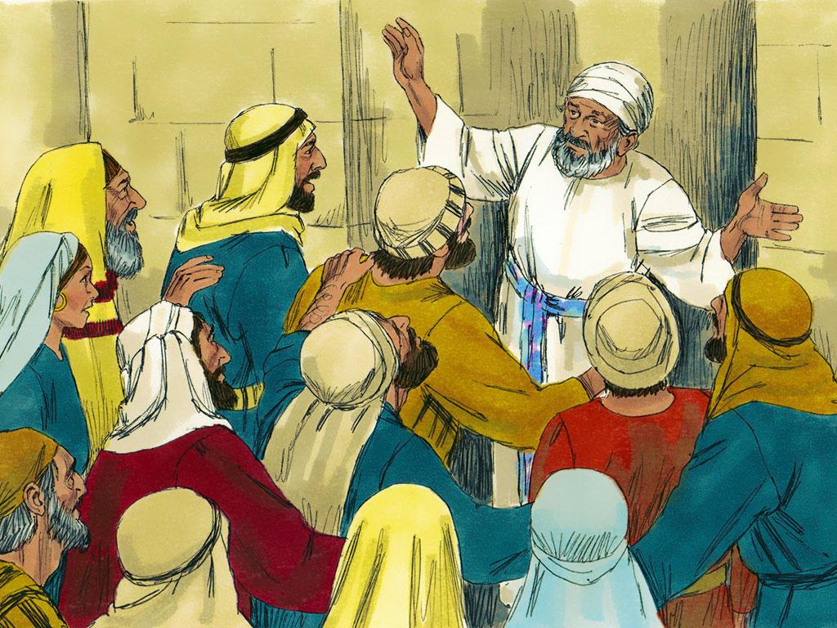
Notes:
5. Outside the temple the crowd was getting impatient. They wondered why Zechariah was taking so long inside the temple. But when he did come out, he couldn’t tell them. The angel’s words had come true: Zechariah couldn’t talk.

Slide 6
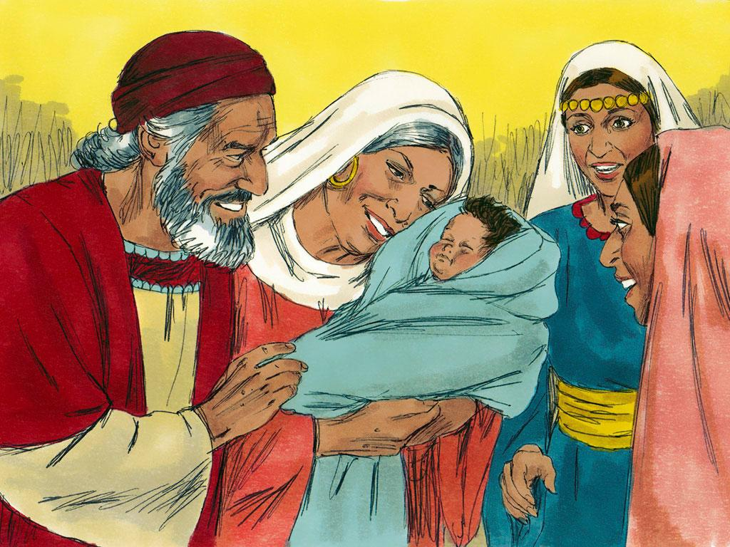
Notes:
6. And more of the angel’s words came true. Zechariah and Elizabeth soon discovered that they were going to have a baby. The neighbours and relatives rejoiced along with the parents. And when the baby was born, it was a boy, just as the angel had said.

Slide 7
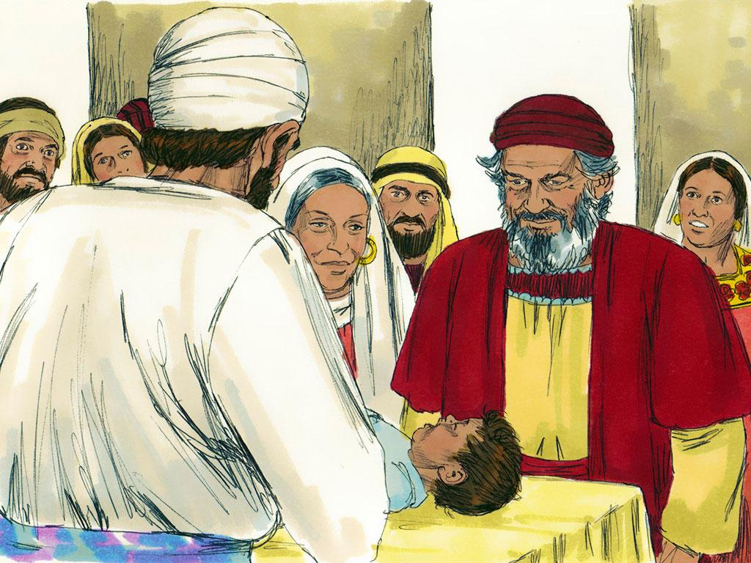
Notes:
7. When the baby was eight days old, many friends and relatives of Zechariah and Elizabeth came for a party to give the baby his name. As people gathered for the party, they talked about how the baby would be named Zechariah after his father. But Elizabeth heard them and said, “No, his name will be John!”
The guests were surprised. “But none of your relatives have that name.”

Slide 8
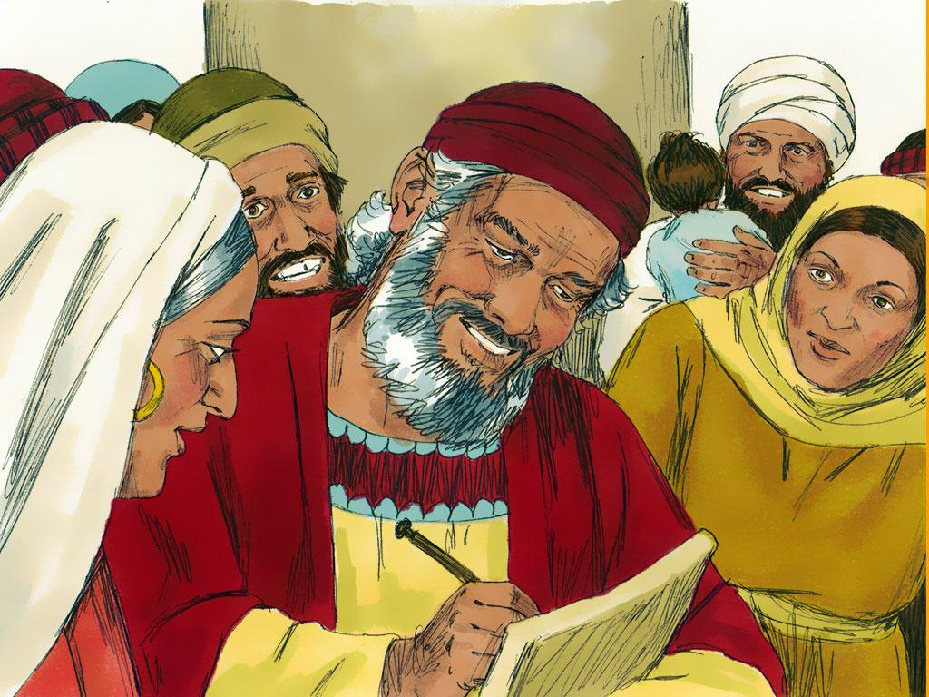
Notes:
8. They turned to Zechariah and gestured for him to show what he wanted the baby to be named---he still could not talk. He asked for a writing tablet and on it wrote, “His name is John.”
All of the sudden Zechariah realized that he could talk! He began praising God for the wonderful way He had kept His promises. He explained to the people that John indeed was a special baby, and God had a special plan for him: John would prepare people to follow Jesus (who would soon be born.)

Slide 9
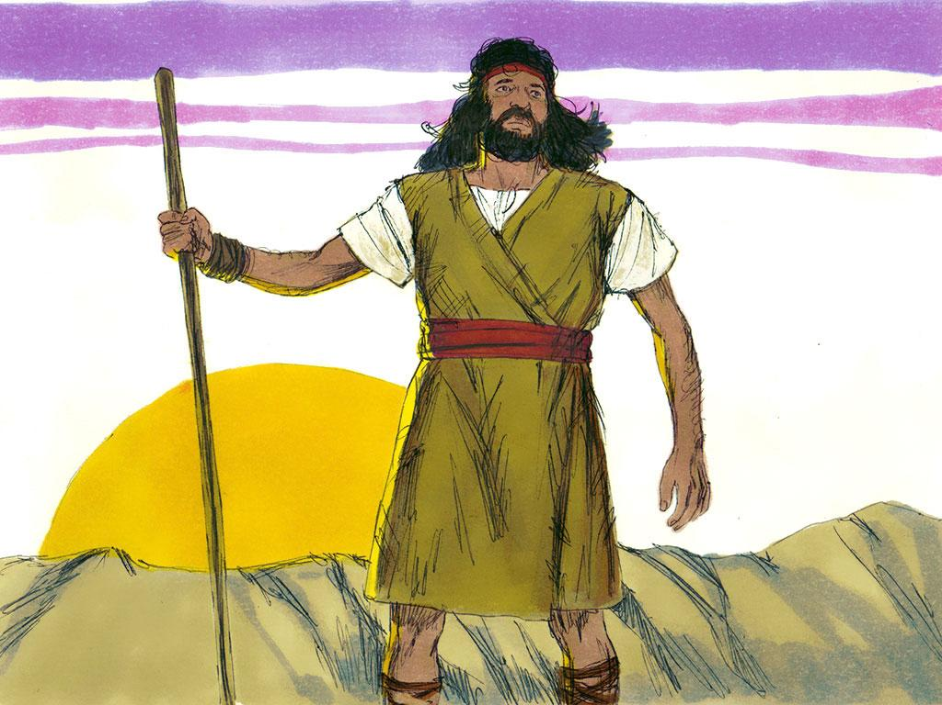
Notes:
9. Zechariah and Elizabeth were excited to have a son after all these years. But they were even happier that God had chosen them as the parents of a boy who would grow up and help others follow God’s own Son.

Slide 10
Teacher Notes Page
5. Outside the temple the crowd was getting impatient. They wondered why Zechariah was taking so long inside the temple. But when he did come out, he couldn’t tell them. The angel’s words had come true: Zechariah couldn’t talk.
6. And more of the angel’s words came true. Zechariah and Elizabeth soon discovered that they were going to have a baby. The neighbours and relatives rejoiced along with the parents. And when the baby was born, it was a boy, just as the angel had said.
7. When the baby was eight days old, many friends and relatives of Zechariah and Elizabeth came for a party to give the baby his name. As people gathered for the party, they talked about how the baby would be named Zechariah after his father. But Elizabeth heard them and said, “No, his name will be John!”
The guests were surprised. “But none of your relatives have that name.”
8. They turned to Zechariah and gestured for him to show what he wanted the baby to be named---he still could not talk. He asked for a writing tablet and on it wrote, “His name is John.”
All of the sudden Zechariah realized that he could talk! He began praising God for the wonderful way He had kept His promises. He explained to the people that John indeed was a special baby, and God had a special plan for him: John would prepare people to follow Jesus (who would soon be born.)
9. Zechariah and Elizabeth were excited to have a son after all these years. But they were even happier that God had chosen them as the parents of a boy who would grow up and help others follow God’s own Son.
1.Cover: Birth of John the Baptist Luke 1:5-25, 36-37
2. Zechariah and his wife Elizabeth were two old people---like grandparents---except that Zechariah and Elizabeth were not grandparents. They weren’t even parents. They had no children, and that made them sad. But all their lives they had followed God’s commands, and that had made their lives happy.
3. Zechariah was a priest who helped in God’s temple. One day a very special thing happened to him. He was chosen to be the one priest to go inside the temple and burn incense while the people stood outside and prayed. Zechariah must have felt especially happy as he entered the temple.
Suddenly an angel appeared in front of him! Zechariah was terrified. The angel comforted him, “don’t be afraid, Zechariah. God has heard your prayer. Your wife Elizabeth will have a son. You will name him John. He will help people follow God’s chosen leader.
4. That seems impossible doesn’t it? Can old people have babies? Only God could make that happen! Zechariah should have believed the angel and rejoiced. But he didn’t. “How can this happen?” he asked. “My wife and I are old.”
“I am the angel Gabriel. God sent me to deliver this good news to you. But now, since you did not believe my news, you will not be able to talk until my words come true.

Slide 11


Attributions: This visual aid was constructed by Mary Nelson www.missionbibleclass.org using:
Text and slideshow compilation by Mary Nelson
Illustrations by Sweet Publishing http://sweetpublishing.com/
As accessed through www.freebibleimages.org
Notice of Alteration: Text added to cover slide.
Attribution-ShareAlike 3.0 Unported (CC BY-SA 3.0) https://creativecommons.org/licenses/by-sa/3.0/
User may reproduce it without permissions.
DOWNLOAD THIS SLIDESHOW FROM www.missionbibleclass.org
Please visit www.missionbibleclass.org to find this and many other free resources to help you
teach the Bible to children.

