Slide 1
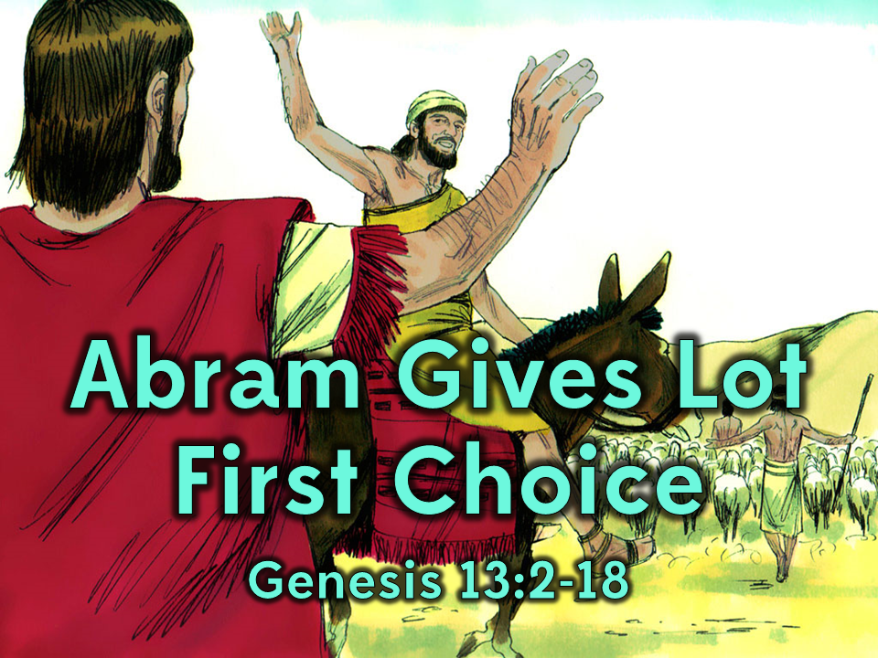
Notes:
1. Cover: Abram Gives Lot First Choice Genesis 13:2-18

Slide 2
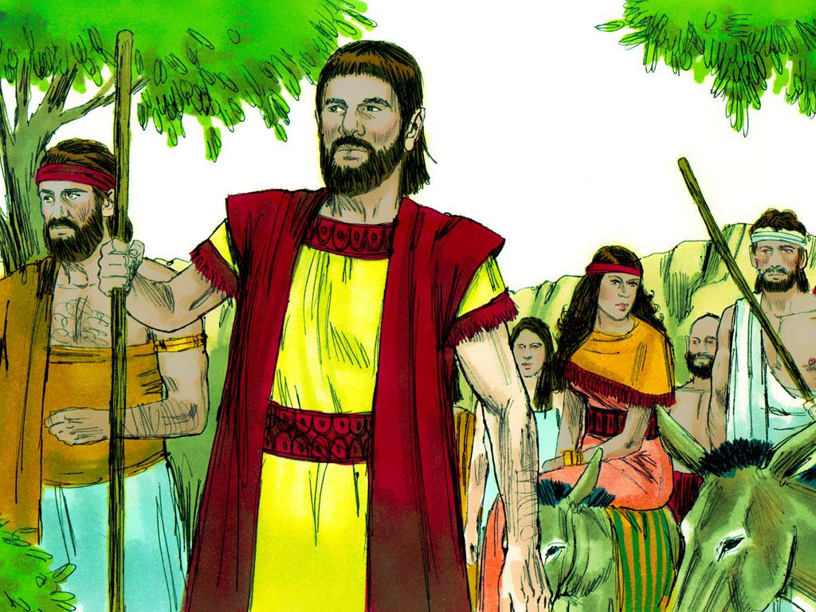
Notes:
2. Abram, his wife Sarai and his nephew, Lot lived in tents and moved from place to place in the Land of Canaan. God had a special plan for Abram and his family to bless the people of the world. Abram had faith in God and went wherever God told him to go.

Slide 3
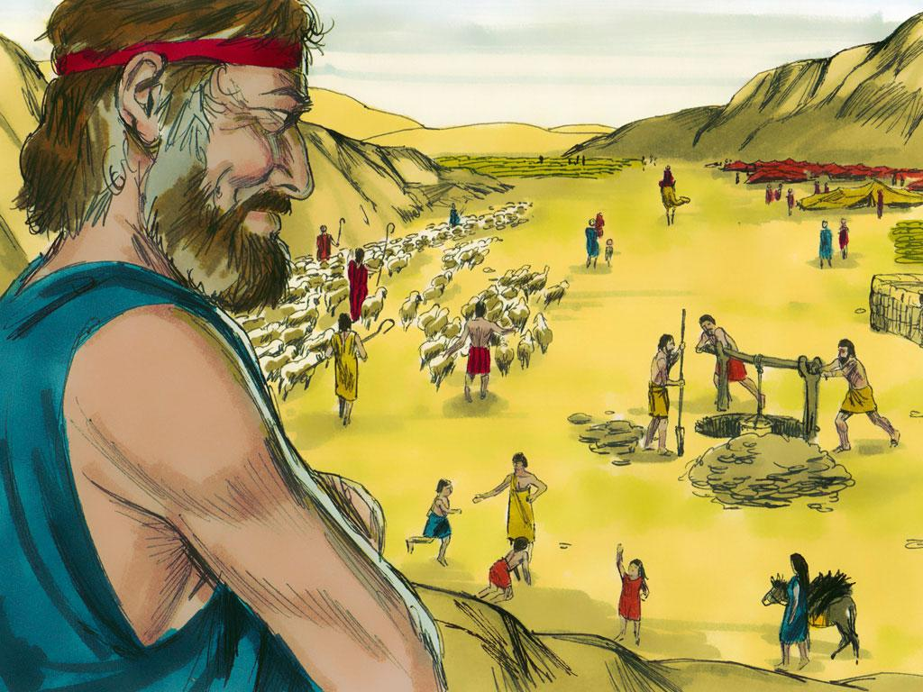
Notes:
3. The family set up tents in the area near the city of Bethel. Abram and his nephew, Lot, were very wealthy. They each had large flocks and herds, many herdsmen, household servants, and tents.

Slide 4
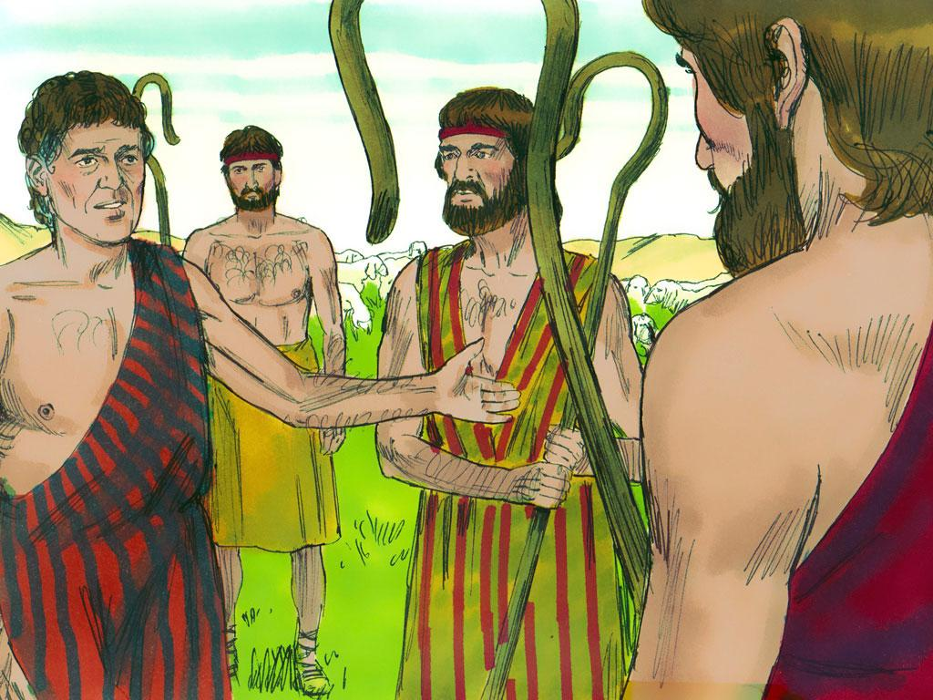
Notes:
4. Every day the men in charge of the sheep, goats, cattle and donkeys would lead the flocks and herds to places where they could eat grass and drink water.

Slide 5
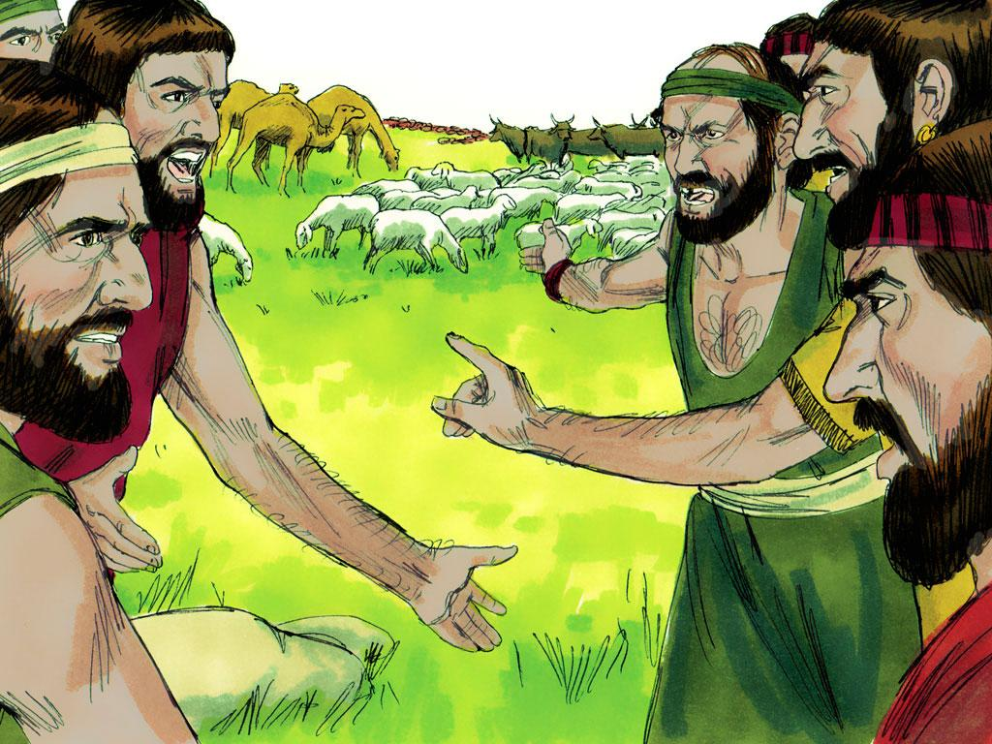
Notes:
5. But there was a problem. There was not enough grass and water for all of the animals. It was just too crowded. Abram’s herdsmen thought that Abram should have the best grass-land. Lot’s herdsmen thought that Lot should have the best grass-land. The herdsmen began to quarrel with one another. And, as if that wasn’t enough there were also other people living in the area too. Everyone wanted the best.

Slide 6
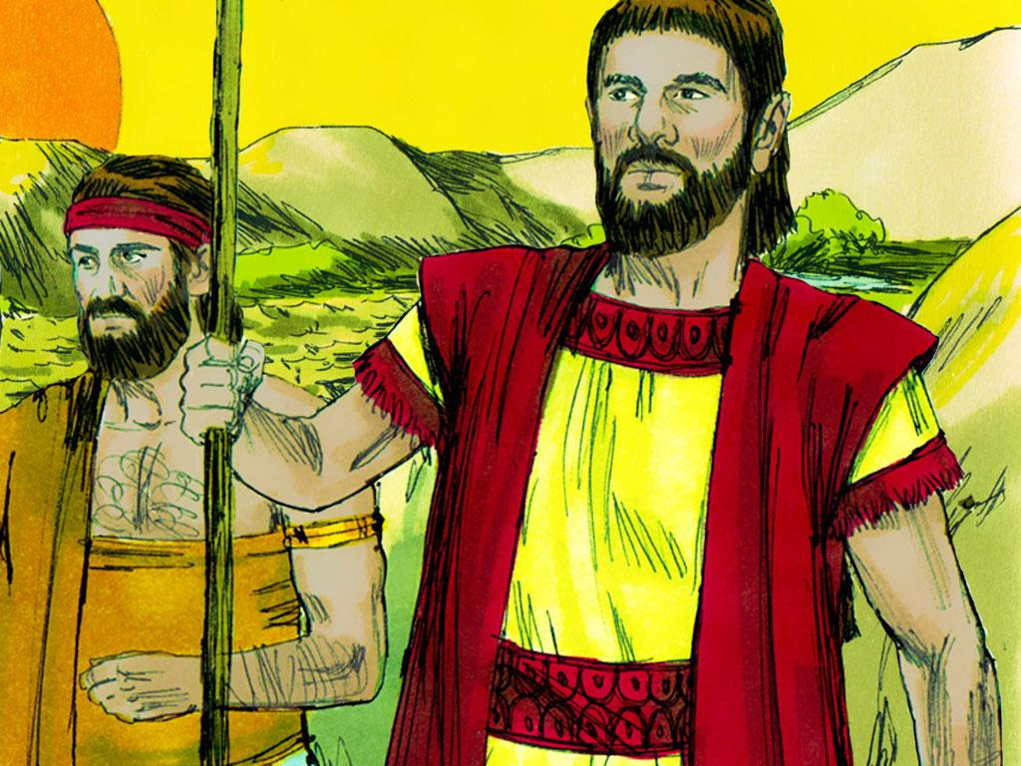
Notes:
6. Abram became worried that all of the quarrelling might lead to fighting. He decided that there was only one thing to do. He and Lot would have to live in separate places. Someone was going to have to choose another place to live.
Abram was the older man and was the one who had led them out of their home country. It would have been all right for him to have whichever land he wanted. He could have chosen first and let Lot have whatever was left. But Abram did not choose first. Instead, Abram decided to let Lot choose first.

Slide 7
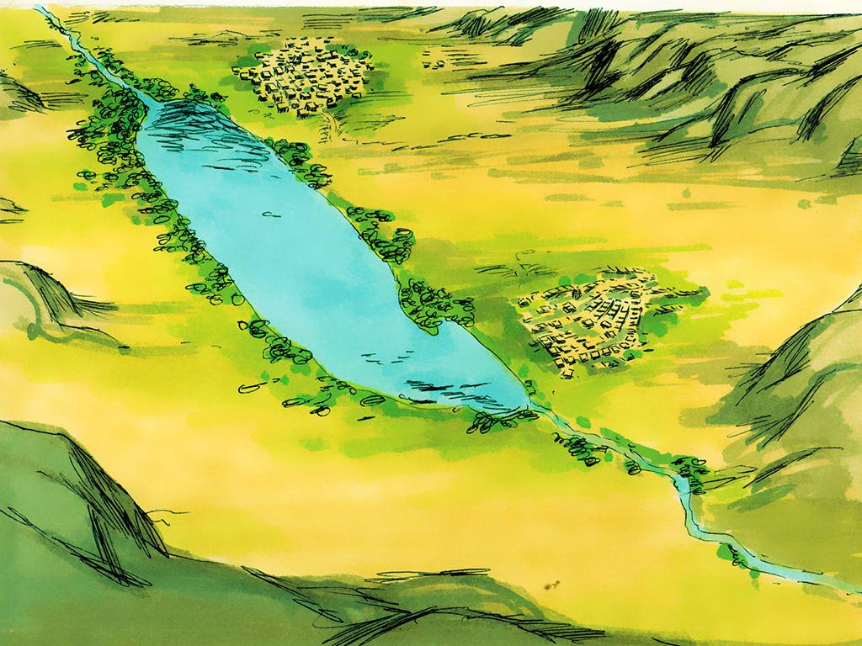
Notes:
7. When Lot looked around he saw that the Jordan Valley was lush and green. Surely this would be the best place to live!

Slide 8
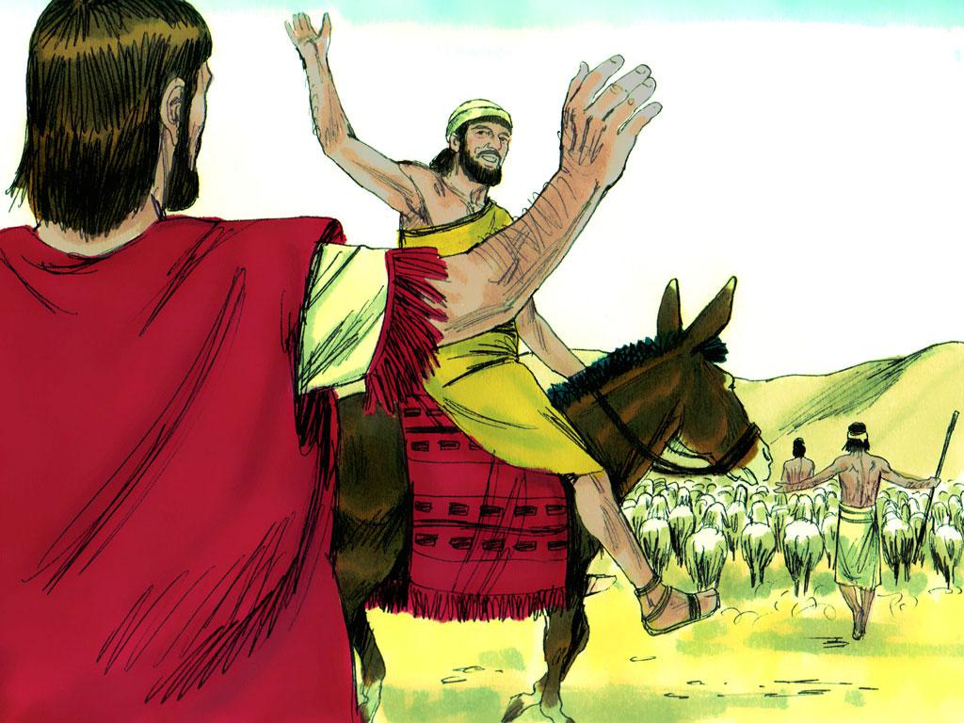
Notes:
8. So Lot took his family and all of his flocks and moved away from Abram. Lot made his home in the valley near the city of Sodom.

Slide 9
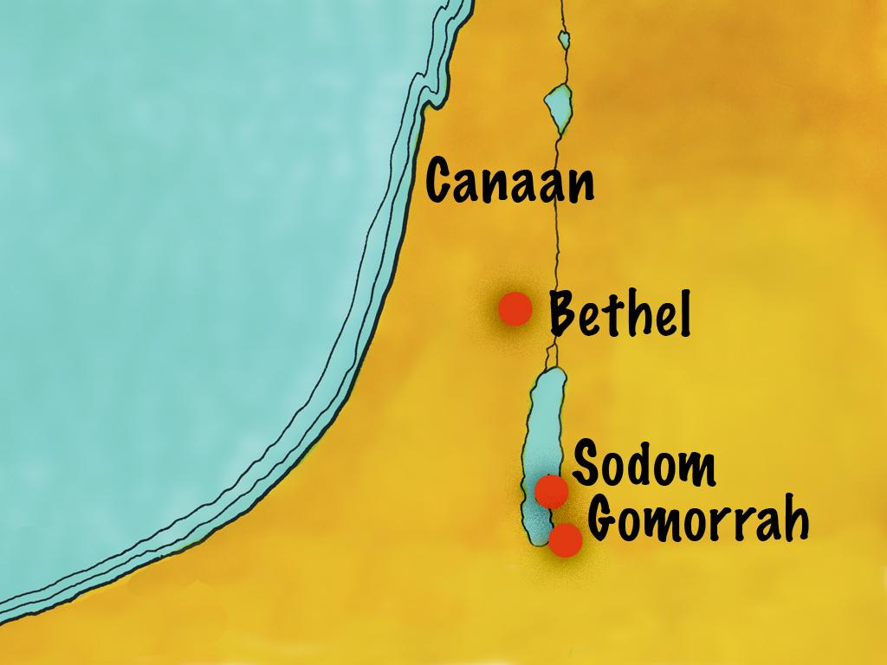
Notes:
9. Lot made his home in the valley. There were a lot of bad people in the valley. Lot had to live near a city called Sodom. The people of Sodom were very wicked. Later, Lot must have been sorry that he chose this valley and had to have such bad neighbours that did not want to obey God.

Slide 10
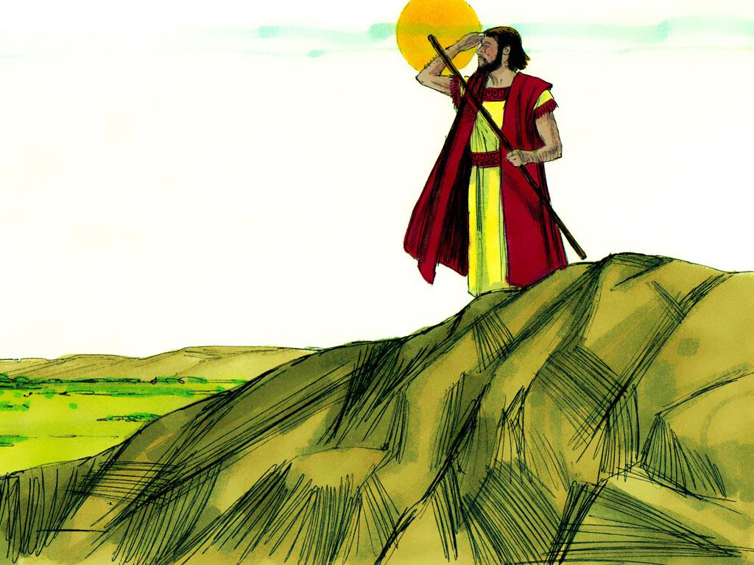
Notes:
10. Abram stayed in the dry land of Canaan. When Abram looked around after Lot left he saw that the land did not look so lush and green as the Jordan Valley. But Abram did not just think about the green grass. Abram had faith in God. He thought about how God would keep his promises.
“The Lord said to Abram after Lot had parted from him, ‘Look around from where you are, to the north and south, to the east and west. All the land that you see I will give to you and your offspring forever. I will make your offspring like the dust of the earth, so that if anyone could count the dust, then your offspring could be counted. Go, walk through the length and breadth of the land, for I am giving it to you.'” Genesis 13:14-17, NIV

Slide 11
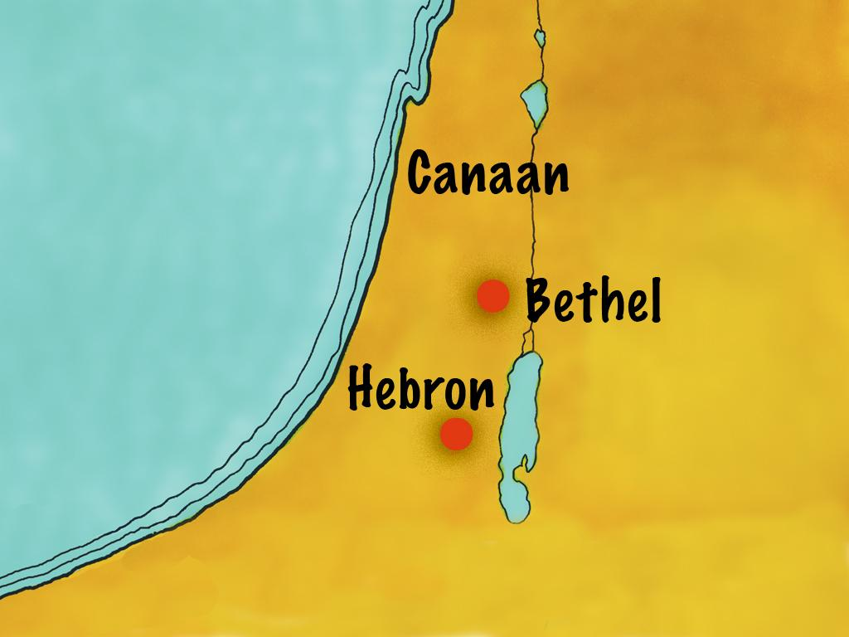
Notes:
11. After this Abram moved his tents near a place called Hebron.

Slide 12
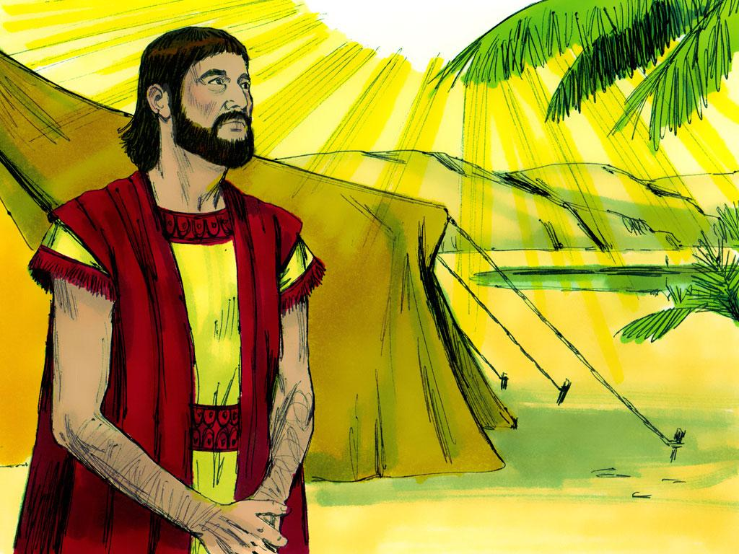
Notes:
12. God continued to bless Abram. Abram must have been happy that he let Lot have first choice.

Slide 13
Teacher Notes Page 1
Cover: Abram Gives Lot First Choice (Genesis 13:2-18)
(When Abram’s and Lot’s flocks and livestock became too large to be supported by the land Abram decided it was best to become two separate groups. He told Lot to choose a land for himself. Lot chose what appeared to be the most fertile land while Abram chose according to God’s promises.
2. Abram, his wife Sarai and his nephew, Lot lived in tents and moved from place to place in the Land of Canaan. God had a special plan for Abram and his family to bless the people of the world. Abram had faith in God and went wherever God told him to go.
3. The family set up tents in the area near the city of Bethel. Abram and his nephew, Lot, were very wealthy. They each had large flocks and herds, many herdsmen, household servants, and tents.
4. Every day the men in charge of the sheep, goats, cattle and donkeys would lead the flocks and herds to places where they could eat grass and drink water.
5. But there was a problem. There was not enough grass and water for all of the animals. It was just too crowded. Abram’s herdsmen thought that Abram should have the best grass-land. Lot’s herdsmen thought that Lot should have the best grass-land. The herdsmen began to quarrel with one another. And, as if that wasn’t enough there were also other people living in the area too. Everyone wanted the best.
6. Abram became worried that all of the quarrelling might lead to fighting. He decided that there was only one thing to do. He and Lot would have to live in separate places.
Someone was going to have to choose another place to live. Abram was the older man and was the one who had led them out of their home country. It would have been all right for him to have whichever land he wanted. He could have chosen first and let Lot have whatever was left. But Abram did not choose first. Instead, Abram decided to let Lot choose first.
7. When Lot looked around he saw that the Jordan Valley was lush and green. Surely this would be the best place to live!
8. So Lot took his family and all of his flocks and moved away from Abram. Lot made his home in the valley near the city of Sodom.
9. Lot made his home in the valley. There were a lot of bad people in the valley. Lot had to live near a city called Sodom. The people of Sodom were very wicked. Later, Lot must have been sorry that he chose this valley and had to have such bad neighbours that did not want to obey God.

Slide 14
Teacher Notes Page 2
10. Abram stayed in the dry land of Canaan. When Abram looked around after Lot left he saw that the land did not look so lush and green as the Jordan Valley. But Abram did not just think about the green grass. Abram had faith in God. He thought about how God would keep his promises.
“The Lord said to Abram after Lot had parted from him, ‘Look around from where you are, to the north and south, to the east and west. All the land that you see I will give to you and your offspring forever. I will make your offspring like the dust of the earth, so that if anyone could count the dust, then your offspring could be counted. Go, walk through the length and breadth of the land, for I am giving it to you.'” Genesis 13:14-17, NIV
11. After this Abram moved his tents near a place called Hebron.
12. God continued to bless Abram. Abram must have been happy that he let Lot have first choice.

Slide 15


Attributions: This visual aid was constructed by Mary Nelson www.missionbibleclass.org using:
Text and slideshow compilation by Mary Nelson
Illustrations by Sweet Publishing http://sweetpublishing.com/
As accessed through www.freebibleimages.org
Notice of Alteration: Text added to cover slide.
Attribution-ShareAlike 3.0 Unported (CC BY-SA 3.0) https://creativecommons.org/licenses/by-sa/3.0/
User may reproduce it without permissions.
DOWNLOAD THIS SLIDESHOW FROM www.missionbibleclass.org
Please visit www.missionbibleclass.org to find this and many other free resources to help you
teach the Bible to children.

